Slide 1
Data Engineering at BUJ

Slide 2
What is Data Engineering?
Data Engineering is the process of taking raw data and constructing a solution ready to meet the requirements of both your organization and your customers.

Slide 3
Why Engineer Data?
“One of the most important assets of any organization is its information”
(Kimball & Ross, 2013, Chapter 1).
You’re a data company – data is your primary asset
Ensure that this primary asset is well managed and available – To the whole organization
Warning – Even strong data science and analytics groups eventually fail without intentional data engineering

Slide 4
Data Science/Analytics without Data Engineering
It’s impossible
Someone is doing it somewhere

Slide 5
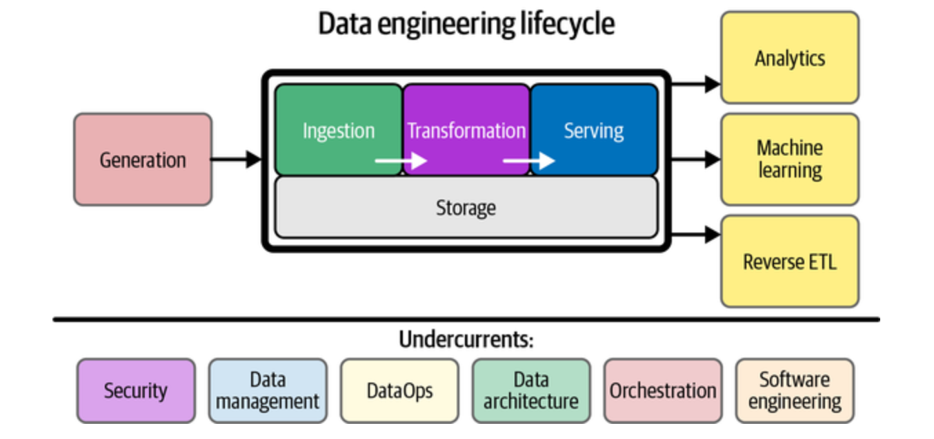
Data Engineering Lifecycle
(Reis & Housley, 2022)
Notes:
1. Generation: The origin points (source systems) where data is created—databases, IoT devices, applications, etc.
2. Storage: Where data lives throughout the lifecycle, underpinning all other stages and often serving multiple functions beyond just storage.
3. Ingestion: Moving data from source systems into your data architecture, either in batches or as continuous streams.
4. Transformation: Converting raw data into useful formats by cleaning, standardizing, applying business logic, and restructuring for downstream
consumption.
5. Serving: Delivering transformed data to end users and systems for analytics, ML, or feeding back into operational systems.

Slide 6
Success Story – Previous Customer
3000 source databases on SQL Server
Requirement – run analytics and data science across all of those databases; sell customers their own data
Solution –union of all sources into a single multi-tenant Snowflake database
Outcome – $500K annual cost with $2M and growing annual revenue; near zero marginal cost

Slide 7
References
Kimball, R., & Ross, M. (2013). The data warehouse toolkit: The definitive guide to dimensional modeling (3rd ed.). Wiley. https://learning.oreilly.com/library/view/the-data-warehouse/9781118530801/9781118530801c01.xhtml#c01_level1_1
Reis, J., & Housley, M. (2022). Fundamentals of data engineering. O'Reilly Media. https://learning.oreilly.com/library/view/fundamentals-of-data/9781098108298/ch02.html#components_and_undercurrents_of_the_dat

