Slide 1

Module 3 Learning Presentation: Modeling Multi-Table Data Relationships
Scott Person

Slide 2
concepts
tables
table relationships
joins
primary and foreign keys
star schema versus snowflake schema
the meaning of "fact table" and "dimension table" in a star schema

Slide 3
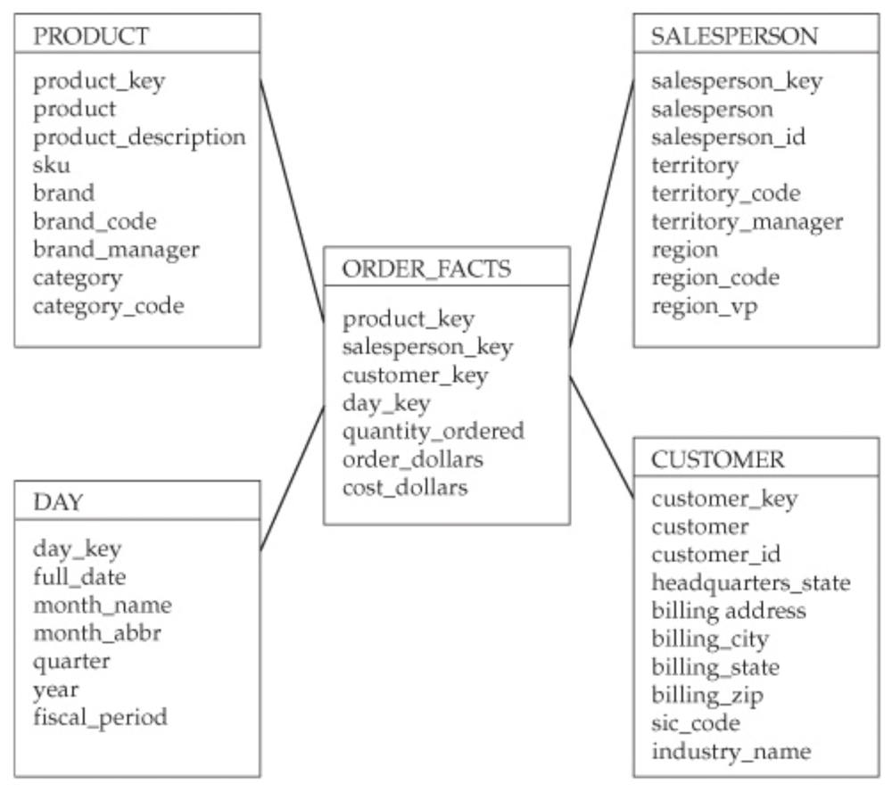
Star Schema
Starting with the end
Fact table one join away from each dimension table
Primary advantage: clear query path for analytical tools

Slide 4
Tables
Organization of data
Columns and Rows
Primary Key

Slide 5
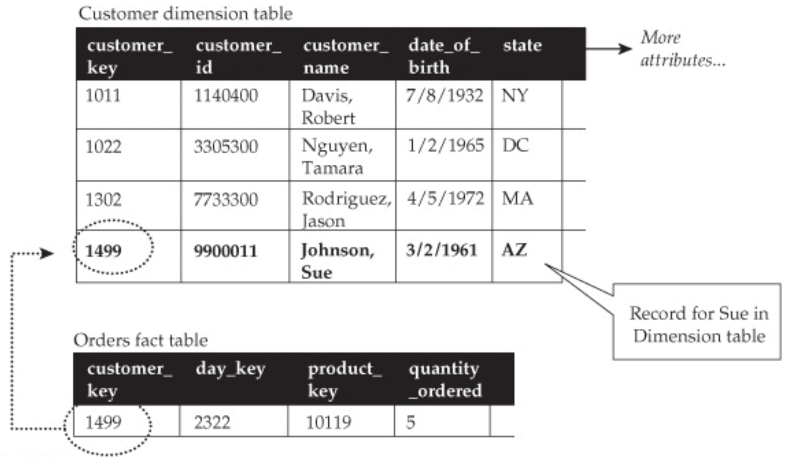
Table relationships, joins, keys
One to many cardinality
Joins made on the keys
Primary key

Slide 6
Fact and dimension tables
Facts are events or Snapshots in time
Dimensions provide context to the facts
“By Rule” – Show me orders BY product

Slide 7
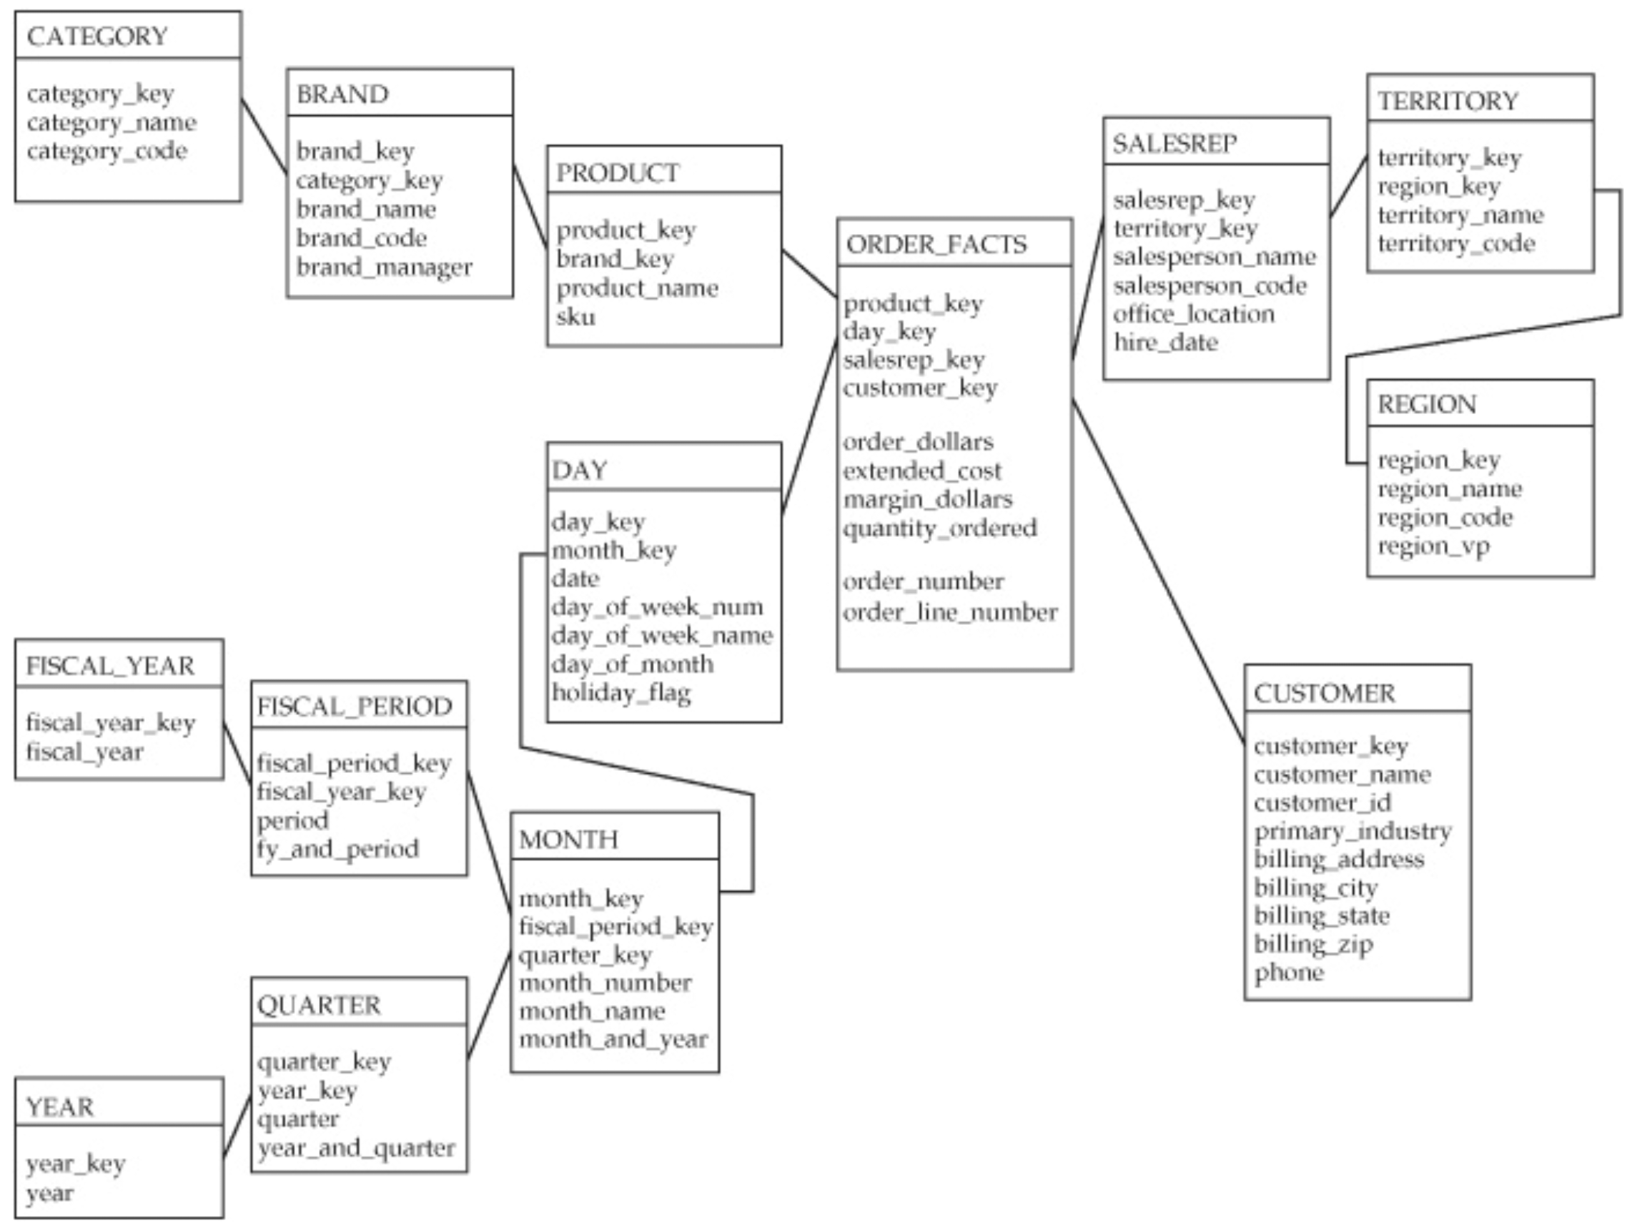
Star vs snowflake schemas
Snowflake schemas are seductive – nicely organized less data duplication
In practice they have few benefits
Increase data maintenance complexity
Slower performance

