Slide 1
SpaceX Launch Analytics
Power BI Dashboard Design
Data-Driven Insights from 578 Launches

Slide 2
SpaceX Brand Colors for Power BI
Primary Blue
#005DAA
Main brand color, headers, KPI highlights
Dark Gray
#292929
Backgrounds, text, professional tone
Success Green
#22C55E
Positive metrics, successful launches
Warning Orange
#FB923C
Attention points, delays, warnings
Danger Red
#EF4444
Failures, critical issues, alerts
Innovation Purple
#8B5CF6
R&D metrics, Starship program
Steel Blue
#475569
Secondary text, borders, dividers
Sky Blue
#7DD3FC
Accent color, hover states, selections

Slide 3
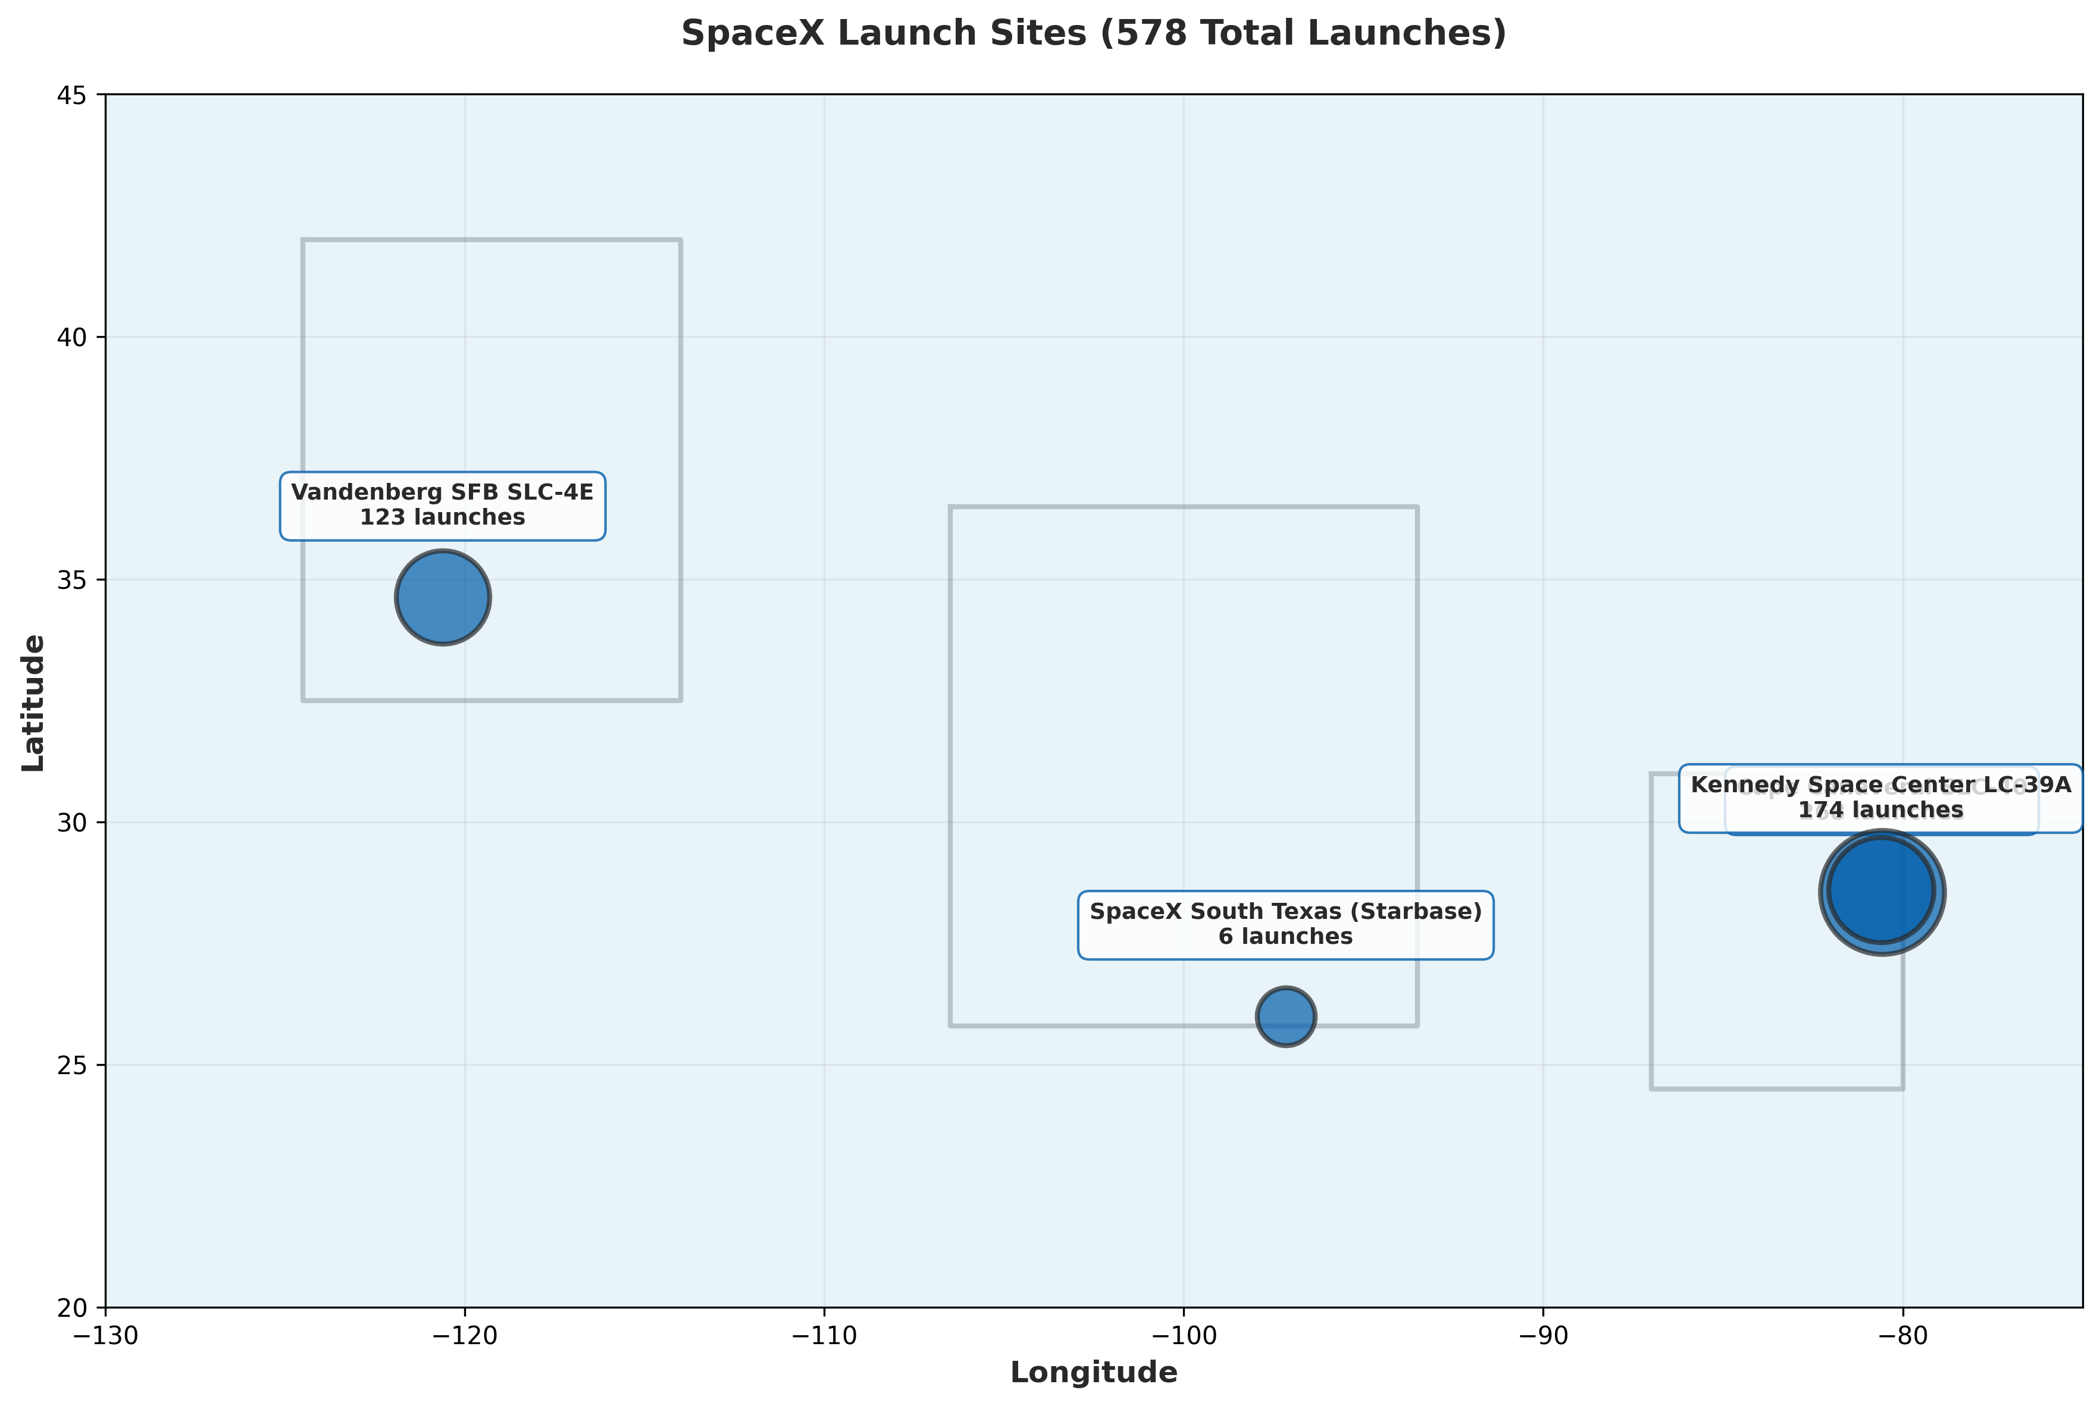
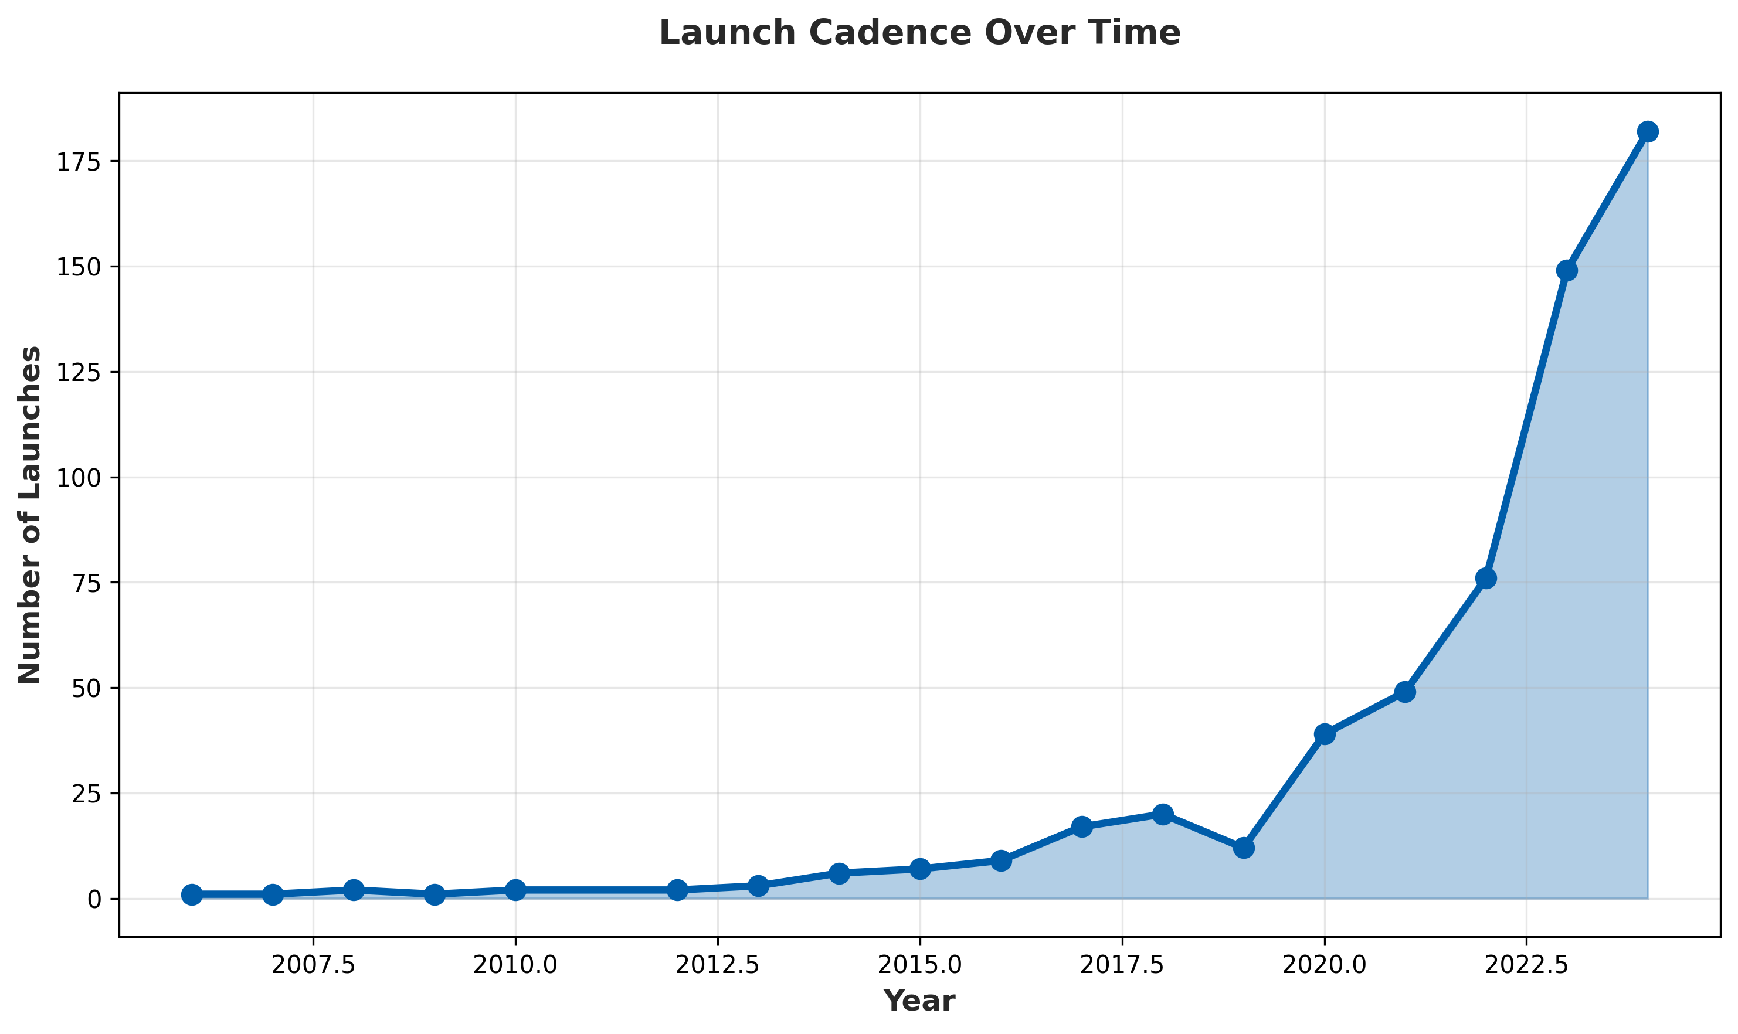
Page 1: Executive Summary
Total Launches
578
+33 YoY
Success Rate
98.6%
+1.3%
Active Sites
4
USA
Reusability
83.7%
484 missions

Slide 4
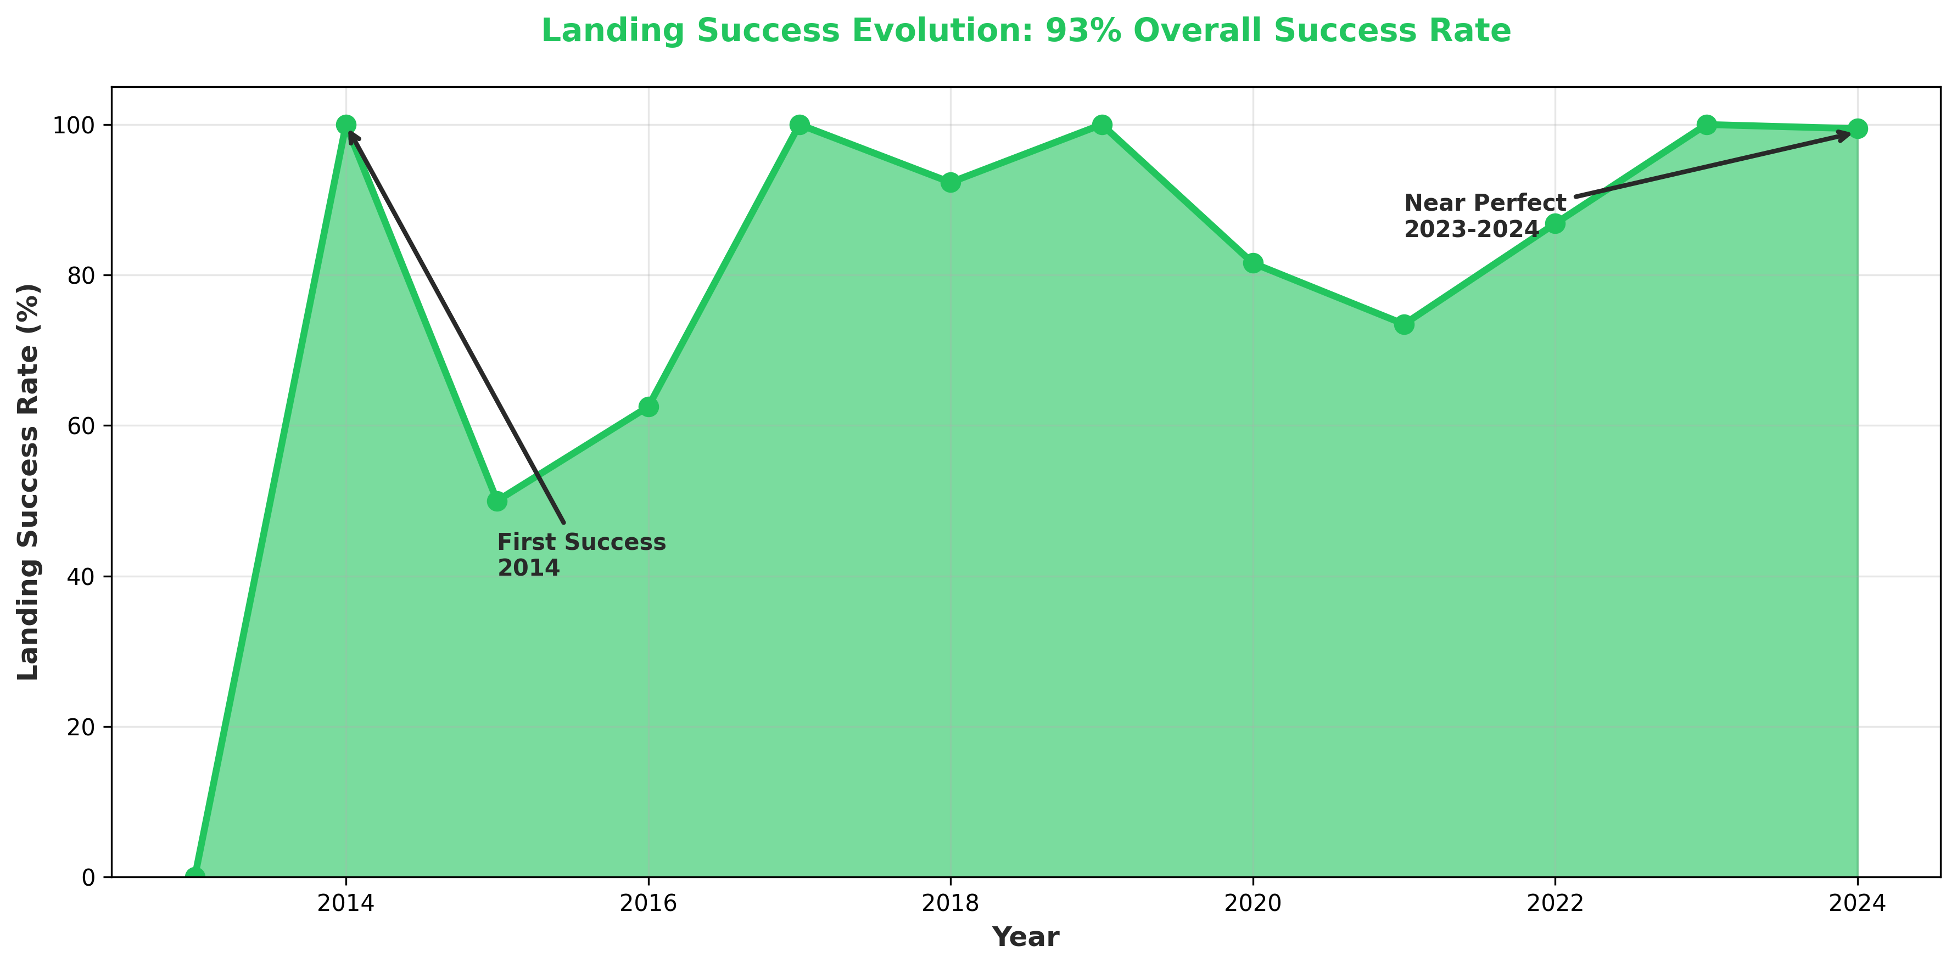
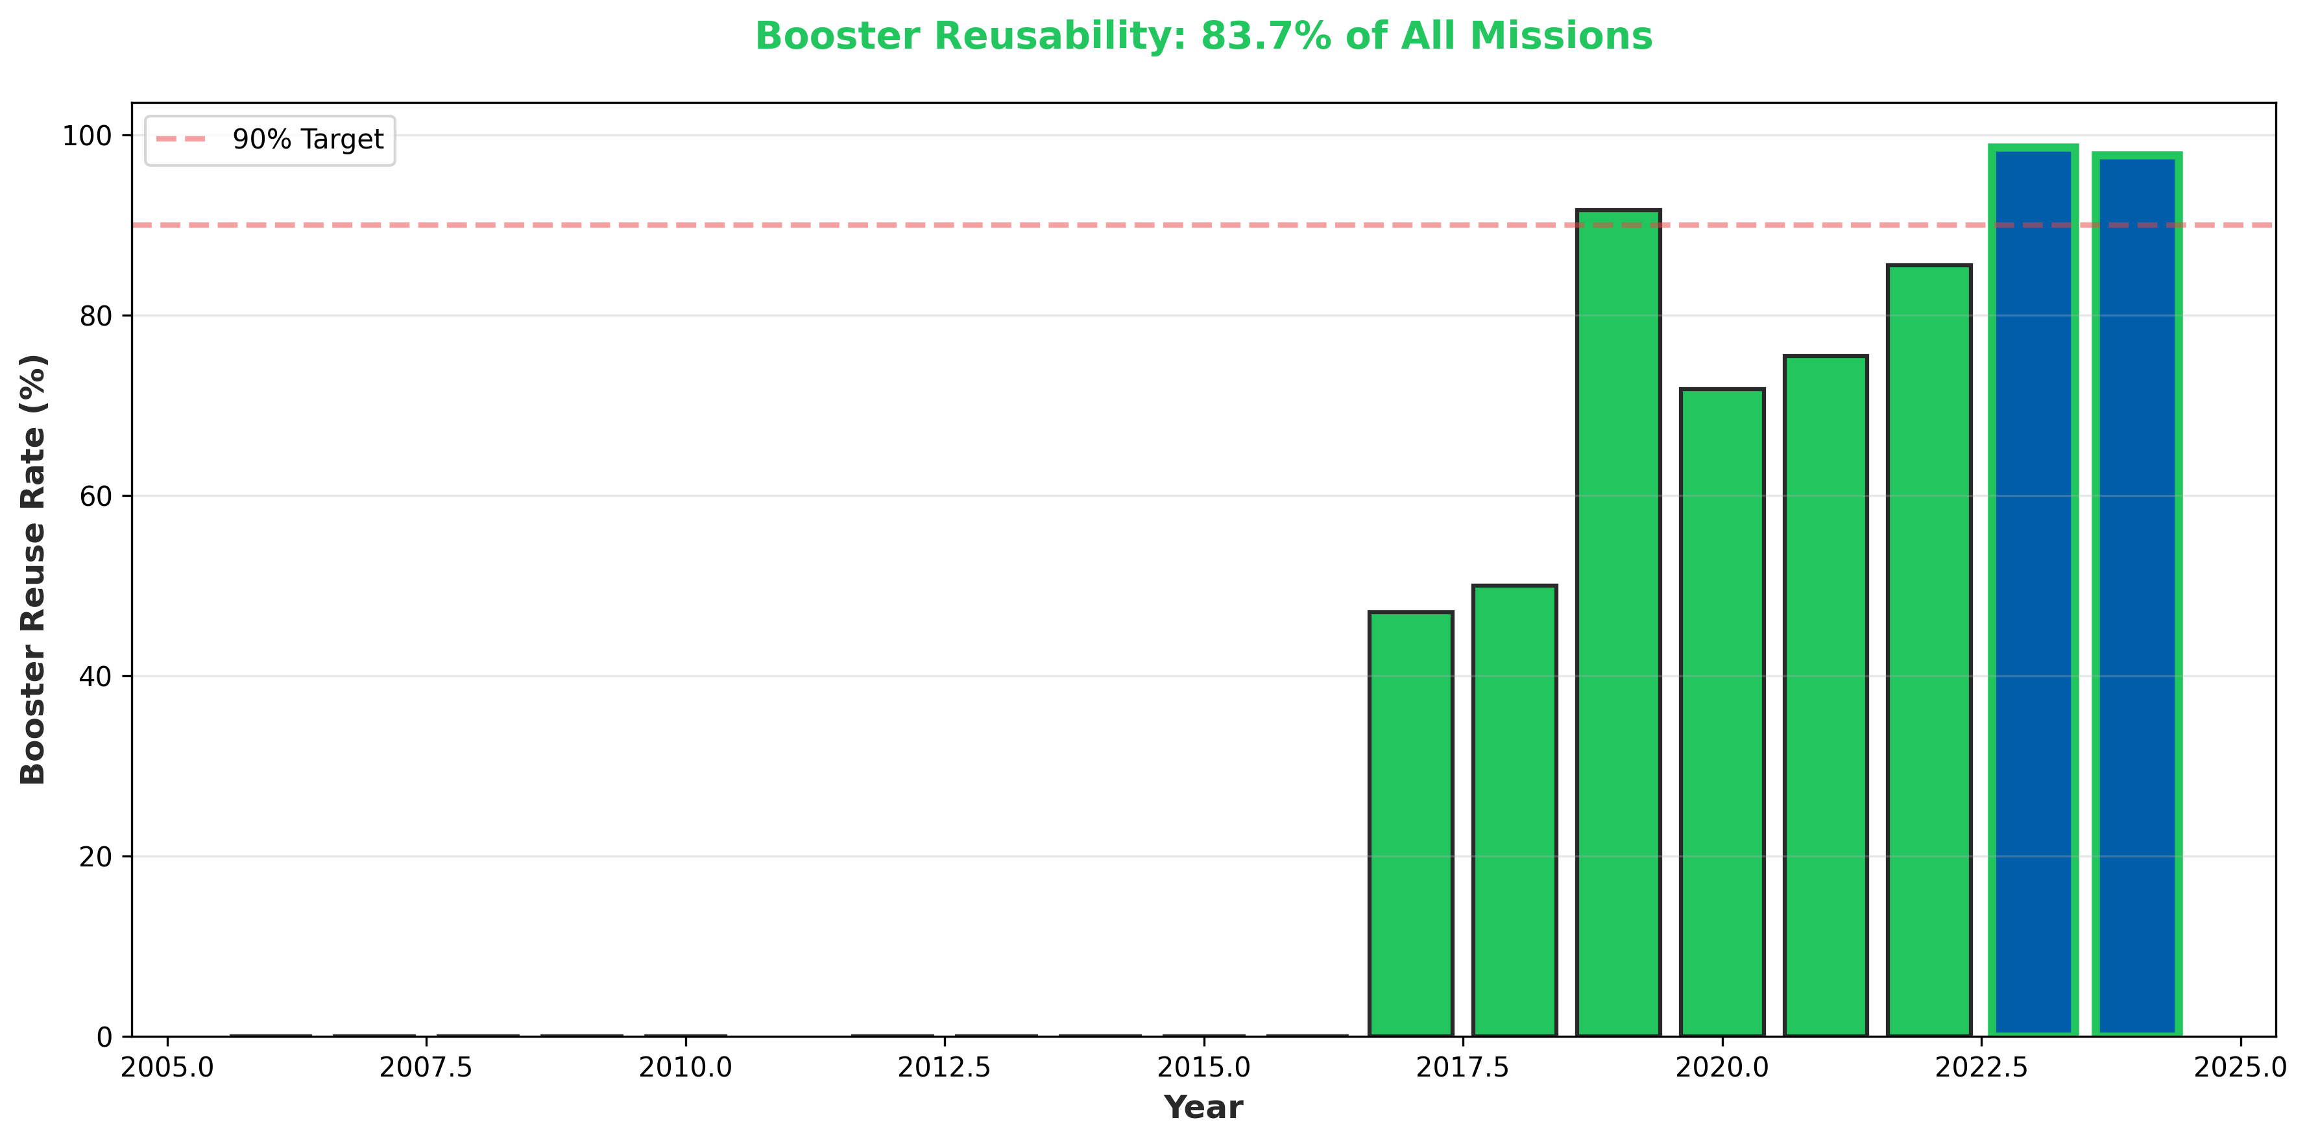
Page 2: Success Story - Landing & Reusability
🎯 Landing Success: 93% (507/545 attempts) | Reusability: 83.7% of all missions using reused boosters

Slide 5
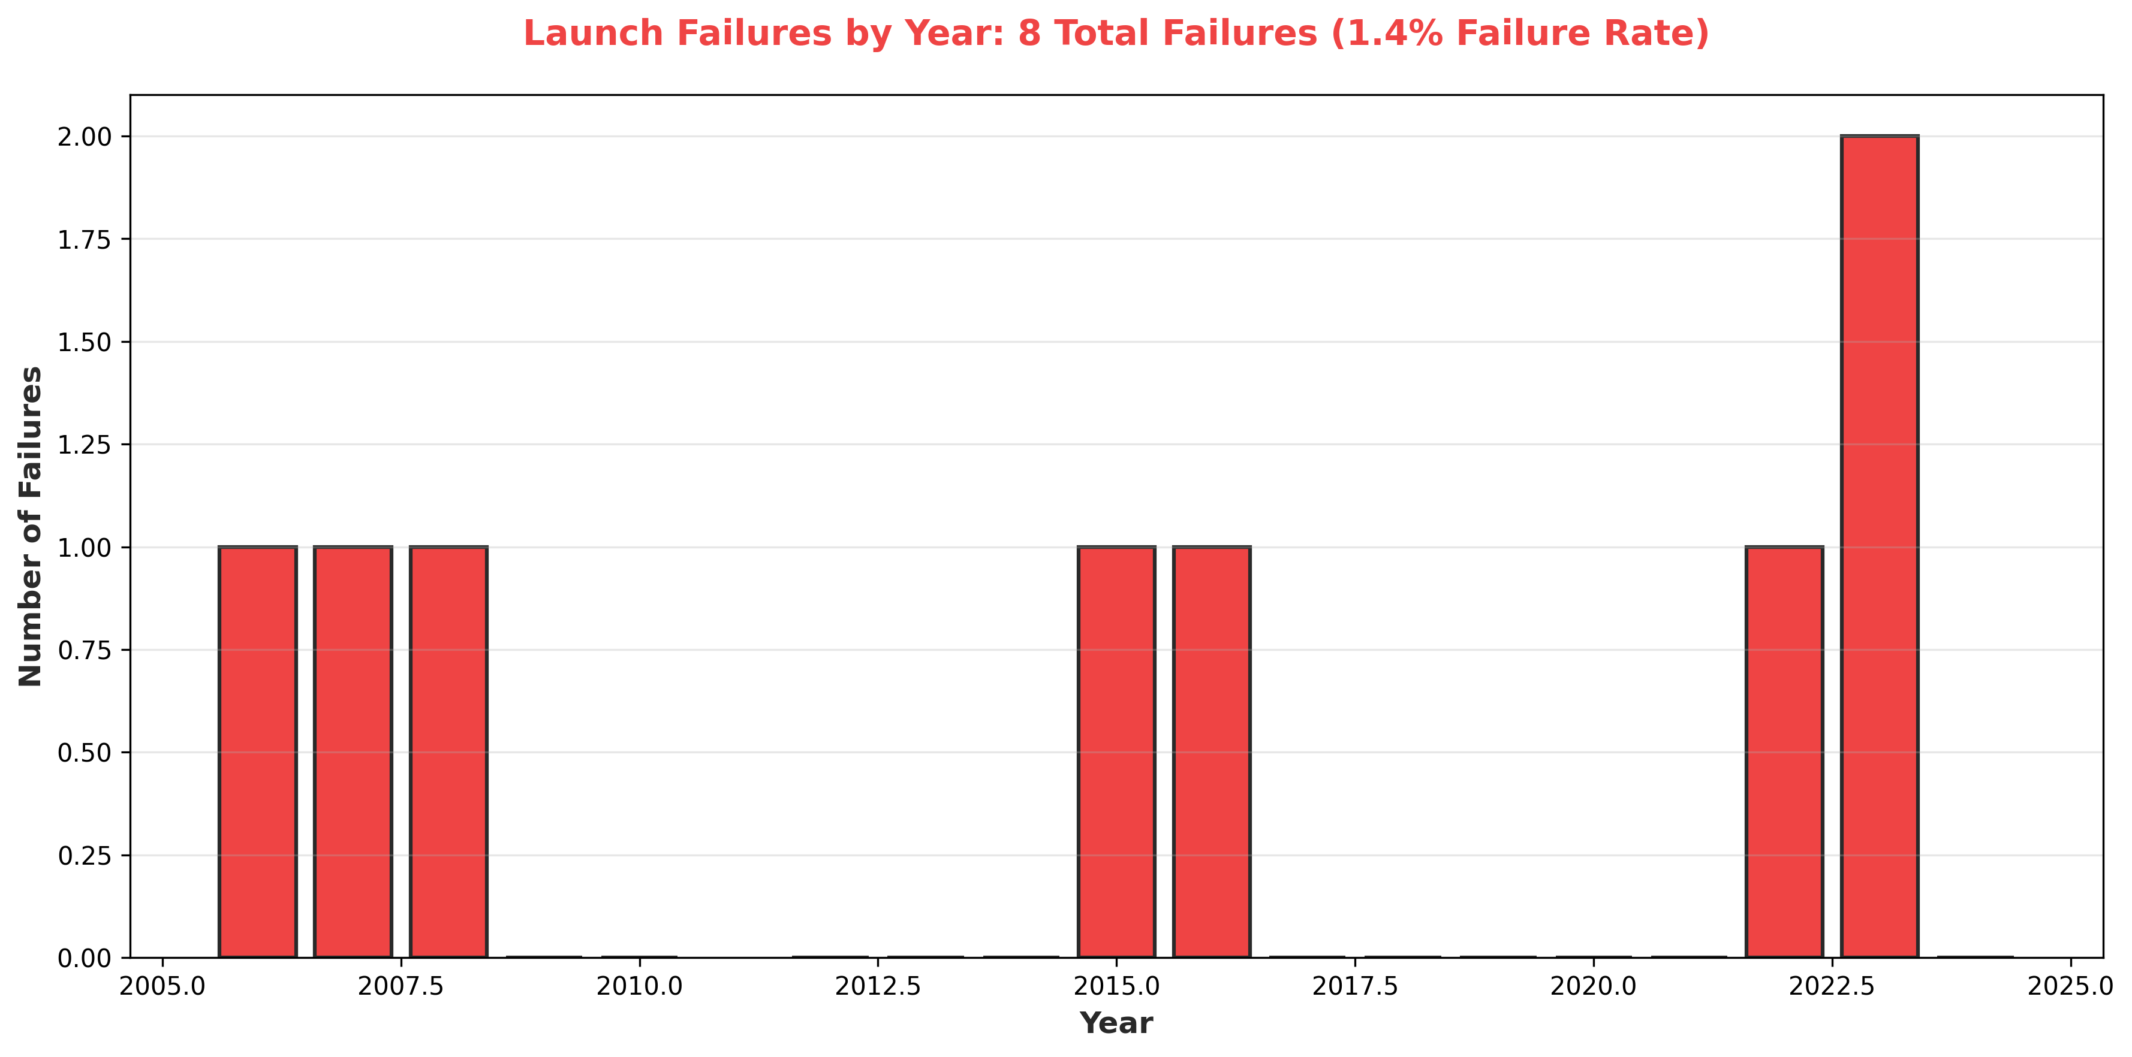
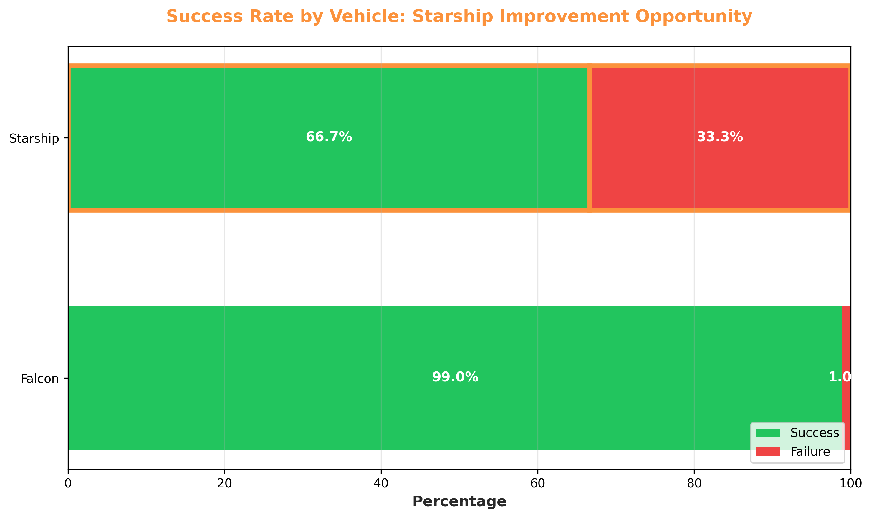
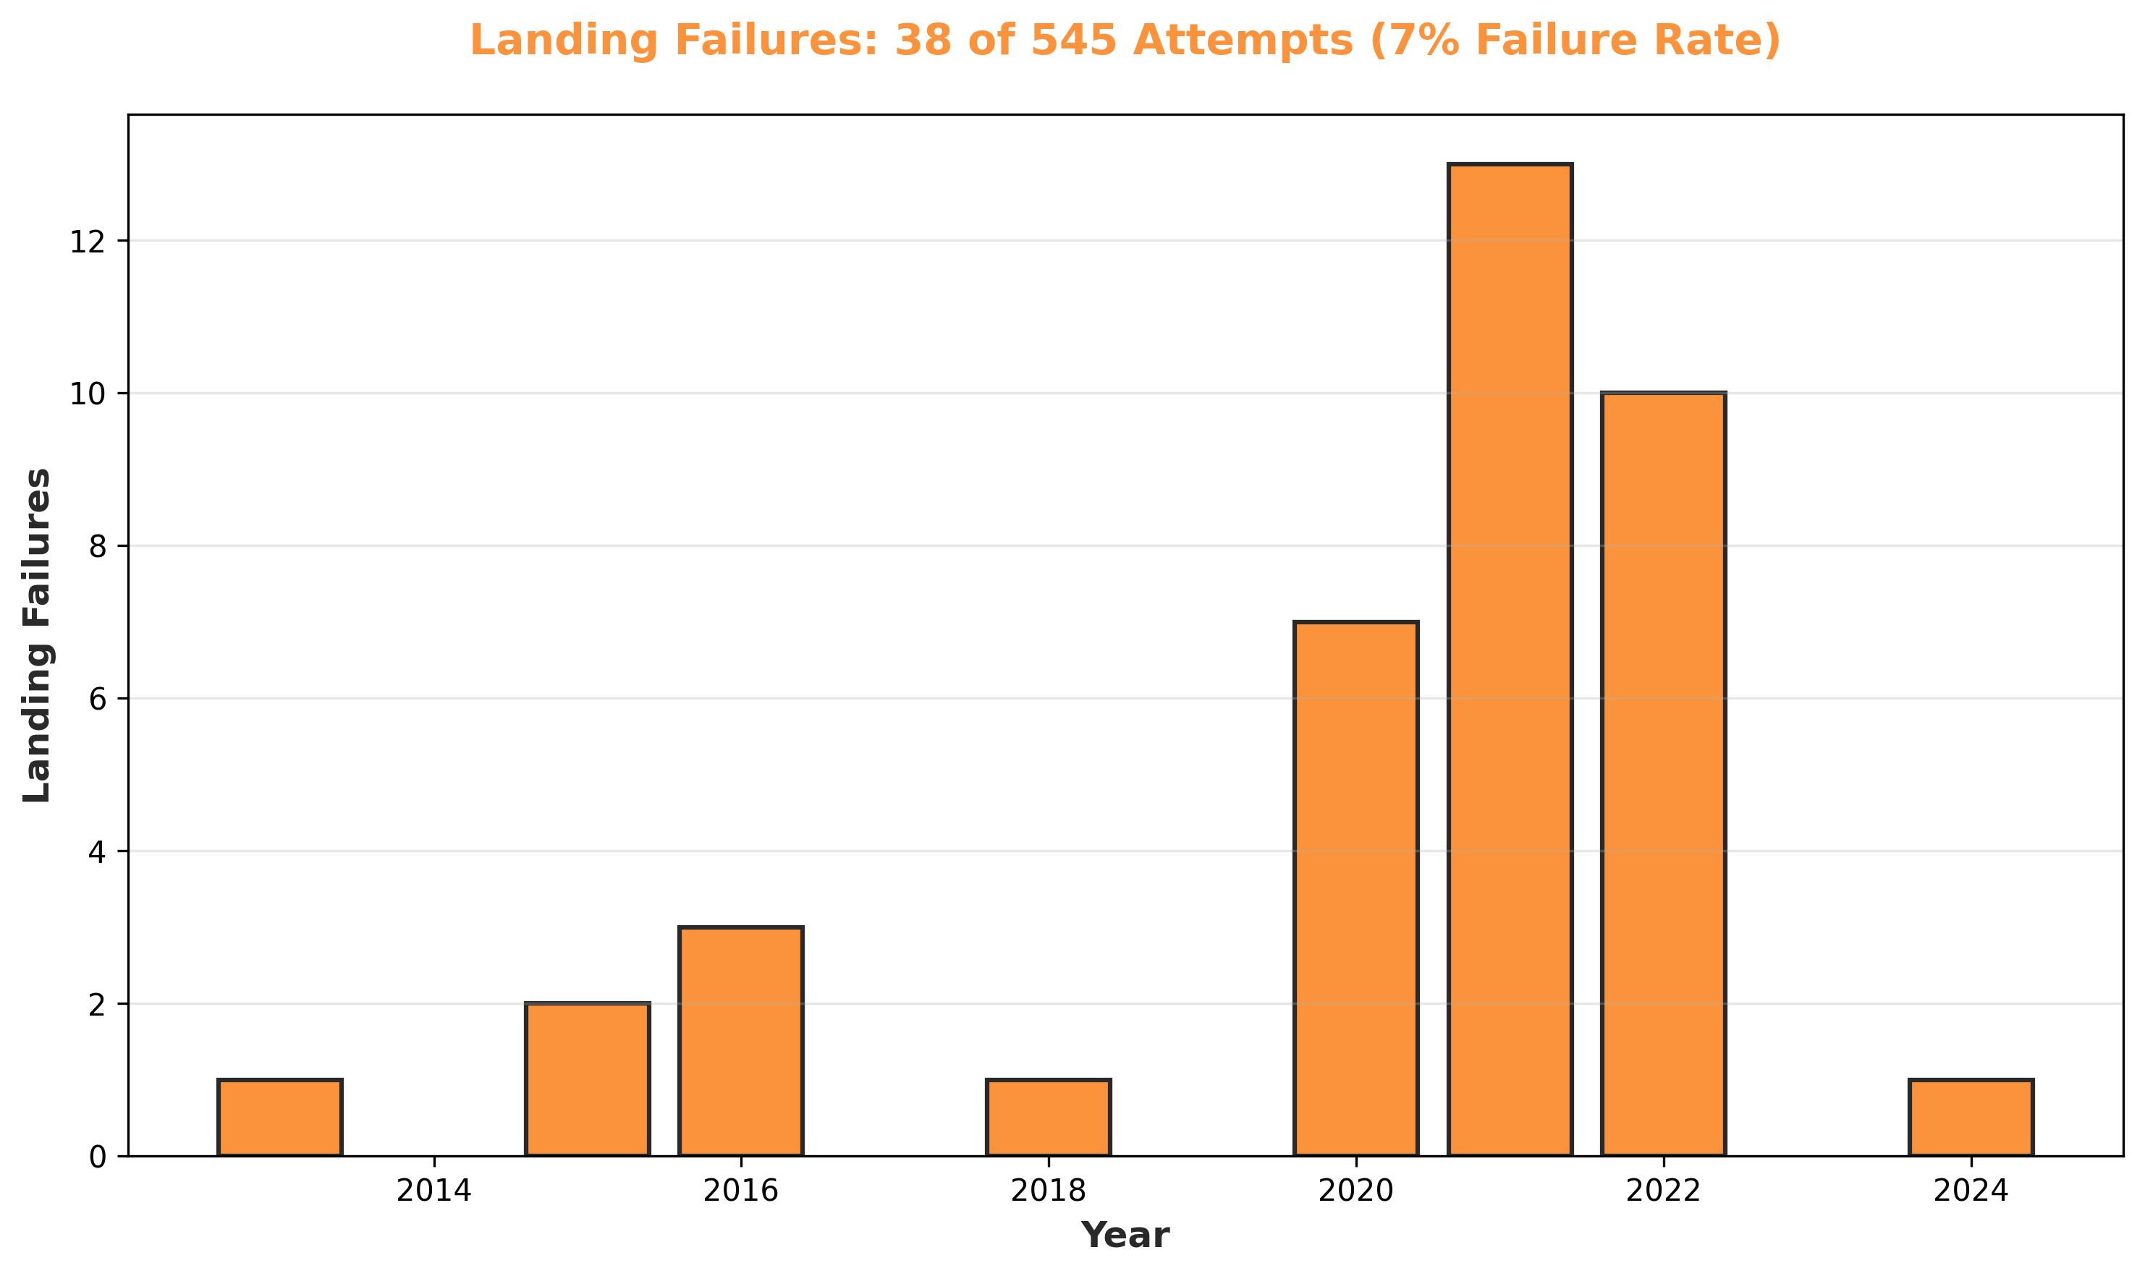
Page 3: Improvement Opportunities
⚠️ Focus Areas: 8 launch failures (1.4%) | 38 landing failures (7%) | Starship: 66.7% success rate

Slide 6
Power BI Implementation Guide
Data Connections
1. Import CSV files:
• fact_launches.csv
• dim_launch_location.csv
• dim_launch_vehicle.csv
2. Create relationships:
• fact→location (location_id)
• fact→vehicle (vehicle_id)
3. Set date table from launch_date_actual
Essential DAX Measures
Success Rate =
DIVIDE(COUNT(launch_success=TRUE),
COUNT(all_launches))
ROI Savings =
COUNT(booster_reused=TRUE) * 30
Improvement Trend =
AVERAGE(improvement_flag)
BY QUARTER
Recommended Visualizations
• KPI Cards: Total launches, Success rate, Cost savings, Reusability %
• Line Charts: Launch trend over time, Landing success evolution
• Bar Charts: Launches by vehicle, Booster reuse count, Cost comparison
• Matrix/Heatmap: Launch calendar, Improvement opportunities by category
• Gauge Charts: Current success rate, Reusability percentage
• Waterfall: Cost reduction breakdown, ROI progression

