Slide 1
querydawg.com
Natural Language Sematic Layer for Text-to-SQL
Scott Person 11/24/2025

Slide 2
Improving Text to SQL
Primary Question: Demonstrate that natural language semantic layers can bridge the gap between database schemas and business understanding, enabling more accurate text-to-SQL generation while producing valuable documentation.
Primary Goal: Explore the use of agentic AI to solve a problem.

Slide 3
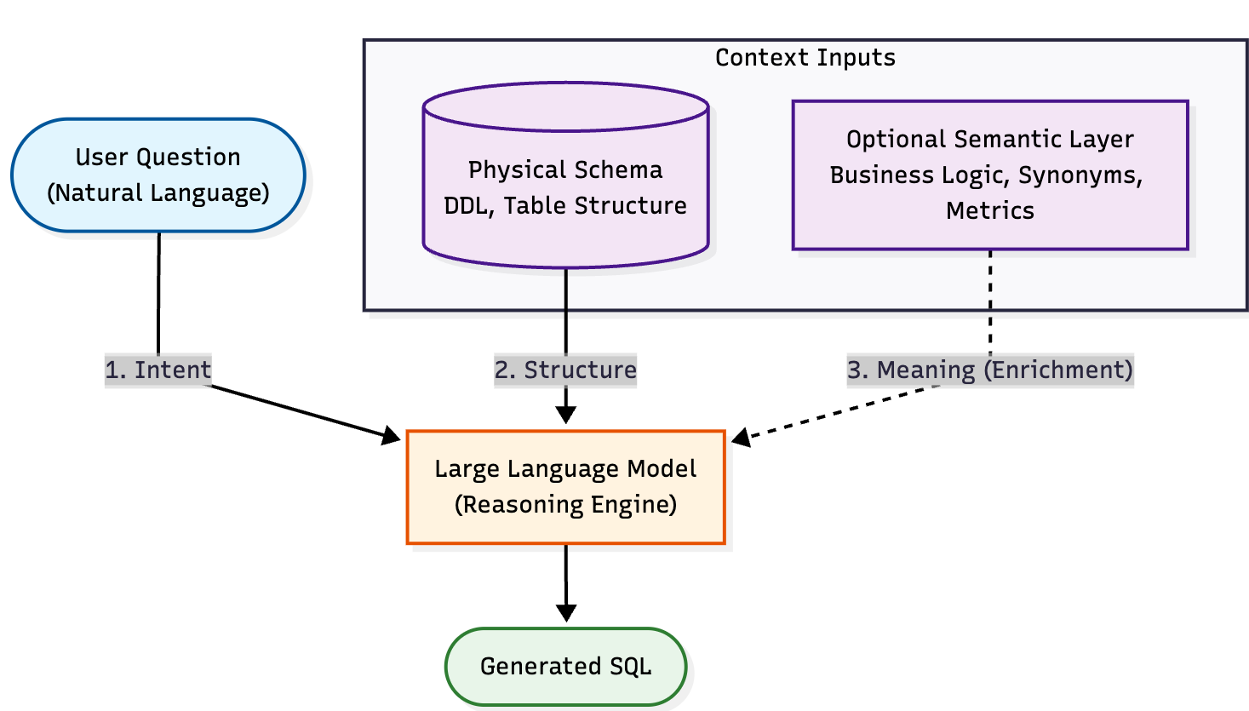
QueryDawg Data Flow

Slide 4
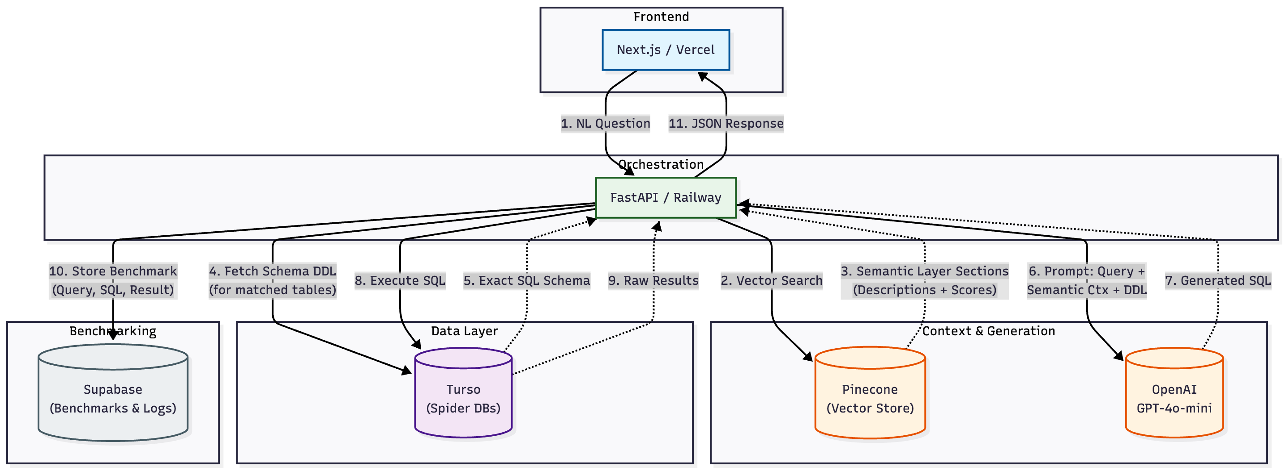
QueryDawg – Complete Architecture

Slide 5
Demo

Slide 6
Conclusion – automated semantic layer generation doesn’t justify the cost and complexity.

Slide 7
Takeaways and Next Steps
Takeaways
Next Steps
Text to SQL isn’t hard
Features are (almost) free
Learning curves are flattening
Hand tune the prompt for Spider 1.0
Add human analyst input to semantic layer

Slide 8
Key Takeaway – Find a use case and build

Slide 9
Resources
Claude Code – primary development tool
OpenAI Codex – brainstorming, code review
Google Gemini – diagrams
Technology components: Vercel, Railway, Supabase, Turso, Pinecone, OpenAI API
Spider 1.0 Benchmark: https://yale-lily.github.io/spider
https://github.com/jsperson/querydawg
https://github.com/jsperson/docker
jsperson@gmail.com

