Slide 1
Naïve Bayes Classifier
Ke Chen
http://intranet.cs.man.ac.uk/mlo/comp20411/
Modified and extended by Longin Jan Latecki
latecki@temple.edu

Slide 2
Outline
Background
Probability Basics
Probabilistic Classification
Naïve Bayes
Example: Play Tennis
Relevant Issues
Conclusions

Slide 3
Background
There are three methods to establish a classifier
a) Model a classification rule directly
  Examples: k-NN, decision trees, perceptron, SVM
  b) Model the probability of class memberships given input data
  Example: multi-layered perceptron with the cross-entropy cost
c) Make a probabilistic model of data within each class
  Examples: naive Bayes, model based classifiers
a) and b) are examples of discriminative classification
c) is an example of generative classification
b) and c) are both examples of probabilistic classification

Slide 4



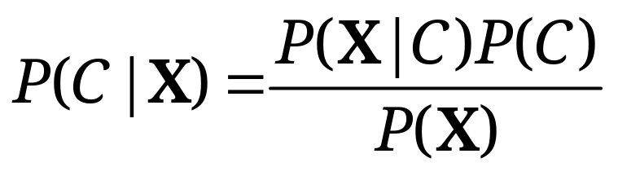
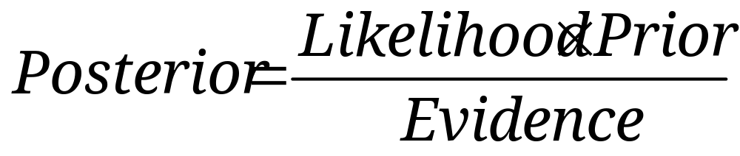
Probability Basics
Prior, conditional and joint probability
  Prior probability:
  Conditional probability:
  Joint probability:
  Relationship:
  Independence:
Bayesian Rule

Slide 5
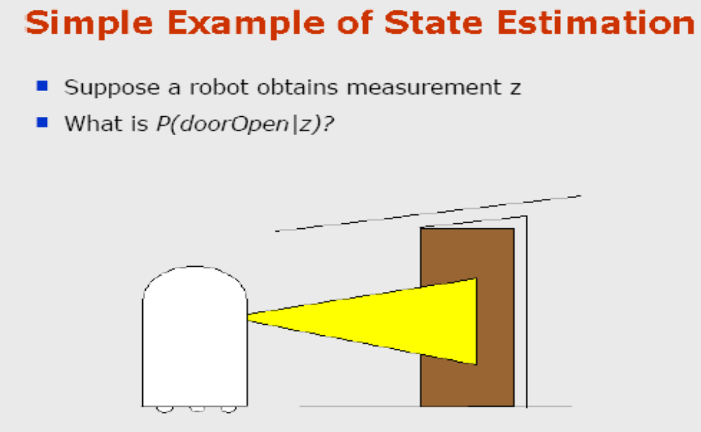
Example by Dieter Fox
Notes:
Discrete Mathematics and its Applications
(c)2001-2002, Michael P. Frank

Slide 6
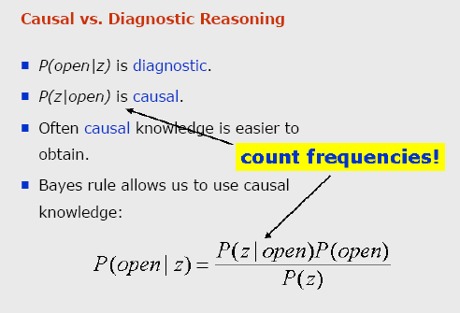
Notes:
Discrete Mathematics and its Applications
(c)2001-2002, Michael P. Frank

Slide 7
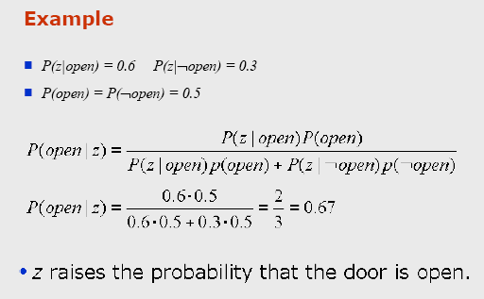
Notes:
Discrete Mathematics and its Applications
(c)2001-2002, Michael P. Frank

Slide 8
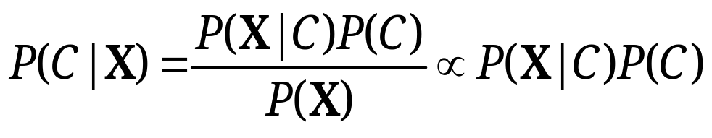
Probabilistic Classification
Establishing a probabilistic model for classification
  Discriminative model
  Generative model
MAP classification rule
  MAP: Maximum A Posterior
  Assign x to c* if
Generative classification with the MAP rule
  Apply Bayesian rule to convert:

Slide 9
Feature Histograms
P(x)
C₁
C₂
x
Slide by Stephen Marsland

Slide 10
Posterior Probability
P(C|x)
1
0
x
Slide by Stephen Marsland

Slide 11

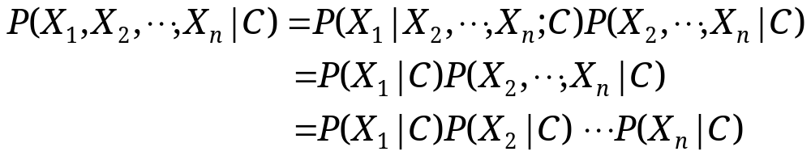
Naïve Bayes
Bayes classification
  Difficulty: learning the joint probability
Naïve Bayes classification
  Making the assumption that all input attributes are independent
  MAP classification rule

Slide 12
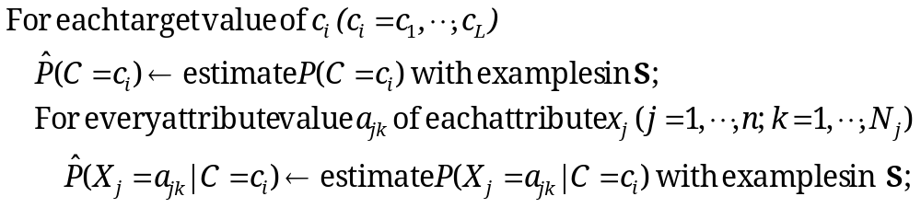


Naïve Bayes
Naïve Bayes Algorithm (for discrete input attributes)
  Learning Phase: Given a training set S,
  Output: conditional probability tables; for elements
  Test Phase: Given an unknown instance ,
  Look up tables to assign the label c* to X’ if

Slide 13

Example
Example: Play Tennis

Slide 14
Learning Phase
P(Outlook=o|Play=b) P(Temperature=t|Play=b)
Outlook | Play=Yes | Play=No
Sunny | 2/9 | 3/5
Overcast | 4/9 | 0/5
Rain | 3/9 | 2/5
Temperature | Play=Yes | Play=No
Hot | 2/9 | 2/5
Mild | 4/9 | 2/5
Cool | 3/9 | 1/5
P(Humidity=h|Play=b) P(Wind=w|Play=b)
Humidity | Play=Yes | Play=No
High | 3/9 | 4/5
Normal | 6/9 | 1/5
Wind | Play=Yes | Play=No
Strong | 3/9 | 3/5
Weak | 6/9 | 2/5
P(Play=Yes) = 9/14
P(Play=No) = 5/14

Slide 15
Example
Test Phase
  Given a new instance,
  x’=(Outlook=Sunny, Temperature=Cool, Humidity=High, Wind=Strong)
  Look up tables
  MAP rule
P(Outlook=Sunny|Play=Yes) = 2/9
P(Temperature=Cool|Play=Yes) = 3/9
P(Huminity=High|Play=Yes) = 3/9
P(Wind=Strong|Play=Yes) = 3/9
P(Play=Yes) = 9/14
P(Outlook=Sunny|Play=No) = 3/5
P(Temperature=Cool|Play==No) = 1/5
P(Huminity=High|Play=No) = 4/5
P(Wind=Strong|Play=No) = 3/5
P(Play=No) = 5/14
P(Yes|x’): [P(Sunny|Yes)P(Cool|Yes)P(High|Yes)P(Strong|Yes)]P(Play=Yes) = 0.0053
P(No|x’): [P(Sunny|No) P(Cool|No)P(High|No)P(Strong|No)]P(Play=No) = 0.0206
Given the fact P(Yes|x’) < P(No|x’), we label x’ to be “No”.

Slide 16

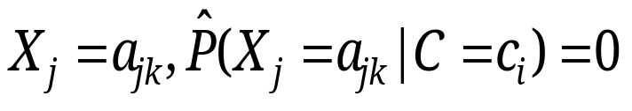
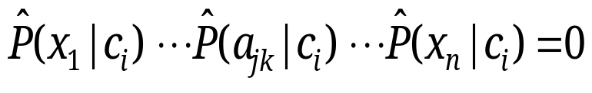
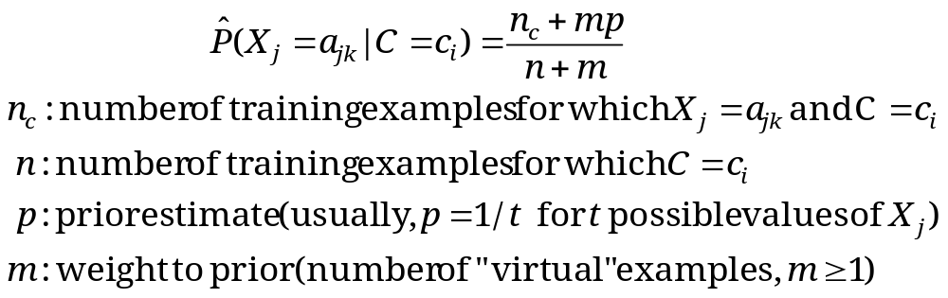
Relevant Issues
Violation of Independence Assumption
  For many real world tasks,
  Nevertheless, naïve Bayes works surprisingly well anyway!
Zero conditional probability Problem
  If no example contains the attribute value
  In this circumstance, during test
  For a remedy, conditional probabilities estimated with Laplace smoothing:

Slide 17
Homework
Redo the test on Slide 15 using the formula on Slide 16 with m=1.
Compute P(Play=Yes|x’) and P(Play=No|x’) with m=0 and with m=1 for
x’=(Outlook=Overcast, Temperature=Cool, Humidity=High, Wind=Strong)
Does the result change?

Slide 18
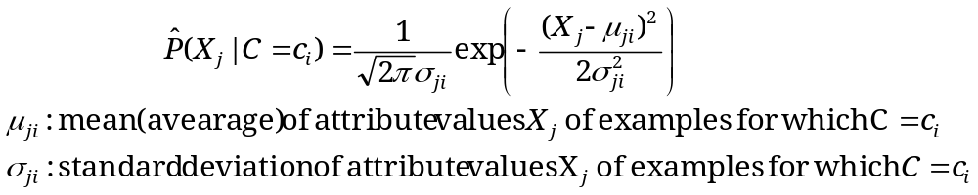




Relevant Issues
Continuous-valued Input Attributes
  Numberless values for an attribute
  Conditional probability modeled with the normal distribution
  Learning Phase:
  Output: normal distributions and
  Test Phase:
    Calculate conditional probabilities with all the normal distributions
    Apply the MAP rule to make a decision

Slide 19
Conclusions
Naïve Bayes based on the independence assumption
  Training is very easy and fast; just requiring considering each attribute in each class separately
  Test is straightforward; just looking up tables or calculating conditional probabilities with normal distributions
A popular generative model
  Performance competitive to most of state-of-the-art classifiers even in presence of violating independence assumption
  Many successful applications, e.g., spam mail filtering
  Apart from classification, naïve Bayes can do more…

