Slide 1
Very Large Scale Integration II - VLSI II
RF & Datapath & Single Cycle Control
Berna Örs Yalçın
ITU VLSI Laboratories
Istanbul Technical University

Slide 2
Topics for today
Register File
Generic Datapath
Single Cycle Control and Issues

Slide 3
Basic Processor Structure
The specification for a computer consists of a description of its appearance to a programmer at the lowest level, its instruction set architecture (ISA)
From the ISA, a high-level description of the hardware to implement the computer, called the computer architecture, is formulated.
This architecture, for a simple computer, is typically divided into two parts;
  Datapath
  Control Unit

Slide 4
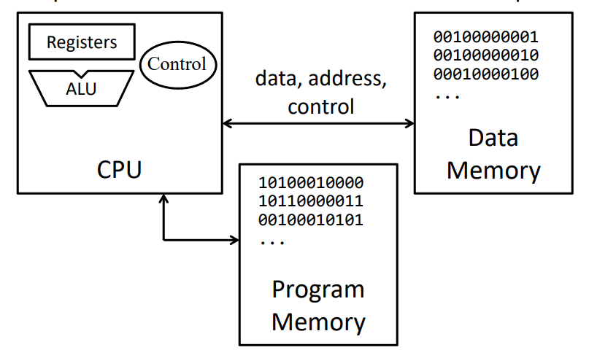
Basic Processor Structure

Slide 5
Basic Processor Structure
The datapath is defined by a few basic components:
  a set of registers (register file)
  the microoperations performed on data stored in the registers (ALU)
  the control interface
  buses, multiplexers, decoders
The control unit
  provides signals that control the microoperations performed in the datapath and in other components of the system, such as memories.
  controls its own operation, determining the sequence of events that occur. This sequence may depend upon the results of current and past microoperations executed.
  directs the information flow through the buses, the ALU, the shifter, and the registers by applying signals to the select inputs.

Slide 6
Datapath Example
Load enable
A select
B select
Four parallel-load
registers
Two mux-based
register selectors
Register destination
decoder
Mux B for external
constant input
Buses A and B with external
address and data outputs
ALU and Shifter with
Mux F for output select
Mux D for external data input
Logic for generating status bits
V, C, N, Z
D data
Write
n
A address
B address
Load
R0
2
2
n
n
Load
R1
n
0
1
MUX
n
2
0
3
Load
1
MUX
R2
2
n
n
3
Load
R3
n
n
0
1
2
3
n
Register file
Decoder
D address
A data
B data
2
Constant in
n
n
Destination select
MB select
n
1
0
Bus A
MUX B
n
Address
Bus B
n
Out
A
B
Data
G select
H select
n
Out
4
S
A
|| C
B
2
S
B
V
2:0
in
0
I
Shifter
I
0
Arithmetic/logic
R
L
C
unit (ALU)
H
N
G
n
Z
Zero Detect
n
MF select
0
1
Function unit
MUX F
F
n
n
Data In
MD select
0
1
n
Bus D
MUX D

Slide 7
Datapath Example: Performing a Microoperation
Microoperation: R0 ← R1 + R2
Load enable
A select
B select
D data
Write
n
A address
B address
Apply 01 to A select to place
contents of R1 onto Bus A
Load
R0
2
2
Apply 10 to B select to place
contents of R2 onto B data and
apply 0 to MB select to place
B data on Bus B
n
n
Load
R1
n
0
1
MUX
n
2
0
3
Load
1
MUX
Apply 0010 to G select to perform addition G = Bus A + Bus B
R2
2
n
n
3
Apply 0 to MF select and 0 to MD
select to place the value of G onto BUS D
Load
R3
n
n
0
1
2
3
n
Register file
Decoder
D address
A data
B data
2
Constant in
n
n
Destination select
MB select
n
1
0
Apply 00 to Destination select to enable the Load input to R0
Bus A
MUX B
n
Address
Bus B
n
Out
A
B
Data
G select
H select
n
Out
Apply 1 to Load Enable to force the Load input to R0 to 1 so that R0 is loaded on the clock pulse (not shown)
The overall microoperation requires
1 clock cycle
4
S
A
|| C
B
2
S
B
V
2:0
in
0
I
Shifter
I
0
Arithmetic/logic
R
L
C
unit (ALU)
H
N
G
n
Z
Zero Detect
n
MF select
0
1
Function unit
MUX F
F
n
n
Data In
MD select
0
1
n
Bus D
MUX D

Slide 8
Datapath Example: Key Control Actions for Microoperation Alternatives
Perform a shift microoperation – apply 1 to MF select
Use a constant in a micro- operation using Bus B – apply 1 to MB select
Provide an address and data for a memory or output write microoperation – apply 0 to Load enable to prevent register loading
Provide an address and obtain data for a memory or output read microoperation – apply 1 to MD select
For some of the above, other control signals become don't cares
Load enable
A select
B select
D data
Write
n
A address
B address
Load
R0
2
2
n
n
Load
R1
n
0
1
MUX
n
2
0
3
Load
1
MUX
R2
2
n
n
3
Load
R3
n
n
0
1
2
3
n
Register file
Decoder
D address
A data
B data
2
Constant in
n
n
Destination select
MB select
n
1
0
Bus A
MUX B
n
Address
Bus B
n
Out
A
B
Data
G select
H select
n
Out
4
S
A
|| C
B
2
S
B
V
2:0
in
0
I
Shifter
I
0
Arithmetic/logic
R
L
C
unit (ALU)
H
N
G
n
Z
Zero Detect
n
MF select
0
1
Function unit
MUX F
F
n
n
Data In
MD select
0
1
n
Bus D
MUX D

Slide 9
Register File
Register File is
  a block of processor registers.
  defined in ISA. It is the first block used to store data hierarchically.
  a special type of fast memory that permits one or more words to be read and one or more words to be written, all simultaneously.
  visible to the programmers.
The size of the register file is 2^{m}× n, where m is the number of register address bits and n is the number of bits per register.

Slide 10
Register File
ISA defines both special purpose registers and general purpose registers.
Compiler makes arrangements according to the Register File which is defined in ISA.
  Zero register
  Stack pointer register
  Return address register
  etc

Slide 11
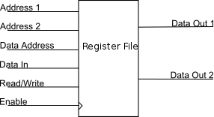
Register File Structure

Slide 12
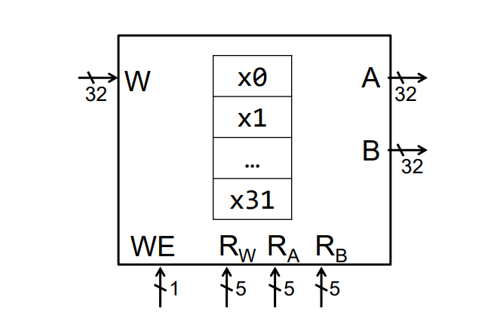
Register File for RISC-V ISA
WE: Write Enable
W: Data input for write operation
RW: Write register address
RA-RB: Read register address
A-B: Data outputs from the readed registers

Slide 13
Register File for RISC-V ISA
32-bit fixed 32 registers numbered from 0 to 31
Referred by numbers x0, x1, x2 ... x31
  All have conventional names:
  Example: x10 – x17 => a0 – a7, x28 – x31 => t3 – t6

Slide 14
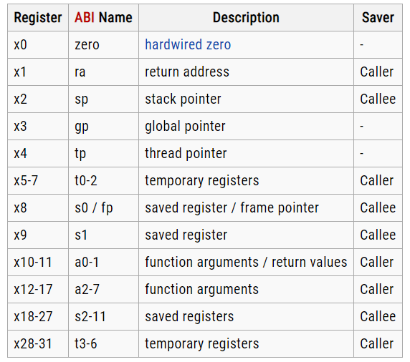
Register File for RISC-V ISA

Slide 15
Datapath Representation
The registers, and the multiplexer, decoder, and enable hardware for accessing them become a register file
The ALU, shifter, MUX F and status hardware become a function unit
In the register file:
  Multiplexer select inputs become A address and B address
  Decoder input becomes D address
  Multiplexer outputs become A data and B data
  Input data to the registers becomes D data
  Load enable becomes write
The G select, H select and MF select become FS
n
D data
m
Write
D address
2
m
x
n
Register file
m
A address
B address
m
A data
B data
Constant in
n
n
n
MB select
1
0
MUX B
Bus A
n
Address out
Bus B
n
Data out
FS
4
A
B
V
C
Function
N
unit
Z
F
n
n
Data in
MD select
0
1
MUX D

Slide 16
Definition of Function Unit Select (FS) Codes
G
Select,
H
Select,
and
MF
in T
of
FS
Codes
MF
G
H
FS(3:0)
Select
Select(3:0)
Select(3:0)
Micr
ooperation
0000
0
0000
XX
←
Boolean
Equations:
MFS = F₃ F₂
GS_{i} = F_{i}
HS_{i} = F_{i}
F A
0001
0
0001
XX
←
+
F A
1
0010
0
0010
XX
←
+
F A
B
0011
0
0011
XX
←
+
+
F A
B
1
0100
0
0100
XX
←
+
F A
B
0101
0
0101
XX
←
+
+
F A
B
1
0110
0
0110
XX
←
−
F A
1
0111
0
0111
XX
F
←
A
1000
0
1
X
00
XX
F
←
∧
A B
1001
0
1
X
01
XX
F
←
∨
A B
1010
0
1
X
10
XX
F
←
⊕
A B
1011
0
1
X
11
XX
F
←
A
1100
1
XXXX
00
F
←
B
1101
1
XXXX
01
F
←
sr
B
1110
1
XXXX
10
F
←
sl
B

Slide 17
Control Word
The datapath has many control inputs
The signals driving these inputs can be defined and organized into a control word
To execute a microinstruction, we apply control word values for a clock cycle. For most microoperations, the positive edge of the clock cycle is needed to perform the register load
The datapath control word format and the field definitions are shown on the next slide

Slide 18
Control Word
  DA – D Address
  AA – A Address
  BA – B Address
  MB – Mux B
  FS – Function Select
  MD – Mux D
  RW – Register Write
15
14
13
12
11
10
9
8
7
6
5
4
3
2
1
0
D
A
AA
BA
M
FS
M
R
B
D
W
Control word

Slide 19
Control Word Block Diagram
n
R
W
0
Write
D data
  DA – D Address
  AA – A Address
  BA – B Address
  MB – Mux B
  FS – Function Select
  MD – Mux D
  RW – Register Write
D
A
15
14
D address
13
8
x
n
Register file
AA
12
A address
B address
9
BA
11
8
10
A data
B data
7
n
n
Constant in
n
MB
6
1
0
Bus A
MUX B
n
Bus B
n
Address out
Data out
A
B
V
5
C
Function
4
FS
N
unit
3
Z
2
n
n
Data in
0
1
MD
1
MUX D
Bus D

Slide 20
Control Word Encoding
Encoding of Control
W
D
A
,
AA,
B
A
MB
FS
MD
R
W
Function
Code
Function
Code
Function
Code
Function
Code
Function
Code
R
←
0
000
Register
0
F
A
0000
Function
0
No write
0
R
1
001
Constant
1
←
+
0001
Data In
1
Write
1
F A
1
R
←
+
2
010
F A
B
0010
R
←
+
+
3
011
F A
B
1
0011
R
←
+
4
100
F A
B
0100
R
←
+
+
5
101
F A
B
1
0101
R
←
−
6
110
F A
1
0110
R
←
7
111
F A
0111
←
∧
F A
B
1000
←
∨
F A
B
1001
←
⊕
1010
F A
B
F
←
A
1011
←
1100
F B
F
←
sr
B
1101
F
←
1110
sl
B

Slide 21
Microoperations for the Datapath - Symbolic Representation
Micr
o-
op
eratio
n
D
A
A
A
B
A
M
B
F
S
M
D
R
W
R
←
1
R
2
R
3
R
1
R
2
R
3
R
e
g
–
ister
F A
B
1
F
unction
Write
=
+ +
R
←
4
s
l R6
R
4
—
R
6
R
e
g
ister
F
=
sl
B
F
unction
Write
R
←
7
R
7 1
R
7
R
+
7
—
Re
gister
F A
1
Function
Write
=
+
R
←
1
R
0 2
R
1
R
0
—
Con
s
+
tant
F A
B
Func
tio
n
Write
=
+
Data out
←
R
3
——
R
3
R
eg
i
s
t
e
r
—
—
N
o Wr
it
e
R
←
4
D
ata in
R
4
——
—
—
Data in
Write
R
←
⊕
5 0
R
5
R
0
R
0
R
e
g
ister
F A
B
F
unction
Write
=

Slide 22
Microoperations for the Datapath - Binary Representation
m
Microoperations from T
a
Binary C
o
o
Micr
o-
o
p
eratio
n
D
A
A
A
B
A
M
B
F
S
M
D
R
W
R
1
←
R
2
–
R
3
0
0
1
0
1
0
011
0
010
1
0
1
R
4
←
s
l R6
10
0
XX
X
110
0
111
0
0
1
R
7
←
R
7 1
11
1
1
11
XXX
0
000
1
0
1
+
R
1
←
R
0 2
00
1
0
00
XXX
1
001
0
0
1
+
Data out
←
R
3
XX
X
X
XX
011
0
XXX
X
X
0
R
4
←
D
ata in
10
0
XX
X
XXX
X
XXX
X
1 1
←
R
5 0
1
0
1
0
0
0
000
0
101
0
0
1

Slide 23
The Entire Datapath
Putting it all together (datapath):
  Arithmetic Logic Unit (ALU)
  Register File
  Memory
    SRAM
    DRAM

Slide 24
Instruction Set Architecture (ISA) for Simple Computer (SC)
A programmable system uses a sequence of instructions to control its operation
An typical instruction specifies:
  Operation to be performed
  Operands to use, and
  Where to place the result, or
  Which instruction to execute next
Instructions are stored in RAM or ROM as a program
The addresses for instructions in a computer are provided by a program counter (PC) that can
  Count up
  Load a new address based on an instruction and, optionally, status information

Slide 25
Instruction Set Architecture (ISA) (continued)
The PC and associated control logic are part of the Control Unit
Executing an instruction - activating the necessary sequence of operations specified by the instruction
Execution is controlled by the control unit and performed:
  In the datapath
  In the control unit
  In external hardware such as memory or input/output

Slide 26
ISA: Storage Resources
The storage resources are "visible" to the programmer at the lowest software level (typically, machine or assembly language)
Storage resources
for the SC =>
Separate instruction and
data memories imply
"Harvard architecture"
Done to permit use of
single clock cycle per
instruction implementation
Due to use of "cache" in
modern computer
architectures, is a fairly
realistic model
Program counter
(PC)
Instruction
memory
2
15
x
16
Register file
8
_{x}
16
Data
memory
2
15
x
16

Slide 27
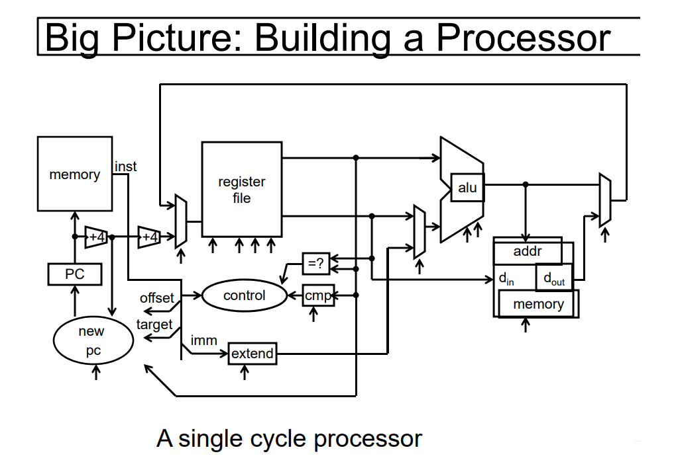
Single Cycle Processor
Weatherspoon, Bala, Bracy, and Sirer, CS3410, Compter Science, Cornell University

Slide 28

Extend
IR(8:6) || IR(2:0)
V
C
Branch
PC
N
Control
Z
P
J
B
Address
L
B
C
Instruction
memory
RW
D
Instruction
DA
Register
AA
A
file
B
BA
IR(2:0)
Zero fill
Constant
Instruction decoder
in
1
0
MB
MUX B
Address out
Bus A
Bus B
Data out
MW
D
B
A
M
F
M
R
M
P
J
B
A
A
A
B
S
D
W
W
L
B
C
FS
A
B
Data in
Address
CONTROL
V
Function
Data
C
unit
memory
N
Data out
Z
F
Data in
MD
0
1
Bus D
MUX D
DATAPATH
Chapter 10 Part 2 28

Slide 29
The Control Unit
The Data Memory has been attached to the Address Out and Data Out and Data In lines of the Datapath.
The MW input to the Data Memory is the Memory Write signal from the Control Unit.
For convenience, the Instruction Memory, which is not usually a part of the Control Unit is shown within it.
The Instruction Memory address input is provided by the PC and its instruction output feeds the Instruction Decoder.
Zero-filled IR(2:0) becomes Constant In
Extended IR(8:6) || IR(2:0) and Bus A are address inputs to the PC.
The PC is controlled by Branch Control logic

Slide 30
PC Function
PC function is based on instruction specifications involving jumps and branches
In addition to the above register transfers, the PC must also implement: PC ← PC + 1
The first two transfers above require addition to the PC of: Address Offset = Extended IR(8:6) || IR(2:0)
The third transfer requires that the PC be loaded with: Jump Address = Bus A = R[SA]
The counting function of the PC requires addition to the PC of 1
Branch
on
Zero
BRZ
if (R[
S
A] =
0) PC
←
PC
+ s
e
A
D
Branch
on
Negative
BRN
if (R[
S
A] <
0) PC
←
PC
+ s
e
A
D
J
u
mp
JMP
P
C
←
R[SA
]

Slide 31
PC Function (continued)
Branch Control determines the PC transfers based on five of its inputs defined as follows:
  N,Z – negative and zero status bits
  PL – load enable for the PC
  JB – Jump/Branch select: If JB = 1, Jump, else Branch
  BC – Branch Condition select: If BC = 1, branch for N = 1, else branch for Z = 1.
The above is summarize by the following table:
Sufficient information is provided here to design the PC
PC Operation | PL | JB | BC
Count Up | 0 | X | X
Jump | 1 | 1 | X
Branch on Negative (else Count Up) | 1 | 0 | 1
Branch on Zero (else Count Up) | 1 | 0 | 0

Slide 32
Instruction Decoder
The combinational instruction decoder converts the instruction into the signals necessary to control all parts of the computer during the single cycle execution
The input is the 16-bit Instruction
The outputs are control signals:
  Register file addresses DA, AA, and BA,
  Function Unit Select FS
  Multiplexer Select Controls MB and MD,
  Register file and Data Memory Write Controls RW and MW, and
  PC Controls PL, JB, and BC
The register file outputs are simply pass-through signals:
DA = DR, AA = SA, and BA = SB
Determination of the remaining signals is more complex.

Slide 33
Instruction Decoder (continued)
The remaining control signals do not depend on the addresses, so must be a function of IR(13:9)
Formulation requires examining relationships between the outputs and the opcodes given before.
Observe that for other than branches and jumps, FS = IR(12:9)
This implies that the other control signals should depend as much as possible on IR(15:13) (which actually were assigned with decoding in mind!)
To make some sense of this, we divide instructions into types as shown in the table on the next page

Slide 34
Instruction Decoder (continued)
T
ruth
T
a
ble for Instruction Decoder Logic
Instruction Bits
Contr
ol
W
o
r
d
Bits
Instruction Function
T
ype
15
14
13
9
M
B
M
D
R
W
M
W
P
L
J
B
B
C
Function unit operations using
0 0 0
X
0 0 1 0
0
X X
registers
Memory read
0
0
1
X
0 1 1 0
0
X X
Memory write
0
1
0
X
0
X
0 1
0
X X
Function unit operations using
1 0 0
X
1 0 1 0
0
X X
register and constant
Conditional branch on zero (Z)
1
1
0
0 X
X
0
0 1 0 0
Conditional branch on negative (N)
1
1
0
1
X X
0
0 1 0 1
Unconditional J
ump
1
1
1
X X
X
0
0 1 1
X

Slide 35
Instruction Decoder (continued)
The types are based on the blocks controlled and the seven signals to be generated; types can be divided into two groups:
  Datapath and Memory Control (First 4 types)
  PC Control (Last 3 types)
In Datapath and Memory Control blocks controlled are considered:
  Mux B (1st and 4th types)
  Memory and Mux D (2nd and 3rd types)
  By assigning codes with no or only one 1 for these, implementation of MB, MD, RW and MW are simplified.
In Control Unit more of a bit setting approach was used:
  Bit 15 = Bit 14 = 1 were assigned to generate PL
  Bit 13 values were assigned to generate JB.
  Bit 9 was use as BC which contradicts FS = 0000 needed for branches. To force FS(6) to 0 for branches, Bit 9 into FS(6) is disabled by PL.
Also, useful bit correlations between values in the two groups were exploited in assigning the codes.

Slide 36
Instruction Decoder (continued)
The end result by use of the types, careful assignment of codes, and use of don't cares, yields very simple logic:
This completes the
design of most of the
essential parts of
the single-cycle
simple computer
Instruction
Opcode
DR
SA
SB
15
14
13
12
11
10
9
8
–
6
5
–
3
2
–
0
16
19
–
14
–
17
13
–
11
10
9
–
6
5
4
3
2
1
0
DA
AA
BA
MB
FS
MD
RW
MW
PL
JB
BC
Control word

Slide 37
Example Instruction Execution
Decoding, control inputs and paths shown for ADI, RD and BRZ on next 6 slides
Six Instructio
ns
for the
Sin
g
le-Cycle Comp
uter
Operation
Symb
ol
ic
co
de
na
m
e
Fo
rm
a
t
D
e
s
c
r
ip
ti
on
Fu
nc
ti
on
MB
MD
R
W
MW
PL
J
B
BC
1000
010
ADI
I
mme
diate
A
dd immediate
R
[ ]
←
[ ]
DR
R
SA
+
zf
I
(2:0)
1
0
1
0 0 0 0
operand
[ ]
←
[ ]
0010
000
LD
Register
Load mem
o
ry
R
DR
M R
[ ]
SA
0
1
1
0 0 1 0
c
ont
e
n
t in
to
reg
i
s
t
er
0100
000
ST
Register
Store re
gister
[ ]
0
1
0
1 0 0 0
M R
[ ]
←
[ ]
SA
R
SB
c
onten
t in
memory
0001
110
SL
Register
Shift
left
R
[ ]
←
[ ]
DR
sl
R
SB
0
0
1
0 0 1 0
0001
011
NO
T
R
egister
Comple
ment
R
[ ]
←
[ ]
DR
R
SA
0
0
1
0 0 0 1
reg
i
s
t
er
1100
000
BRZ
J
ump/Branch
If
R
[SA]
= 0, branch
If R[
SA] = 0,
1
0
0
0 1 0 0
to PC
+ se AD
PC
←
P
C
+
se
AD
,
If R[S
A
]
≠
0,
PC
←
PC
+
1

Slide 38
Decoding for ADI
1 0 0 0 0 1 0
Instruction
Opcode
DR
SA
SB
15
14
13
12
11
10
9
8
–
6
5
–
3
2
–
0
16
19
–
14
–
17
13
–
11
10
9
–
6
5
4
3
2
1
0
1
0 0 1 0
0
1
0
0
0
0
DA
AA
BA
MB
FS
MD
RW
MW
PL
JB
BC
Control word

Slide 39
Extend
IR(8:6) || IR(2:0)
V
C
Branch
PC
Control Inputs and Paths for ADI
N
Control
Z
P
J
B
Address
L
B
C
Instruction
1
0
0
0
memory
RW
D
Instruction
DA
Register
Increment
PC
AA
A
file
B
BA
IR(2:0)
Zero fill
Constant
Instruction decoder
in
1
0
MB
1
MUX B
Address out
Bus A
Bus B
0
No Write
Data out
MW
D
B
A
M
F
M
R
M
P
J
B
0 0 1 0
A
A
A
B
S
D
W
W
L
B
C
A
+
B
Data in
Address
1
0
1
0
0
0
0
FS
0 0 1 0
CONTROL
V
Function
Data
C
unit
memory
N
Data out
Z
F
Data in
0
MD
0
1
Bus D
MUX D
DATAPATH

Slide 40
Decoding for LD
0 0 1 0 0 0 0
Instruction
Opcode
DR
SA
SB
15
14
13
12
11
10
9
8
–
6
5
–
3
2
–
0
16
19
–
14
–
17
13
–
11
10
9
–
6
5
4
3
2
1
0
0
0 0 0 0
1
1
0
0
1
0
DA
AA
BA
MB
FS
MD
RW
MW
PL
JB
BC
Control word

Slide 41
Extend
IR(8:6) || IR(2:0)
V
C
Branch
PC
Control Inputs and Paths for LD
N
Control
Z
P
J
B
Address
L
B
C
Instruction
1
0
1
0
memory
RW
D
Instruction
DA
Register
Increment
PC
AA
A
file
B
BA
IR(2:0)
Zero fill
Constant
Instruction decoder
in
1
0
MB
0
MUX B
Address out
Bus A
Bus B
0
No Write
Data out
MW
D
B
A
M
F
M
R
M
P
J
B
0 0 0 0
A
A
A
B
S
D
W
W
L
B
C
A
B
Data in
Address
0
1
1
0
0
1
0
FS
0 0 0 0
CONTROL
V
Function
Data
C
unit
memory
N
Data out
Z
F
Data in
1
MD
0
1
Bus D
MUX D
DATAPATH

Slide 42
Decoding for BRZ
1 1 0 0 0 0 0
Instruction
Opcode
DR
SA
SB
15
14
13
12
11
10
9
8
–
6
5
–
3
2
–
0
16
19
–
14
–
17
13
–
11
10
9
–
6
5
4
3
2
1
0
1
0 0 0 0
0
0
0
1
0
0
DA
AA
BA
MB
FS
MD
RW
MW
PL
JB
BC
Control word

Slide 43
Extend
IR(8:6) || IR(2:0)
V
C
Branch
PC
Control Inputs and Paths for BRZ
N
Control
Z
No Write
P
J
B
Address
L
B
C
Instruction
0
1
0
0
memory
RW
D
Instruction
DA
Register
Branch on
Z
AA
A
file
B
BA
IR(2:0)
Zero fill
Constant
Instruction decoder
in
1
0
MB
1
MUX B
Address out
Bus A
Bus B
0
No Write
Data out
MW
D
B
A
M
F
M
R
M
P
J
B
0 0 0 0
A
A
A
B
S
D
W
W
L
B
C
A
B
Data in
Address
1
0
0
0
1
0
0
FS
0 0 0 0
CONTROL
V
Function
Data
C
unit
memory
N
Data out
Z
F
Data in
0
MD
0
1
Bus D
MUX D
DATAPATH

Slide 44
Single Cycle Control
Imagine that you have designed all datapath.
Then, you need apply a technique to control the datapath.
One of the basic methods is called single cycle control. Basically, the all datapath operations are done in one clock cycle.

Slide 45
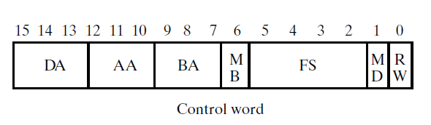
Single Cycle Control
The selection variables for the datapath control the microoperations executed within the datapath for any given clock pulse.
The selection variables control the addresses for the data read from the register file, the function performed by the function unit, and the data loaded into the register file, as well as the selection of external data.

Slide 46
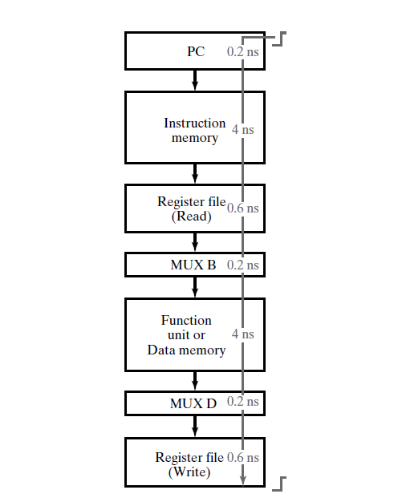
Single Cycle Control
Delay path in a single cycle processor = delay of whole datapath

Slide 47
Single Cycle Control
Although advantageous in terms of resource utilization and control circuit simplicity, there are some important issues with the single cycle control strategy.
One is in the area of performing complex operations.
For example, suppose that an instruction is desired that executes unsigned binary multiplication using a multiplication algorithm that processes one bit of the multiplier at a time.

Slide 48
Single Cycle Control
With the given datapath, this cannot be accomplished by a microoperation that can be executed in a single clock cycle.
Thus, a control organization that provides multiple clock cycles for the execution of instructions is needed.
Finally, the single-cycle computer has a lower limit on the clock period based on a long worst-case delay path.

Slide 49
Single Cycle Control
Also, the single-cycle computer has two distinct N-bit memories, one for instructions and one for data.
For a simple computer with instructions and data in the same N-bit memory, two read accesses of memory are required to execute an instruction that loads a data word from memory into a register.

Slide 50
Single Cycle Control
The first access obtains the instruction, and the second access, if required, reads or writes the data word.
Since two different addresses must be applied to the memory address inputs, at least two clock cycles, one for each address, are required for obtaining and executing the instruction.
All of these issues can be handled by using multi-cycle control strategy (subject of next week).

Slide 51
References
Krste Asanovic, CS 152 Computer Architecture and Engineering, University of California at Berkeley, 2015.
Logic and Computer Design Fundamentals,M. Morris Mano Charles Kime,Fourth Edition.
Weatherspoon, Bala, Bracy, and Sirer, CS3410, Compter Science, Cornell University

