Slide 1
PC
An Instruction
Translator
TCG Ops
int foo();
void instruction_cb();
void bar();
Guest Operating
System State
Translation Cache
op-helper.c

Slide 2
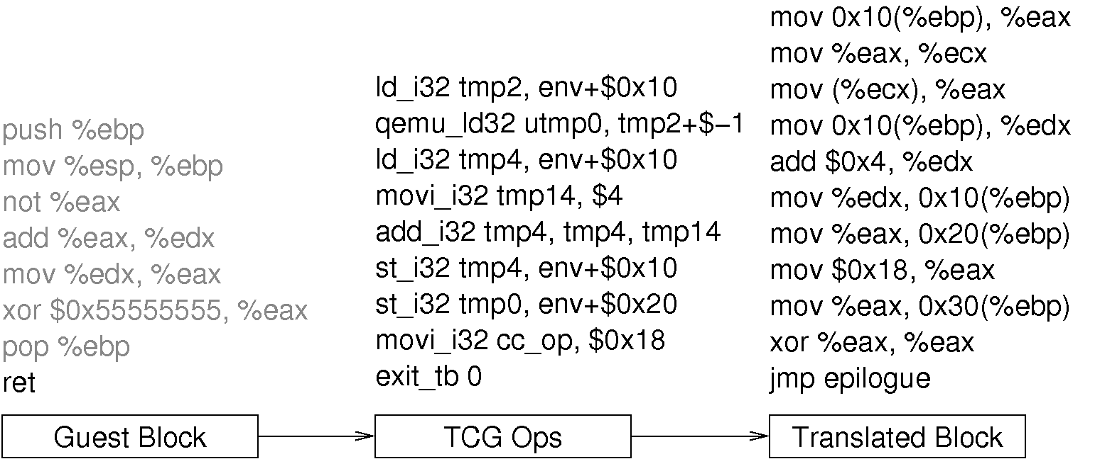

Slide 3
Guest Instructions
Load
Add
Host Machine Code
Store
Instruction
Analyzer
Makes Callbacks
QEMU frontend translator
QEMU Backend Translator
Host CPU
TCG OPs
RAM
Chad’s instrumentation code generator
Guest Machine State
Advance state of the guest machine

