Slide 1
PC
An Instruction
Translator
TCG Ops
int foo();
void instruction_cb();
void bar();
Guest Operating
System State
Translation Cache
op-helper.c

Slide 2
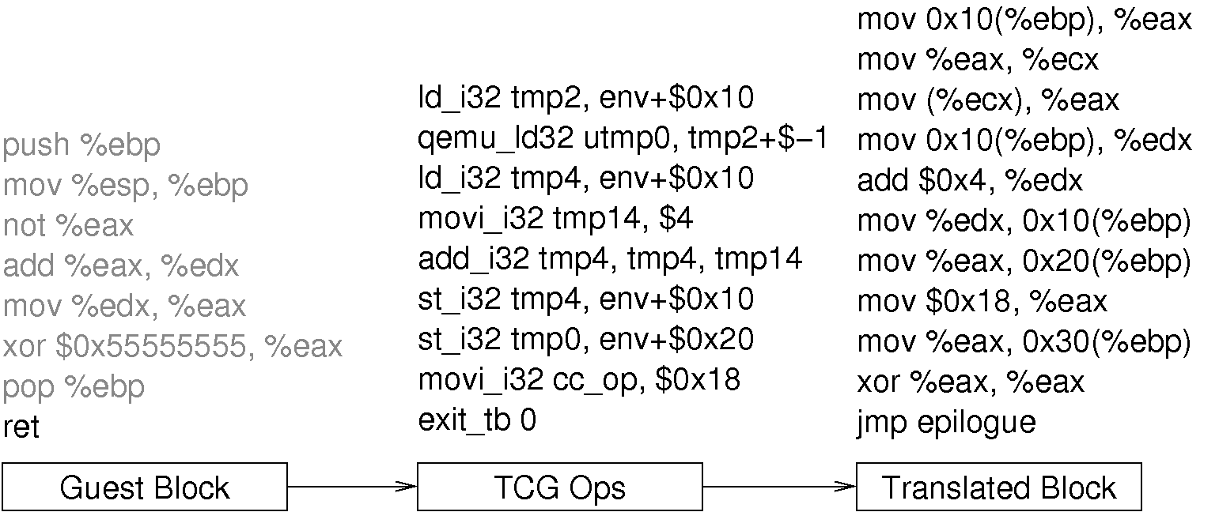

Slide 3
Load
Add
Store
Guest Instructions
Instruction
Analyzer
Backend Translator
TCG Ops
Host Instructions
thing
RAM
Guest Machine State

