Slide 1
Don’t count, predict! A systematic comparison of context-counting vs. context-predicting semantic vectors Marco Baroni and Georgianna Dinu and Germán Kruszewski Center for Mind/Brain Sciences (University of Trento, Italy)
Presentation by Jake Pitkin
Notes:
2014

Slide 2
Motivation
A history of work supporting contextual information provides good approximation to word meaning.
Semantically similar words tend to have similar contextual distributions (Miller and Charles, 1991).
Layers of transformations must be applied to get good results.
Predictive models are attractive as they are well-defined.
No heuristic stacking of vector transformations.
Weights in a word vector are directly set to optimally predict the contexts in which the corresponding words tend to appear.
Similar words appear in similar contexts, so the system assigns similar vectors to similar words.
Supervised learning comes at no manual annotation cost, context windows auto extracted.
Lacking a systematic comparison of new predictive models with classic, count vector based distributional semantic approaches.
Which camp of models performs better empirically on various tasks.
Where should we focus future research efforts?

Slide 3
Previous evaluations
A long tradition of extensive evaluation of count models.
Work that provides a direct comparison is limited in scope and sparse.
Huang et al. (2012) compares one count model and server predict models on the standard WordSim353 benchmark.
Blacoe and Lapata (2012) compare models as input to composition functions.
Mikolov et al. (2013d) compared LSA count vectors to their RNN model on syntactic and semantic analogy tasks.
Finding in favor of the predict model.
But provided little detail on modeling choices for LSA.
This is the first real work that provides a systematic comparison of wealthy assortment of models.
Notes:
Only three known works that provide a direct comparison
Mikolov paper is the first paper we read in the group.
LSA = “Latent Semantic Analysis”

Slide 4
Model creation
Corpus of 2.8 billion tokens
ukWaC - large web corpus built from crawling .uk domains
English Wikipedia
British National Corpus - wide cross-section of British English (various sources)
The top 300k most frequent words are used as both target and context elements.

Slide 5
Count models
We will refer to traditional DSMs that are initialized with co-occurrence counts as count models.
Symmetric context windows of two and five words to either side
Pointwise Mutual Information and Local Mutual Information (Evert, 2005)
Both full and compressed vectors
Singular Value Decomposition (Golub and Van Loan, 1996)
Non-negative Matrix Factorization (Lee and Seung, 2000)
Lin algorithm (2007)
Compressed vectors ranging from 200 to 500 in steps of 100.
36 count models were evaluated in total.
This subset of parameter settings from previous systematic explorations (Bullinaria and Levy 2007;2012).
Notes:
Pointwise Mutual Information and Local Mutual Information are “weighting schemes”

Slide 6
Predict models
Trained using the word2vec toolkit
Using CBOW approach and not skip-gram
Recommended for larger datasets for computation reasons
Vector dimensionality within 200 to 500 range in steps of 100
Context window of 2 and 5 words on both sides of target
Hierarchical softmax classifier
Computationally proportional to log(unigram.perplexity(W)) instead of W where W is the vocabulary size.
Negative sampling with k values of 5 and 10
Estimates probability of an output word by learning to distinguish it from draws from a noise distribution.
Very frequent words such as the and a down sized
Captures the same intuition as PMI in count vectors
48 predict models were evaluated in total.

Slide 7
Distributional Memory (dm) model
Best performing model from work by Baroni and Lenci (2010).
Based on the same input corpus used in count and predict models.
Count-based DSM that is “linguistically rich”.
Relies on lemmas instead of raw word forms.
Showed near-state-of-the-art performance on a variety of semantic tasks.
Notes:
Main author of this paper is the main author of this model

Slide 8
Collobert and Weston (cw) vectors
Predict model from work by (Collobert et al., 2011)
100-dimensional vectors trained on a Wikipedia corpus for two months.
Trained to optimize the task of choosing the right word, over a random alternative in the middle of an 11-word context window.
Notes:
Natural Language Processing (almost) from scratch

Slide 9
Semantic relatedness
Humans rated the degree of semantic similarity of two words
Performance is evaluated by looking at the correlation between average human scores and cosine similarity of the two word vectors.
The classic data set of Rubenstein and Goodenough (1965) (rg) 65 noun pairs
Soa by Hassan and Mihalcea (2011) exploiting the Wikipedia linking structure and word sense disambiguation techniques.
Wordsim353 set (ws) from Finkelstein et al. (2002) 353 pairs
Soa reached by Halawi et al. (2012) using a method in the spirt of predict models, but using synonymy information from WordNet to constrain training.
Agirre et al. (2009) split the ws set into similarity (wss) and relatedness (wsr) subsets.
wss contains tighter taxonomic relations such as (king/queen)
Where wsr contains possibly topical or syntagmatic relations (family/planning)
Notes:
Five different evaluation tasks

Slide 10
Semantic relatedness results
rg | best for task | best across tasks | worst across tasks | best on rg
cnt | 74 | 70 | 11 | 74
pre | 84 | 83 | 74 | 84
ws | other models
soa | 86
dm | 82
cw | 48
ws | best for task | best across tasks | worst across tasks | best on rg
cnt | 62 | 62 | 16 | 59
pre | 75 | 73 | 60 | 71
ws | other models
soa | 81
dm | 35
cw | 48
wss | best for task | best across tasks | worst across tasks | best on rg
cnt | 70 | 70 | 23 | 66
pre | 80 | 78 | 73 | 76
wss | other models
soa | 77
dm | 60
cw | 61
wsr | best for task | best across tasks | worst across tasks | best on rg
cnt | 59 | 57 | 4 | 52
pre | 70 | 68 | 48 | 64
wsr | other models
soa | 62
dm | 13
cw | 38
10

Slide 11
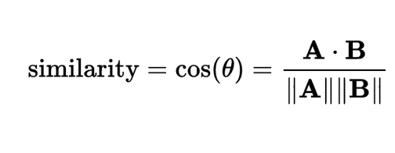
Synonym detection
Classic TOEFL (toefl) set introduced by Landauer and Dumais (1997)
80 multiple-choice questions, pairing a target term with 4 synonym candidates.
Cosines of each candidate is taken with the target term and the candidate with the largest cosine is picked.
imposed
believed
requested
correlated
levied

Slide 12
Synonym detection results
Bullinaria and Levy (2012) achieved 100% accuracy.
Very thorough exploration of the count model parameter space
toefl | best for task | best across tasks | worst across tasks | best on rg
cnt | 76 | 76 | 49 | 64
pre | 91 | 86 | 71 | 85
 | other models
soa | 100
dm | 77
cw | 56

Slide 13
Concept categorization
Unsupervised clustering task
e.g., helicopters and motorcycles should go into the vehicle class.
Performance evaluated in terms of purity
A measure of the extent each cluster contains concepts from a single gold category.
The Almuhareb-Poesio (ap) benchmark
402 concepts organized into 21 categories (Almuhareb, 2006)
Soa count model by Rothenhäusler and Schütze (2009)
The ESSLLI 2008 Distributional Semantic Workshop set (esslli)
44 concepts organized into 6 categories (Baroni et al., 2008)
Katrenko and Adriaans (2008) hold the state-of the-art
Battig (battig) test set from Baroni et al. (2010)
83 concepts organized into 10 categories
Previous soa window-based count model (Baroni and Lenci 2010)

Slide 14
Concept categorization results
ap | best for task | best across tasks | worst across tasks | best on rg
cnt | 66 | 64 | 24 | 64
pre | 75 | 71 | 65 | 72
ap | other models
soa | 79
dm | 76
cw | 58
esslli | best for task | best across tasks | worst across tasks | best on rg
cnt | 84 | 84 | 43 | 84
pre | 86 | 77 | 82 | 84
esslli | other models
soa | 91
dm | 84
cw | 61
battig | best for task | best across tasks | worst across tasks | best on rg
cnt | 98 | 98 | 38 | 98
pre | 99 | 98 | 88 | 98
battig | other models
soa | 96
dm | 94
cw | 70
14

Slide 15
Selectional preferences
Verb-noun pairs rated by humans for the typicality of the noun as a subject or object of the verb.
e.g. people received a high score as the subject of to eat while receiving a lower score as object of to eat.
Baroni and Lenci (2010) propose a procedure for tackling this problem.
For each verb, use the corpus-based tuples and find the 20 nouns with strongest association as either the subject or 20 as the object.
The average of those 20 vectors is the “prototype” vector for the relevant argument slot.
Cosine similarity is taken with the prototype vector and a target noun.
Evaluation is the Spearman correlation between the above cosine and averaged human typicality ratings.

Slide 16
Selectional preferences
Ulrike Padó (2007) provides the (up) dataset with 211 pairs.
Top performance from Herdagdelen and Baroni (2009) using a supervised approach of directly training a classifier on gold data.
The mcrae dataset (McRae et al., 1998) with 100 pairs.
Top performance by Baroni and Lenci (2010) using a count model focusing on syntactic information.

Slide 17
Selectional preferences results
up | best for task | best across tasks | worst across tasks | best on rg
cnt | 41 | 37 | -6 | 37
pre | 41 | 41 | 33 | 39
up | other models
soa | 60
dm | 51
cw | 28
mcrae | best for task | best across tasks | worst across tasks | best on rg
cnt | 27 | 27 | -10 | 20
pre | 28 | 26 | 20 | 25
mcrae | other models
soa | 32
dm | 29
cw | 15

Slide 18
Analogy
Newer task created to specifically test predict models.
9K semantic and 10.5K syntactic analogy questions.
Nearest neighbor of vector arithmetic from the vocabulary.
Vocabulary size affects performance.
State-of-the-art by Mikolov et al. (2013a/c)
(ansyn) – 1M words and (an/ansem) on 700k words
Our experiments on a vocabulary of 300k words
Semantic
brother – sister + grandson = ?
Syntactic
work – works + speak = ?
granddaughter
speaks

Slide 19
Analogy results
an | best for task | best across tasks | worst across tasks | best on rg
cnt | 49 | 43 | 1 | 35
pre | 68 | 67 | 27 | 66
an | other models
soa | 61
dm | NA
cw | 11
ansyn | best for task | best across tasks | worst across tasks | best on rg
cnt | 43 | 41 | 0 | 42
pre | 71 | 69 | 40 | 70
ansyn | other models
soa | 64
dm | NA
cw | 12
ansem | best for task | best across tasks | worst across tasks | best on rg
cnt | 60 | 44 | 1 | 26
pre | 66 | 64 | 10 | 61
ansem | other models
soa | 61
dm | NA
cw | 9

Slide 20
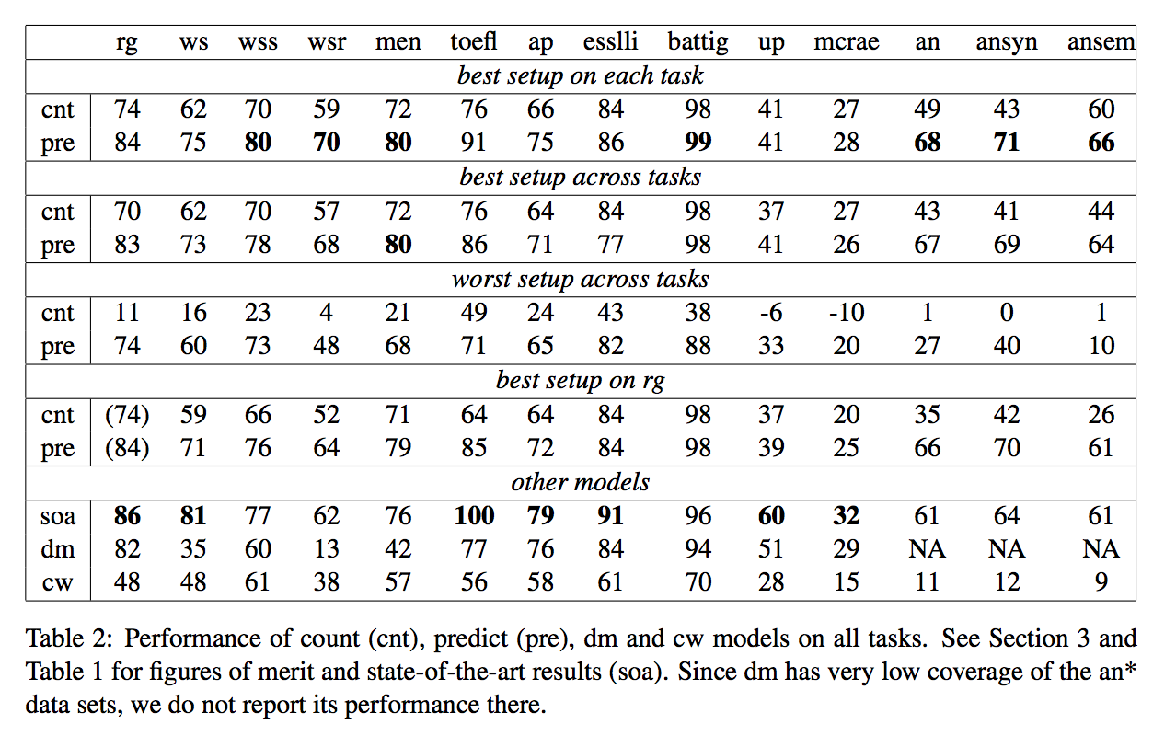
Overall results

Slide 21
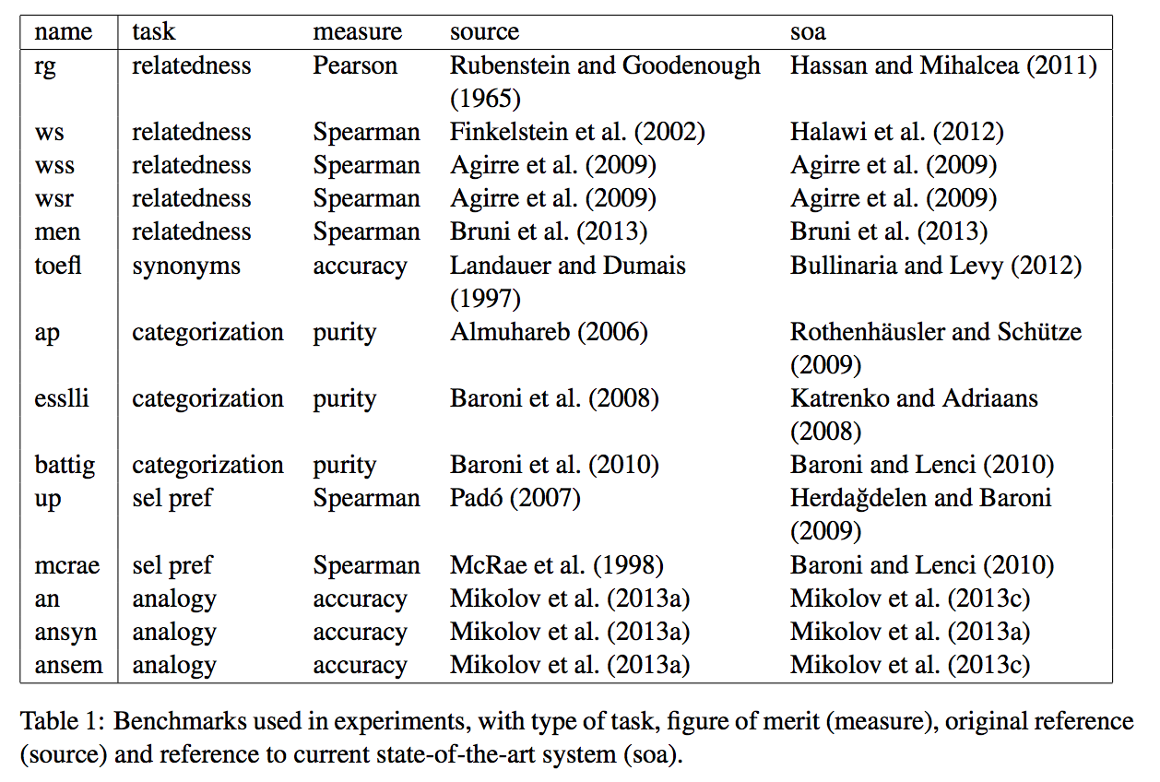
Tasks

Slide 22
Conclusions
Predictive models show impressive overall performance, beating the state of the art in many tasks.
These results were achieved by simply using the word2vec toolkit and running it with a range of recommended parameter choices.
The state-of-the-art results for almost all tasks relied on external knowledge, manually-crafted rules, parsing, larger corpora and/or task-specific tuning.
The selectional preference task is the only tested task where predict models are behind the state of the art and count models.
Predict models are more robust than count models
By looking at the worst setup across tasks table

Slide 23
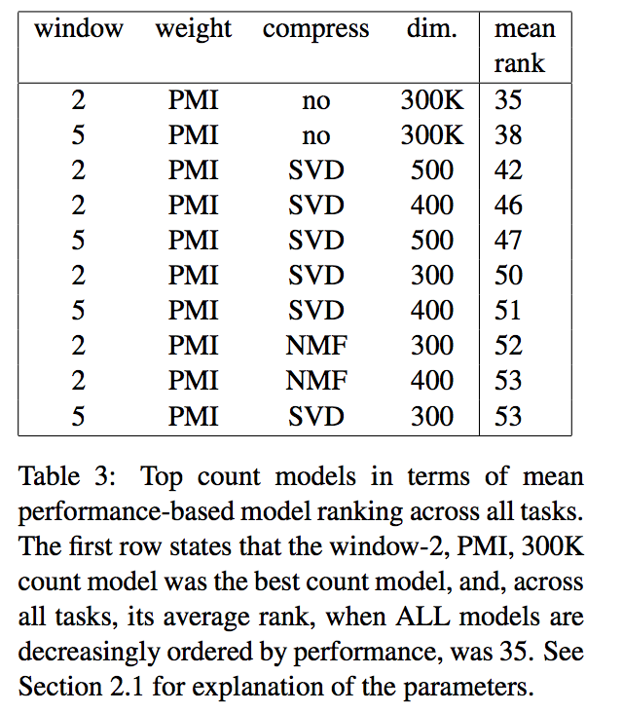
Conclusions – count model parameters
For count models, PMI is a better weighting scheme over Local Mutual Information.
SVD outperforms NMF as a dimensionality reduction technique.
However, using all 300k original dimensions works best.

Slide 24
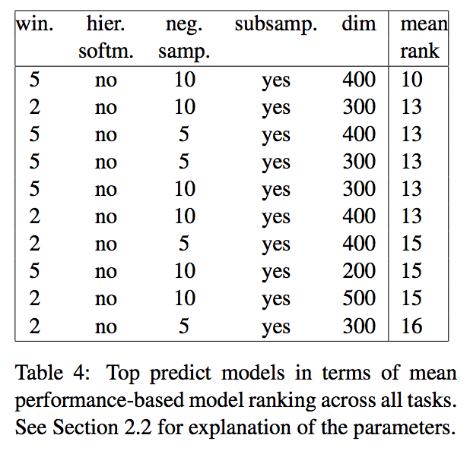
Conclusions – predict model parameters
Best count model uses all 300k original dimensions where the best predict model uses 400.
More computationally practical.
Negative sampling out performs hierarchical softmax method.
Win as softmax is more costly than negative sampling.

Slide 25
Future work & questions
Their predict vectors had vastly better performance than the out of the box Collobert and Weston (cw) vectors. What parameter choices did they make that enabled this?
Does this mean that word2vec-trained vectors are superior to cw?
This work focused on quantitative measure, a theoretical analysis of count and predict models could prove valuable.
The better or near state-of-the-art results of predict models in this work were obtained by trying only a few parameter settings. Further tuning for specific tasks (as the unbeaten state-of-the-art does) could be worthwhile.

