Slide 1
The Importance of Syntactic Parsing and Inference in Semantic Role Labeling
Vasin Punyakanok - BBN Technologies
Dan Roth – University of Illinois at Urbana-Champaign
Wen-tau Yih – Microsoft Research

Slide 2
Outline
Full parsing vs. shallow parsing
Semantic Role Labeling (SRL)
Architecture of their SRL system
Experimental results comparing full parsing and shallow parsing
Combining several SRL systems with a global inference algorithm

Slide 3
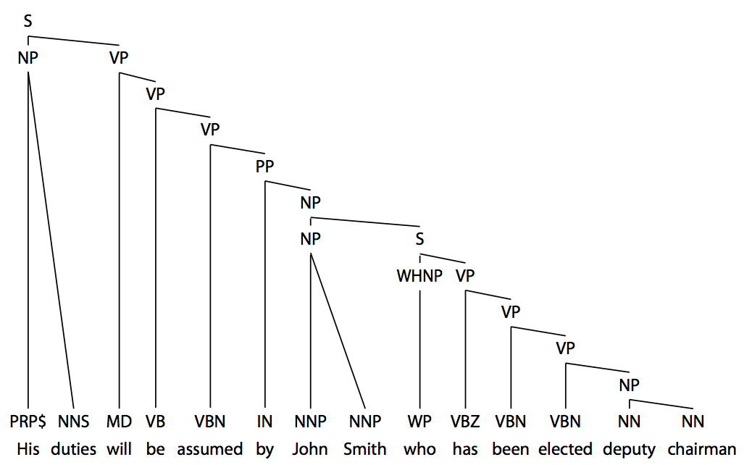
Full Parsing
Full phrase-structure parse tree as defined in the Penn tree-bank (Marcus et al., 1993) but without trace and functional tags.

Slide 4
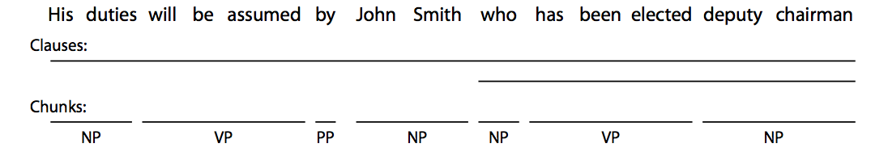
Shallow Parsing
The full parse tree is reduced to only the chunks and the clause constituents.
Chunk – a phrase containing syntactically related words.
Clause – the clausal constituent as defined by treebank standard.

Slide 5
Semantic Role Labeling (SRL)
The task of discovering the predicate-argument structure of each predicate in a given input sentence.
A0 – leaver
A1 – thing left
A2 – beneficiary
AM-LOC – location of the action
V – the boundaries of the verb predicate

Slide 6
Semantic Role Labeling (SRL)
PropBank has six different types of arguments labeled as A0-A5 and AA.
These labels have different semantics for each verb.
There are additionally 13 types of adjuncts labeled as AM-adj
We will refer to these as arguments.
Arguments may span over different parts of a sentence.
They might also be relative pronouns that refers to the actual agent.

Slide 7
Semantic Role Labeling (SRL)
This work focuses only on the verb predicate.
Focus on identifying the boundaries and the labels of the arguments.
Ignoring the verb sense disambiguation problem.
Semantic arguments of the same verb do not overlap.
Overlapping is defined as arguments sharing some of their parts.
TODO: embedded and exclusively overlapping

Slide 8
SRL System Architecture
Pruning
Argument Identification
Argument Classification
Inference
The goal of pruning and argument identification is to identify argument candidates for a given verb predicate.
In the first three stages, decisions are independently made for each argument.
The final stage uses argument classifications along with linguistic and structural constraints in order to make global predictions.

Slide 9
Pruning – Full Parse Tree
Only constituents in the parse tree are considered as argument candidates.
A set of heuristics from Xue and Palmer (2004) filter out simple constituents that are very unlikely to be arguments.
Starting at the target verb – collect siblings.
Move to the parent of the verb – repeat until you reach the root.
If a constituent is a PP collect it’s children.

Slide 10
Pruning – Shallow Parse
No parse tree, so all possible subsequences in the sentences are potential argument candidates.
We train two classifiers and use heuristics to find candidates.
Predict the beginnings and ends of possible arguments.
Arguments cannot overlap with the predicate.
If a predicate is outside a clause, its arguments cannot be embedded in that clause.
Arguments cannot exclusively overlap with the clauses.
Notes:
The first constraint comes from the definition of this task that the predicate simply cannot take itself or any constituents that contain itself as arguments. The other two constraints are due to the fact that a clause can be treated as a unit that has its own verb–argument structure. If a verb predicate is outside a clause, then its argument can only be the whole clause, but may not be embedded in or exclusively overlap with the clause.

Slide 11
Argument Identification
Binary classification task to identify whether each candidate is an argument or not.
Features attempt to capture the relationship between the predicate and candidate arguments using the available syntactic information.
Propbank inspired by the works of Levin (1993) and Levin and Hovav (1996) which discussed the relation between syntactic and semantic information.

Slide 12
Features

Slide 13

Argument Classification
SNoW (Roth, 1998; Carlson et al., 1999)
Variation of the Winnow update rule tailored for large scale learning tasks.
Multi-class decisions are done via a winner-take-all mechanism.
Regularization term to achieve a large margin and voted (averaged) weight vector.
The softmax function (Bishop, 1995) converts raw activation to conditional probabilities. If there are n classes and the raw activation of a class I is act_{i} the posterior estimation for class i is given by

Slide 14
Inference
Combine decisions from previous stages with both linguistic and structural knowledge.
Constrained optimization problem, represented as an integer linear problem (Roth and Yih, 2004).
Takes as input the confidence scores for each type of argument of all the candidates, along with a list of constraints.
The output is the optimal solution that maximizes the linear sum of the confidence scores while obeying the constraints.

Slide 15
Inference

