Slide 1
The Importance of Syntactic Parsing and Inference in Semantic Role Labeling
Vasin Punyakanok - BBN Technologies
Dan Roth – University of Illinois at Urbana-Champaign
Wen-tau Yih – Microsoft Research
Notes:
Paper is from 2008

Slide 2
Outline
Full parsing vs. shallow parsing
Semantic Role Labeling (SRL)
Architecture of their SRL system
Experimental results comparing full parsing and shallow parsing
Combining SRL systems with a global inference algorithm
Notes:
Each of the four steps in the SRL system use syntactic information.

Slide 3
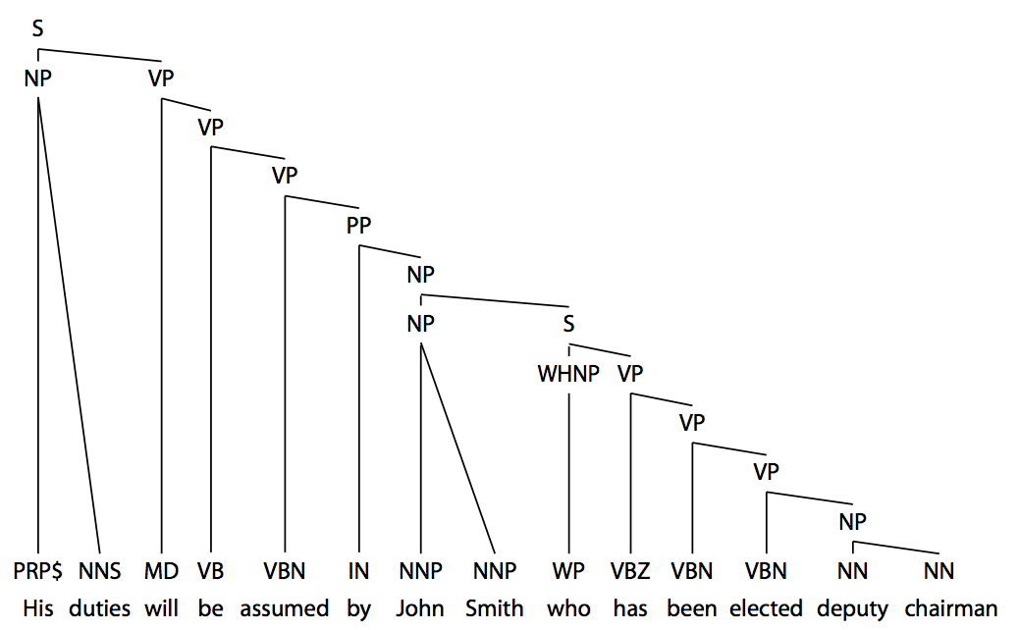
Full Parsing
Full phrase-structure parse tree as defined in the Penn tree-bank (Marcus et al., 1993) but without trace and functional tags.
Notes:
Allows for path features

Slide 4
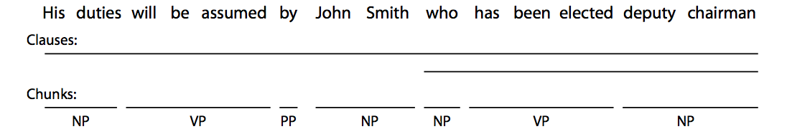
Shallow Parsing
The full parse tree is reduced to only the chunks and the clause constituents.
Chunk – a phrase containing syntactically related words.
Clause – the clausal constituent as defined by treebank standard.

Slide 5
Semantic Role Labeling (SRL)
The task of discovering the predicate-argument structure of each predicate in a given input sentence.
A0 – leaver
A1 – thing left
A2 – beneficiary
AM-LOC – location of the action
V – the boundaries of the verb predicate
Notes:
Saw this four weeks ago in another paper.

Slide 6
Semantic Role Labeling (SRL)
PropBank is a large human-annotated corpus of verb predicates and their arguments – enabling supervised machine learning techniques.
PropBank has six different types of arguments labeled as A0-A5 and AA.
These labels have different semantics for each verb.
There are additionally 13 types of adjuncts labeled as AM-adj
We will refer to these as arguments.
Arguments may span over different parts of a sentence.
They might also be relative pronouns that refers to the actual agent.
Notes:
Not always clean cut.
A0 – leaver which is unique to the verb “left”

Slide 7
Semantic Role Labeling (SRL)
This work focuses only on the verb predicate.
Focus on identifying the boundaries and the labels of the arguments.
Ignoring the verb sense disambiguation problem.
Semantic arguments of the same verb do not overlap.
Overlapping is defined as arguments sharing some of their parts.

Slide 8
Motivation
Systems rely heavily on full syntactic parse trees which are still far from perfect.
Shallow parsing techniques (chunkers and clausers), while providing less information, tend to be more robust.
SRL systems consist of many stages that use parsing – it’s unclear where syntactic information helps the most.

Slide 9
SRL System Architecture
Pruning
Argument Identification
Argument Classification
Inference
The goal of pruning and argument identification is to identify argument candidates for a given verb predicate.
In the first three stages, decisions are independently made for each argument.
The final stage uses argument classifications along with linguistic and structural constraints in order to make global predictions.

Slide 10
Pruning – Full Parse Tree
Only constituents in the parse tree are considered as argument candidates.
A set of heuristics from Xue and Palmer (2004) filter out simple constituents that are very unlikely to be arguments.
Starting at the target verb – collect siblings.
Move to the parent of the verb – repeat until you reach the root.
If a constituent is a PP collect it’s children.

Slide 11
Pruning – Shallow Parse
No parse tree, so all possible subsequences in the sentences are potential argument candidates.
We train two classifiers and use heuristics to find candidates.
Predict the beginnings and ends of possible arguments.
Arguments cannot overlap with the predicate.
If a predicate is outside a clause, its arguments cannot be embedded in that clause.
Arguments cannot exclusively overlap with the clauses.
Notes:
The first constraint comes from the definition of this task that the predicate simply cannot take itself or any constituents that contain itself as arguments. The other two constraints are due to the fact that a clause can be treated as a unit that has its own verb–argument structure. If a verb predicate is outside a clause, then its argument can only be the whole clause, but may not be embedded in or exclusively overlap with the clause.

Slide 12
Argument Identification
Binary classification task to identify whether each candidate is an argument or not.
Features attempt to capture the relationship between the predicate and candidate arguments using the available syntactic information.
Propbank inspired by the works of Levin (1993) and Levin and Hovav (1996) which discussed the relation between syntactic and semantic information.
Using features commonly used for SRL. When the full parse tree is unavailable, features are mimicked with heuristics or discarded.
Notes:
Won’t go into details of features due to time.

Slide 13

Argument Classification
SNoW (Roth, 1998; Carlson et al., 1999)
Variation of the Winnow update rule tailored for large scale learning tasks.
Multi-class decisions are done via a winner-take-all mechanism.
Regularization term to achieve a large margin and voted (averaged) weight vector.
The softmax function (Bishop, 1995) converts raw activation to conditional probabilities. If there are n classes and the raw activation of a class i is act_{i} the posterior estimation for class i is given by
Notes:
Labels are a discrete set
Multiplicative update rule

Slide 14
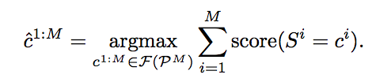
Inference
Combine decisions from previous stages with both linguistic and structural knowledge.
Constrained optimization problem, represented as an integer linear problem (Roth and Yih, 2004).
Takes as input the confidence scores for each type of argument of all the candidates, along with a list of constraints.
The output is the optimal solution that maximizes the linear sum of the confidence scores while obeying the constraints.
Notes:
Score from the SNoW algorithm.
F is a filter function subject to the contraints.
S – argument
c – label
Maximizes the expected value among all legitimate outputs.

Slide 15
Constraints
Arguments cannot overlap with the predicate.
Arguments cannot exclusively overlap with the clauses.
Predicate is outside a clause, its arguments cannot be embedded in that clause.
No overlapping or embedding arguments.
No duplicate argument classes for core arguments (A0-A5, AA).
If R-arg argument is present, then there has to be an arg argument.
If C-arg argument is present, then there has to be an arg argument.
Some argument classes are illegal for a given predicate (according to PropBank)
Notes:
Paper gives a nice explanation on how to represent each of these constraints.

Slide 16
Experiments
PropBank is partitioned and used as training, validation, and evaluation data.
The goal is to understand the importance of full vs. shallow parsing at different stages of the SRL pipeline.
Gold parse trees are also considered to show the error contributions of parsing and the SRL system.
Precision, recall, and F1 measure.
Predicting the verb predicate is trivial and is not included in results to avoid giving overly optimistic results.

Slide 17
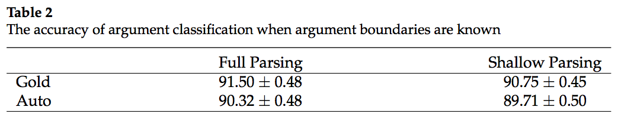
Experiments - Argument Classification
Assume argument boundaries are known, and only train classifiers to classify the labels of these arguments.
Difference is parse information available to construct features.
Conclusion: Performance is similar, especially after the inference step.

Slide 18
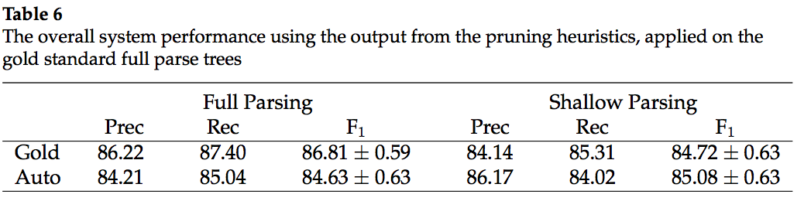
Experiments – Argument Identification
Candidate list is the outputs of the pruning heuristic applied on the gold standard parse trees.
Difference is parse information available to construct features.
Conclusion: when automatic parsing is used to extract features, performance is similar.

Slide 19
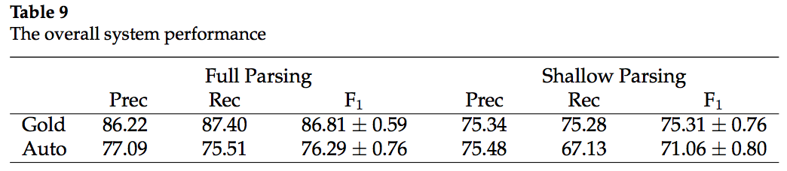
Experiments - Pruning
Full parsing uses the standard four stage system using full paring at every stage.
Shallow parsing doesn’t have enough information for pruning.
Pruning is replaced by two word based classifiers.
Each classifier classifies if a word is the start or end of an argument.
Shallow parsing is used in the remaining stages
Conclusion: The most crucial contribution of full parsing is in the pruning stage. Parse trees help identify argument candidates, improving later stages.

Slide 20
The Effect of Inference
Constraints give an overall precision gain of 1 to 2 percent regardless of full/shallow parsing and gold/auto parsing.
Recall is decreased a little as could be expected by adding constraints.
Overall an F1 gain of about 0.5 to 1 percent.
From previous experiments, it’s clear that parsing quality plays a large role in SRL system performance.
What if we used joint inference to combine multiple SRL systems that are derived using different full parse trees?

Slide 21
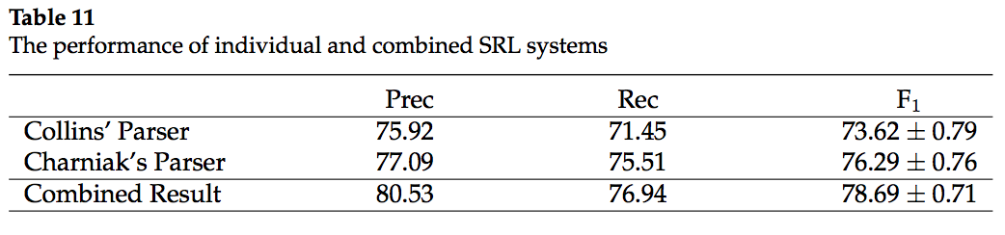
Joint Inference
Syntactic parsing is most important during pruning as errors during this step propagate through the system.
Use two parsers with different outputs, train two separate SRL systems, and combine them during inference.
Collins’ parser (Collins, 1999) – 81.05% recall on candidates.
Charniak’s parser (Charniak, 2001) – 86.08% recall on candidates.

Slide 22
Conclusion
Full syntactic parsing is most important during the pruning stage of the SRL system and gives significant overall performance gains.
Inference is a flexible way to introduce linguistic and structural knowledge to the system.
As well as a way to glue together multiple SRL system as a technique to combat parsing errors and improve performance.

