Slide 1
VSA labeled from upstream to downstream
FMS 1: Vista Village Dr., in the city of Vista
VSA Sign 1: Sunset Dr., in the city of Vista
VSA Sign 2: Sycamore Ave, in the city of Vista
VSA Sign 3: Las Posas Rd, in the city of San Marcos
VSA Sign 4: San Marcos Blvd, in the city of San Marcos
VSA Sign 5: Twin Oaks Valley Rd, in the city of San Marcos
VSA Sign 6: Woodland Parkway, in the city of San Marcos
VSA Sign 7: Nordahl Rd., in the city of San Marcos

Slide 2
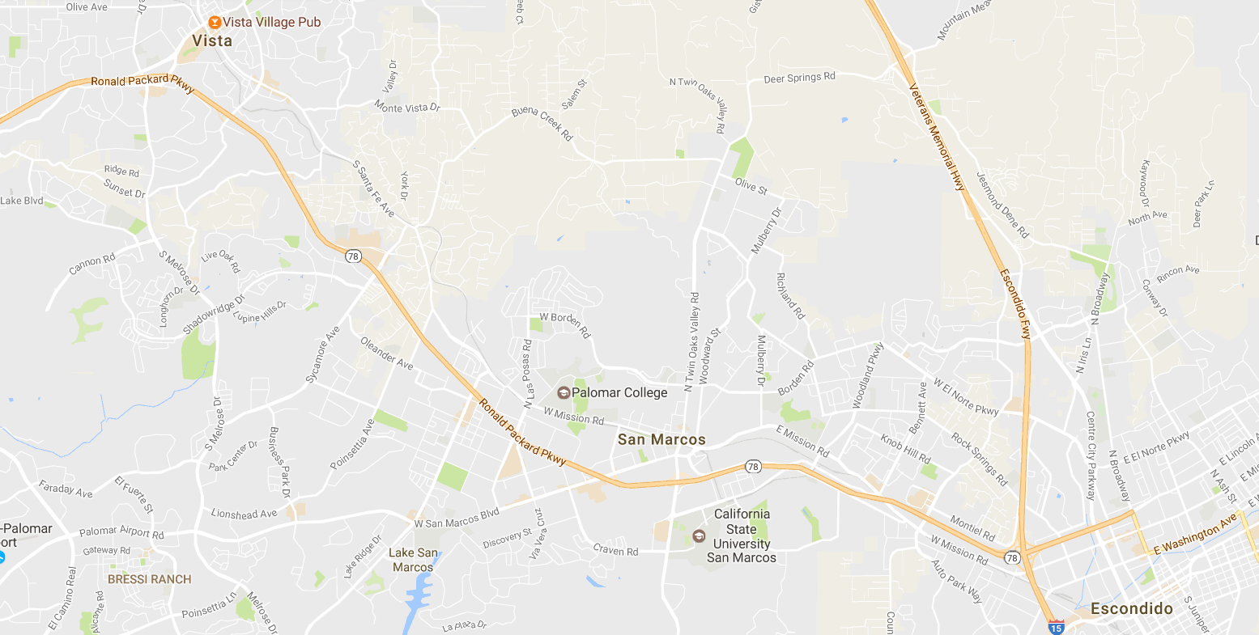
CMS 1
VSA 1
0.9 mi
0.6 mi
2.2 mi
construction project
of the auxiliary lane
VSA 2
2.2 mi
VSA 3
VSA 4
VSA 5
VSA 6
VSA 7
0.7 mi
0.8 mi
1.1 mi
1.5 mi
0.8 mi

