Slide 1
2017 Prius Prime Longitudinal Control with Man in the Middle ACC Override

Slide 2
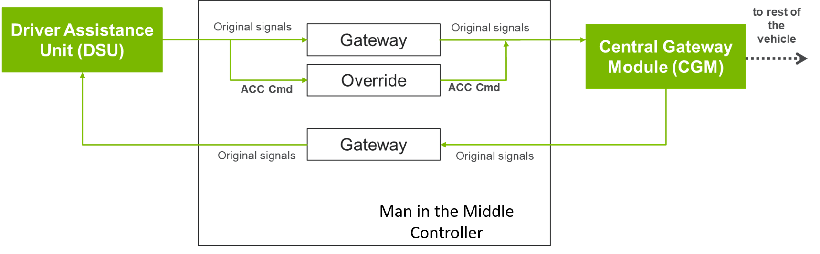
Man in the Middle Control Method
All CAN messages allowed to pass through except acceleration command
Block commanded acceleration from DSU and insert desired command to pass on to Vehicle CAN Gateway
Requires stock ACC to be turned on to gain longitudinal override control
Override control can be disabled by switching ACC off using stock vehicle controls
Requires cutting of vehicle CAN wires to implement

Slide 3
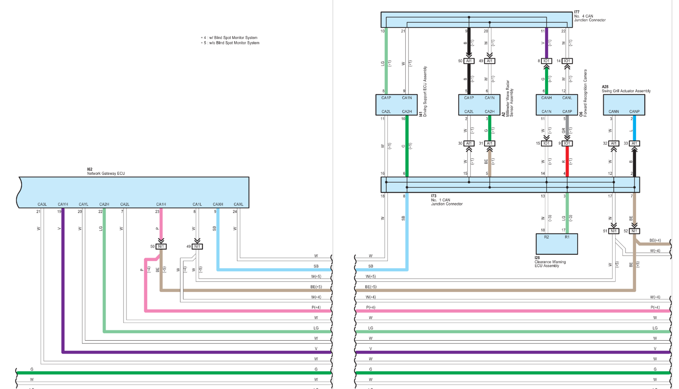
Prius CAN Diagram
~
~
~
~
Man in the Middle
CAN 1
Rx/Tx
x
x
CAN 0
Rx/Tx

Slide 4
Bus Messages
*
*Acceleration Control - Exclude from gateway

Slide 5
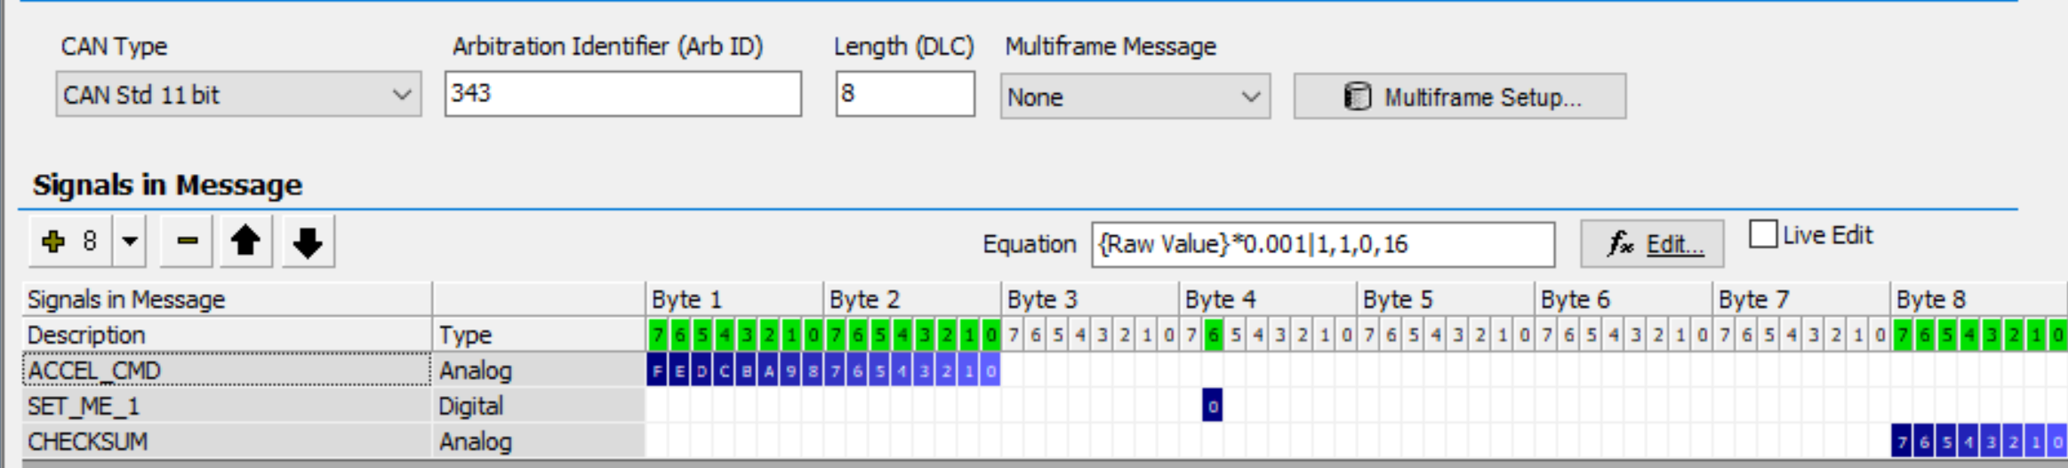
Acceleration Control
Arb ID 343 (Hex)
ACCEL_CMD: Acceleration Command [m/s^2]
Scale= 0.001, Offset = 0
Signed 2’s complement integer
Motorola Format
SET_ME_1: must be set to 1 during override control
The rest of the payload copied from Driving Support ECU (DSU) output message
Checksum calculated based on payload in bytes 1-7

Slide 6
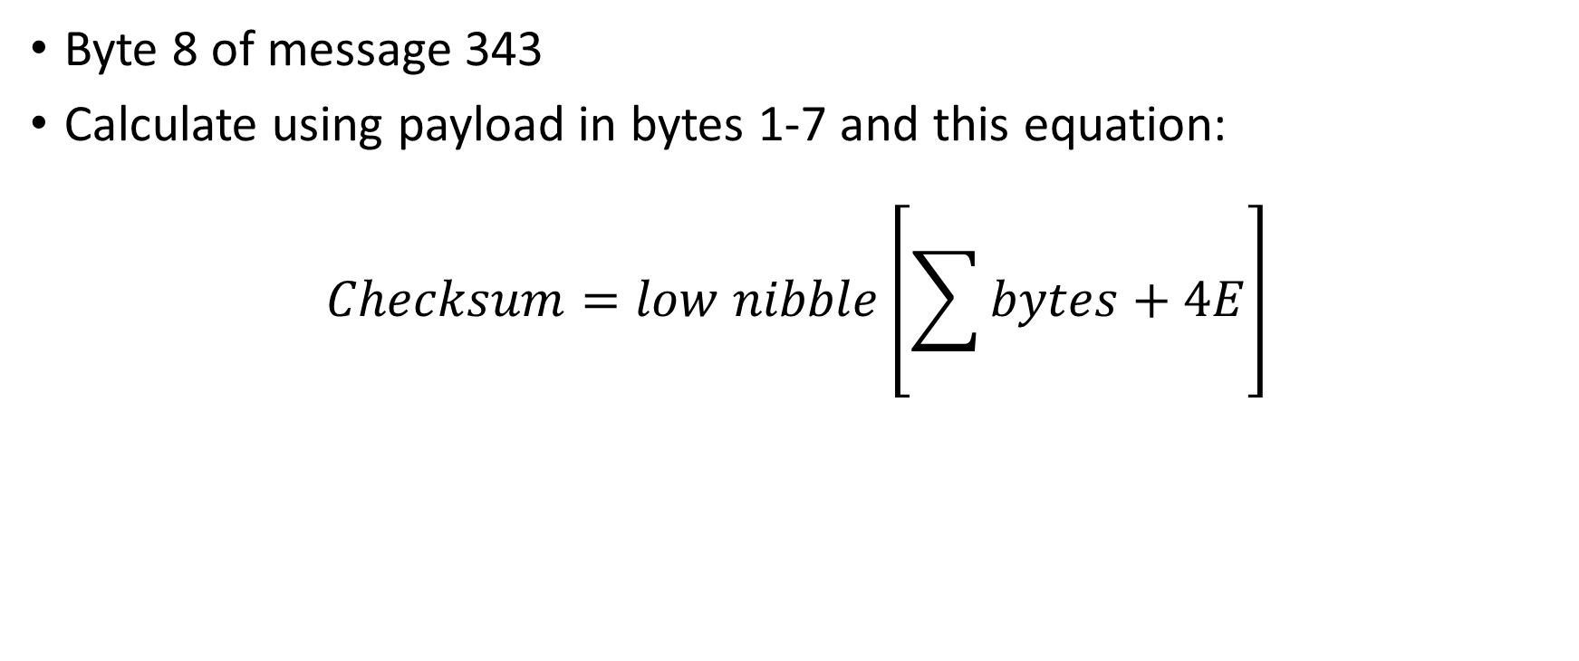
Checksum
Byte 8 of message 343
Calculate using payload in bytes 1-7 and this equation:

Slide 7
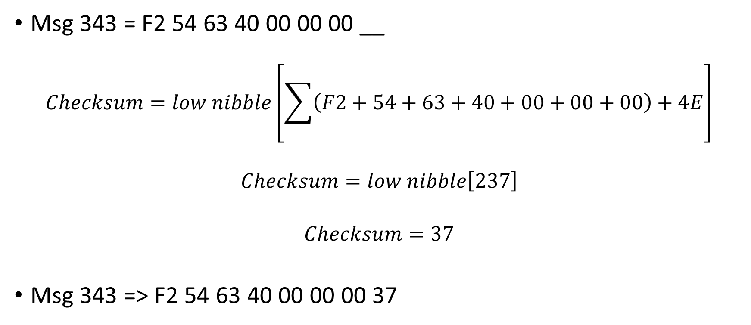
Checksum Example
Msg 343 = F2 54 63 40 00 00 00 __
Msg 343 => F2 54 63 40 00 00 00 37
Note: all numbers are hexadecimal numerals

Slide 8
Acceleration Control Envelope
Manual Driving
Some wheel slip occurring during ACC override
Acceleration based on wheel speed
Speed [mph]

