Slide 1

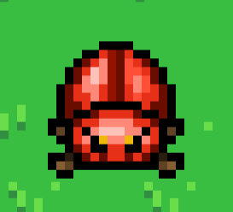





Master Giblin:
Health: 100
Max Damage: 20
Rarity: Epic
Sell Amount: 50

