Slide 1
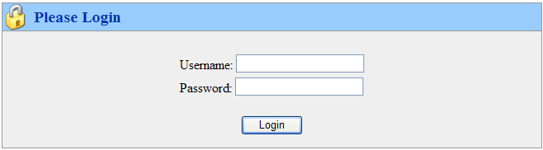
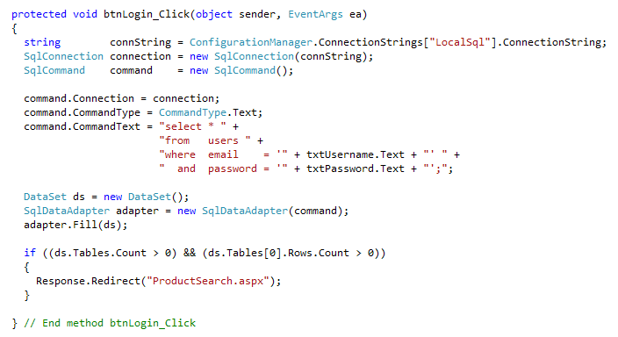
What’s Wrong With This Code?

Slide 2
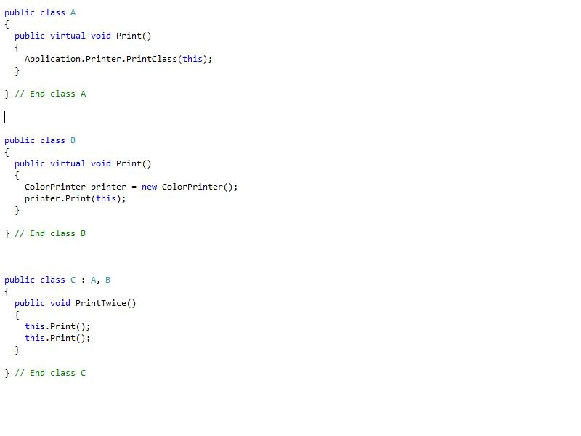
What Method Gets Called?

Slide 3
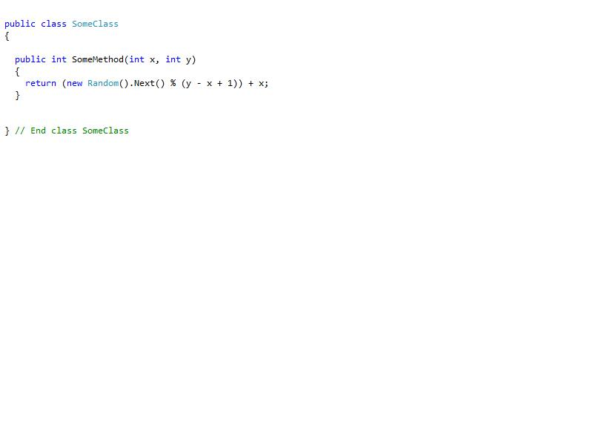
Name This Method

Slide 4
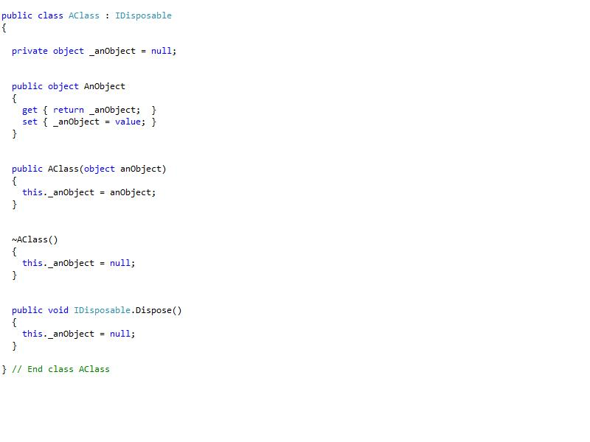
Review This Code

Slide 5
What is Wrong With This Code?

Slide 6
What Does This Code Do?

