Slide 1
Determining the practical range of Bluetooth Low energy on an iPhone and a raspberry pi
Luke Howe-Kerr

Slide 2

What is Bluetooth Low energy?
Wireless low energy opportunistic networking

Slide 3
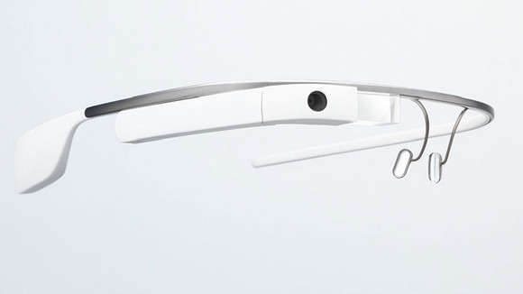
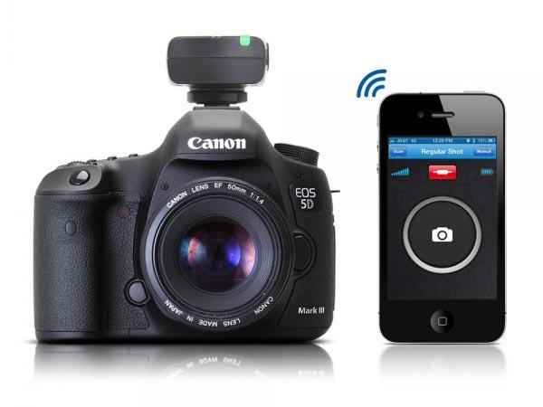
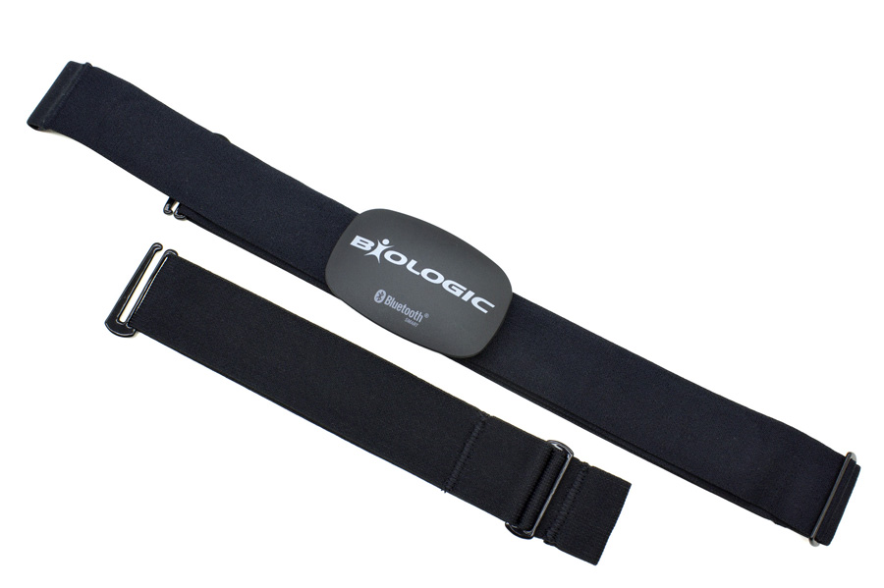
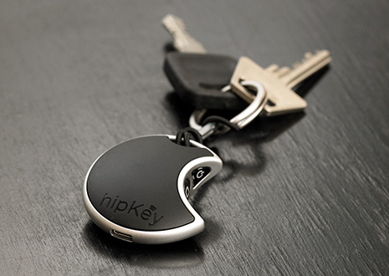
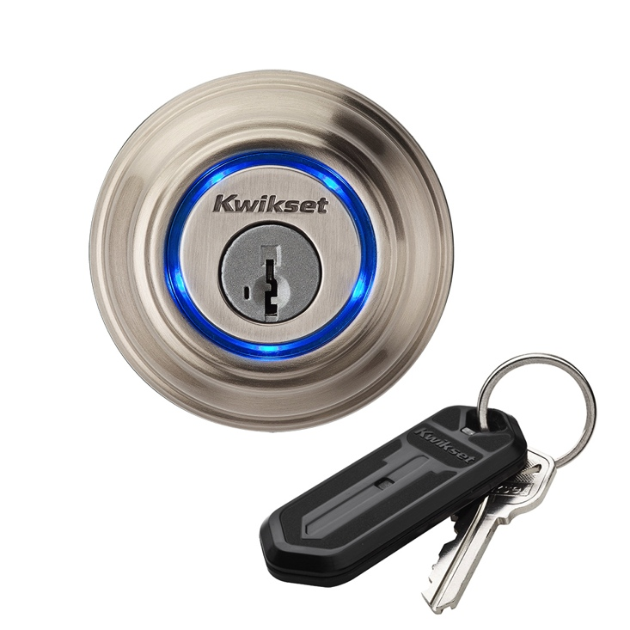
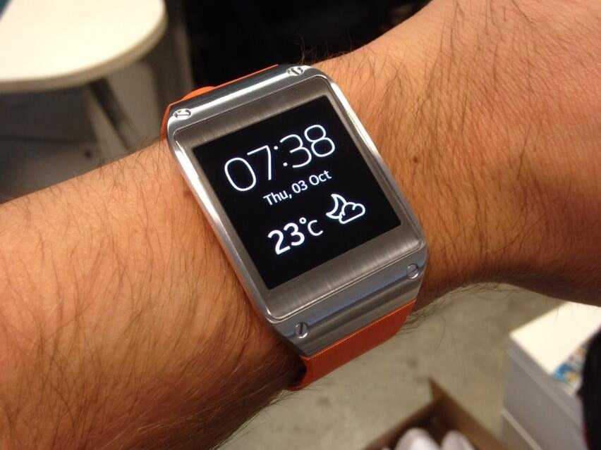
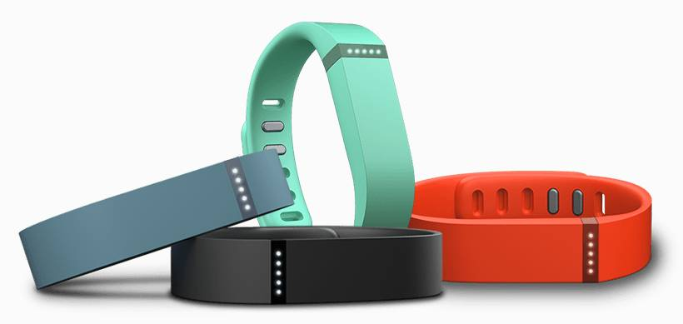
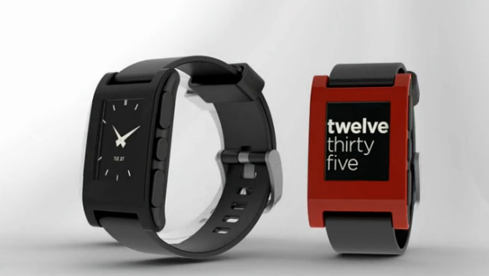
Everything is connected
Wearables are exploding
Small enough to put into anything

Slide 4
Bluetooth is showing up everywhere in our lives
Why not figure out how to use it?

Slide 5
The technology

Slide 6
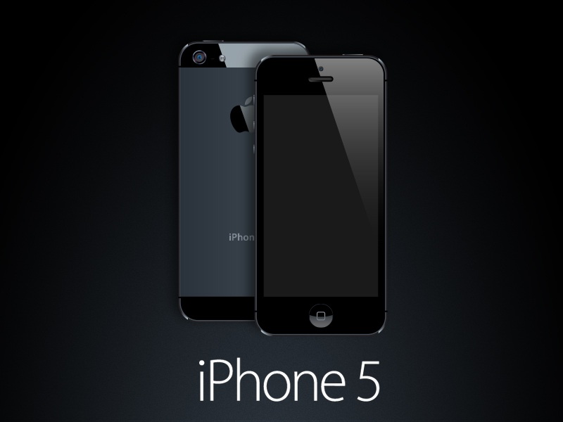

iPhone 5
Allows apps to take advantage of Bluetooth Low Energy
LightBlue allows the user to utilize Bluetooth
low energy

Slide 7
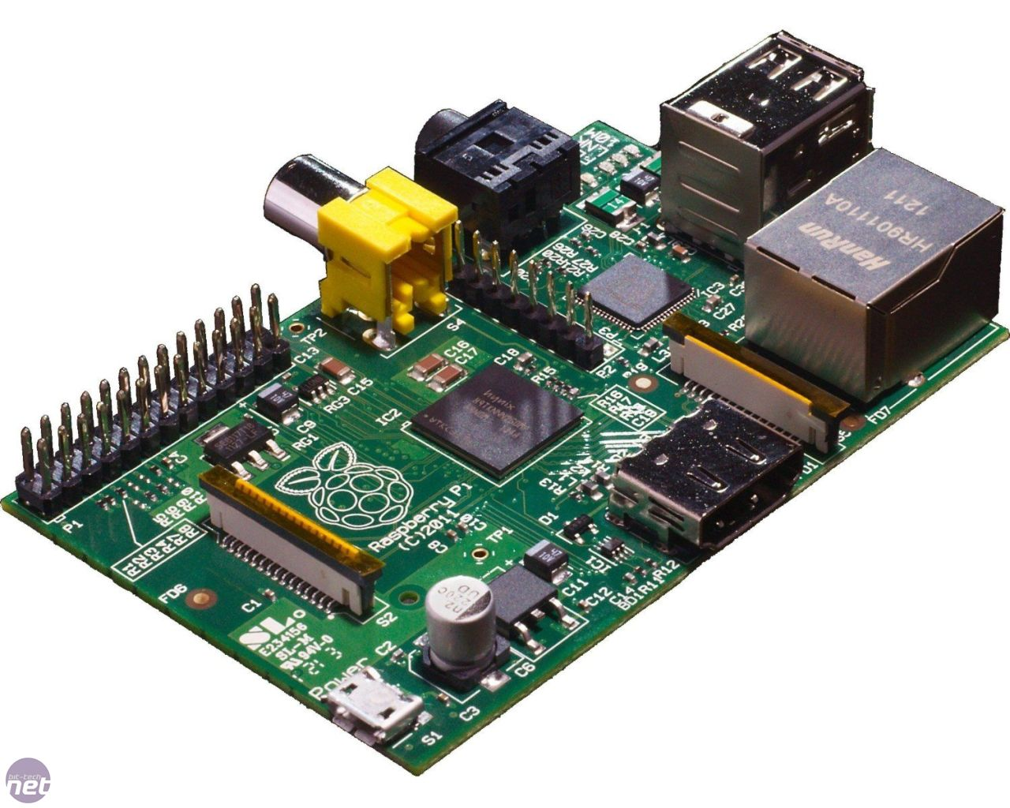
Raspberry Pi
USB
Credit card sized educational computer
Perfect for experimenting
Ethernet
HDMI

Slide 8
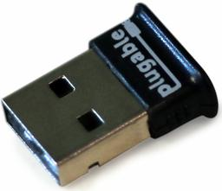
Bluetooth USB nub
Cheap
Works great with the Raspberry Pi

Slide 9
Hypothesis
A Raspberry Pi using a Low Energy Bluetooth USB nub will be able to detect nearby devices from a distance no greater than 40 feet.

Slide 10
The Setup

Slide 11
Baseline Tests
Raspberry Pi
iPhone
0ft
iPhone
5ft
iPhone
10ft
iPhone
35ft
iPhone
40ft
5ft increments
270º
Raspberry Pi
180º
0º
BTN
90º

