Slide 1
NETool opportunities
DFS (+ Digital Well Operations)
Light version (take PROSPER market share)
Clariti
Well completion schematic + well Head Xmass tree
Well completion import (excel, pdf)
Dynamic (material balance, dynamic reservoir pressure, etc)
Gas/Water conning risks
Sand production risks
Correlation modifications
Multistage Fracturing (revive)
Reporting (pdf generate)
Add lithology
Add economics (look at wellcost? Aries?)
Hydrating, methanol injection
Well interference (Res Simulation integration, ML)
DTS, DAS (+ Well Integrity - https://tgtdiagnostics.com/)
Client – server (web, cloud) architecture
Trainings
Novatek list
OSDU?
GIT repository for models?
Integration?
Nexus
Wellcat
DSWellplanning
Pvt eos to BO
Transforming our software to become an advisory tool, we have good science in our tools but there is no focus on the end result that the client need which is; a decision to take in the asset (Mahmoud Bedewi)

Slide 2
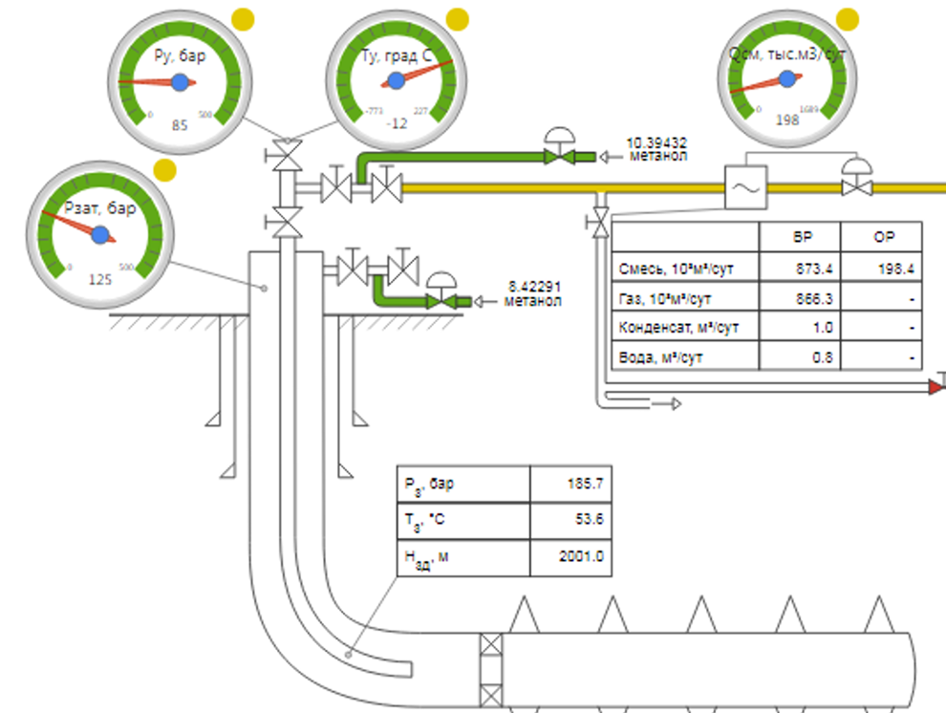
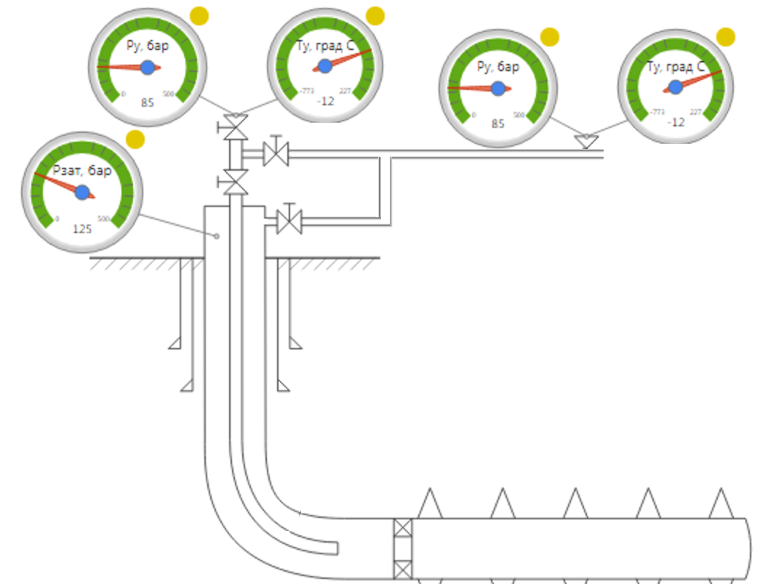
Well completion schematic + well Head Xmass tree

Slide 3
Dynamic (material balance, dynamic reservoir pressure, etc)
P(t) - % decline or increase per timestep
2) P = f(t) – plot (derived from reservoir simulation for example)
3) Extrapolation of historic data
3) material balance of drainage area (may consider influx / outflux – adjacent producers, injectors, aquifer )

Slide 4
Risks: Gas/Water conning, Sand production
GOC
Risk free: Δ P < Δ P critical
Δ P critical
Δ P critical
WOC

Slide 5
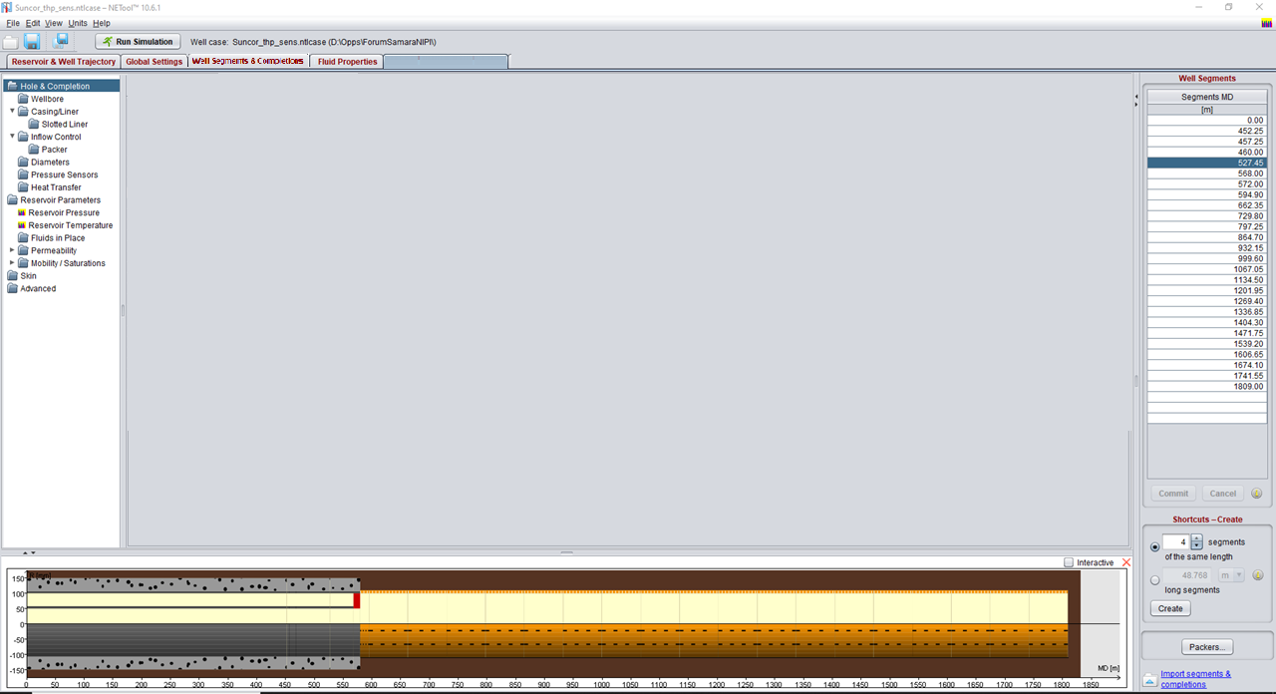
Client – server (web, cloud) architecture
Netool Hub
What’s new?
Did you know?
How to add pump
How to add pump
Area for:
Chat bot
Knowledge base, FAQ, lessons learned
Feedback
Petrowiki
News, articles, announcements, (blog ☺)
How to workflows
Interactive courses
Model repository (or OSDU connect)
….

Slide 6
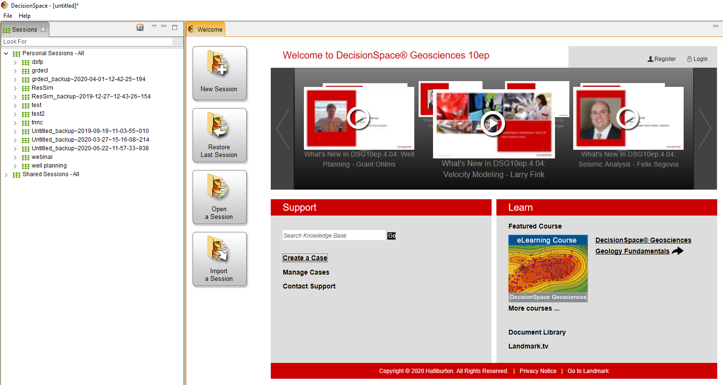
Client – server (web, cloud) architecture – DS example

Slide 7
есть ли у вас пакеты связанные с проектированием воздействия на пласт и ПЗС

