Slide 1
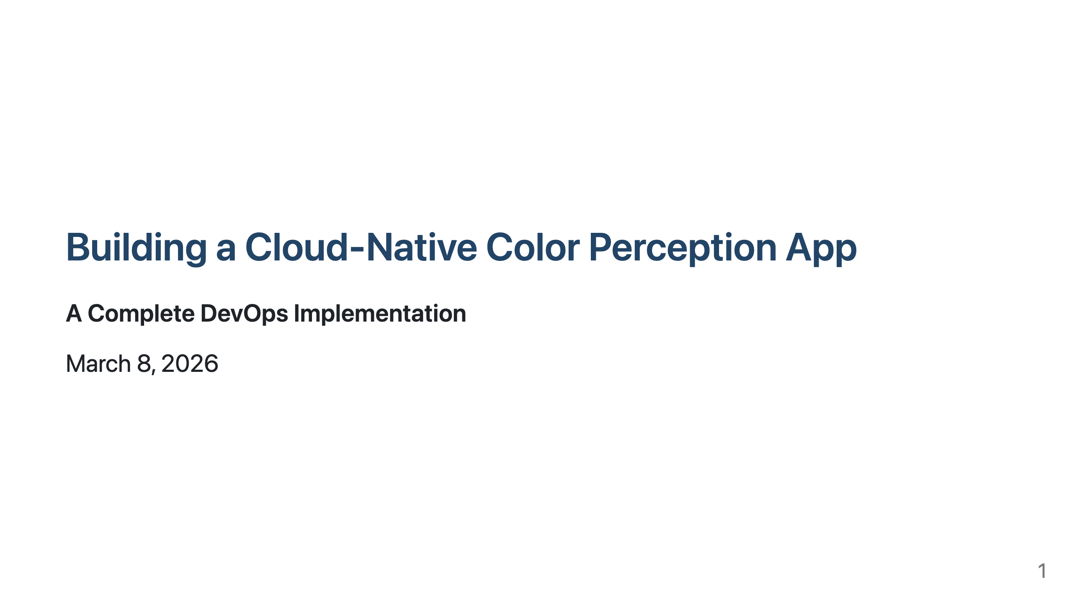

Slide 2
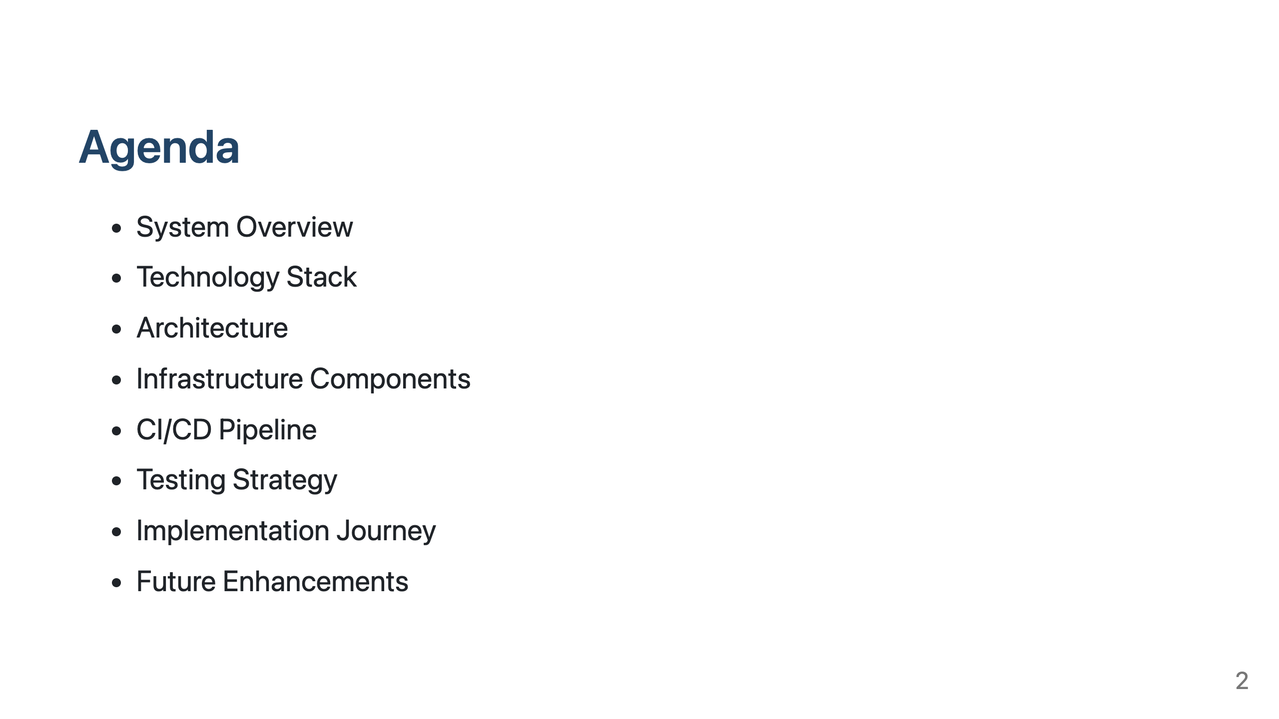

Slide 3
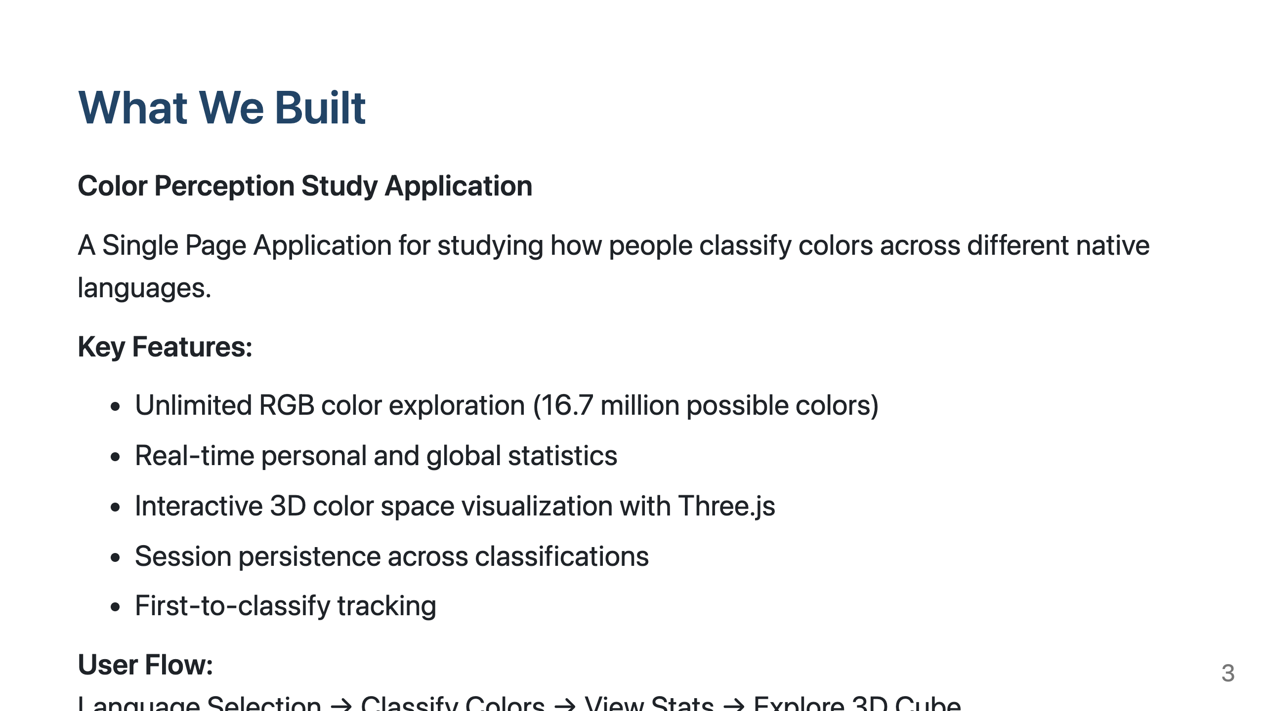

Slide 4
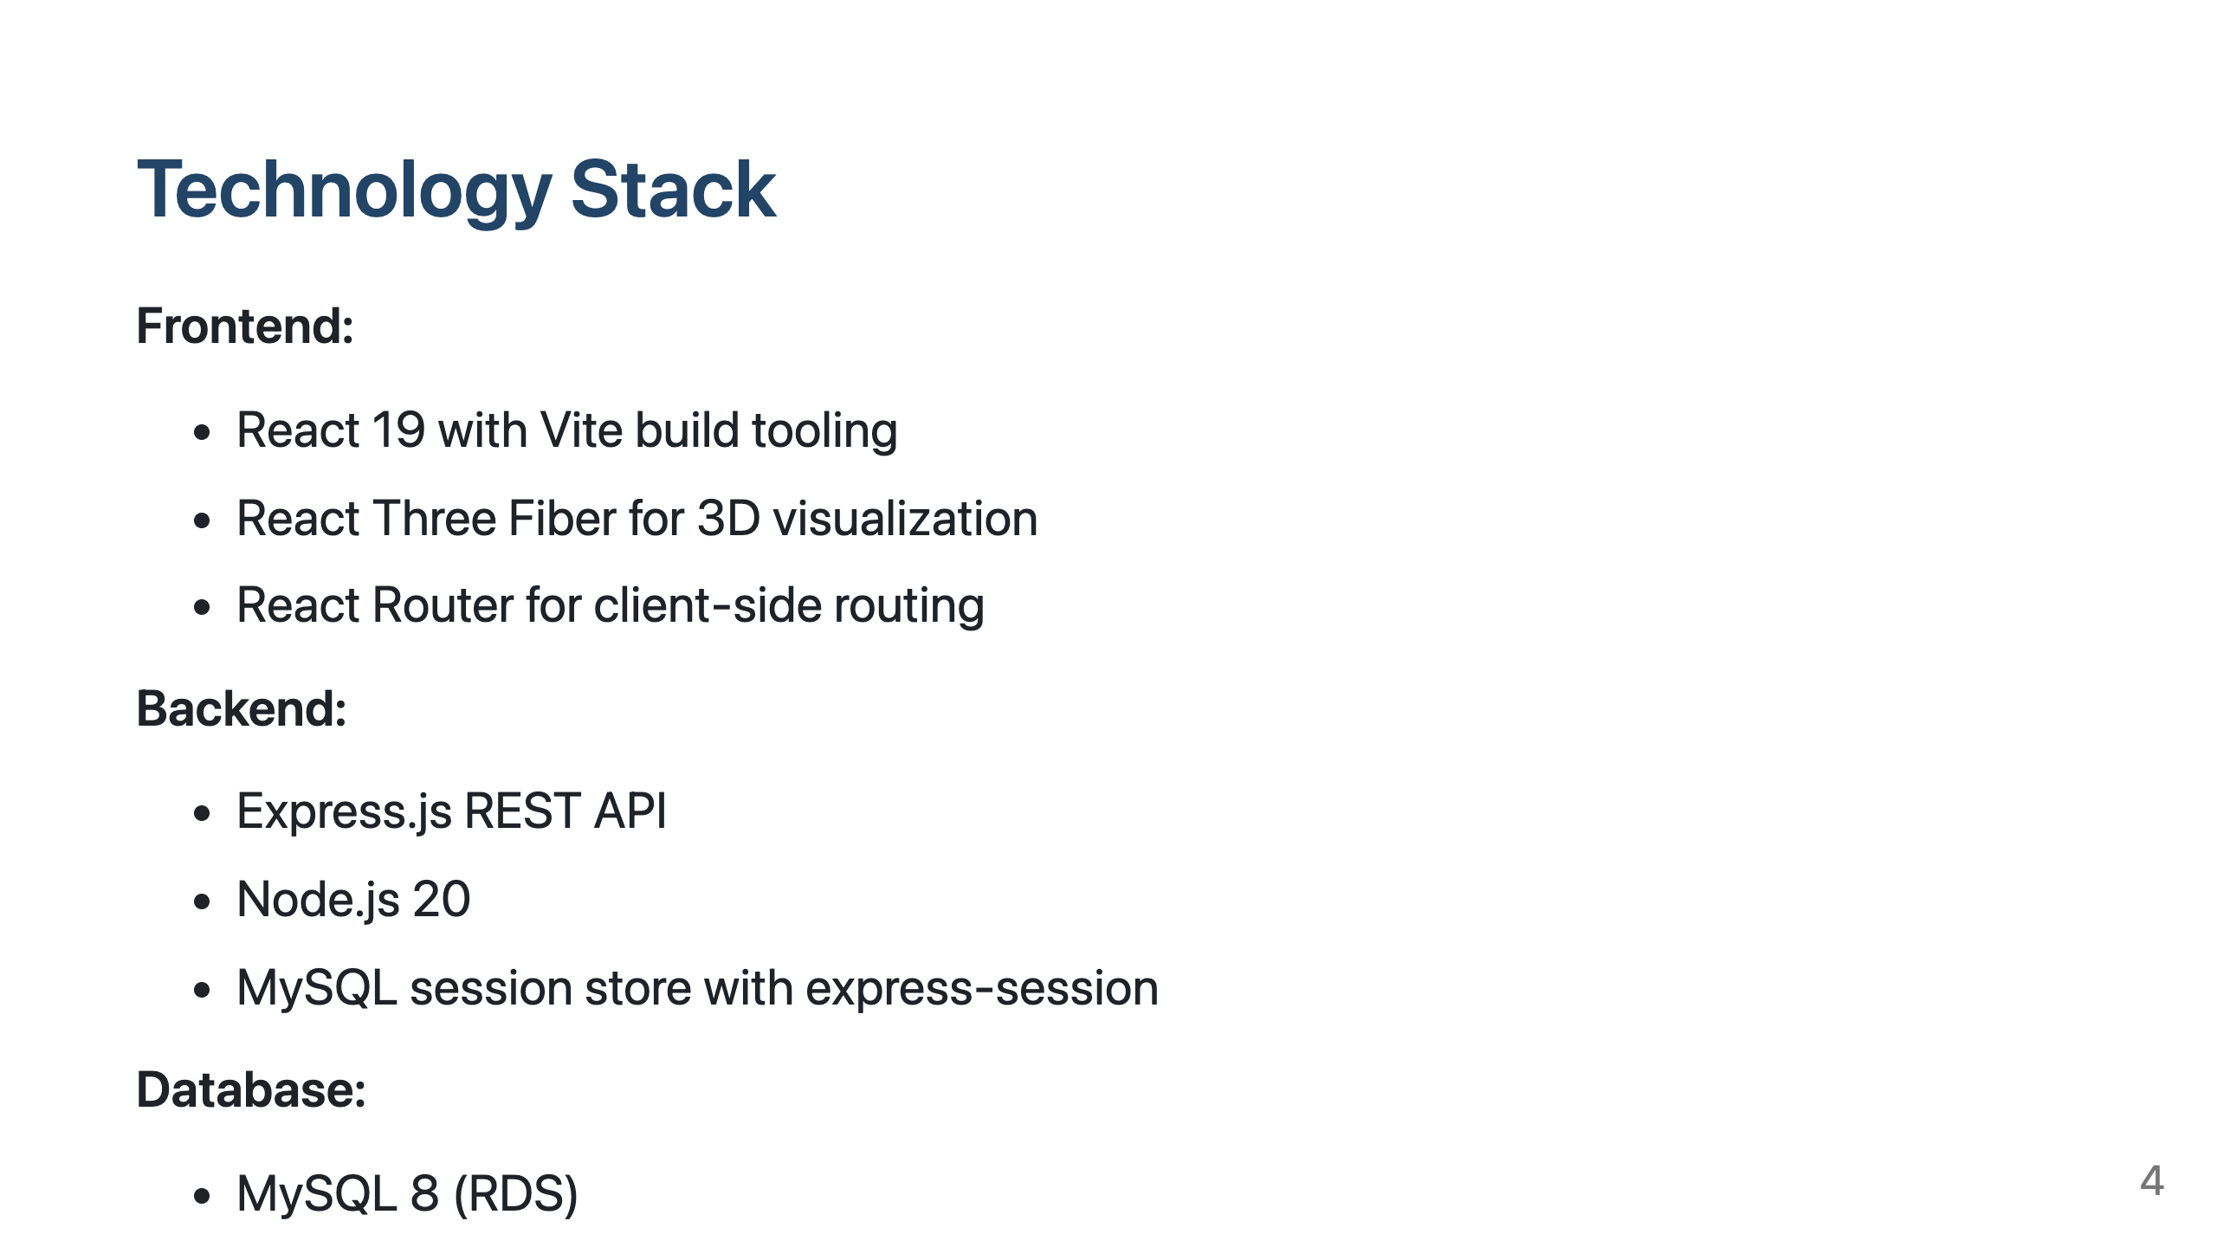

Slide 5
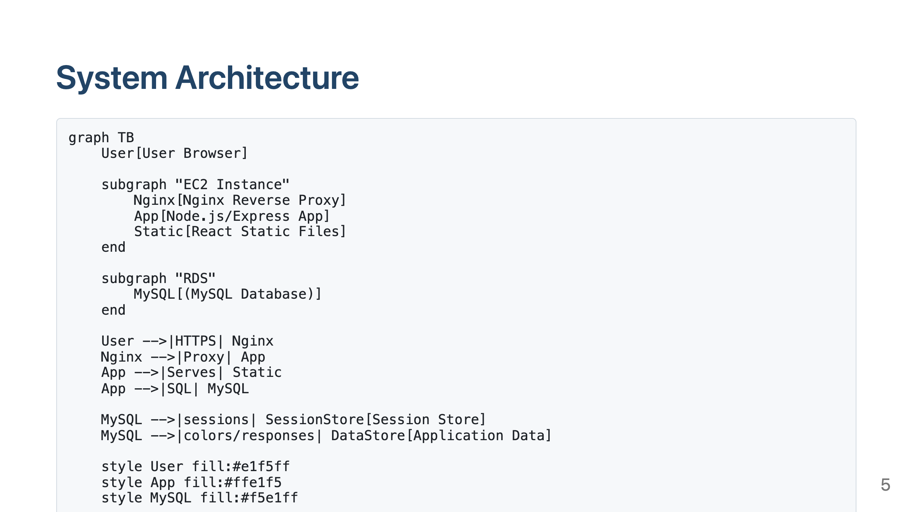

Slide 6
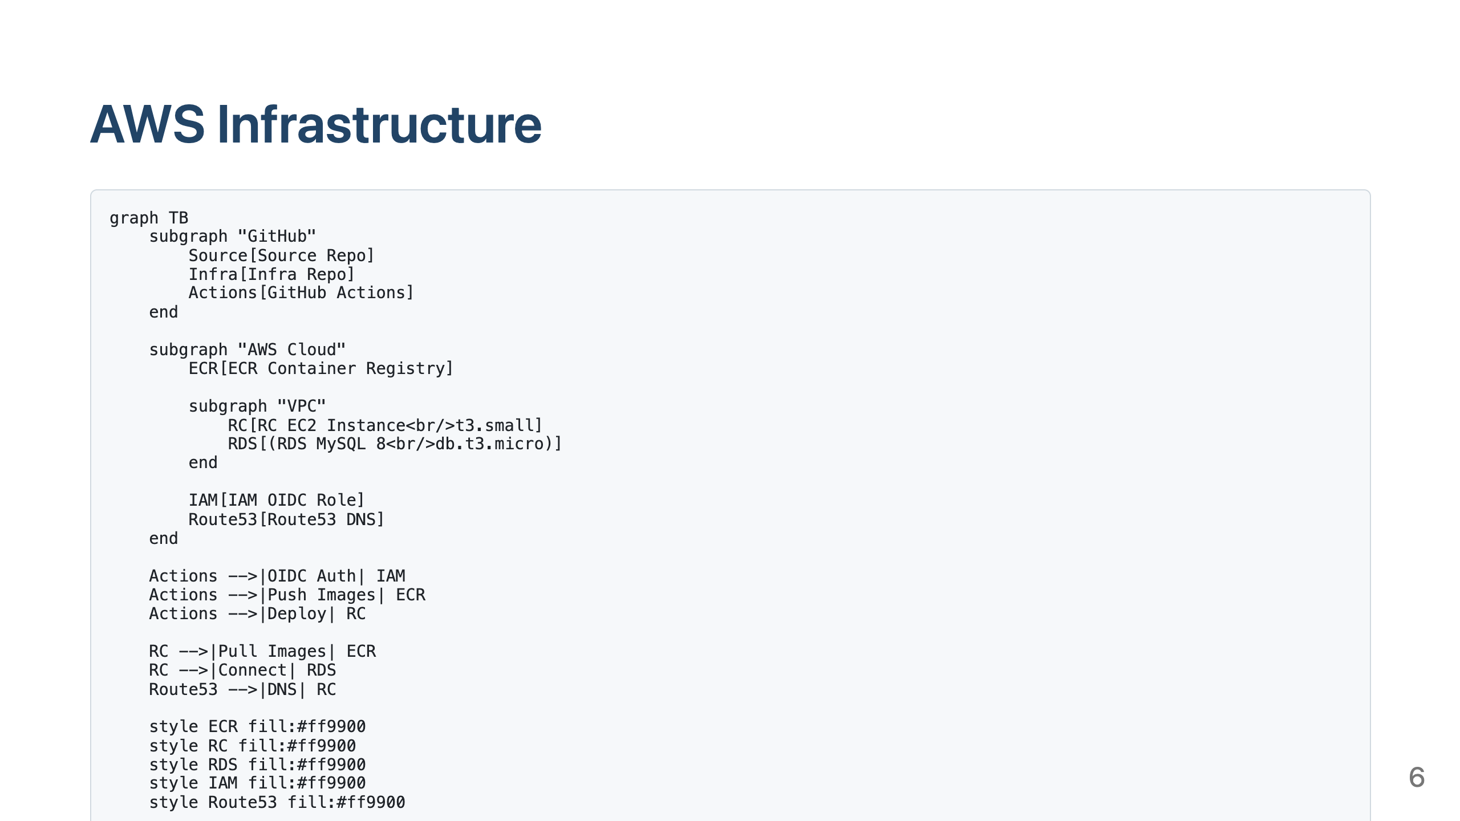

Slide 7
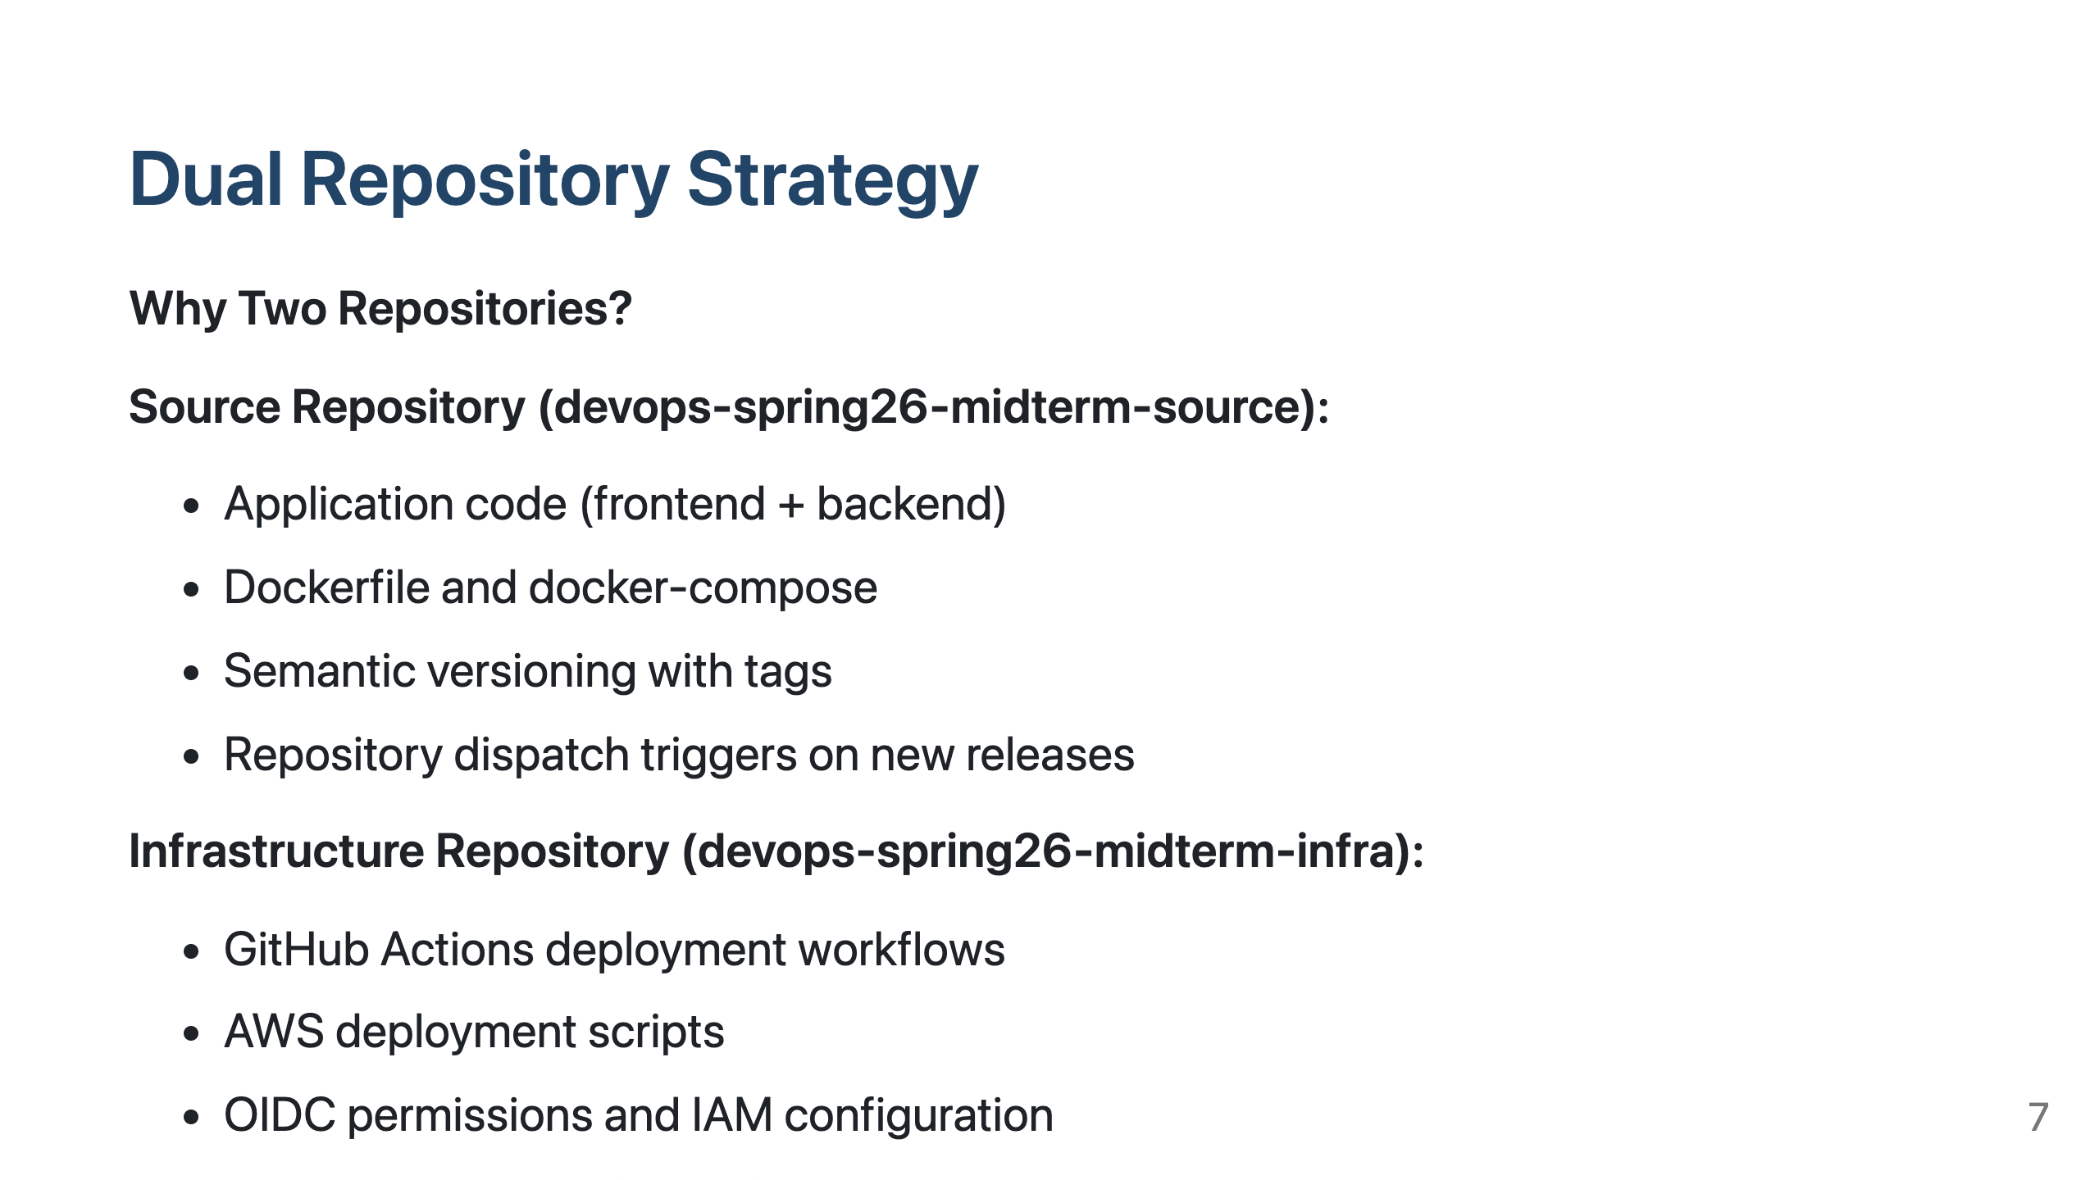

Slide 8
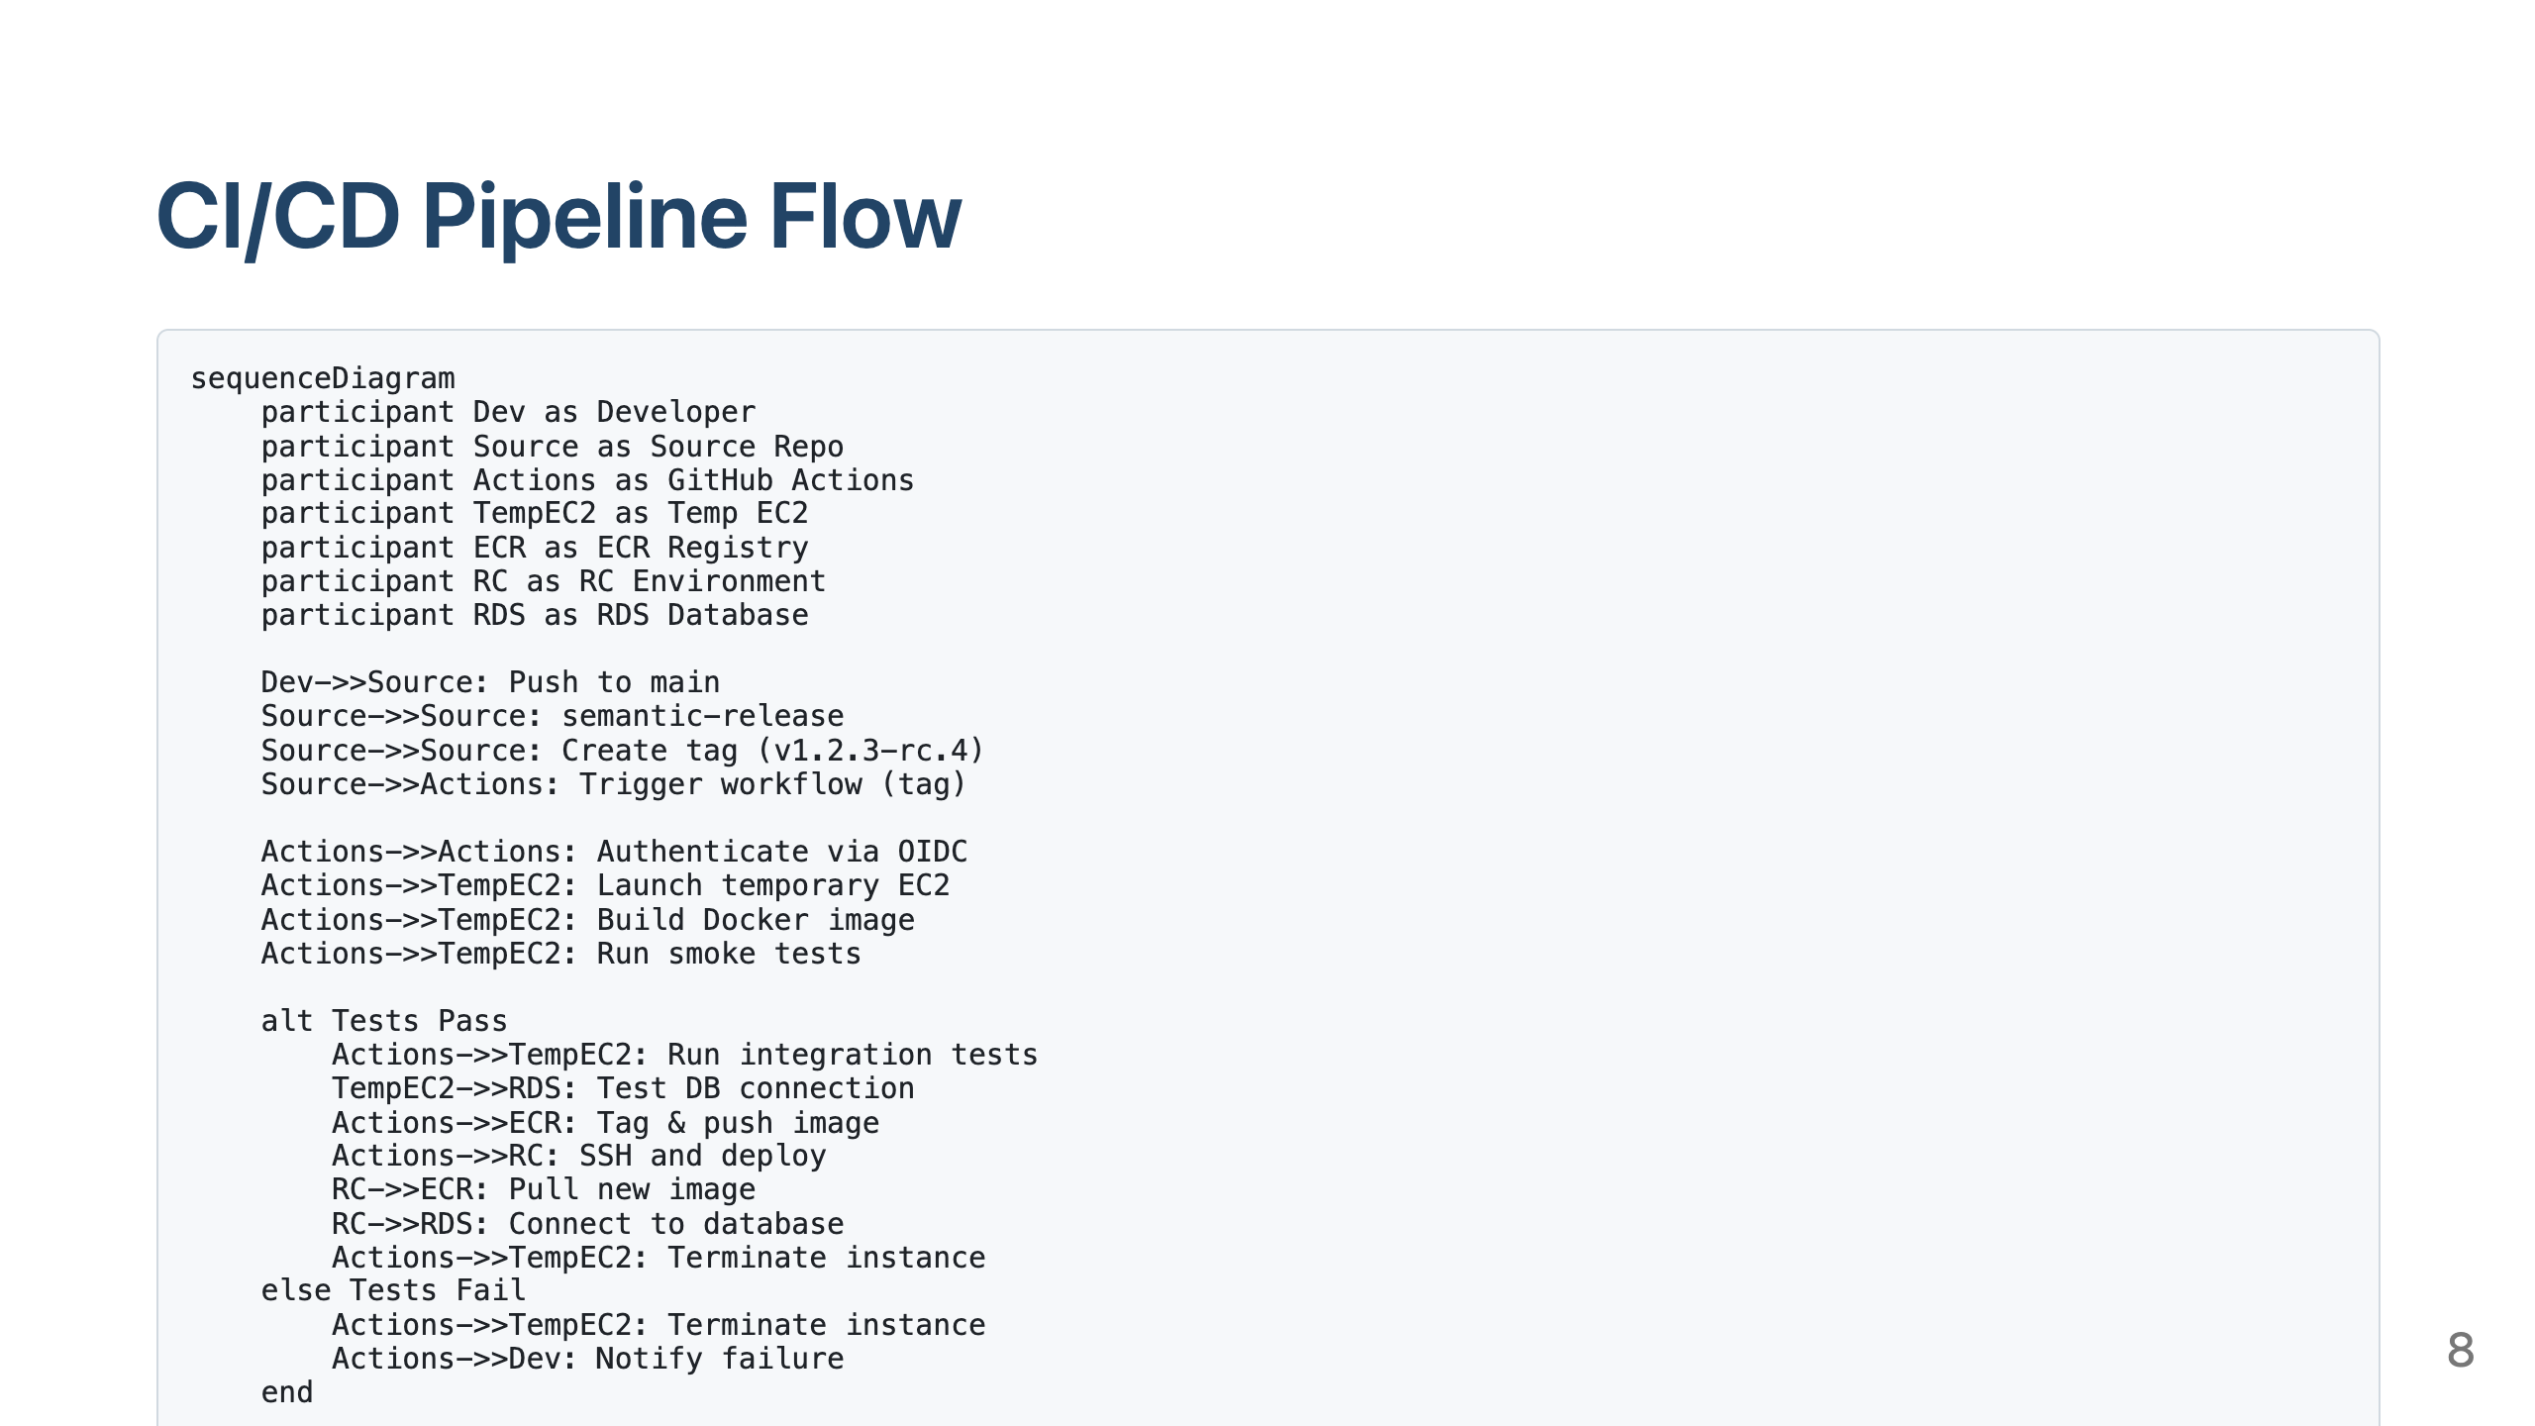

Slide 9
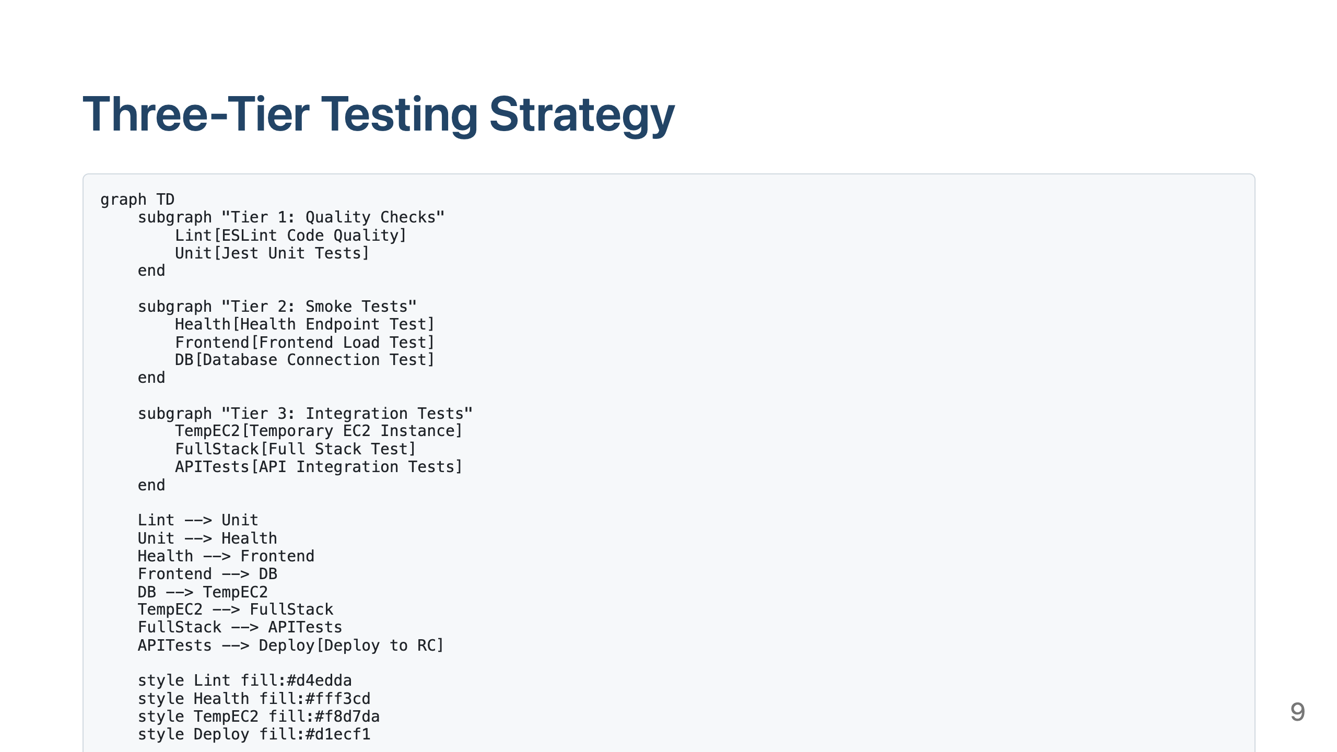

Slide 10
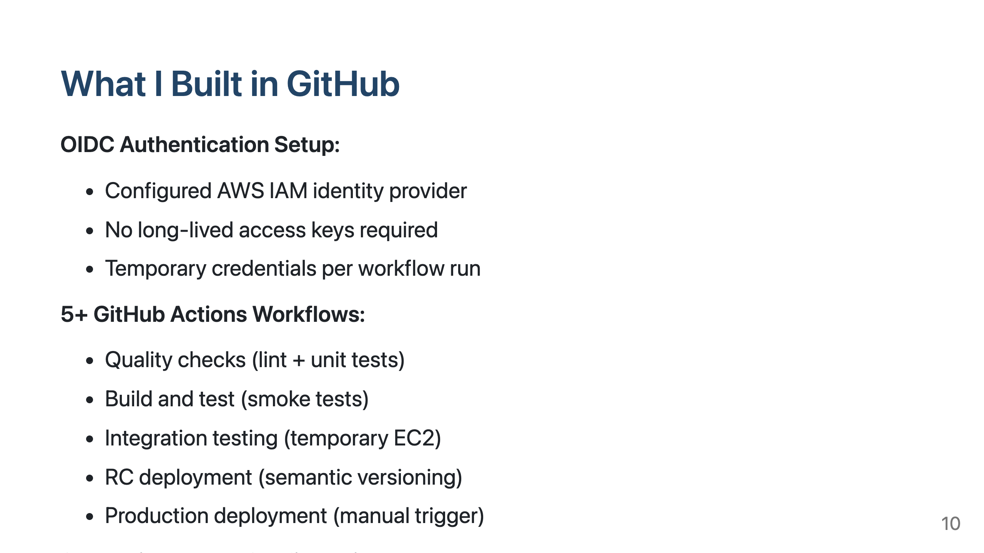

Slide 11
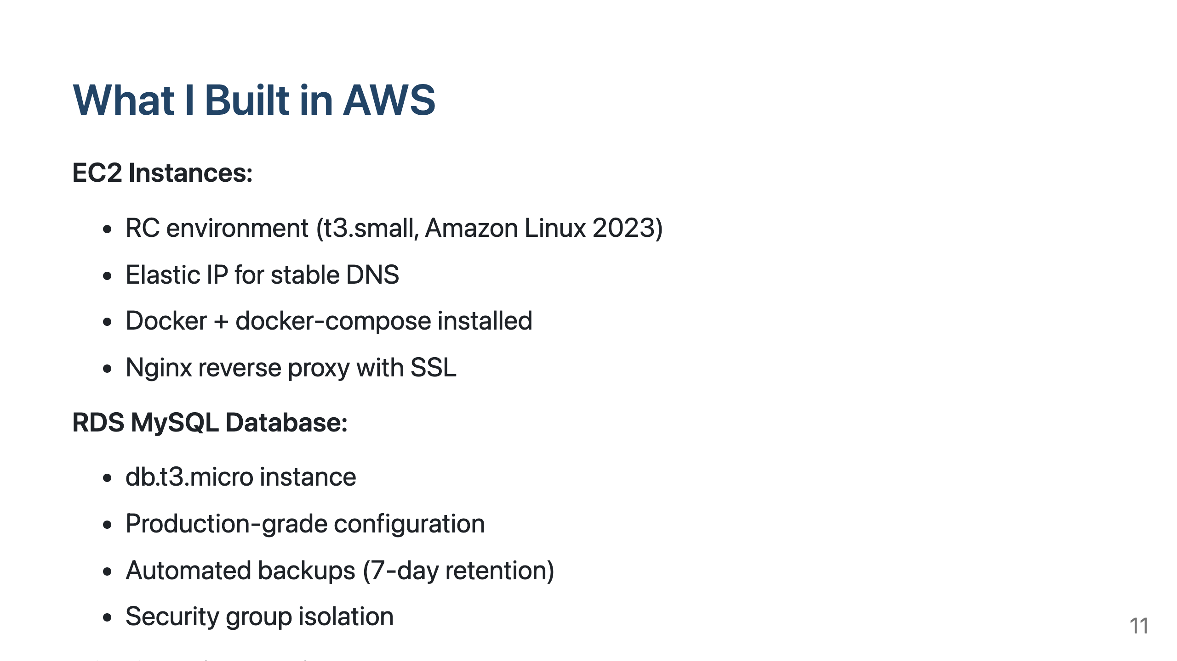

Slide 12
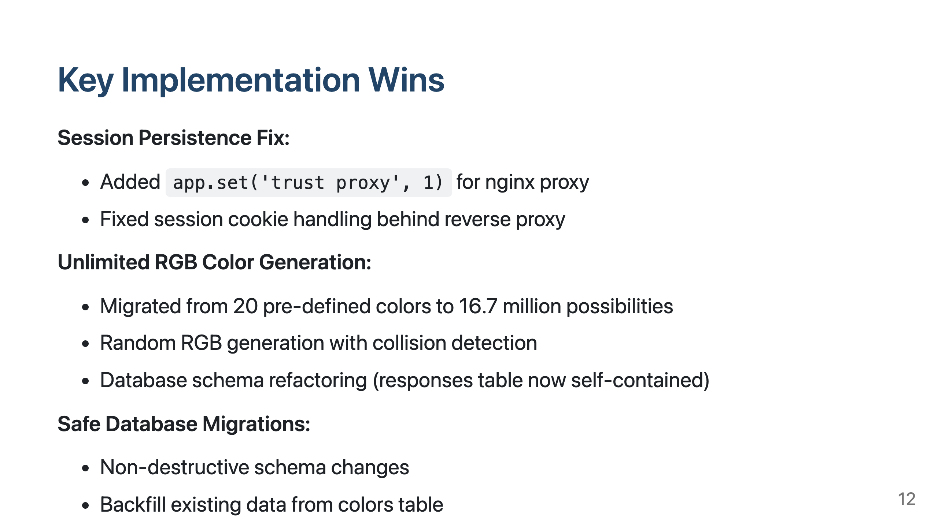

Slide 13
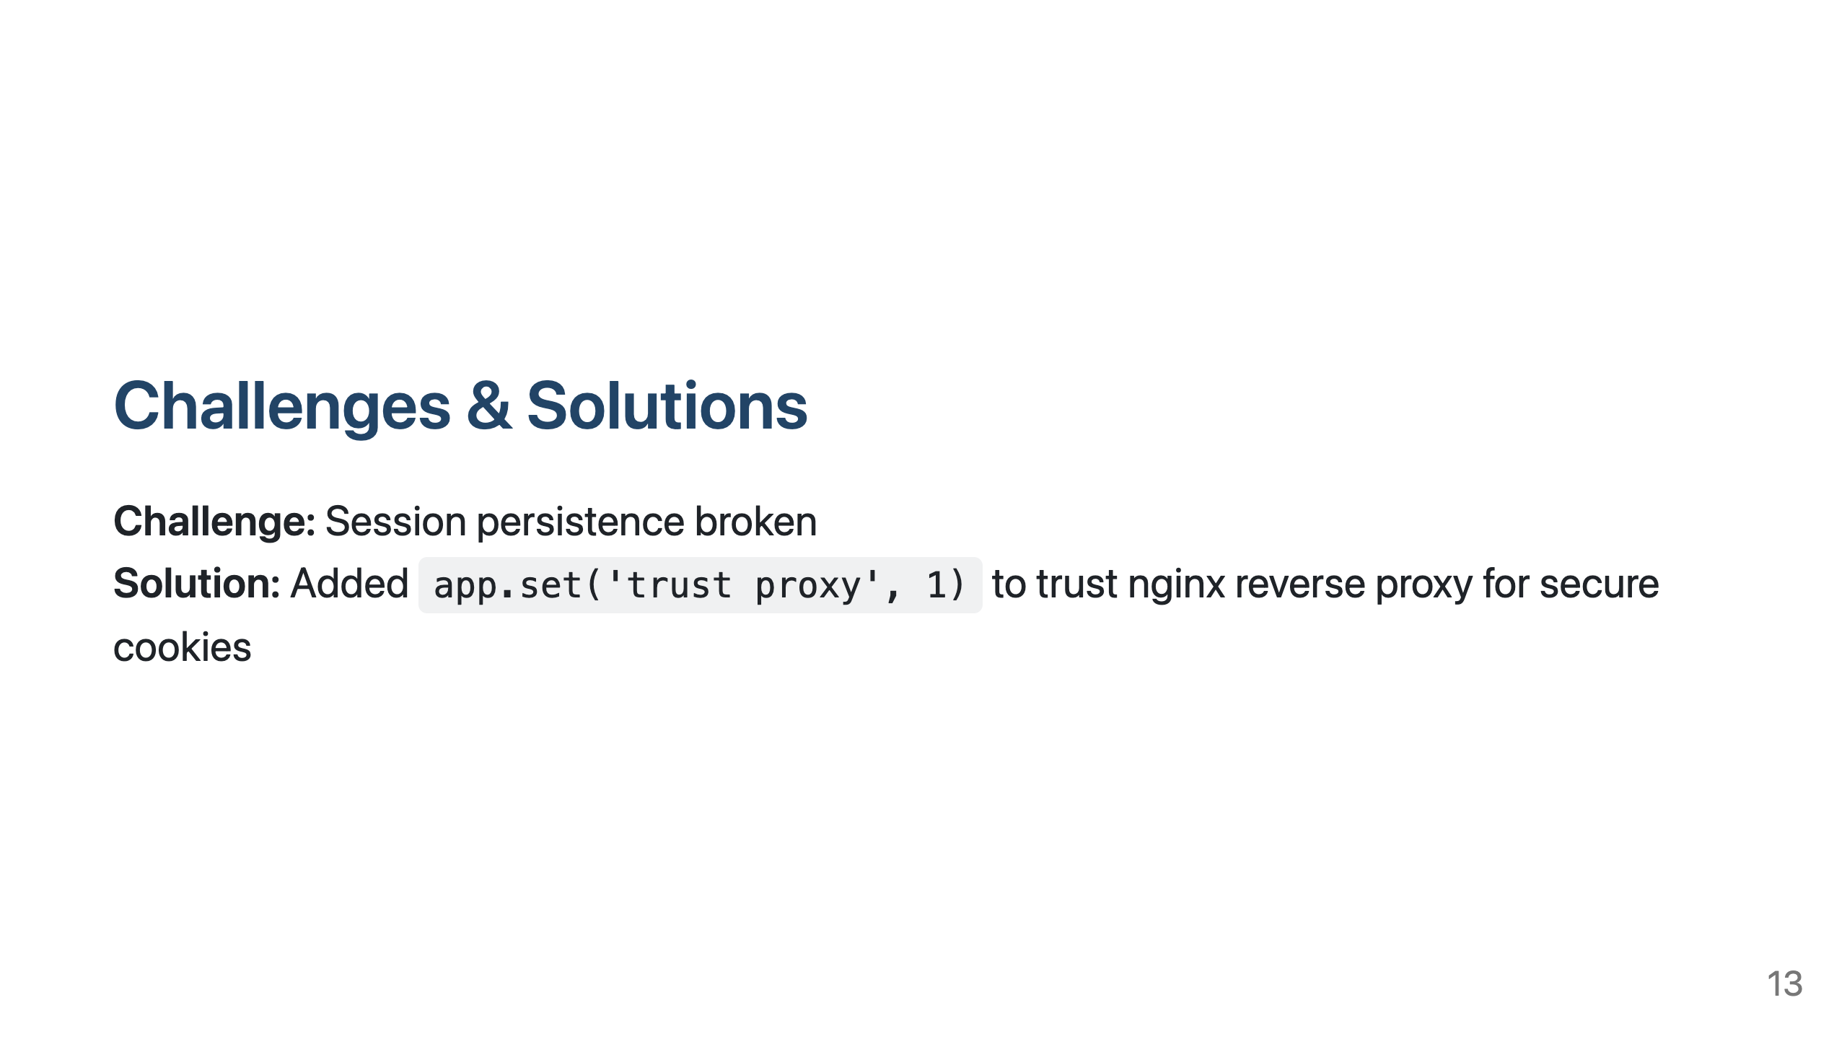

Slide 14
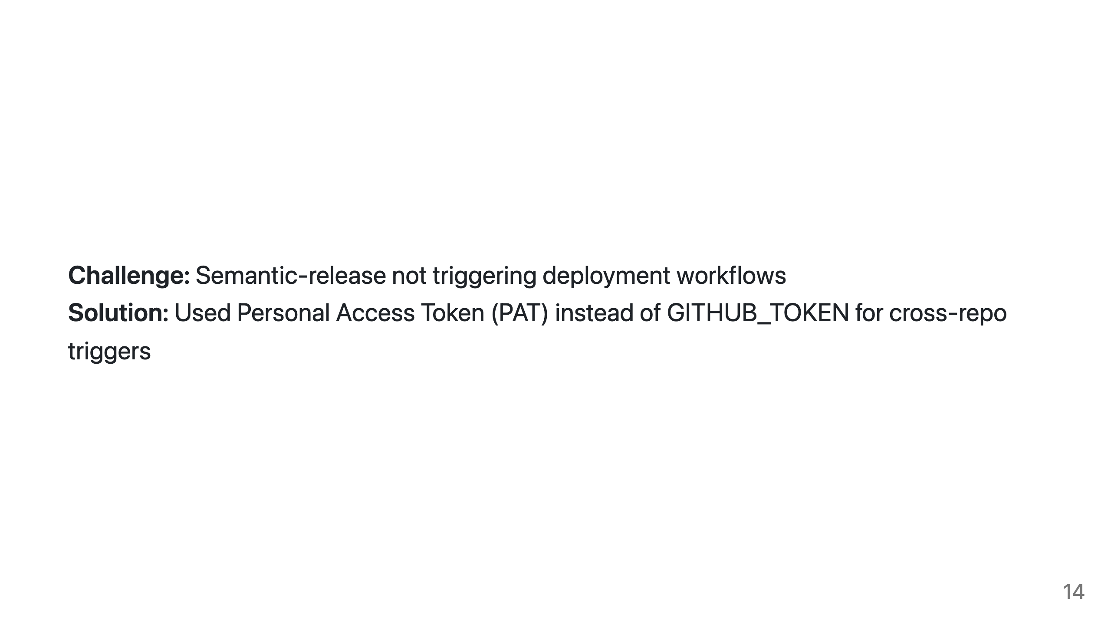

Slide 15
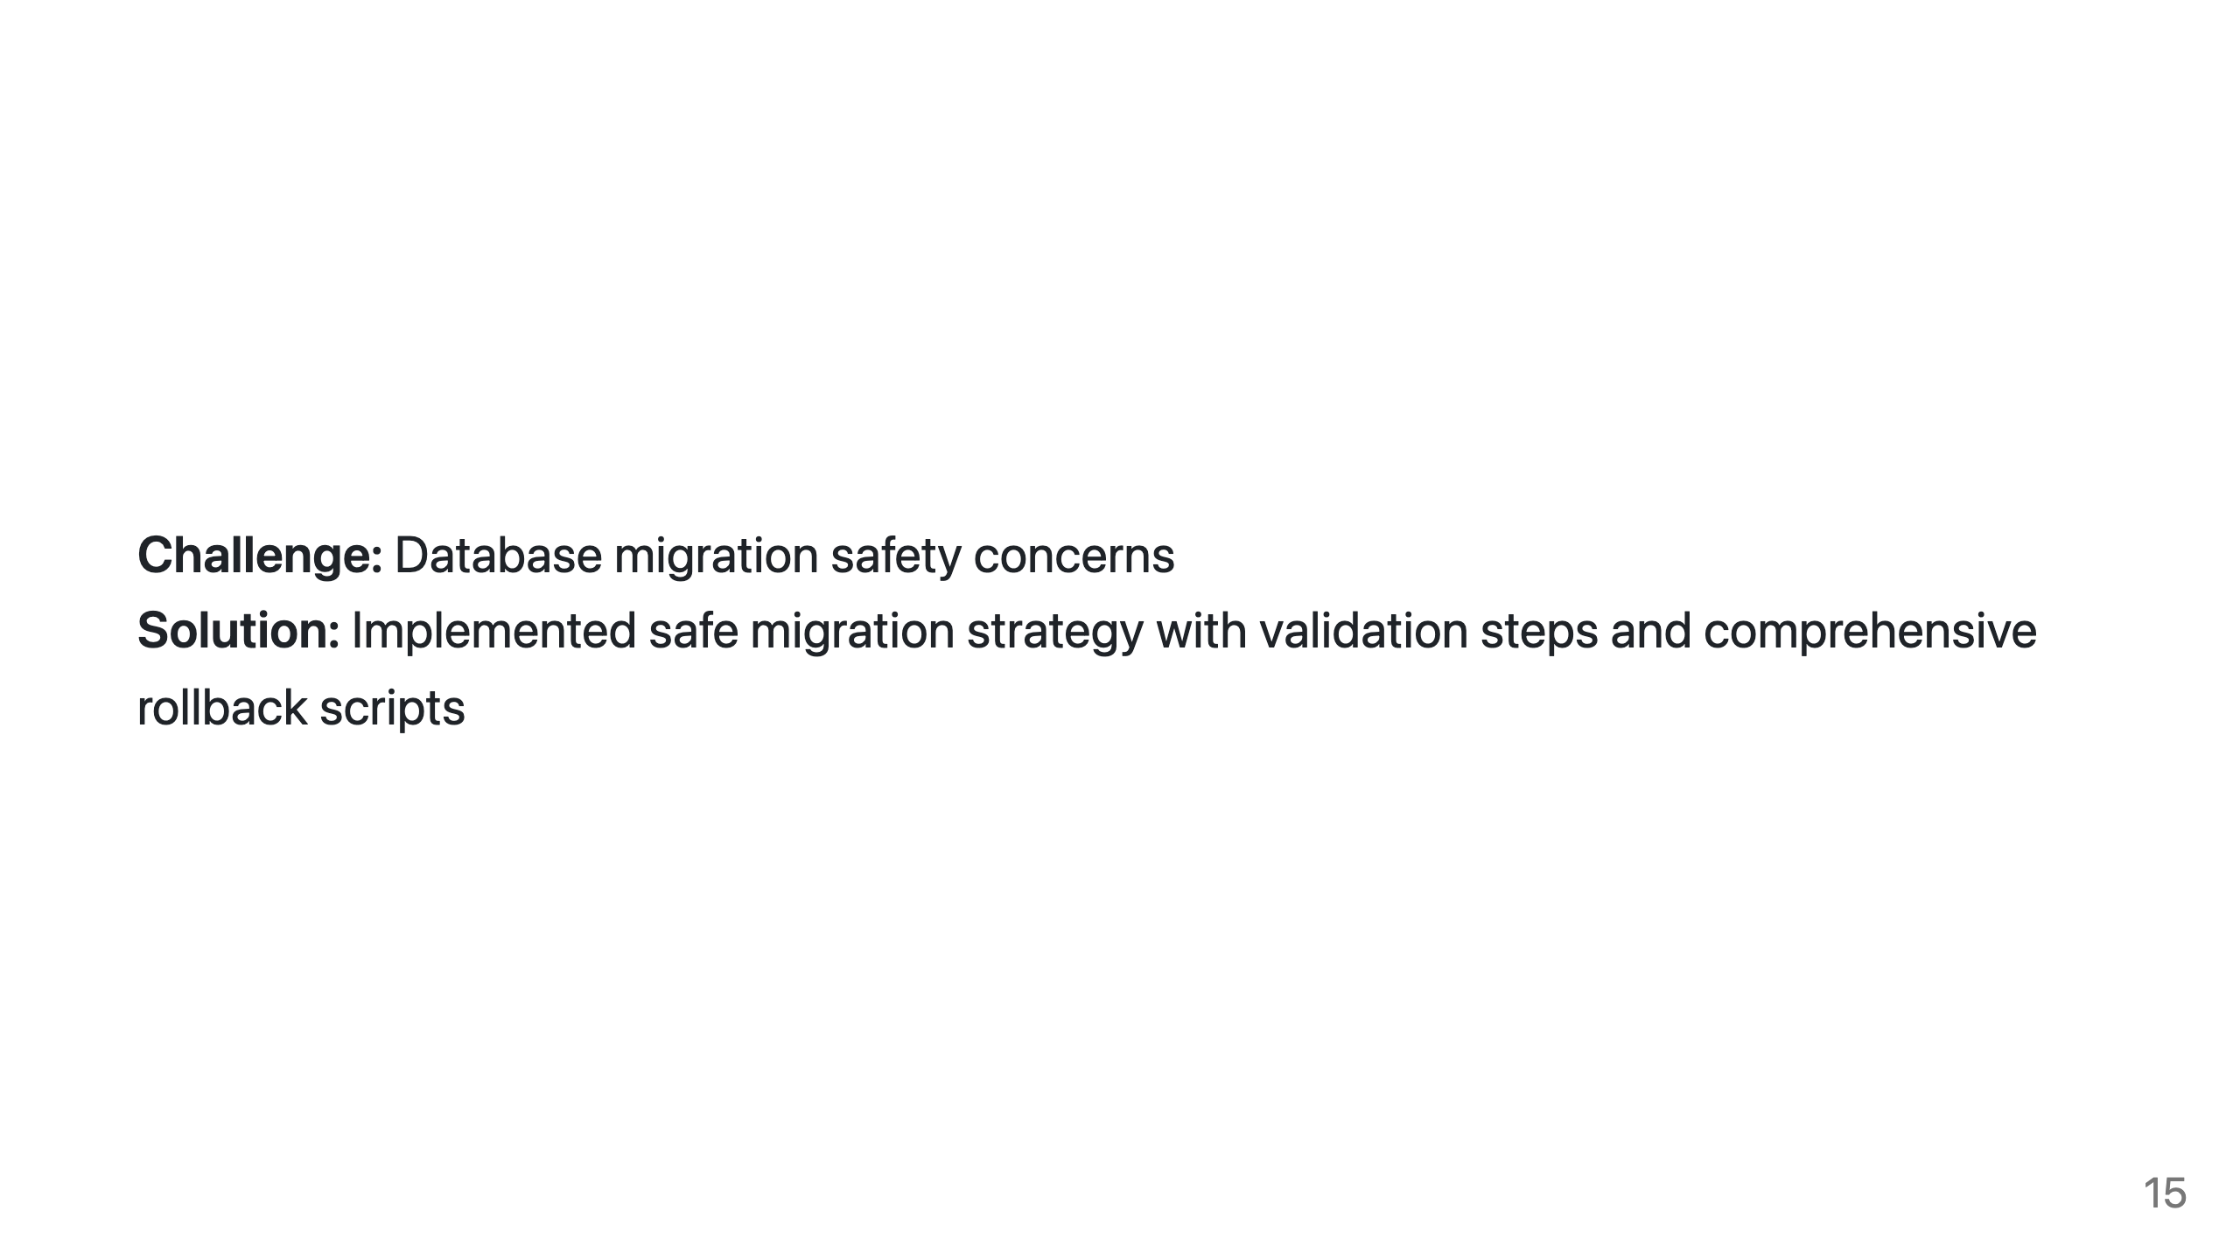

Slide 16
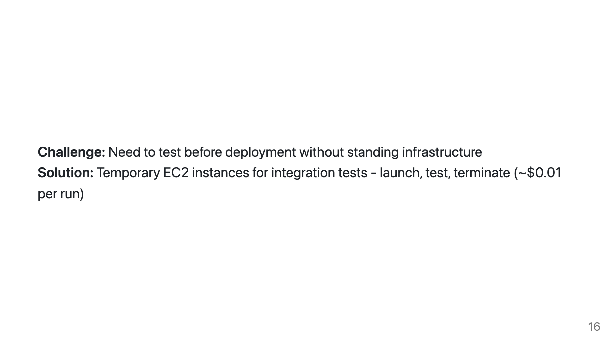

Slide 17
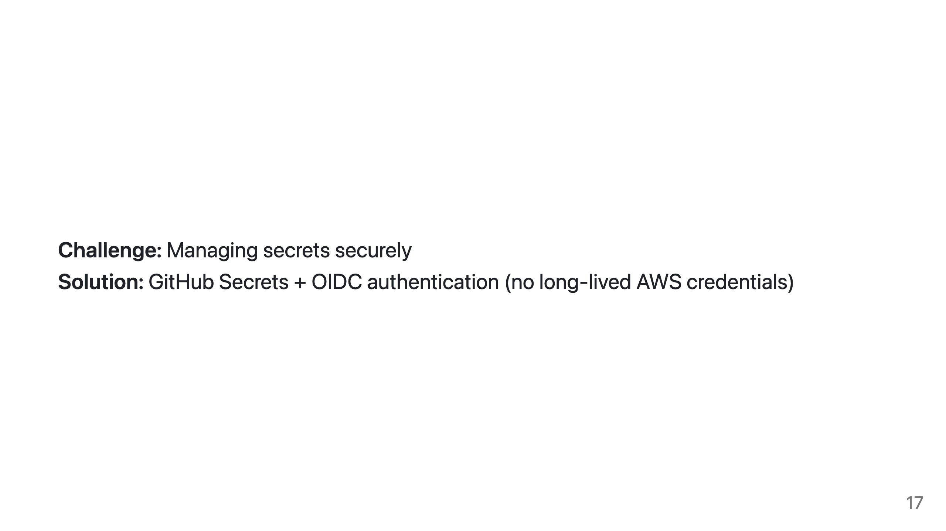

Slide 18
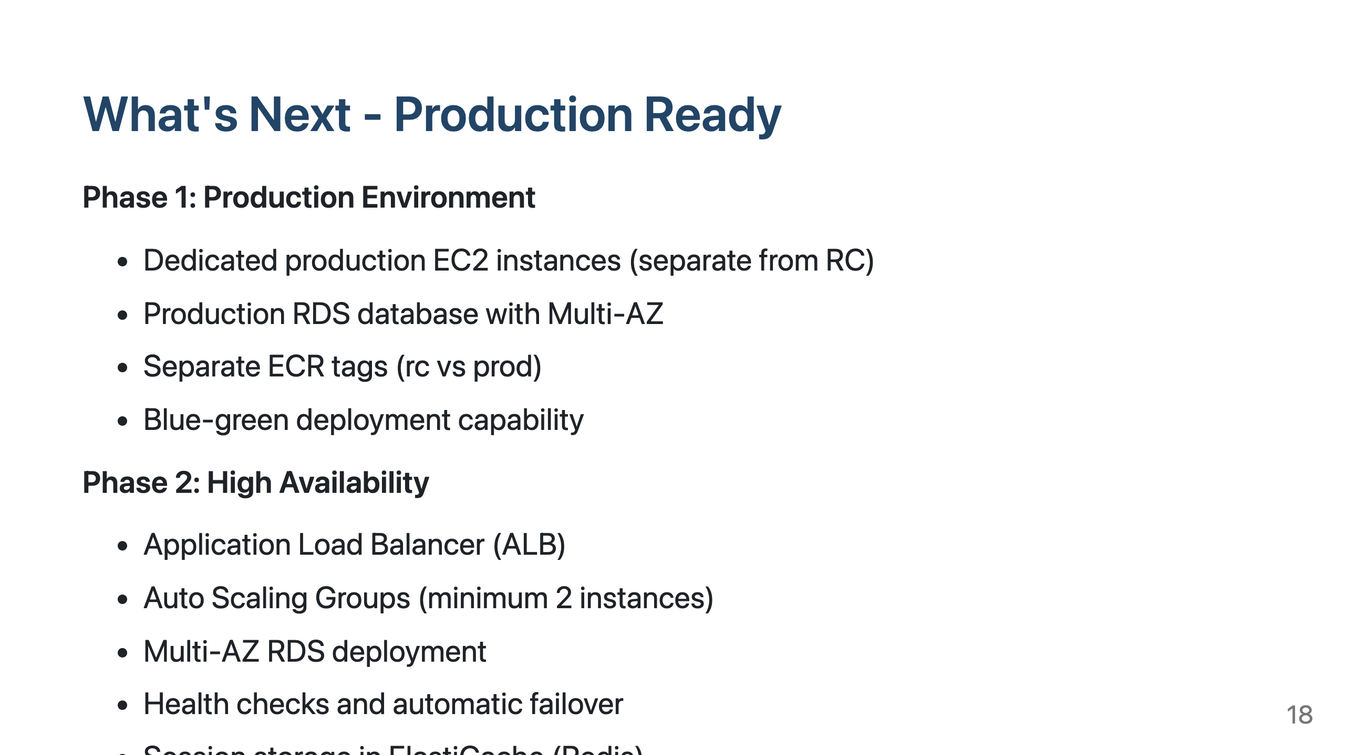

Slide 19
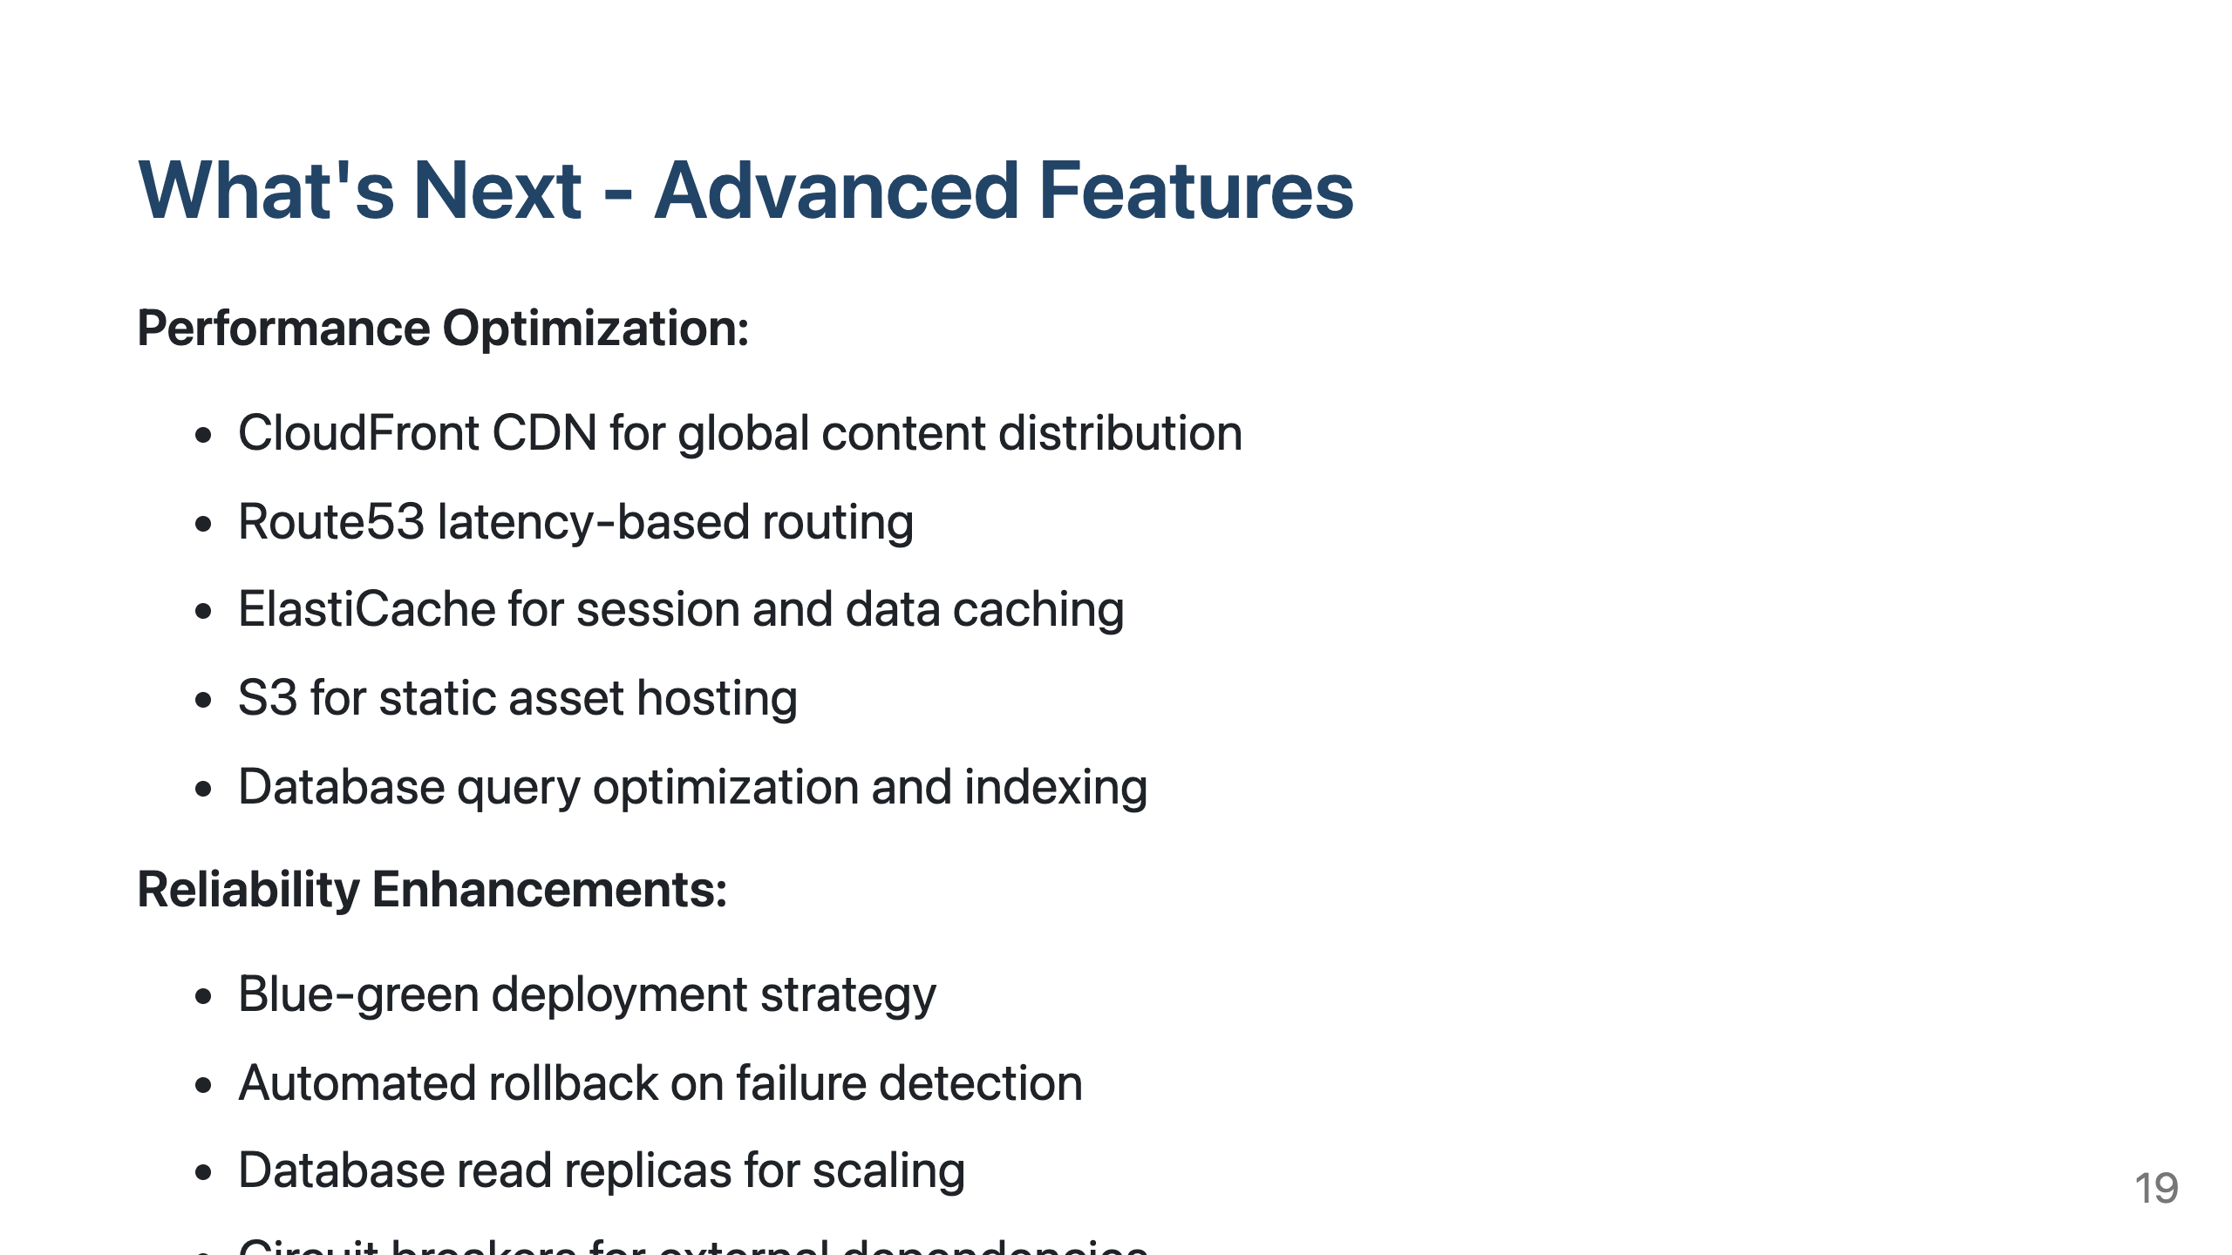

Slide 20
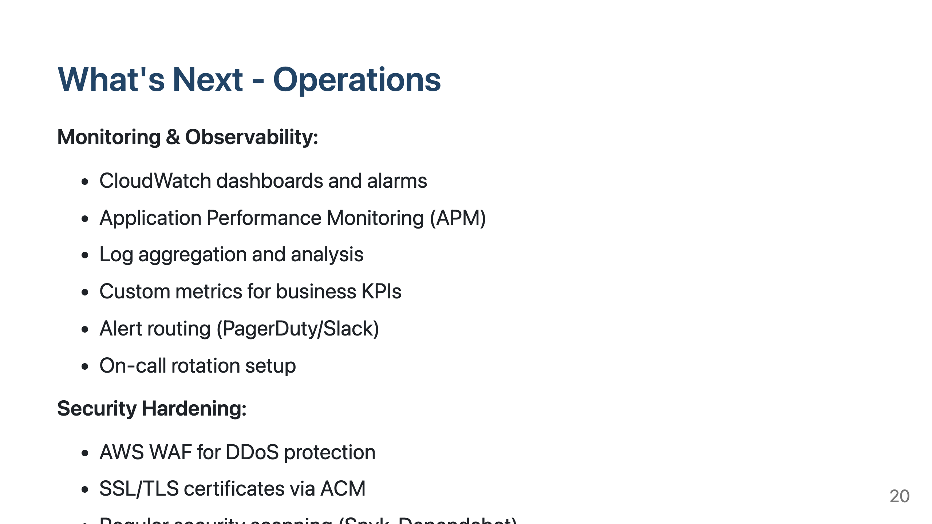

Slide 21
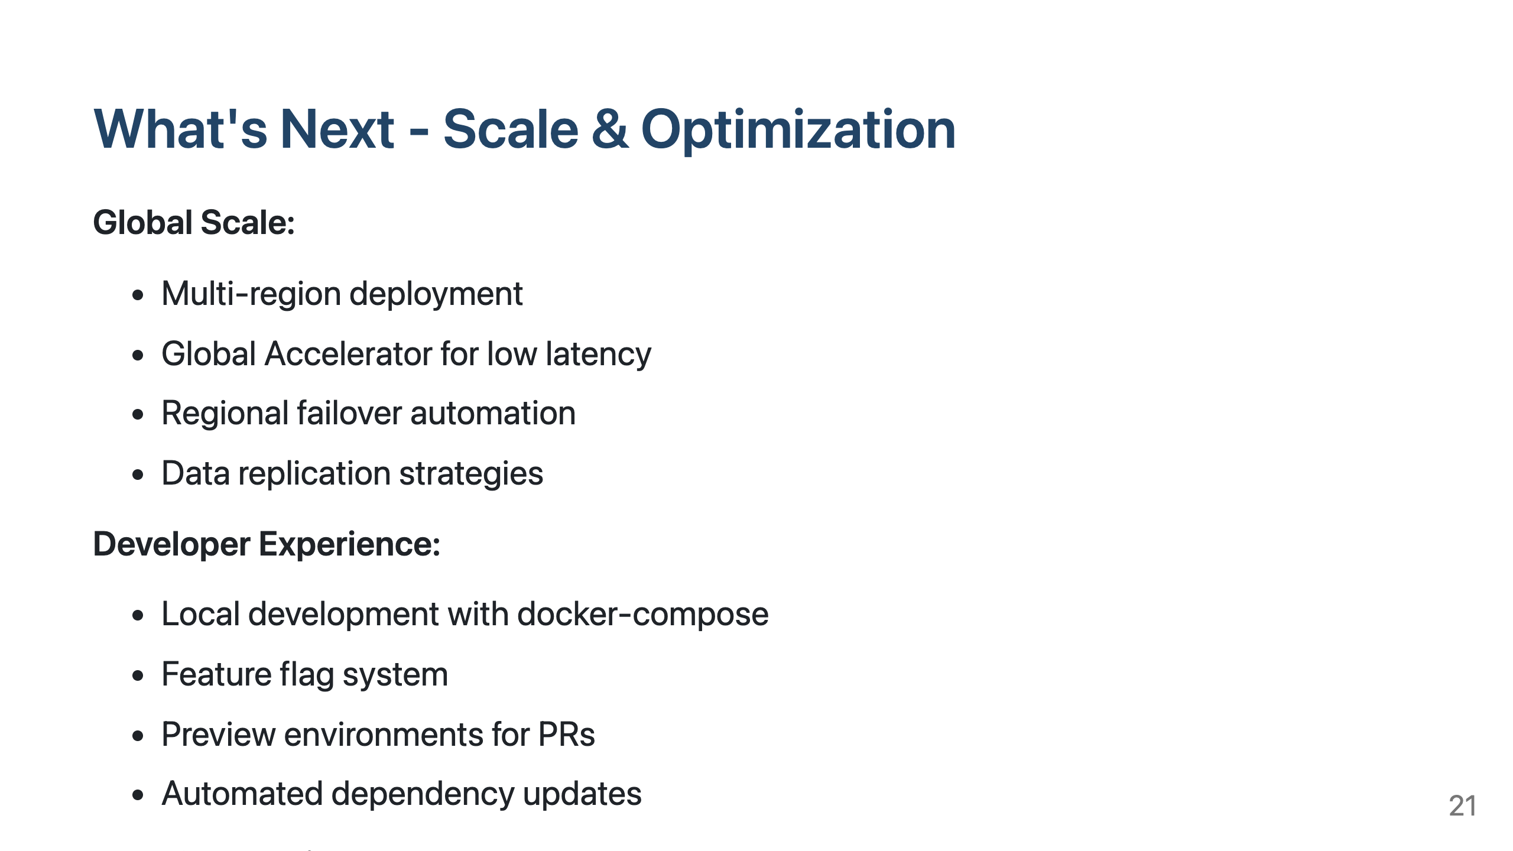

Slide 22
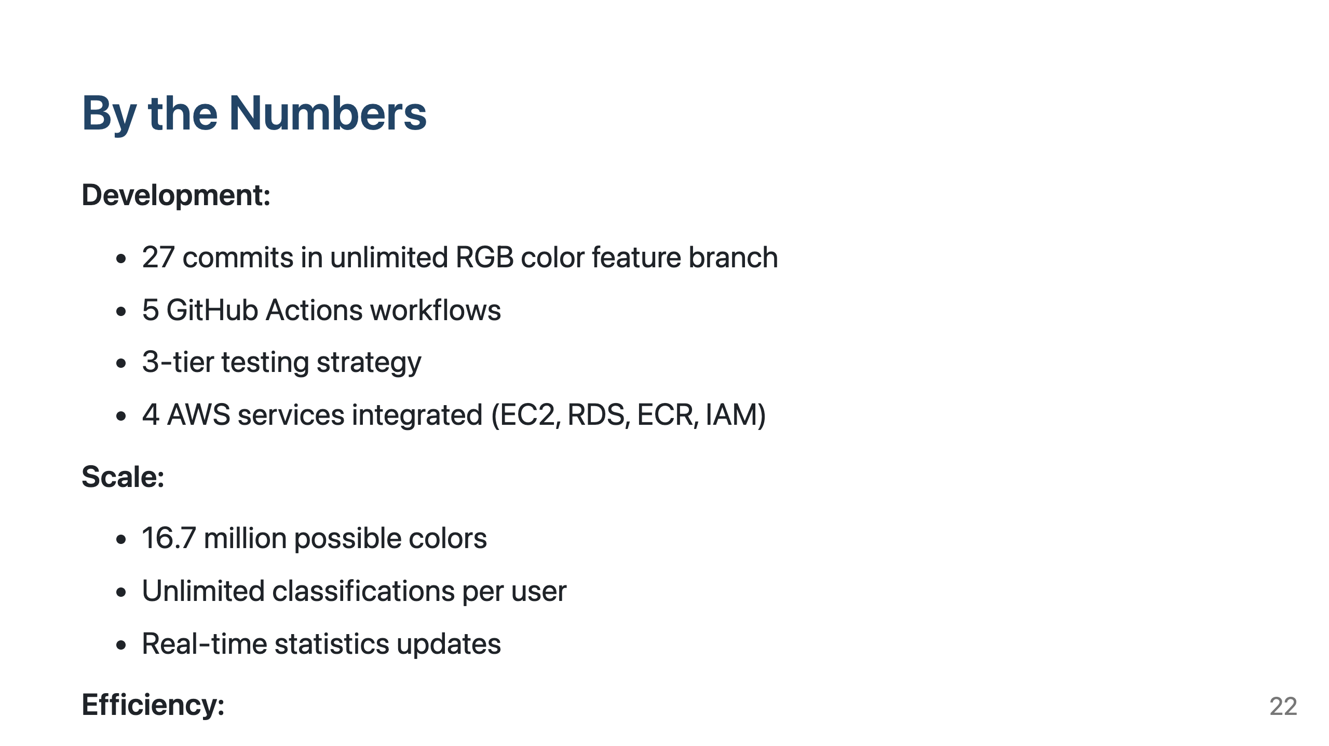

Slide 23
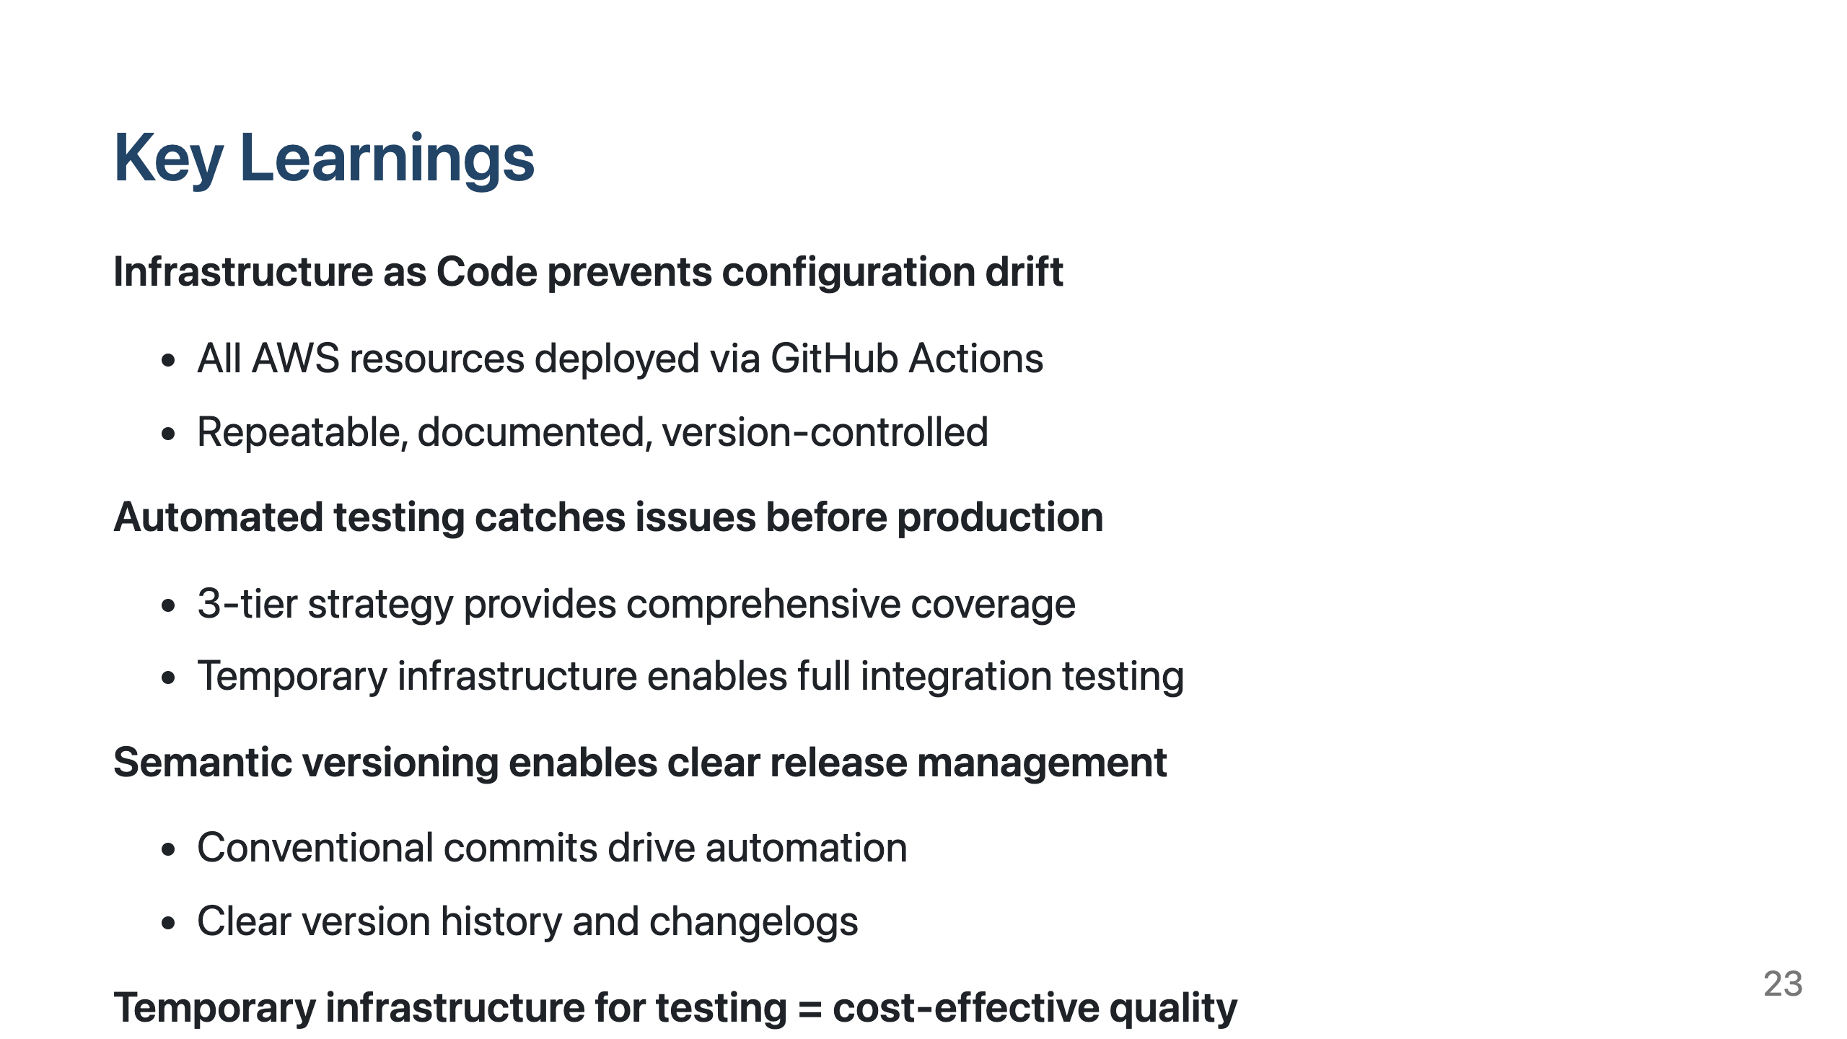

Slide 24
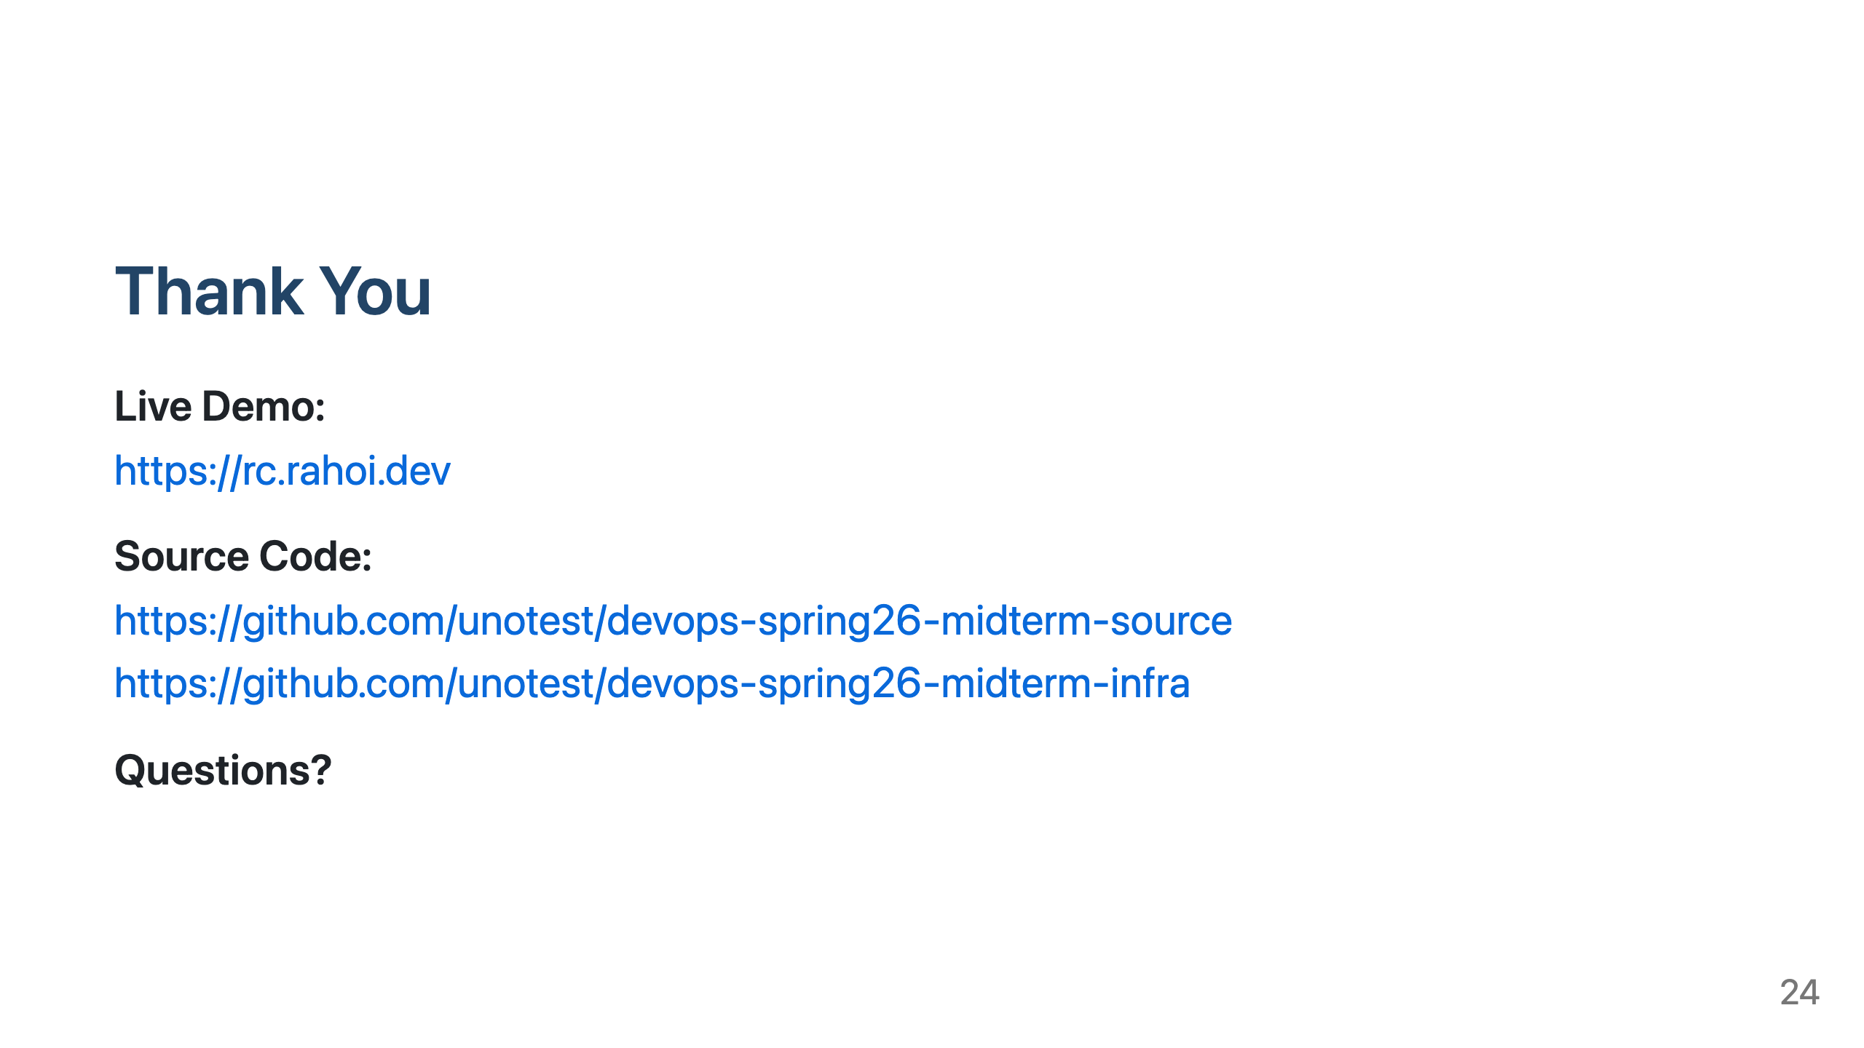

Slide 25

Notes:
Presenter Notes Slide 1 (30s): Introduce the project - color perception study app with full DevOps pipeline Slide 2 (10s): Quick overview of what we'll cover Slide 3 (30s): Demo the core functionality - explain the unlimited color feature Slide 4 (20s): Walk through the tech stack - modern, production-ready choices Slide 5 (30s): Show the architecture diagram - monolithic container approach Slide 6 (30s): Explain AWS infrastructure - all managed services, security-focused Slide 7 (20s): Dual repo strategy - separation of concerns Slide 8 (40s): CI/CD pipeline - automated quality gates Slide 9 (30s): Testing strategy - 3 tiers for comprehensive coverage Slide 10 (20s): GitHub achievements - automation and security Slide 11 (20s): AWS achievements - infrastructure as code Slide 12 (30s): Implementation wins - real technical challenges solved Slide 13 (40s): Challenges and solutions - honest assessment Slide 14-17 (60s total): Future roadmap - production, HA, scale Slide 18 (20s): Metrics - quantify the work Slide 19 (30s): Key learnings - DevOps best practices Slide 20 (20s): Thank you and Q&A Total: ~7 minutes

