Slide 1
Skinny MVC
The lighter side of MVC
Feb 2nd, 2012
Jag Srawan

Slide 2
Overview
Motivated by configuration over control paradigm
Avoid the bloat that is created by Zend Bootstrap
No configuration, besides a .htaccess file to do route
Still use OO principles to access database, such as DAO pattern and collection objects over list
Route things based on file name and folder, so convention is assumed from the controller
  i.e. /user/login
      => controllers/userController.php with login() function
      => view with user/show.php
      => empty model file for each database, i.e. user.php
  Note, we have many show.php, so that can be confusing, we we don't autoload the views as that would have namespace collision.

Slide 3
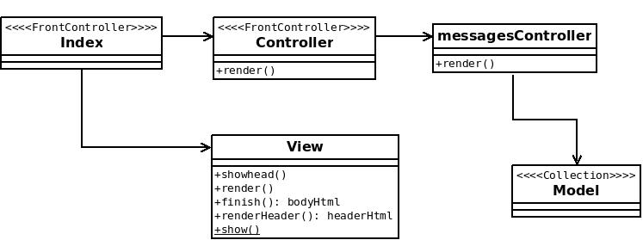
MVC classes

Slide 4
MVC Classes
On each request we the htaccess directs the url and splits is up before call to index.php
    RewriteRule ^(.*)$ /index.php?u=$1
Index.php does following things
Invokes the controller, which in turn call render() to call messagesController.php
Calls view->finish() to get all the data buffered by controller's call to view.
Then call the shell.php, which is our skelton of the page with basic.html (<head> and <body> stuff.

Slide 5
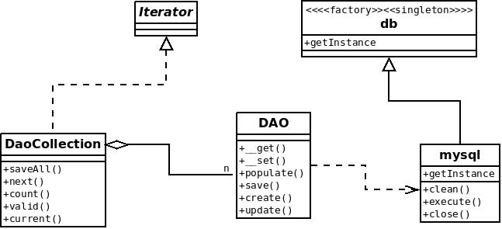
DAO

Slide 6
Data Access Layer
The data access is lightweight and only requires a single Model class that derives from the DAO class.
The Model class is empty. Why? See the DAO, we use PHP interceptors
  public function __set($name, $value)
  public function __get($name)
When we populate the DAO.populate()
    $this->$name = $value;
The mysql is also abstracted out using a factory and singleteon in one from db class. So we can easily add an oracle db, mongo in this manner
Mysqli driver for php5 provides faster access than mysql php 4 driver.

Slide 7
Data Access Layer
Just need to override the DaoCollection interface
    class boardCollection extends daocollection implements daocollectioninterface {
    private $_connection;
    public function __construct()
    {
    $this->_connection = db::factory('mysql');
    }
    public function findAll()
    {
    $query = "select * from board";
    $query .= " order by entered_on desc";
    $results = $this->_connection->getArray($query);
    $this->populate($results, 'board');
    }

Slide 8
Others
Lib class to do all the writing to sessions and manage the session cache
AuthStandard class implements authenticator interface. This is if we want to switch auth routines
Autoloader to load all PHP dynmically
CustomErrorHandler function to pint to command line, and also json dump errors to screen to speed up debugging process
View had standard/header.php and standard/footer.php to help
Exceptions for page level errors
Output debugging to ./log for application, and php.log, error.log if errors occur in php interpreter

Slide 9
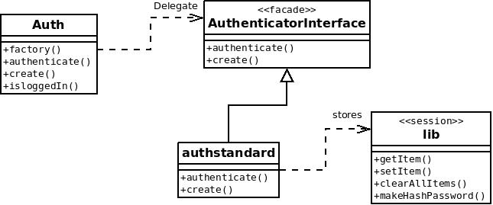
Authentication UML

Slide 10
Others
Lib class to do all the writing to sessions and manage the session cache
AuthStandard class implements authenticator interface. This is if we want to switch auth routines
Autoloader to load all PHP dynmically
CustomErrorHandler function to pint to command line, and also json dump errors to screen to speed up debugging process
View had standard/header.php and standard/footer.php to help
Exceptions for page level errors
Output debugging to ./log for application, and php.log, error.log if errors occur in php interpreter

Slide 11
Now create a new view through stack
Database table added
Simple Model file
Collection object to iterate over set
Controller to call view
View to render data
How much code?

Slide 12
Beautiful Code - Model
<?php
class board extends dao {
protected $table = __CLASS__;
}
?>

Slide 13
Beautiful Code - Collection
class boardCollection extends daocollection implements daocollectioninterface {
private $_connection;
public function __construct() {
$this->_connection = db::factory('mysql'); }
public function findAll() {
$query = "select * from board";
$query .= " order by entered_on desc";
$results = $this->_connection->getArray($query);
$this->populate($results, 'board'); }

Slide 14
Beautiful Code - Controller
      class messages {
      public function defaultaction() {
      $this->showAll();
      }
      public function showAll() {
      $userName = lib::getitem('username');
      $boardColl = new boardCollection();
      $boardColl->findAll();
      echo view::show('messages/show', array('boardColl'=>$boardColl ) );
      }

Slide 15
Beautiful Code - View
    $boardColl = $view['boardColl'];
    echo '<table>';
    while ( $boardColl->valid() )
    {
    $dataCurrent = $boardColl->current();
    $dataRow = $dataCurrent->getGenericArray();
    echo '<tr>';
    echo '<td>' . $dataRow['username'] . '</td>';
    echo '<td>' . $dataRow['entered_on'] . '</td>';
    echo '<td>' . $dataRow['message'] . '</td>';
    echo '</tr>';
$boardColl->next();
}
echo '</table>';
echo "</div>";

Slide 16
Lessons
Fast practical object oriented design cannot be done from the ground up in one hour
Need to have a repository of patterns
Refactor constantly
Build and sandbox
Work on RAD based prototyping skills, practice consitentl
Pre-defined migration path from client to server,
  i.e. the model is straightforward from yaml file
  Controller login is in function
  View we can use smarty in our prototype, no need to have abstraction
PHP Storm IDE DID speed up the object oriented adherence of the RAD prototype

Slide 17
Things I can do
Use Xdebug to profile 1000 request using a selenium test driver to measure the same project in Zend vs Skinny MVC
Add Smarty Templating
Add Transaction
Consider a stronger typed version of model more ORM basded
Build in memcache using a Identity Map design pattern into DAO layer and make it transparent
Look into PDO or doctrine
Secret SALT = sha1($password . $secret), secret = username . Id
Memcache session

Slide 18
Why Zend?
Zend_Forms is nice for creating and validating forms.
Doctrine integration was through config files
Ability to have mulitple configurations, production, staging etc
Other goodies, like Zend_Rest_Controller, Zend_Json_Server
  (Then again you can use “_” again :)

Slide 19
Final Notes on Zend Vs Skinny MVC
Zend does not really have any great commercial support, and poor user community.
Is NOT the Zend_Framework, which is a critical part of the system.
Is Zend really faster for adding controllers and view? Does it really provide anything with things like helper funcitions :(

