Slide 1

ELASTIX INSTALLATION
Elastix® Certification
© 2012, PALOSANTO SOLUTIONS All rights reserved. This documentation is confidential and its intellectual property belongs to PaloSanto Solutions. Any unauthorized use, reproduction, preparation of derivative works, performance, or display of this document, or software represented by this document, without the express written permission of PaloSanto Solutions is strictly prohibited. PaloSanto Solutions, Elastix and Elastix logo design, trademarks and/or service marks belongs to Megatelcon S.A. all other trademarks, service marks, and trade names are owned by their respective companies.

Slide 2


Installing from CD (1)
It is strongly recommended to install Elastix’s latest stable version available from the project’s webpage
To install from a CD, we must download the image file (iso extension) and burn it onto a blank disc.
It is important to burn the iso using a dedicated burning software. A mistake frequently made is to unpack the image and copy the resulting directory structure on the disk. This will not result in a bootable CD.

Slide 3
Installing from CD (2)
Insert the installation CD in the drive and proceed to turn on/reboot the computer.
It is important to verify that the computer is configured to boot from a CD. This can be checked from the BIOS.
The Elastix installer will appear on your screen.

Slide 4
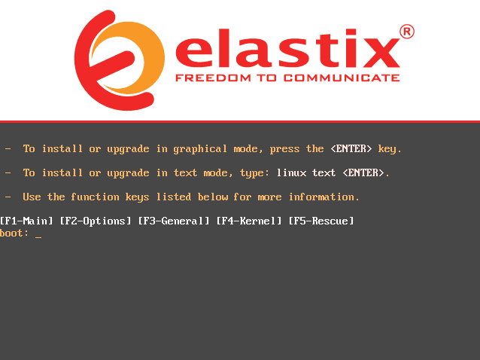
Installing from CD (3)
To perform a standard installation just press ENTER
Note: The standard installation will erase the hard drive completely.

Slide 5
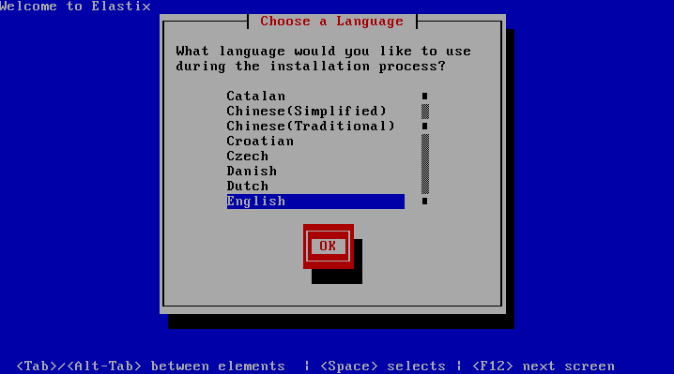
Installing from CD (4)
Select the language to be used during the installation process.
Notes:
5

Slide 6
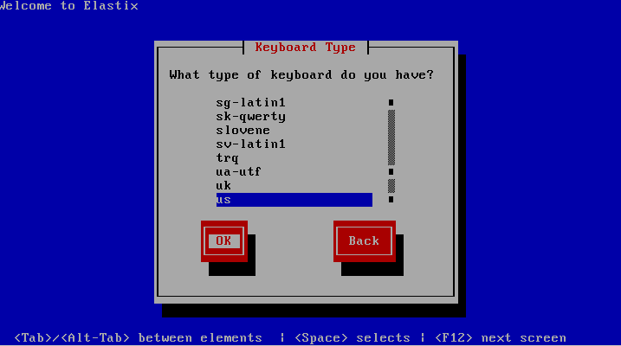
Installing from CD (5)
The installer asks you to select the keyboard layout

Slide 7
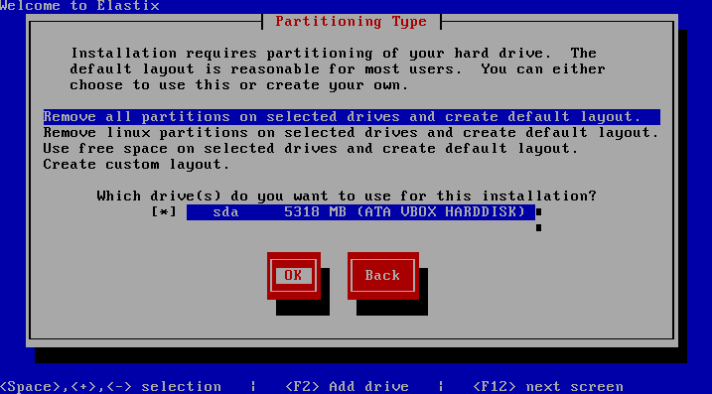
Installing from CD (6)
Select the partitioning type
Notes:
7

Slide 8
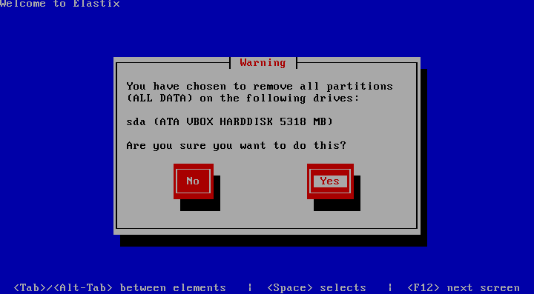
Installing from CD (7)
Confirm the removal of the partitions (Yes).
Notes:
8

Slide 9
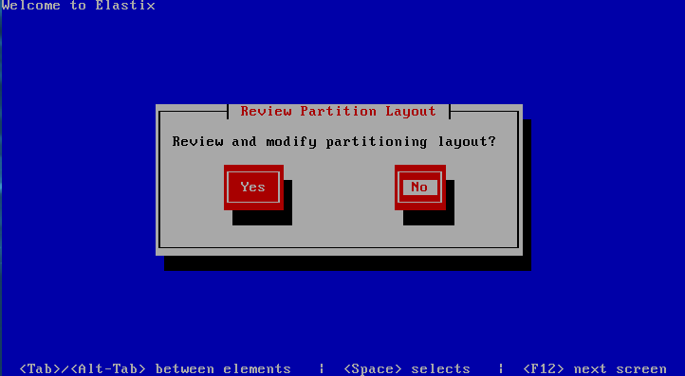
Installing from CD (8)
Review/modify partitioning layout (No).
Notes:
9

Slide 10
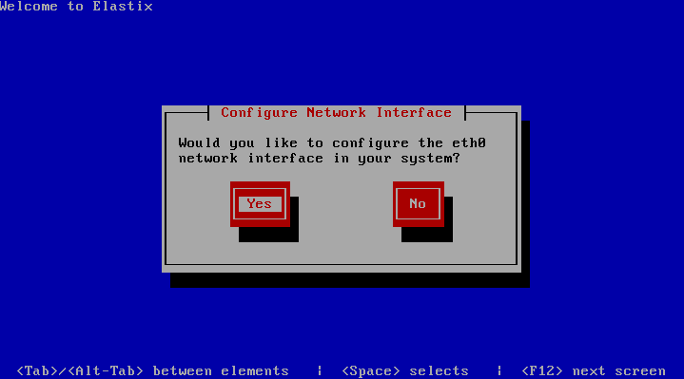
Installing from CD (9)
Select to configure the Network Interface (Yes).
Notes:
10

Slide 11
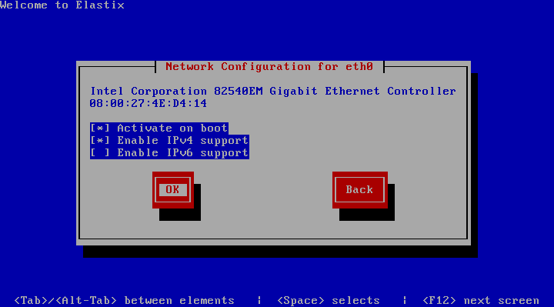
Installing from CD (10)
Select to activate on boot and to enable IPv4 support.
Notes:
11

Slide 12
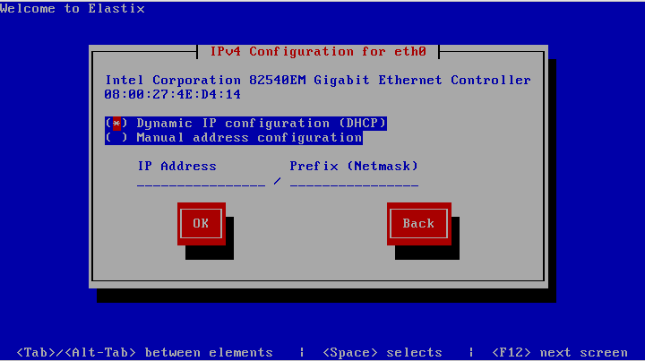
Installing from CD (11)
Select to use either DHCP or manual configuration.
Notes:
12

Slide 13
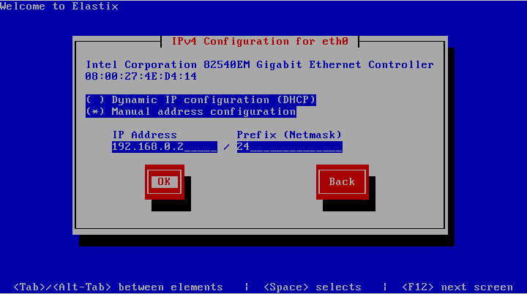
Installing from CD (12)
If manual configuration is used enter the address and mask.
Notes:
13

Slide 14
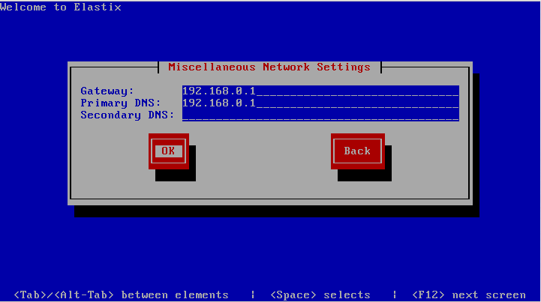
Installing from CD (13)
Enter the Gateway and DNS servers IP address.
Notes:
14

Slide 15
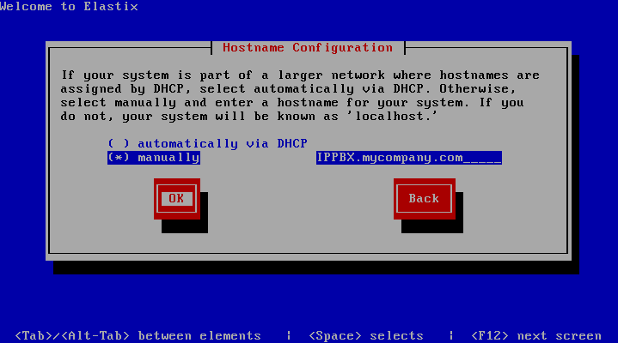
Installing from CD (14)
Enter the hostname.
Notes:
15

Slide 16
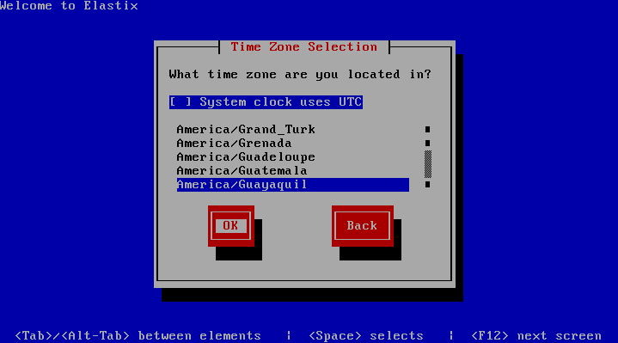
Installing from CD (15)
Select the appropriate time zone.

Slide 17
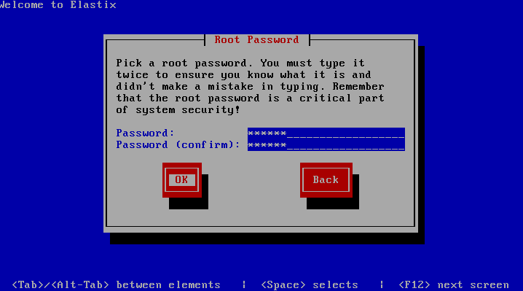
Installing from CD (16)
Type a password for root, write it down in a safe place too.

Slide 18
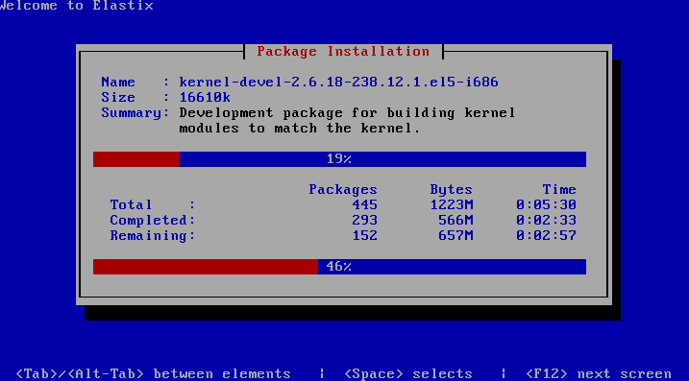
Installing from CD (17)
Wait until the automatic packages installation finishes.

Slide 19
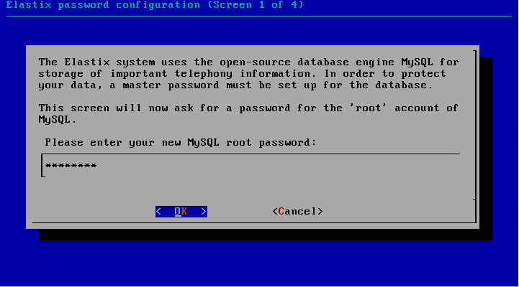
Installing from CD (18)
Type a root password for MySQL, write it down in a safe place too
Notes:
19

Slide 20
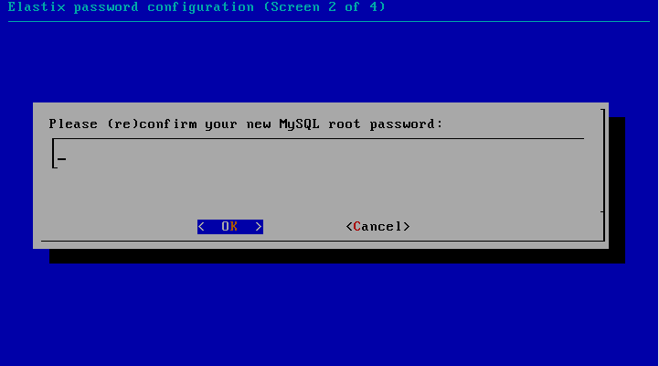
Installing from CD (19)
Reenter the MySQL root password.
Notes:
20

Slide 21
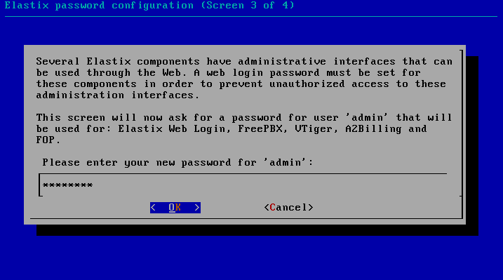
Installing from CD (20)
Type a password for Elastix’s web GUI ‘admin’ user, write it down in a safe place too.
Note: This will also be the password for the following services: FreePBX, Vtiger, A2Billing and FOP. Although not mentioned here this password is also the AMI admin password.
Notes:
21

Slide 22
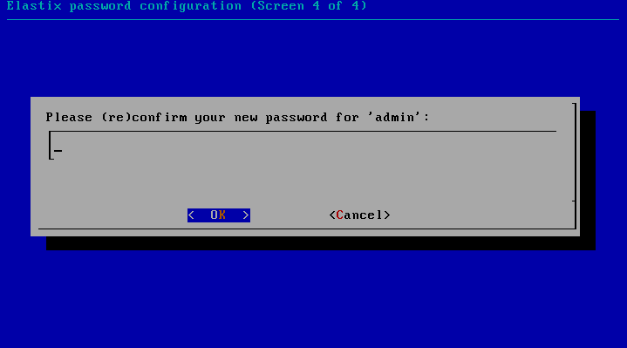
Installing from CD (21)
Reenter the password for Elastix’s web GUI ‘admin’ user.
Notes:
22

Slide 23
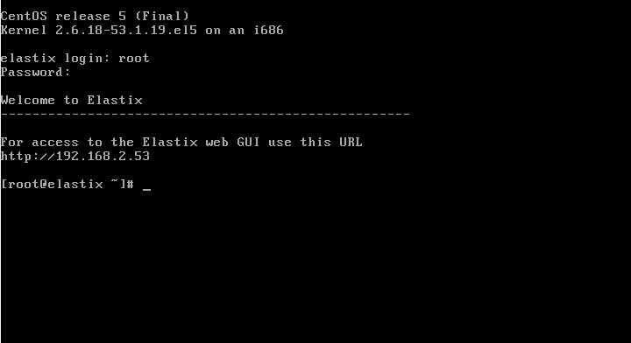
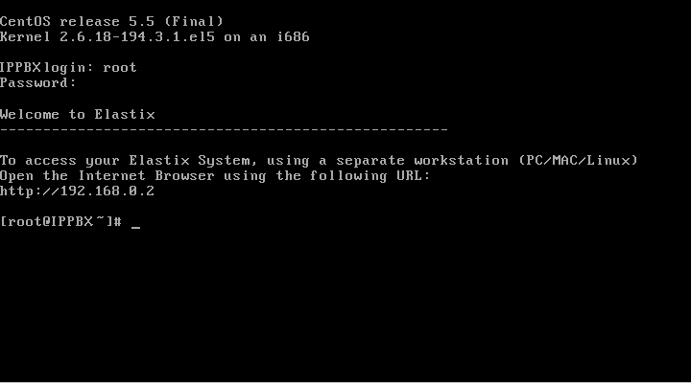
Installing from CD (22)
Installation is complete, we can enter the system using username root and its password entered during the installation

Slide 24
Installation with soft RAID (1)
RAID refers to use an array of multiple hard drives, primarily to provide data redundancy.
Depending on the number of hard drives available and the method to configure the array, different RAID levels can be arranged. The RAID level we will look into is RAID1.
This RAID level involves two hard drives one being a mirror image of the other.

Slide 25
Installation with soft RAID (2)
When possible, it is always preferable to try to make the RAID arrays through hardware.
However, if your server doesn’t have a disk controller for the creation of RAID arrays, we can use the operating system, sacrificing some performance in favor of redundancy.
This technique is known as soft RAID.
It is important to point out that while hardware RAID mirrors disks, software RAID mirrors partitions.

Slide 26
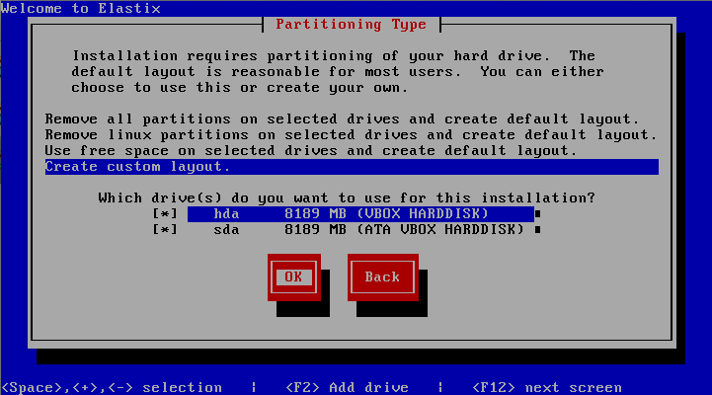
Installation with soft RAID (3)
The process begins in the same way of a normal installation until the “Partitioning Type” window.
In this step we must select “Create custom layout”
Notes:
26

Slide 27
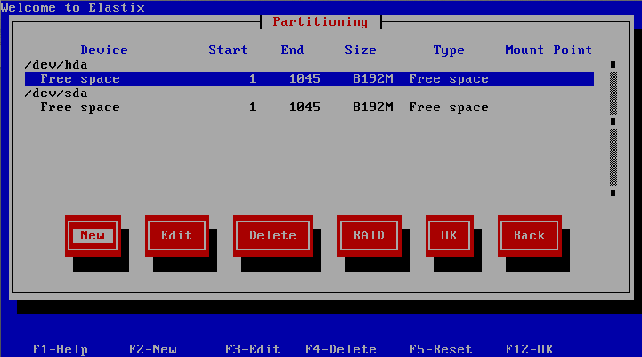
Installation with soft RAID (4)
We will see both hard drives, we must create three (3) partitions on each drive.
Select the option “New” and press enter.
Notes:
27

Slide 28
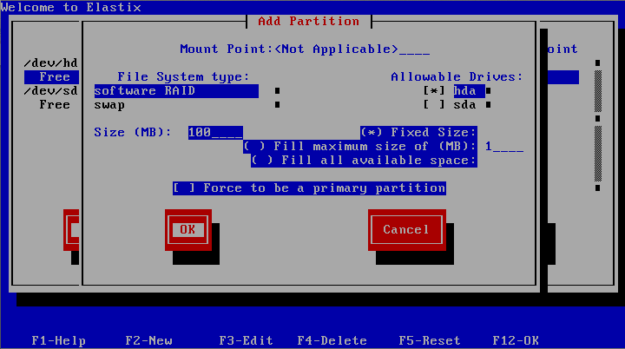
Installation with soft RAID (5)
Drive Sizes: 1st partition = 100MB for boot, 2nd partition = the double of size of the system’s RAM for swap (in this example RAM is 512 MB), 3rd partition = fill it with the available space.
On each partition we must select “software RAID” as the “File System type”.
Remember to select just the corresponding “Allowable Drive”, in the image example is “hda”
Notes:
28

Slide 29
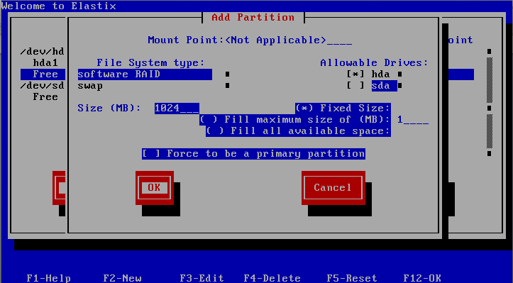
Installation with soft RAID (6)
Image of the process for the second partition (SWAP)
Notes:
29

Slide 30
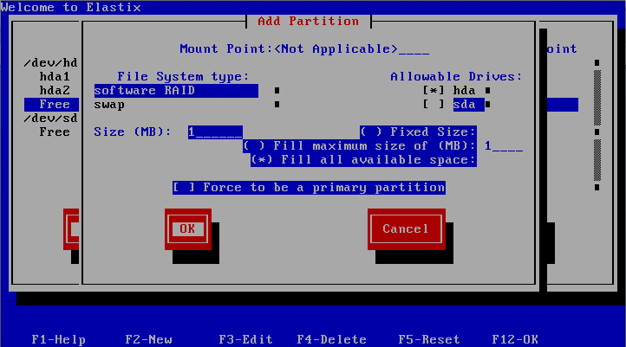
Installation with soft RAID (7)
Image of the process for the third partition (we select “Fill all available data”)

Slide 31
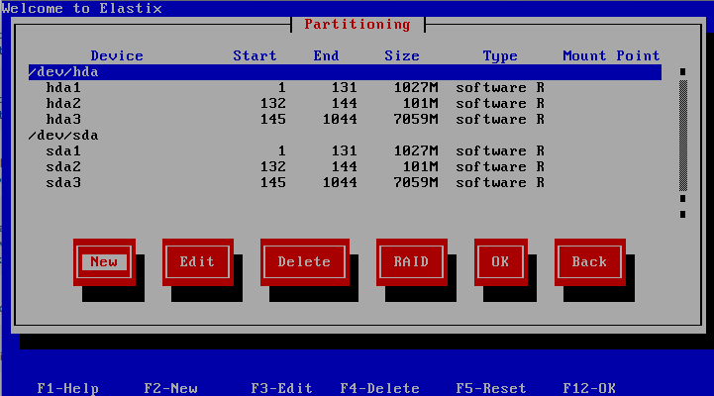
Installation with soft RAID (8)
At the end we will have 3 partitions on each drive.
Don’t worry about the order of every partition they will arrange in order when we configure the RAID.

Slide 32
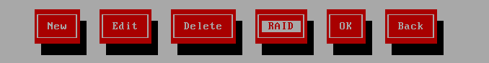
Installation with soft RAID (9)
To begin with the partitions mirroring we must select the option "RAID”
Here we will select the partitions that will be mirrored, the file system to use and the Mount Point
Mounting point: boot partition = /boot, swap = don’t put anything, “root” partition = use /

Slide 33
Installation with soft RAID (10)
File system type: boot partition = select ext3, swap partition = select swap, and ext3 for the “root” partition.
RAID level: Select RAID1 for all three partitions
RAID members: Choose the partition pairs that have been created in each one of the hard disks respectively.

Slide 34
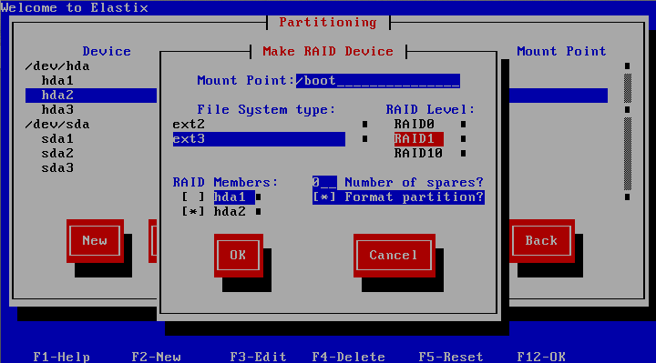
Installation with soft RAID (11)
Example of the mirroring of the boot partition.
Note: It is important to select the corresponding pairs of partitions in the RAID Members section. In this example hda2 and sda2 are the partitions with 100MB for boot.

Slide 35
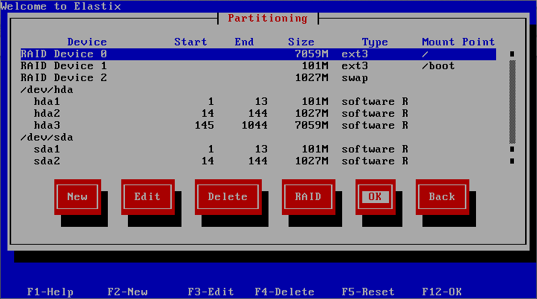
Installation with soft RAID (12)
The RAID configurations will appear over the previously created partitions. When we finished select OK to continue with the installation normally.

Slide 36
More at:
www.elastixbook.com

