Slide 1
By,
Madhumathi V,
KGiSL IAS

Slide 2

BLOCK CHAIN

Slide 3


What is Blockchain and Bitcoin?

Slide 4
A Blockchain can be called the spine of the entire crypto-currency system. The Blockchain technology not only helps with the users perform transactions using crypto-currencies but also ensures the security and anonymity of the users involved. It is a continuously growing list of records called blocks, which are linked and secured using cryptographic techniques.

Slide 5
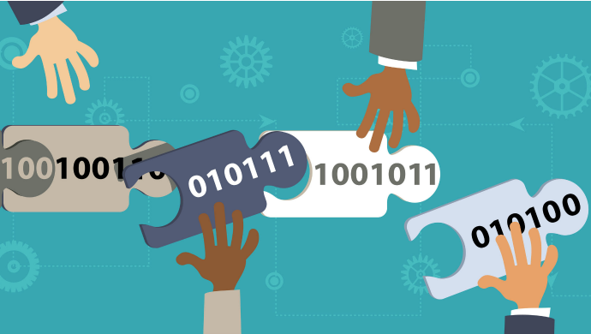
Concept of Bitcoins

Slide 6
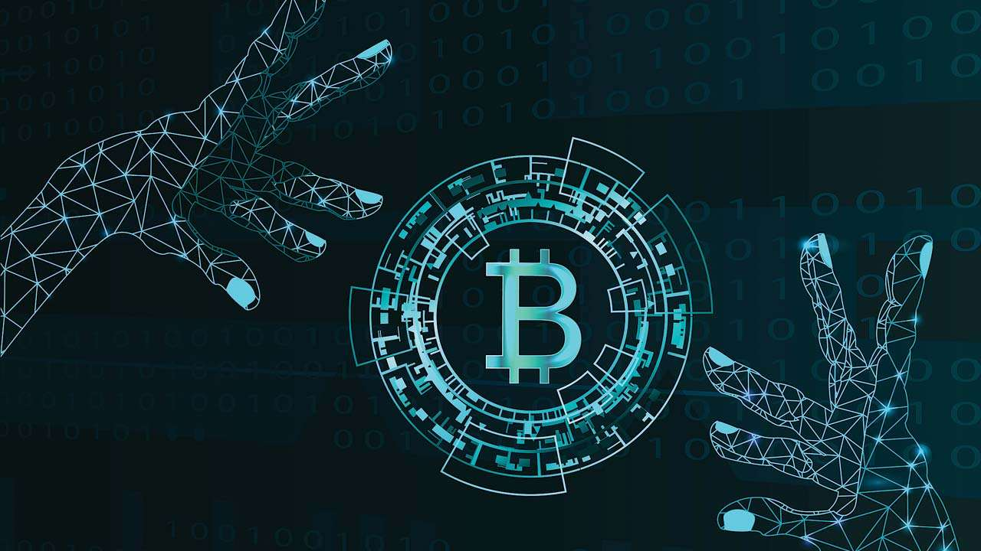
Bitcoins are a crypto-currency and digital payment system invented by an unknown programmer, or a group of programmers, under the name Satoshi Nakamoto. That means they can be used like a usual currency, but don’t physically exist like dollar bills. They are an online currency which can be used to buy things. These are similar to “digital cash” that exist as bits on people’s computers. Bitcoins exist only in the cloud, like Paypal, Citrus or Paytm. Even though they are virtual, rather than physical, they are used like cash when transferred between people through the web.

Slide 7
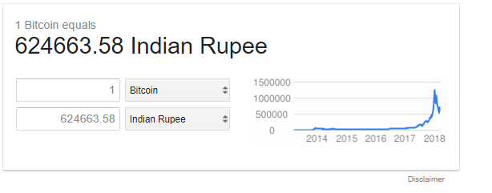
1 Bitcoin in INR

Slide 8
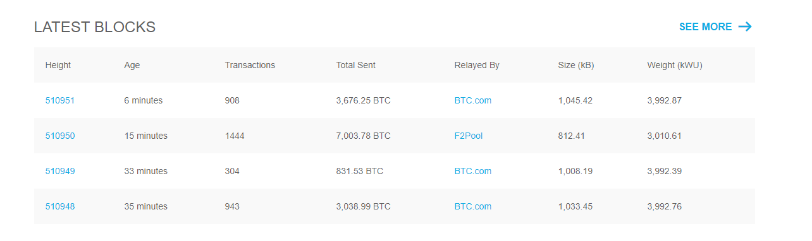
Latest blocks in internet

Slide 9
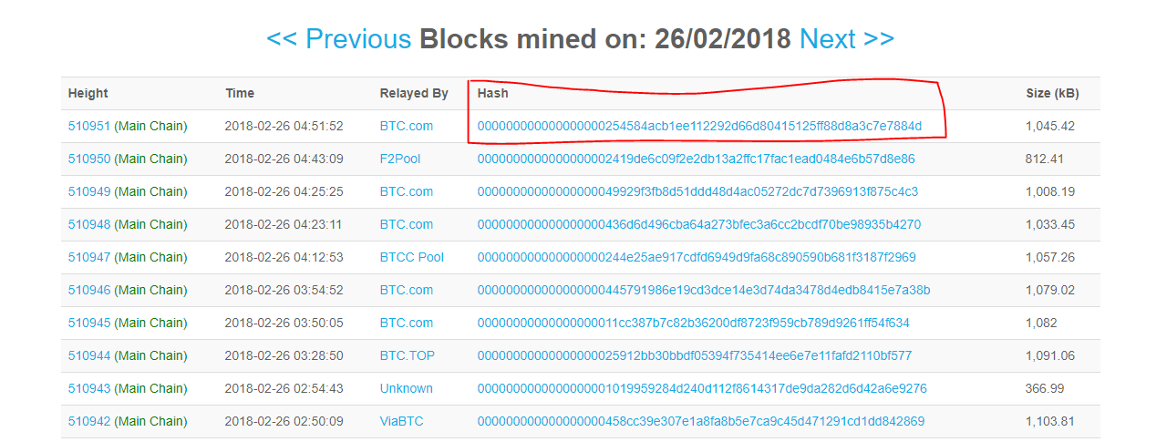
Hash code of the blocks

Slide 10
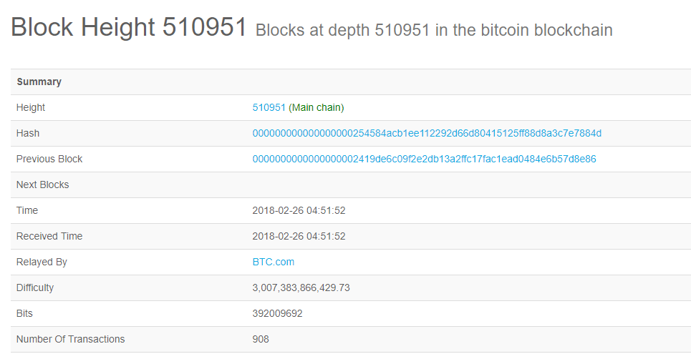
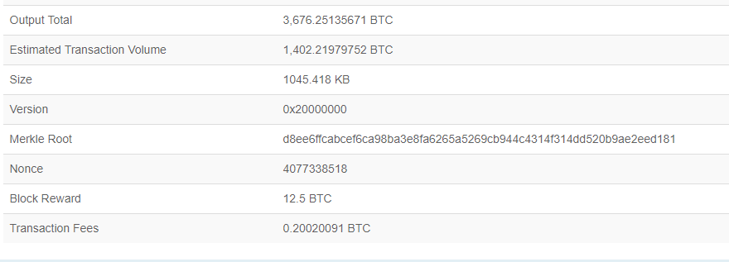
Block details

Slide 11
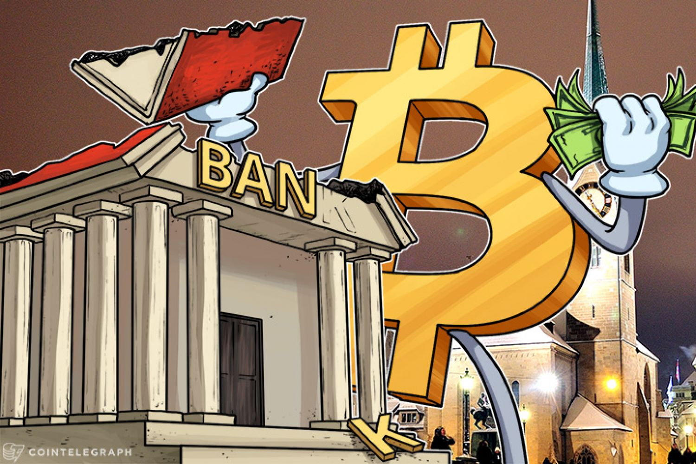
Issues with Current Banking System

Slide 12
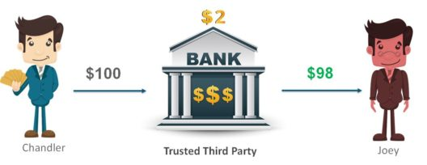
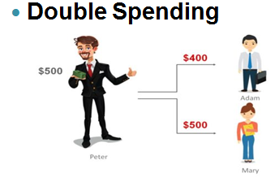
High Transaction Fees

Slide 13
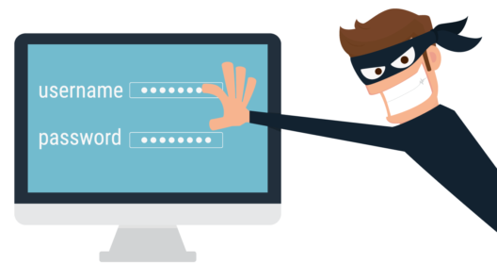
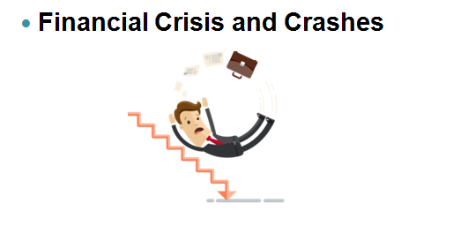
Net Frauds and Account Hacking

Slide 14
How does Blockchain solve these issues?

Slide 15
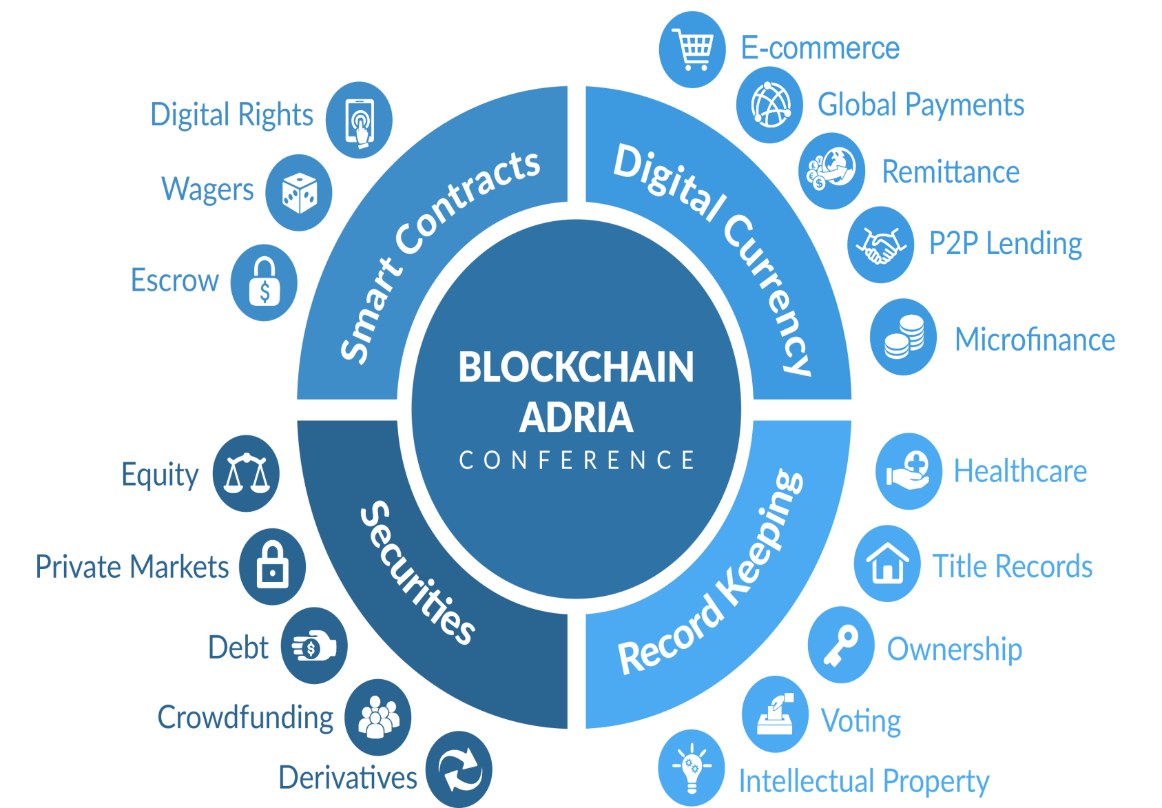

Slide 16
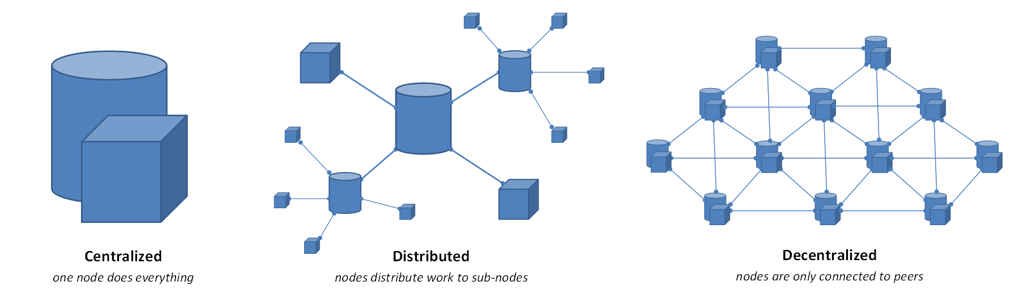
1.Decentralized System

Slide 17
The Block chain system follows a decentralized approach when compared to banks and financial organizations which are controlled and governed by Central or Federal Authorities. Here, everyone who is part of the system becomes equally responsible for the growth and downfall of the system. Rather than one single entity holding the power, everyone who is involved with the system holds some power.

Slide 18
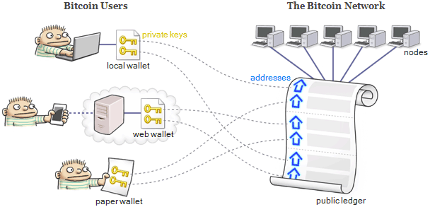
2. Public Ledgers

Slide 19
The ledger which holds the details of all transactions which happen on the Blockchain, is open and completely accessible to everyone who is associated with the system. Once you join the Blockchain network, then you can download the complete list of transaction since its initiation. Even though the complete ledger is publicly accessible, the details of the people involved in the transactions remains completely anonymous.

Slide 20

3.Verification of Every Individual Transaction
Every single transaction is verified by cross-checking the ledger and the validation signal of the transaction is sent after a few minutes. Through the usage of several complex encryption and hashing algorithm, the issue of double spending is eliminated.

Slide 21

4. Low or No Transaction Fees
The transaction fees are usually not applicable but certain variants of Blockchain do implement certain minimal transactions fees. These transaction fees are however relatively quite less when compared to the fees implied by banks and other financial organizations. If a transaction needs to be completed on priority then an additional transaction fees can be added by the user so as to have the transaction verified on priority.

Slide 22


Slide 23

SHA256 Hash Function
Public Key Cryptography
Distributed Ledger & Peer to Peer Network
Incentives for Validation

Slide 24
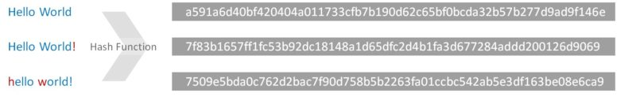
1. SHA256 Hash Function
The purpose of using a hash is because the output is not ‘encryption’ i.e it cannot be decrypted back to the original text. It is a ‘one-way’ cryptographic function, and is a fixed size for any size of source text

Slide 25
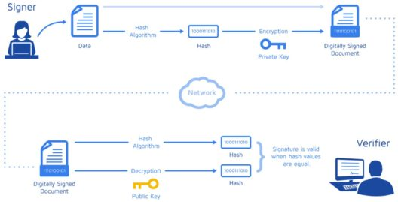
2.Public Key Cryptography
This cryptographic technique helps the user by creating a set of keys referred as Public key and Private key. Here the Public key is shared with others whereas the Private key is kept as a secret by the user.

Slide 26
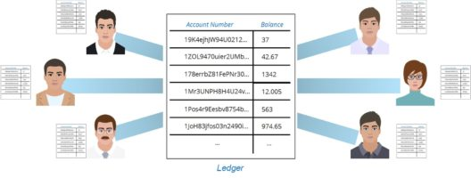
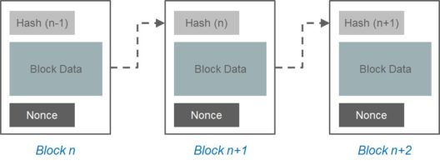
3. Distributed Ledger and P2P Network
Every single person on the network has a copy of the ledger. There is no single centralized copy.

Slide 27
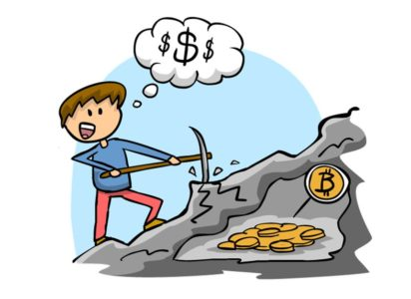
4. Incentives for Validation
A Bitcoin transaction is to giving a reward to the miner who has created the latest block. This rewards is provided by the Blockchain system for validating the transactions and maintaining the Blockchain.

Slide 28

Blockchain Use Cases
Transport and logistics
Energy sectors
Business need : Being a part of an extremely dynamic Supply Chain industry, tracking the slightest change is of highest priority for the client. They needed a solution that could enable them to complete the shipping process without having the delay in paper work. A solution that would be able to bring together all the stakeholders of the system and provide a real-time status on the shipment.

Slide 29

Today, 90% of the goods in global trade are carried by the shipping industry. This supply chain is flowed by the complexity and sheer volume of point-to-point communication. These communications are across a loosely coupled web of land transportation providers, freight forwarders, customs, brokers, government’s ports and ocean carriers processing. Documents and information for a container shipment is estimated to cost more than twice that of the actual physical transportation.

Slide 30

IBM and Maersk are addressing this problem with a distributed permission platform accessible by the supply chain ecosystem designed to exchange event data and handled document workflows.

Slide 31
Results:
Provided a secure Data Exchange platform for all the stakeholders involved in the supply chain system.
Established a Tamper proof repository to store all the documents involved as part of the process.
Regular shipping events help reduce significant Delays and Frauds, saving Billions of dollars annually.
Reduced the barrier between trade organizations thereby increasing worldwide GDP by 3%.
Helped increase the overall trade volume by 12%.

Slide 32
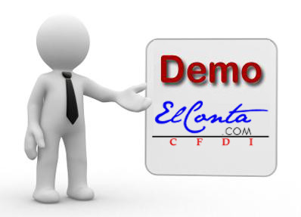
Blockchain Demo
Cloning Geth Code
Creating a Genesis Block
Making Rules for our Blockchain
Validating & Mining Ether.

Slide 33

1.Cloning Geth Code
$ git clone https://github.com/ethereum/go-ethereum
$ cd go-ethereum & $ git tag
$ git checkout tags/v1.6.7 -b EdurekaEthereumV1.6.7 & $ git branch
$ make all

Slide 34

2. Creating Genesis Block
First chain in a block
$ cd go-ethereum
$ mkdir genesis
$ cd genesis
$ gedit genesis.json

Slide 35

3. Making Rules for our Blockchain
$ /home/edureka/go-ethereum/build/bin/geth --datadir ~/ethereum/net3 init genesis/genesis3.json
$ /home/edureka/go-ethereum/build/bin/geth --datadir ~/ethereum/net3/ --networkid 3 console

Slide 36

4. Validating & Mining Ether
In the Geth console, execute the following command
personal.newAccount()
eth.accounts
miner.start()
miner.stop()
eth.blockNumber()
eth.getBalance: (“account number”)
exit: Exit the geth console.

Slide 37

References
https://blockchain.info/
https://en.wikipedia.org/wiki/Blockchain
https://hackernoon.com/learn-blockchains-by-building-one-117428612f46
https://www.forbes.com/sites/bernardmarr/2018/01/10/blockchain-is-changing-our-world-here-are-the-best-practical-examples-of-how-it-is-used-in-2018/2/#600564a257c1
https://www.edureka.co/blog/blockchain-tutorial/

Slide 38



Slide 39


