Slide 1
PV System Price Prediction
Springboard

Slide 2

Overview
Problem Statement
Key beneficiaries
Reference Data and Analysis
Key Features and Price Drivers
ML Model and insights

Slide 3
Problem Statement
Increase PV system adoption
What's driving the costs?
Can we get a better deal?

Slide 4



Who might this help?

Slide 5
Data and Analysis Reference
Berkeley Lab’s annual Tracking the Sun report
Galen Barbose
Naim Darghouth
Eric O’ Shaughnessy

Slide 6
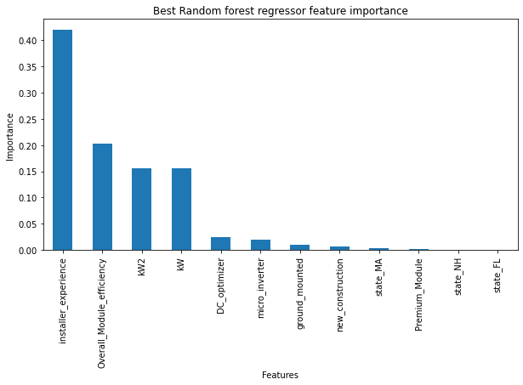
Key Price Drivers
Installer Experience
Module Efficiency
System Size

Slide 7
Installer Experience
Positive Regression coefficient
Size and experience
Premium components

Slide 8
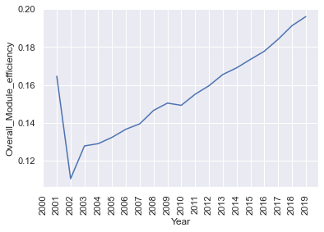
Module Efficiency

Slide 9
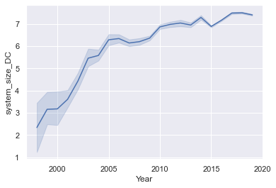
System Size

Slide 10
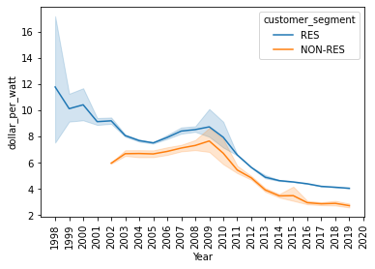
System price

Slide 11
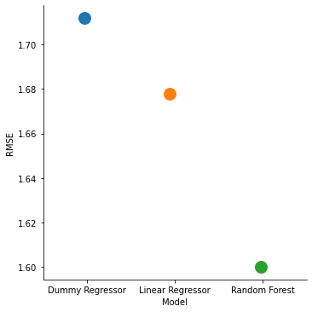
Model Selection
Dummy Regressor
Linear Regressor
Random Forest Regressor

Slide 12
Conclusions
Best Model – Random forest
Key Metric – RMSE
Top Features :
- Installer Experience
- Module Efficiency
- System Size

Slide 13
Acknowledgements
Dr. Guy Maskall-Springboard mentor
Galen Barbose – Lawrence Berkeley Laboratory
Naim Darghouth– Lawrence Berkeley Laboratory
Eric O’ Shaughnessy– Lawrence Berkeley Laboratory

Slide 14
THANK YOU!!

