Slide 1
Spain Electricity Price Prediction
Springboard

Slide 2

Overview
Problem Statement
Key beneficiaries
Reference Data and Analysis
Key Features
ML Model and Recommendations

Slide 3
Problem Statement
Predict the price of electricity
What factors affect the price?
What is the price trajectory?

Slide 4
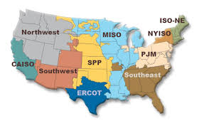


Who might this help?

Slide 5
Data and Analysis Reference
Hourly energy demand and weather data from Spain- Kaggle
Hourly Energy Data
Hourly Weather data

Slide 6
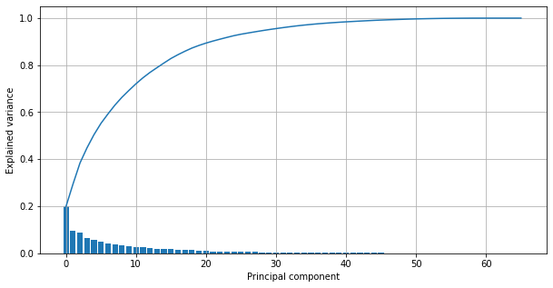
Key Features
Generation
Load demand
Weather data- pressure, temperature,

Slide 7
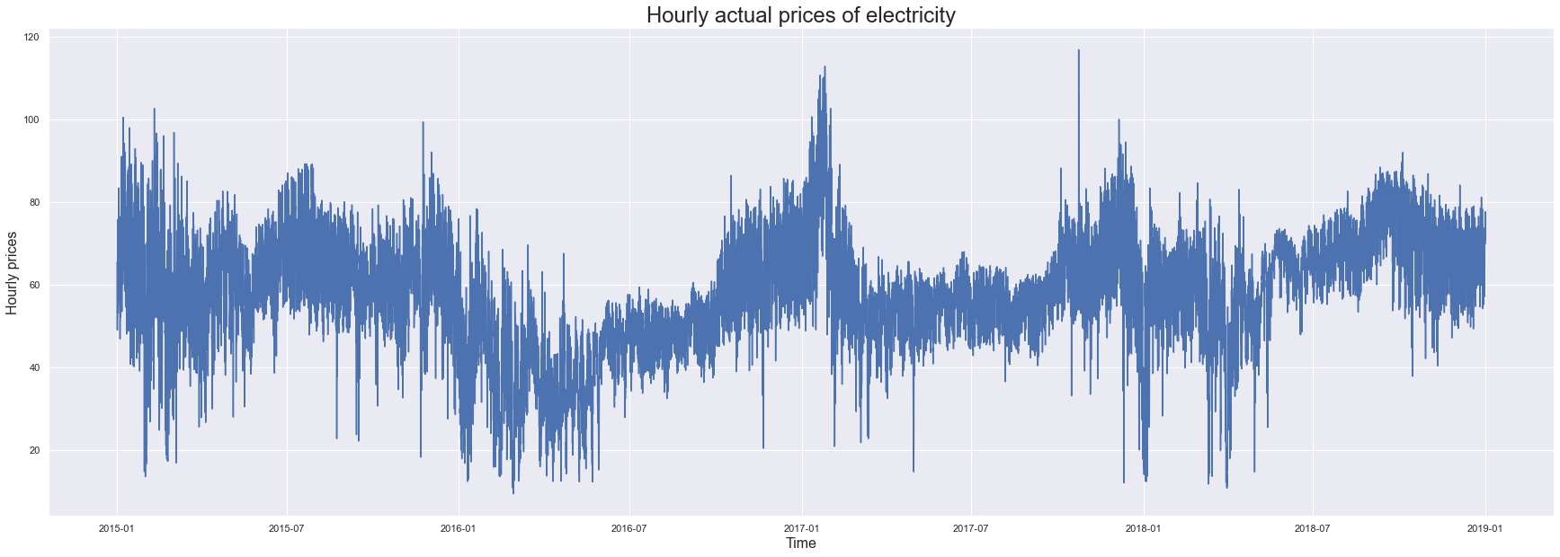
Hourly price trend

Slide 8
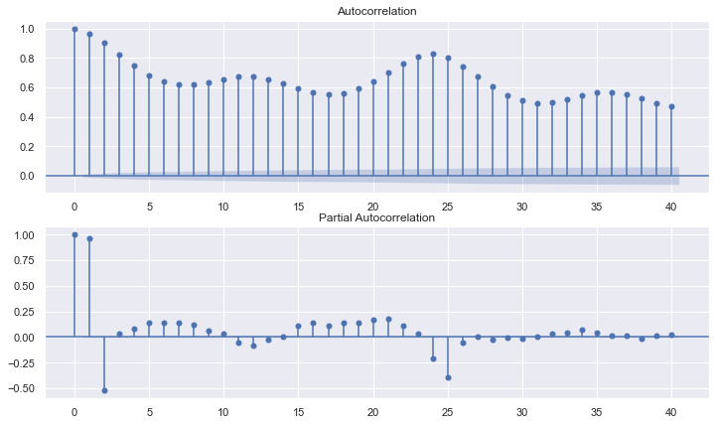
Auto-correlation plots
Dependency on previous time lags

Slide 9
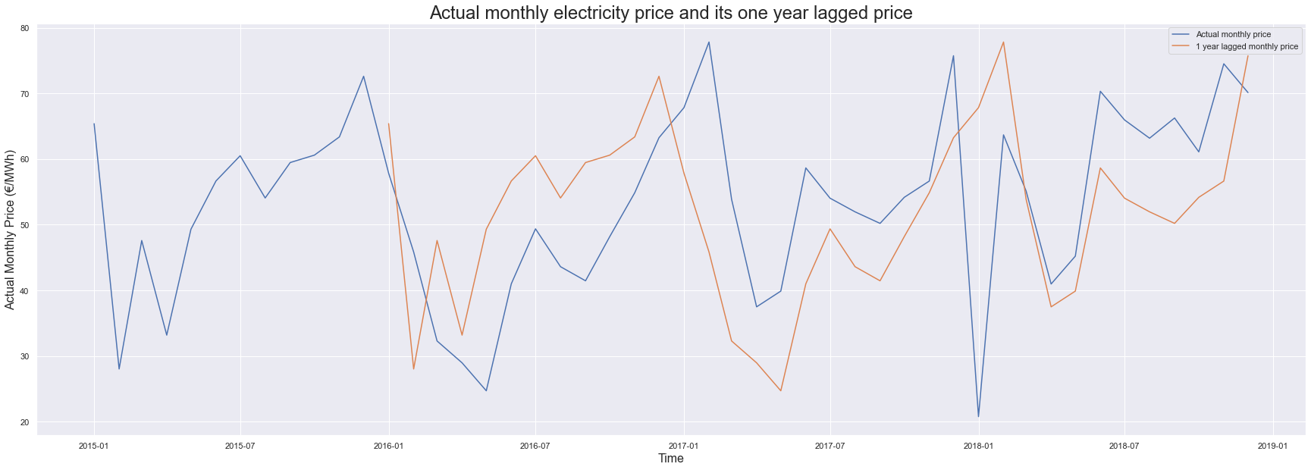
Price seasonality
- Actual Price vs One year Lagged price

Slide 10
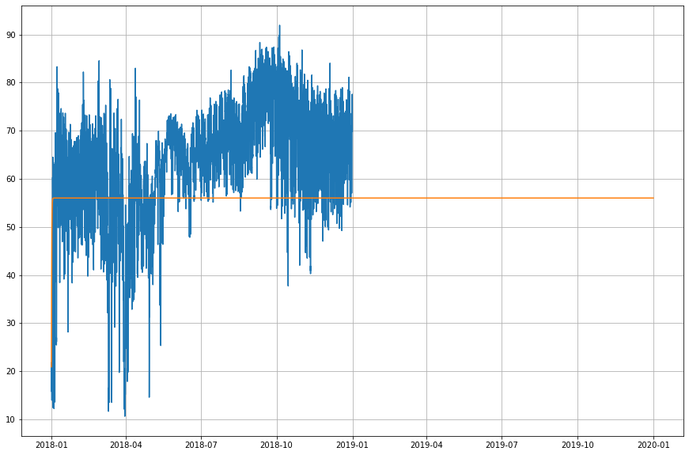
AR Model – Price Prediction

Slide 11
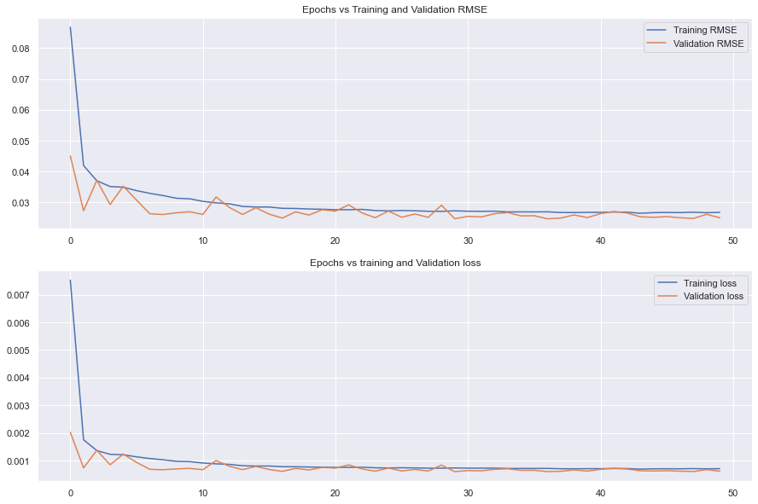
Deep Learning
LSTM – Univariate
Previous Time Steps = 12

Slide 12
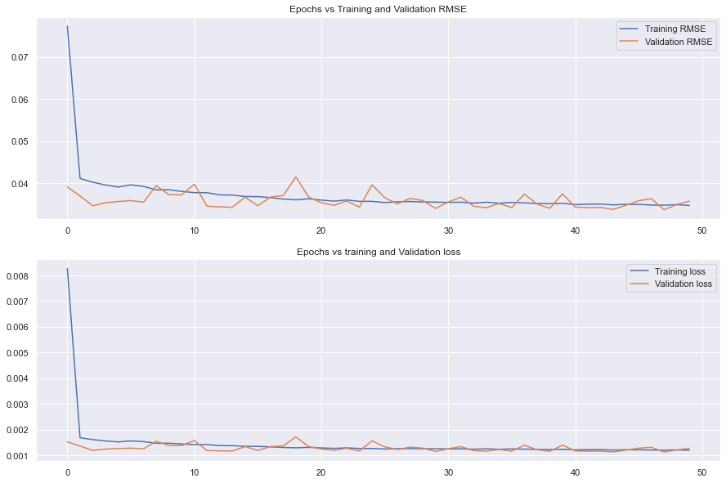
Deep Learning
LSTM – Multivariate
15 PCA components – Generation, load, weather
Previous Time Steps = 1

Slide 13
Model Comparison
Model | Metric - RMSE
AR Model (2, 0 , 0) | 2.66 Euro / MWh
LSTM Univariate | 2.68 Euro / MWh
LSTM Multivariate | 3.69 Euro / MWh

Slide 14
Conclusions
Best Model – AR Model p = 2
Key Metric – RMSE
Further Research :
- Increase number of time steps to 24 for Univariate and Multivariate analysis.

Slide 15
Acknowledgements and References
Kenneth Gil-Pasquel-Springboard mentor
Kaggle EDA Analysis
Multivariate Time Series Analysis
LSTM - Time Series Analysis

Slide 16
THANK YOU!!

