Slide 1

CS6150 – Supporting Adults With Autism
Jeetesh Srivastva(jsrivastva3)
Date 02/15/2022

Slide 2
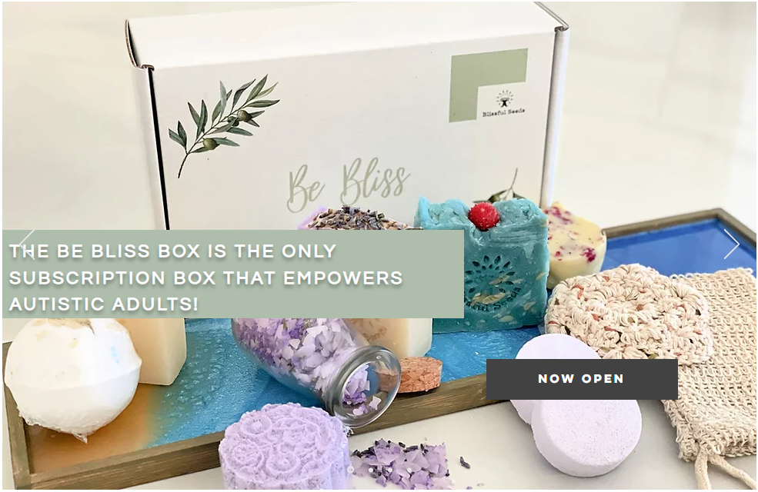
Supporting Adults with Autism
Autism Spectrum Disorder (ASD) is a class of neuro-developmental delay that impacts 1 in 44 children¹ in US today.
There are resources available to help young children(early intervention, support and therapy). However, resources to support adults who remain on the spectrum are limited.
Blisfulseeds is a non-profit organization that provides adults with autism an inclusive environment and an avenue to be employed. The program helps by creating bath soaps, bath bombs etc. that are sold to support participating adults.
My project is focused on increasing the reach of Blissfulseeds across the community by helping re-design https://www.blissfulseeds.org/ to add missing functionality – supporters, volunteers, SEO (Search Engine optimization) and marketing campaigns.
1 https://www.autismspeaks.org/what-autism

Slide 3
Partner and Project Team
Partner
As a parent, everyone expects to see their children grow , blossom and be accomplished in their lives. Rita Saliba, was also such a parent , her kid was an active, happy and engaged toddler. However, as Michael turned 2, he became withdrawn, depressed and uninterested in things around him. When Michael was diagnosed with Autism, Rita sought to understand how she could help her son and saw other families facing similar challenges.
While there are resources to help young kids. Vast majority of adults on the Autism spectrum either stay with their parents or live in group homes and have limited opportunities to contribute back to the community. Social anxiety and rejection is a common problem with Autistic adults, limiting their opportunities to work. Adults on the spectrum need constant support and an avenue to be a part of community and provide for themselves.
Blissfulseeds is an organization attempting to help autistic adults by providing them a community and opportunity to give back to the society. The founders hope that this step, provides an avenue and opportunity for autistic adults to be independent. Adults and young adults on spectrum work at blissfulseeds to make products such as bath soaps, bath bombs , scrubs etc. as a means to contribute back to the society.
Their Mission - EMPOWERMENT, SUPPORT, AND HOPE FOR INDIVIDUALS LIVING WITH AUTISM SPECTRUM DISORDER – HANDMADE AND DELIVERED TO YOUR DOORSTEP.
Project Team
Partner Organization – Blissfulseeds
Professor – Prof. Vempala
Guide – Dante Ciolfi
Student – Jeetesh Srivastva

Slide 4
Current Challenges and Project Goals
Challenges
https://www.blissfulseeds.org/ is the main landing page for blissfulseeds. Main aim of my project is to use technology to build awareness about Blissfulseeds, helping community and society support the noble cause.
Challenges with blissfulseeds website has been classified into 3 buckets:
There are no volunteers and limited support for Blissfulseeds mission.
Current landing page (blissfulseeds.org) is not maintained. Site has several broken or unavailable links
Navigation of site is not intuitive and site searchability on search engines is low (leading to lack of awareness).
Project Goals
My project will focus on 3 main functionalities:
Enhanced and structured website for https://www.blissfulseeds.org/ for volunteers, adults with autism, and supporters. [challenges – 1,2 and 3]
SEO across search engines, enabling the organization to be more discoverable and reachable [challenge – 3]
3. Functionality to build marketing and sales campaign on the site (limited to owner) to generate demand and sales [challenge – 1]
The main deliverable will be a new augmented site for blissfulseeds.org with the 3 main functionalities highlighted above.

Slide 5

Project Details
Who are the intended users (persona) ?
There are 5 sets of users for the site:
Owner – Administrator for the website
Volunteers – For registering their availability and time
Autistic Adults – Adults with autism who will be working at Blisfulseeds to produce products
Supporters – Supporters of this cause, who may pledge an amount on a monthly basis.
Buyers – People who would like to buy products made by participating adults from blissfulseeds.org.
Project Engagement Plan
Review current webpage and identify improvement opportunities.
Conduct a 60 mins session with the owner of https://www.blissfulseeds.org/ to review my findings and understand if there are any other challenges or pain points.
Marketing campaigns have been one of the main ask. I need to explore this area with the partner to understand more details around the campaigns and what is the intended outcome.
Build a project plan with deliverables and milestones identified, this would be the plan shared with GATech faculty and the owner which we will be working together on with periodic reviews.
Every week a report will be submitted to keep track of the functionality identified in the project plan. GATech Faculty and myself will be reviewing progress against the deliverables. This will also be a time to incorporate any faculty feedback and changes.
I will be meeting with partner organization on a bi-weekly/monthly basis and will be conducting demos to demonstrate the functionality (as we reach key milestones).

Slide 6
Project Details
Design Decisions
Based on initial conversations I plan to use wix (as hosting platform) , python and PHP for developing custom functionalities as needed.
Project Execution
Build of newer version for Blissfulseeds.org will be with a different domain name. I will be reviewing the functionality with the partner on a bi-weekly basis. Once the functionality has been built, we will swap the original website with the newly developed webpage.

Slide 7
Sample User Story and Survey
Sample Use Stories
User Story1 - As a volunteer, I want to register myself on https://www.blissfulseeds.org/ , so I can provide my availability to support Blissfulseeds activities.
Implementation – This user story defines a new persona (volunteer) and maps function of this persona on the website. The new version of Blissfulseeds.org would provide
A landing page → Identify the persona (Visitor, Supporter, Volunteer, Admin( do not want to display this publicly))→ Volunteer landing page – Login, Register
→ Register screen to provide volunteer details and register. Validate the new volunteer, and provide available programs for them to register.
User Story2 - As a volunteer, I want to be notified of my upcoming engagements with Blissfulseeds, so I can confirm m
User Story3 - As an owner/admin, I want to view the availability of volunteers, so I can plan the activity schedule for students.
Survey Questions
Example Survey questions (for owners/admin of the website).
What are 3 main challenges that Blissfulseeds as an organization is facing?
How can we leverage technology to help solve for the identified problems?
Are there any solutions identified for the problems described in question#1?
What would be the success criteria to evaluate proposed/implemented solution?
How will you test the solution provided by GATech team.

