Slide 1
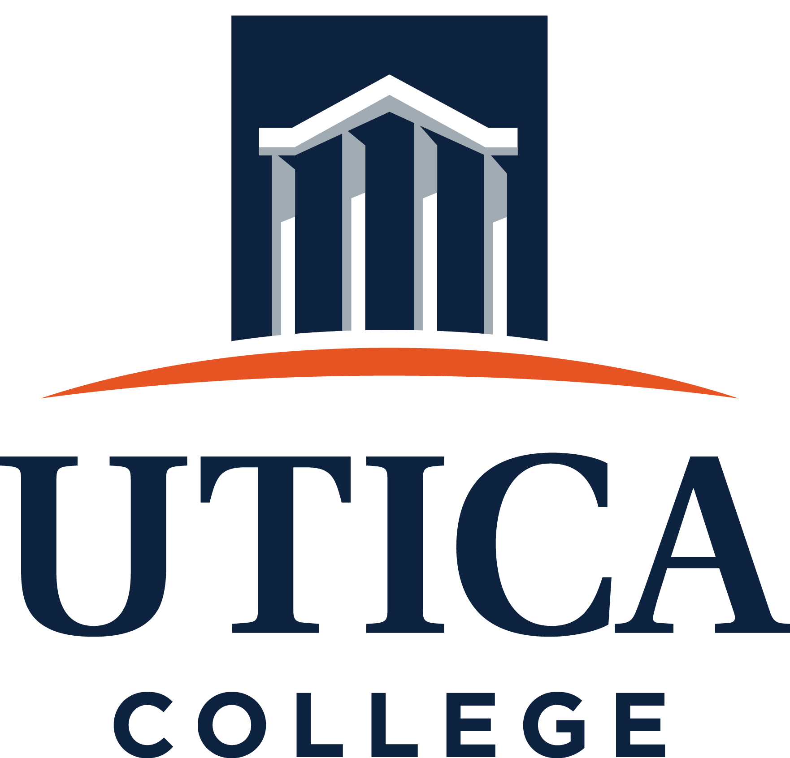
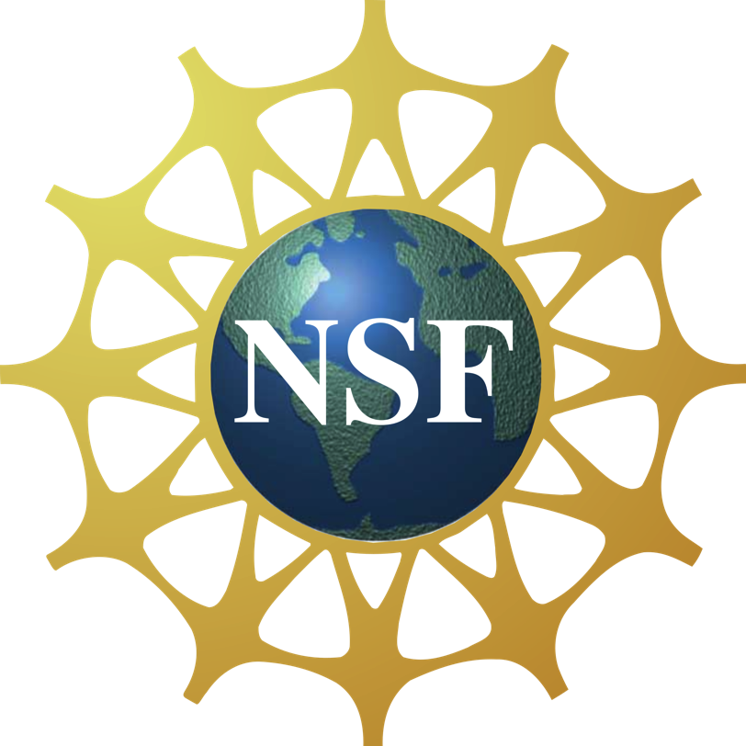
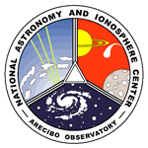
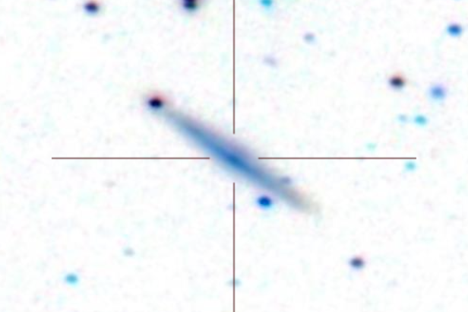
The Arecibo Pisces-Perseus Supercluster Survey: Declination Strip 35
Chelsey McMichael¹, J. Ribaudo¹, R. Koopmann², M. Haynes³, APPSS Team, Undergraduate ALFALFA Team
¹Utica College, ²Union College, ³Cornell University
APPSS
ABSTRACT
The NSF-sponsored Undergraduate ALFALFA (Arecibo Legacy Fast ALFA) Team (UAT) is a consortium of 20 institutions across the US and Puerto Rico, founded to promote undergraduate research and faculty development within the extragalactic ALFALFA HI blind survey project and follow-up programs. The objective of the UAT is to provide opportunities for its members to develop expertise in the technical aspects of observational radio spectroscopy, its associated data analysis, and the motivating science. Partnering with Arecibo Observatory, the UAT has worked with more than 280 undergraduates and 26 faculty to date, offering 8 workshops onsite at Arecibo (148 undergraduates), observing runs at Arecibo (81 undergraduates), remote observing runs on campus, undergraduate research projects based on Arecibo science (133 academic year and 185 summer projects), and presentation of results at national meetings such as the AAS (at AAS229: Ball et al., Davis et al., Miazzo et al., Ruvolo et al, Singer et al., Thoreen et al., Cannon et al., Craig et al., Finn et al., Hallenbeck et al., Koopmann et al., O'Donoghue et al.). 40% of the students and 45% of the faculty participants have been women and members of underrepresented groups. More than 85% of student alumni are attending graduate school and/or pursuing a career in STEM. 42% of those pursuing graduate degrees in Physics or Astronomy are women.
In this presentation, we summarize the UAT program and the current research efforts of UAT members based on Arecibo science, including multiwavelength followup observations of ALFALFA sources, the UAT Collaborative Groups Project, the Survey of HI in Extremely Low-mass Dwarfs (SHIELD), and the Arecibo Pisces-Perseus Supercluster Survey (APPSS). This work has been supported by NSF grants AST-0724918/0902211, AST-075267/0903394, AST-0725380, AST-121105, and AST-1637339.
The Arecibo Pisces-Perseus Supercluster Survey (APPSS) is a UAT program led by Martha Haynes, Michael Jones, and Rebecca Koopmann. APPSS uses correlations (Huang et al. 2012) between ALFALFA HI and SDSS/GALEX photometry to target Pisces-Perseus Supercluster (PPS) galaxies likely to be gas-rich but too distant to have been detected by ALFALFA. The Arecibo L-Band Wide (LBW) observations will be used to measure the infall rate onto the PPS filament. ABOVE: The top panel shows the preliminary APPSS detections in blue, with non-detections in red and Arecibo General Catalog (AGC) sample in the vicinity of the PPS in grey. The bottom panel shows the velocities. PPS galaxies lie between ~4000-8000 km/s.
LEFT: A baseline subtracted LBW spectrum of an APPSS detection showing HI-emission at ~8500 km/s. RIGHT: The corresponding SDSS image of the APPSS source. With hundreds of similar spectra, APPSS is now in the data analysis phase. See Craig et al. (AAS 229.132.03) and Davis et al. (AAS 229.347.40) for details.

