Slide 1



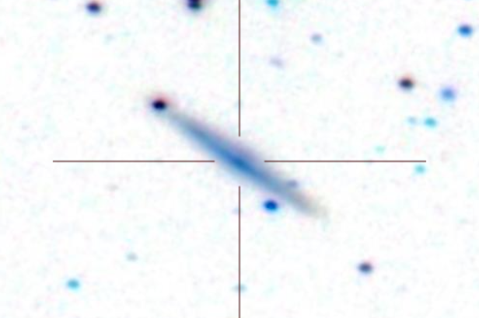
The Arecibo Pisces-Perseus Supercluster Survey: Declination Strip 35
Chelsey McMichael¹, J. Ribaudo¹, R. Koopmann², M. Haynes³, APPSS Team, Undergraduate ALFALFA Team
¹Utica College, ²Union College, ³Cornell University
Declincation Strip 35
ABSTRACT
The Arecibo Pisces-Perseus Supercluster Survey (APPSS) will provide strong observational constraints on the mass-infall rate onto the main filament of the Pisces-Perseus Supercluster. The survey data consist of HI emission-line spectra of cluster galaxy candidates, obtained primarily at the Arecibo Observatory (with ALFA as part of the ALFALFA Survey and with the L-Band Wide receiver as part of APPSS observations). Here we present the details of the data reduction process and spectral-analysis techniques used to determine if a galaxy candidate is at a velocity consistent with the Supercluster, as well as the detected HI-flux and rotational velocity of the galaxy, which will be used to estimate the corresponding HI-mass. We discuss the results of a preliminary analysis on a subset of the APPSS sample, corresponding to 98 galaxies located within ~1.5° of DEC = +35.0°, with 65 possible detections. We also highlight several interesting emission-line features and galaxies discovered during the reduction and analysis process and layout the future of the APPSS project.
This work has been supported by NSF grants AST-1211005 and AST-1637339.
The Arecibo Pisces-Perseus Supercluster Survey (APPSS) is a UAT program led by Martha Haynes, Michael Jones, and Rebecca Koopmann. APPSS uses correlations (Huang et al. 2012) between ALFALFA HI and SDSS/GALEX photometry to target Pisces-Perseus Supercluster (PPS) galaxies likely to be gas-rich but too distant to have been detected by ALFALFA. The Arecibo L-Band Wide (LBW) observations will be used to measure the infall rate onto the PPS filament. ABOVE: The top panel shows the preliminary APPSS detections of declination strip 35 in red, with non-detections in blue and ALFALFA Catalog sample in the vicinity of the strip in grey. The bottom panel shows the velocities.
LEFT: A baseline subtracted LBW spectrum of an APPSS detection showing HI-emission at ~8500 km/s. RIGHT: The corresponding SDSS image of the APPSS source. With hundreds of similar spectra, APPSS is now in the data analysis phase. See Craig et al. (AAS 229.132.03) and Davis et al. (AAS 229.347.40) for details.

