Slide 1
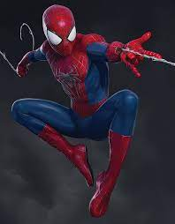
PANDEMIC SHOPPING
A new way to explore the joy!

Slide 2
Here ,we “ANONYMOUS” are too help our Dear Spider Man , whom we out of love call Spider Baba in Hindi !! Our spider Baba is always with us , fighting against odds and helping each one of us . He is a bit topsy-turvy about his worn out SUIT . Pandemic being going on and he has no shop available to buy. So ,we are here , with a great idea to solve the problem of our profound Spider Baba!

Slide 3
AUGMENTED SHOPPING
Our Technology enables the Baba not only to get access to all the stores selling his suit , but also entitles him to virtually try his outfit .
We could make a website , which can connect all the local stores having the Spider Man costumes .
Along with it , we are developing an Human- Recognition software which will scan Spiderman's whole body and later will enable him to look at his virtual profile wearing the costume of the store.
All the items at the store assigned to sell online will already be scanned by our end , so that user can experience any type of item on himself.
This will not only enable Spiderman to buy his suit but he will be able to explore much more!

Slide 4
THANK YOU
By ANONYMOUS !

