Slide 1
UNIT -2
UNIT II BLOCK CIPHERS & STREAM CIPHERS MECHANISMS
Block Cipher Mechanisms: DES, Block cipher modes of operation. Introduction to Finite Fields: Groups, Rings and Fields, Modular Arithmetic, Euclid’s Algorithm, Finite Fields, Advanced Encryption Standard, Blowfish. Stream Cipher Mechanisms: RC4Stream Cipher, Key Distribution -Diffie Hellman Key Exchange, Psuedo Random Number Generation.

Slide 2
STREAM CIPHERS & BLOCK CIPHERS
A stream cipher is one that encrypts a digital data stream one bit or one byte at a time.
Examples of classical stream ciphers are the autokeyed Vigenere cipher and the Vernam cipher
In this approach (Figure 2.1a), the bit-stream generator is a key-controlled algorithm and must produce a bit stream that is cryptographically strong. Now, the two users need only share the generating key, and each can produce the keystream
A block cipher is one in which a block of plaintext is treated as a whole and used to produce a ciphertext block of equal length.
Typically, a block size of 64 or 128 bits is used.
As with a stream cipher, the two users share a symmetric encryption key (Figure 2.1b).

Slide 3
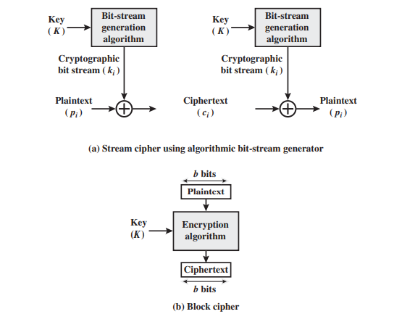
Fig 2.1 a) & b) Stream Cipher and Block Cipher

Slide 4
Feistel Network
Feistel proposed that we can approximate the ideal block cipher by utilizing the concept of a product cipher, which is the execution of two or more simple ciphers in sequence in such a way that the final result or product is cryptographically stronger than any of the component ciphers
The essence of the approach is to develop a block cipher with a key length of k bits and a block length of n bits, allowing a total of possible transformations, rather than the transformations available with the ideal block cipher
Used in DES, IDEA, RC5 (Rivest's Cipher n. 5), and many other block ciphers
Not used in AES

Slide 5
Feistel proposed the use of a cipher that alternates substitutions and permutations, where these terms are defined as follows:
• Substitution: Each plaintext element or group of elements is uniquely replaced by a corresponding ciphertext element or group of elements.
• Permutation: A sequence of plaintext elements is replaced by a permutation of that sequence. That is, no elements are added or deleted or replaced in the sequence, rather the order in which the elements appear in the sequence is changed
Feistel’s is a practical application of a proposal by Claude Shannon to develop a product cipher that alternates confusion and diffusion functions

Slide 6
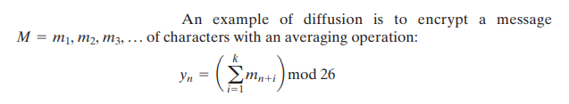
In diffusion, the statistical structure of the plaintext is dissipated into long-range statistics of the ciphertext.
This is achieved by having each plaintext digit affect the value of many ciphertext digits; generally, this is equivalent to having each ciphertext digit be affected by many plaintext digits.
On the other hand, confusion seeks to make the relationship between the statistics of the ciphertext and the value of the encryption key as complex as possible, again to thwart attempts to discover the key

Slide 7
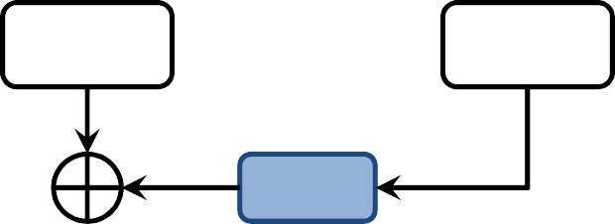
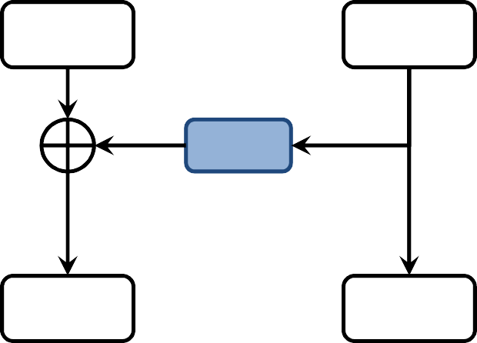
Feistel Network
R₀
Encryption:
L₁ = R₀ R₁ = L₀ ⊕ f₁(R₀)
L₀
f₁(•)
L₂ = R₁ R₂ = L₁ ⊕ f₂(R₁)
………
L_{d} = R_{d-1} R_{d} = L_{d-1} ⊕ f_{d}(R_{d-1})
Decryption:
R_{d-1} = L_{d} L_{d-1} = R_{d} ⊕ f_{d}(L_{d})
………
R₀ = L₁; L₀ = R₁ ⊕ f₁(L₁)
L₁
R₁
f₂(•)
^{L}d-1
^{R}d-1
f₁(•)
R_{d}
L_{d}

Slide 8
Data Encryption Standard (DES)
The most widely used encryption scheme is based on the Data Encryption Standard (DES) adopted in 1977 by the National Bureau of Standards, now the National Institute of Standards and Technology (NIST), as Federal Information Processing Standard 46 (FIPS PUB 46)
The algorithm itself is referred to as the Data Encryption Algorithm (DEA)
For DES, data are encrypted in 64-bit blocks using a 56-bit key
The algorithm transforms 64-bit input in a series of steps into a 64-bit output
The same steps, with the same key, are used to reverse the encryption

Slide 9
DES Features
Features:
  Block size = 64 bits
  Key size = 56 bits (in reality, 64 bits, but 8 are used as parity-check bits for error control, see next slide)
  Number of rounds = 16
  16 intermediary keys, each 48 bits
DES
Plaintext
64 bit
Ciphertext
64 bit
Key
56 bit

Slide 10
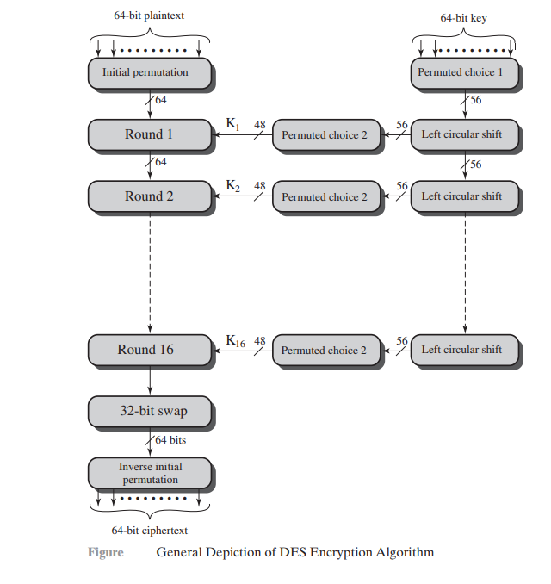
DES
Encryption

Slide 11
Key length in DES
In the DES specification, the key length is 64 bit:
8 bytes; in each byte, the 8th bit is a parity-check bit
...
1 2 3 4 5 6 7 8
57585960616263 64
first 7 bits
7 bits
Parity-check bits
Each parity-check bit is the XOR of the previous 7 bits
9

Slide 12
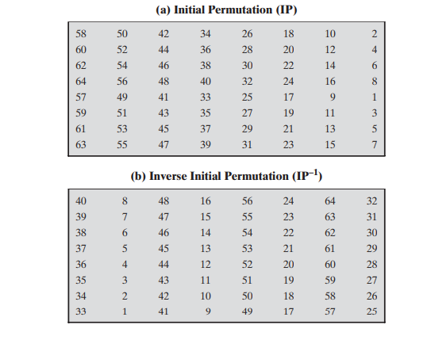
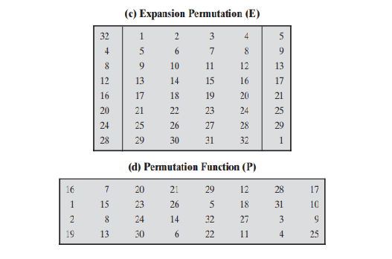

Slide 13
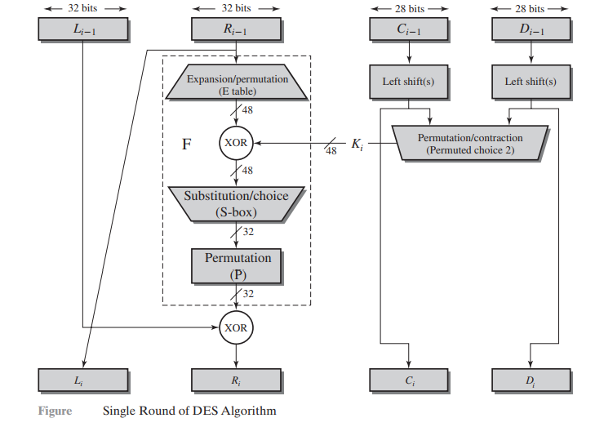
DETAILS OF SINGLE ROUND

Slide 14

Figure shows the internal structure of a single round. Again, begin by focusing on the left-hand side of the diagram.
The left and right halves of each 64-bit intermediate value are treated as separate 32-bit quantities, labeled L (left) and R (right)
As in any classic Feistel cipher, the overall processing at each round can be summarized in the following formulas:

Slide 15
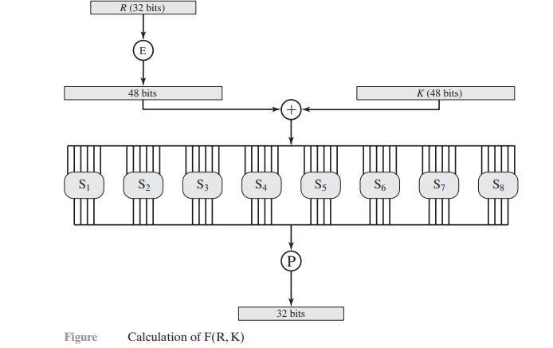

Slide 16
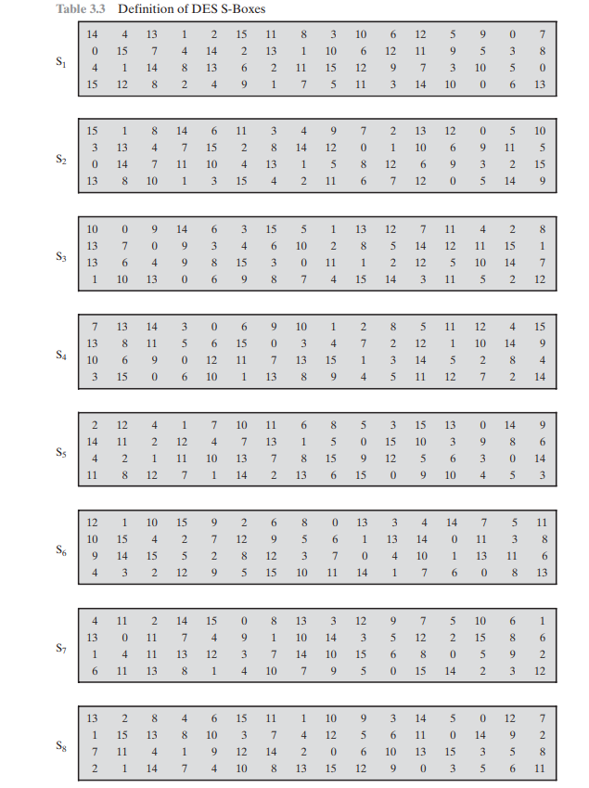

Slide 17
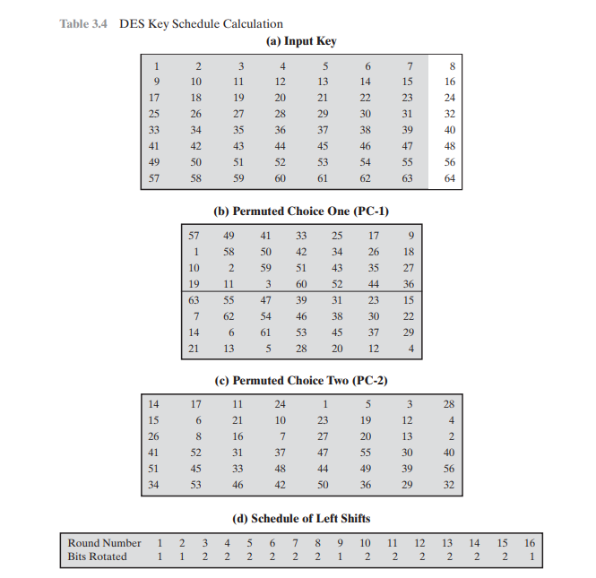

Slide 18
DES Decryption
A change in one bit of the plaintext or one bit of the key should produce a change in many bits of the cipher text is known as the Avalanche Effect
The statistical structure of the plaintext is dissipated into long-range statistics of the cipher text is called Diffusion

Slide 19
Strength of DES
The Use of 56-Bit Keys - With a key length of 56 bits, there are 256 possible keys, which is approximately 7.2 * 1016 keys. Thus a
brute-force attack appears impractical.
• DES finally and definitively proved insecure in July 1998, when the Electronic Frontier Foundation (EFF) announced that it had broken a DES encryption using a special-purpose “DES cracker” machine that was built for less than $250,000.
The attack took less than three days.

Slide 20
The Nature of the DES Algorithm - cryptanalysis is possible by
exploiting the characteristics of the DES algorithm.
• A timing attack is one in which information about the key or the plaintext is obtained by observing how long it takes a given implementation to perform decryptions on various ciphertexts.
• A timing attack exploits the fact that an encryption or decryption algorithm often takes slightly different amounts of time on different inputs.

Slide 21
Block Cipher Modes of operation
• Electronic Codebook (ECB)
• Cipher Block Chaining (CBC)
• Cipher Feedback (CFB)
• Output Feedback (OFB)
• Counter (CTR)

Slide 22
When we use block cipher modes of operation?
Block cipher only allow to encrypt entire blocks.
What if our message is longer/shorter than the block size?
When message is longer/shorter than the block size, we use modes of operations.
Algorithms that exploit a block cipher to provide a service (e.g. confidentiality ).

Slide 23
Block cipher mode of operation –
Electronic Codebook (ECB)
The simplest mode is the electronic codebook (ECB) mode, in which plaintext is handled one block at a time and each block of plaintext is encrypted using the same key (Figure)
The term codebook is used because, for a given key, there is a unique ciphertext for every b-bit block of plaintext
Therefore, we can imagine a gigantic codebook in which there is an entry for every possible b-bit plaintext pattern showing its corresponding ciphertext
For a message longer than bits, the procedure is simply to break the message into b-bit blocks, padding the last block if necessary. Decryption is performed one block at a time, always using the same key

Slide 24
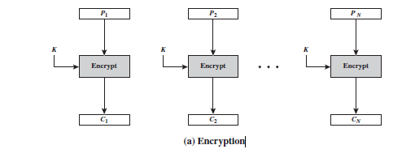
Electronic Codebook (ECB) - Encryption

Slide 25
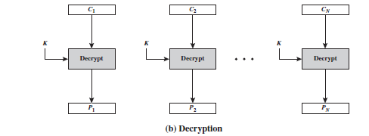
Electronic Codebook (ECB) - Decryption

Slide 26
The ECB method is ideal for a short amount of data, such as an encryption key
Thus, if you want to transmit a DES or AES key securely, ECB is the appropriate mode to use.
The most significant characteristic of ECB is that if the same b-bit block of plaintext appears more than once in the message, it always produces the same ciphertext.
For lengthy messages, the ECB mode may not be secure. If the message is highly structured, it may be possible for a cryptanalyst to exploit these regularities.
For example, if it is known that the message always starts out with certain predefined fields, then the cryptanalyst may have a number of known plaintext–ciphertext pairs to work with.

Slide 27
Cipher Block Chaining Mode(CBC)
To overcome the security deficiencies of ECB, we would like a technique in which the same plaintext block, if repeated, produces different ciphertext blocks
A simple way to satisfy this requirement is the cipher block chaining (CBC) mode (Figure)
In this scheme, the input to the encryption algorithm is the XOR of the current plaintext block and the preceding ciphertext block; the same key is used for each block
In effect, we have chained together the processing of the sequence of plaintext blocks.
The input to the encryption function for each plaintext block bears no fixed relationship to the plaintext block.
Therefore, repeating patterns of bits are not exposed.
As with the ECB mode, the CBC mode requires that the last block be padded to a full bits if it is a partial block.

Slide 28

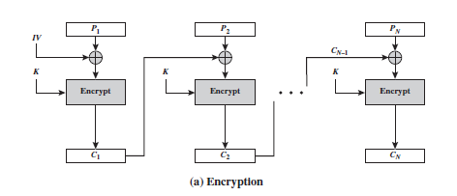
To produce the first block of ciphertext, an initialization vector (IV) is XORed with the first
block of plaintext.
To see that this works, we can write

Slide 29
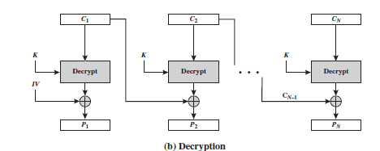

For decryption, each cipher block is passed through the decryption algorithm.
The result is XORed with the preceding ciphertext block to produce the plaintext block.
On decryption, the IV is XORed with the output of the decryption algorithm to recover the first block of plaintext.
The IV is a data block that is that same size as the cipher block. We can define CBC mode as

Slide 30
The IV must be known to both the sender and receiver but be unpredictable by a third party.
In particular, for any given plaintext, it must not be possible to predict the IV that will be associated to the plaintext in advance of the generation of the IV.
For maximum security, the IV should be protected against unauthorized changes.
This could be done by sending the IV using ECB encryption. One reason for protecting the IV is as follows: If an opponent is able to fool the receiver into using a different value for IV, then the opponent is able to invert selected bits in the first block of plaintext

Slide 31
What is initialization vector?
An initialization vector (IV) or starting variable is a block of bits that is used by several modes to randomize the encryption and hence to produce distinct cipher texts even if the same plain text is encrypted multiple times, without the need for a slower re-keying process
An initialization vector has different security requirements than a key, so the IV usually does not need to be secret
However, in most cases, it is important that an initialization vector is never reused under the same key

Slide 32
What is initialization vector? (continue…)
For CBC and CFB, reusing an IV leaks some information about the first block of plaintext, and about any common prefix shared by the two messages
For OFB and CTR, reusing an IV completely destroys security. This can be seen because both modes effectively create a bit stream that is XORed with the plaintext, and this bit stream is dependent on the password and IV only. Reusing a bit stream destroys security.
In CBC mode, the IV must, in addition, be unpredictable at encryption time; in particular, the (previously) common practice of re-using the last cipher text block of a message as the IV for the next message is insecure.

Slide 33
So long as it is unpredictable, the specific choice of IV is unimportant
Sp800-38a recommends two possible methods: The first method is to apply the encryption function, under the same key that is used for the encryption of the plaintext, to a nonce
The nonce must be a data block that is unique to each execution of the encryption operation. For example, the nonce may be a counter, a timestamp, or a message number.
The second method is to generate a random data block using a random number generator
In conclusion, because of the chaining mechanism of CBC, it is an appropriate mode for encrypting messages of length greater than bits.

Slide 34
Cipher Feedback Mode(CFB)
ECB and CBC modes encrypt and decrypt blocks of the message
Block size n is predetermine by the underlying cipher ;
for example, for DES n = 64 for AES n =128
In some situations, we need use DES or AES as secure cipher , but the plain text or cipher text block size are to be smaller
For example, to encrypt and decrypt 8-bit characters , you would not want to use one of the traditional cipher like Caesar cipher
The solution is to use DES or AES in cipher feedback mode

Slide 35
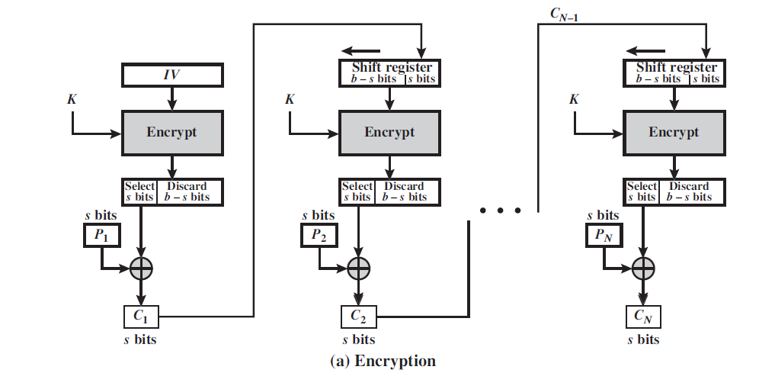

Slide 36
Figure depicts the CFB scheme for Encryption. In the figure, it is assumed that the unit of transmission is s bits; a common value is s = 8
As with CBC, the units of plaintext are chained together, so that the ciphertext of any plaintext unit is a function of all the preceding plaintext
In this case, rather than blocks of b bits, the plaintext is divided into segments of s bits
First, consider encryption. The input to the encryption function is a b-bit shift register that is initially set to some initialization vector (IV)
The leftmost (most significant) s bits of the output of the encryption function are XORed with the first segment of plaintext P1 to produce the first unit of ciphertext C1, which is then transmitted
In addition, the contents of the shift register are shifted left by s bits, and C1 is placed in the rightmost (least significant) s bits of the shift register.
This process continues until all plaintext units have been encrypted

Slide 37
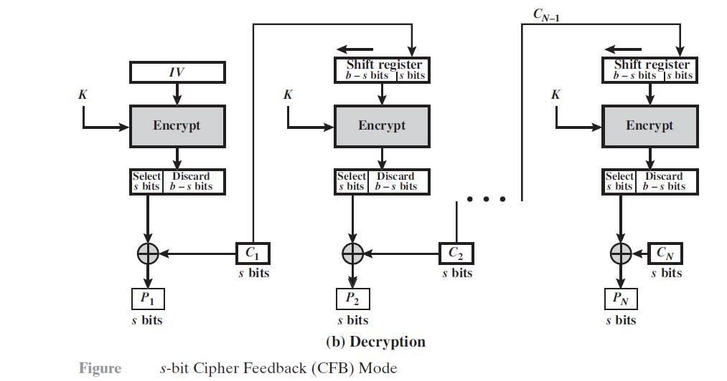

Slide 38
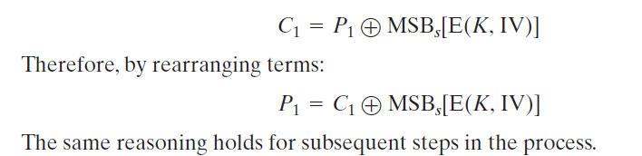
For decryption, the same scheme is used, except that the received ciphertext unit is XORed with the output of the encryption function to produce the plaintext unit
Note that it is the encryption function that is used, not the decryption function.
Let MSBs(X) be defined as the most significant s bits of X .
Then

Slide 39
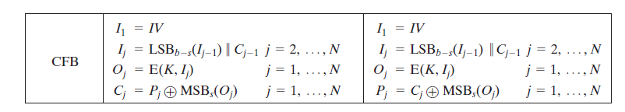
Although CFB can be viewed as a stream cipher, it does not conform to the
typical construction of a stream cipher
In a typical stream cipher, the cipher takes as input some initial value and a key
and generates a stream of bits, which is then XORed with the plaintext bits
In the case of CFB, the stream of bits that is XORed with the plaintext also
depends on the plaintext

Slide 40
Cipher feedback mode Security issues
Just like CBC , patterns at the block level are not preserved
More than one message can be encrypted with the same key , but the value of the IV should be changed for each message.
This means that sender needs to use a different IV each time sender sends a message
Attacker can add some cipher text block to the end of the cipher text stream.

Slide 41
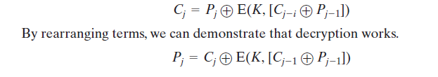
Output Feedback Mode (OFB)
The output feedback (OFB) mode is similar in structure to that of CFB.
As can be seen in Figure, it is the output of the encryption function that is fed back to the shift register in OFB, whereas in CFB, the ciphertext unit is fed back to the shift register
The other difference is that the OFB mode operates on full blocks of plaintext and ciphertext, not on an s -bit subset
Encryption can be expressed as

Slide 42
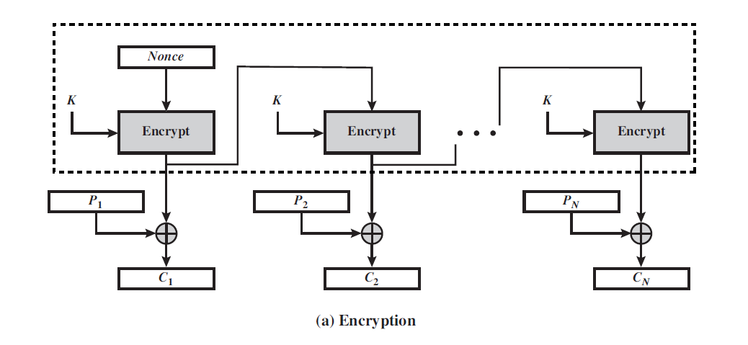

Slide 43
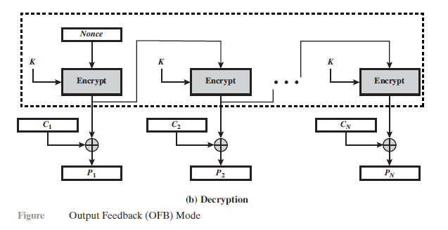

Slide 44
As with CBC and CFB, the OFB mode requires an initialization vector.
In the case of OFB, the IV must be a nonce; that is, the IV must be unique to each execution of the encryption operation
For a given key and IV, the stream of output bits used to XOR with the stream of plaintext bits is fixed
One advantage of the OFB method is that bit errors in transmission do not propagate
The disadvantage of OFB is that it is more vulnerable to a message stream modification attack than is CFB
Consider that complementing a bit in the ciphertext complements the corresponding bit in the recovered plaintex
Thus, controlled changes to the recovered plaintext can be made
This may make it possible for an opponent, by making the necessary changes to the checksum portion of the message as well as to the data portion, to alter the ciphertext in such a way that it is not detected by an error-correcting code.

Slide 45
OFB has the structure of a typical stream cipher, because the cipher generates a stream of bits as a function of an initial value and a key, and that stream of bits is XORed with the plaintext bits
The generated stream that is XORed with the plaintext is itself independent of the plaintext; this is highlighted by dashed boxes in Figure
One distinction from the stream ciphers is that OFB encrypts plaintext a full block at a time, where typically a block is 64 or 128 bits
Many stream ciphers encrypt one byte at a time

Slide 46
Cipher output feedback mode
Output feedback mode is very similar to CFB mode , with one difference: each bit in the cipher text is independent of the previous bit or bits
This avoids error propagation
If an error occur in transmission , it does not affect the bits that follow
Note that , like cipher feedback mode , both the sender and the receiver use the encryption algorithm

Slide 47
Cipher output feedback mode Security issues
Just like CBC , patterns at the block level are not preserved.
Any change in the cipher text affects the plain text encrypted at the receiver side.

Slide 48
Counter Mode(CTR)
Although interest in the counter (CTR) mode has increased recently with applications to ATM (asynchronous transfer mode) network security and IP sec (IP security), this mode was proposed early on (e.g., [DIFF79])
Figure depicts the CTR mode, a counter equal to the plaintext block size is used
The only requirement stated in SP 800-38A is that the counter value must be different for each plaintext block that is encrypted
Typically, the counter is initialized to some value and then incremented by 1 for each subsequent block

Slide 49
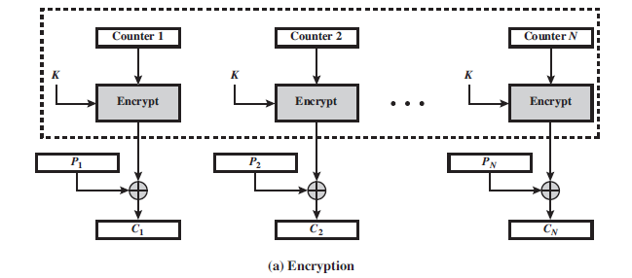

Slide 50
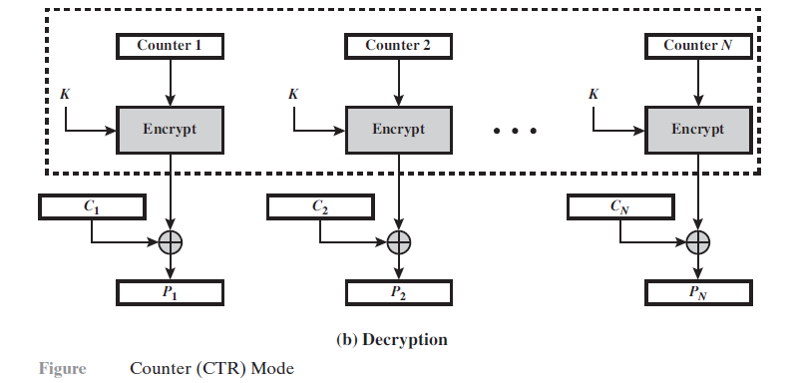

Slide 51
For encryption, the counter is encrypted and then XORed with the plaintext block to produce the ciphertext block; there is no chaining
For decryption, the same sequence of counter values is used, with each encrypted counter XORed with a ciphertext block to recover the corresponding plaintext block
Thus, the initial counter value must be made available for decryption
Unlike the ECB, CBC, and CFB modes, we do not need to use padding because of the structure of the CTR mode
A counter value is used multiple times, then the confidentiality of all of the plaintext blocks corresponding to that counter value may be compromised
In particular, if any plaintext block that is encrypted using a given counter value is known, then the output of the encryption function can be determined easily from the associated ciphertext block

Slide 52
This output allows any other plaintext blocks that are encrypted using the same counter value to be easily recovered from their associated ciphertext blocks
One way to ensure the uniqueness of counter values is to continue to increment the counter value by 1 across messages
That is, the first counter value of the each message is one more than the last counter value of the preceding message
Advantages of CTR mode:
Hardware efficiency, Software efficiency, Preprocessing, Random access, Provable security and Simplicity

Slide 53
Counter Mode Extra points
In the counter mode , there is no feedbck
The pseudo randomness in the key streams achieved using a counter
An n bit counter is initialized to a predetermined value(IV) and incremented based on a predefined rule(mod 2^{n})
To provide a better randomness , the increment value can depend on the block numbers to be incremented
The plain text and cipher block text block have same block size as the underlying cipher.
Both encryption and decryption can be performed fully in parallel on multiple blocks ,provides true random access to cipher text blocks

Slide 54
Introduction to Finite Fields: Groups, Rings and Fields
Groups
A group G, sometimes denoted by {G, ·}, is a set of elements with a binary operation denoted by · that associates to each ordered pair (a, b) of elements in G an element (a · b) in G, such that the following axioms are obeyed:
(A1) Closure: If a and b belong to G, then a · b is also in G.
(A2) Associative: a · (b · c) = (a · b) · c for all a, b, c in G.
(A3) Identity element: There is an element e in G such that
a · e = e · a = a for all a in G.

Slide 55
Groups
(A4) Inverse element: For each a in G, there is an element a′ in G such that a · a′ = a′ · a = e.
A group is said to be abelian if it satisfies the following additional condition:
Commutative: a · b = b · a for all a, b in G.

Slide 56
Rings
A ring R, sometimes denoted by {R, +, * }, is a set of elements with two binary operations, called addition and multiplication, such that for all a, b, c in R the following axioms are obeyed.
(M1) Closure under multiplication: If a and b belong to R, then ab is also in R.
(M2) Associativity of multiplication: a(bc) = (ab)c for all a, b, c in R.
(M3) Distributive laws: a(b + c) = ab + ac for all a, b, c in R. (a + b)c = ac + bc for all a, b, c in R.
A ring is said to be commutative if it satisfies the following additional condition:
(M4) Commutativity of multiplication: ab = ba for all a, b in R.

Slide 57
Rings
An integral domain, which is a commutative ring that obeys the following axioms:
(M5) Multiplicative identity: There is an element 1 in R such that
a1 = 1a = a for all a in R.
(M6) No zero divisors: If a, b in R and ab = 0, then either a = 0 or b = 0.

Slide 58
Fields
A field F denoted by {F, +, * }, is a set of elements with two binary operations, called addition and multiplication, such that the following conditions hold:
A field F, sometimes denoted by {F, +, x}, is a set of elements with two binary operations, called addition and multiplication, such that for all a, b, c in F the following axioms are obeyed:
(A1 - M6) F is an integral domain; that is, F satisfies axioms A1 through A5 and M1 through M6.
(M7) Multiplicative inverse: For each a in F, except 0, there is an element a⁻¹ in F such that aa⁻¹ = (a⁻¹)a = 1.

Slide 59
Modular Arithmetic
The Modulus
If a is an integer and n is a positive integer, we define a mod n to be the remainder when a is divided by n. The integer n is called the modulus. Thus, for any integer a,
we can rewrite Equation as follows:
a = qn + r 0<r <n; q = [a/n] a =[a/n] * n + (a mod n)
Two integers a and b are said to be congruent modulo n,
if (a mod n) = (b mod n).
This is written as as a = b (mod n).²
11 mod 7 = 4; - 11 mod 7 = 3
73 = 4 (mod 23); 21 = - 9 (mod 10)

Slide 60

Properties of Congruences
Congruences have the following properties:
To demonstrate the first point, if n | (a - b), then (a - b) = kn for some k. So we can write a = b + kn. Therefore, (a mod n) = (remainder when b + kn is divided by n) = (remainder when b is divided by n) = (b mod n).
23 = 8 (mod 5) | because | 23 - 8 = 15 = 5 * 3
- 11 = 5 (mod 8) | because | - 11 - 5 = - 16 = 8 * (- 2)
81 =0 (mod 27) | because | 81 - 0 = 81 = 27 * 3

Slide 61
Modular Arithmetic Operations
Modular arithmetic exhibits the following properties:
[(a mod n) + (b mod n)] mod n = (a + b) mod n
[(a mod n) - (b mod n)] mod n = (a - b) mod n
[(a mod n) * (b mod n)] mod n = (a * b) mod n
We demonstrate the first property. Define (a mod n) = r_{a} and (b mod n) = r_{b}.
Then we can write a = r_{a} + jn for some integer j and b = r_{b} + kn
for some integer k. Then
(a + b) mod n = (r_{a} + jn + r_{b} + kn) mod n
= (r_{a} + r_{b} + (k + j)n) mod n
= (r_{a} + r_{b}) mod n
= [(a mod n) + (b mod n)] mod n

Slide 62
The remaining properties are proven as easily. Here are examples of the three properties:
11 mod 8 = 3; 15 mod 8 = 7
[(11 mod 8) + (15 mod 8)] mod 8 = 10 mod 8 = 2
(11 + 15) mod 8 = 26 mod 8 = 2
[(11 mod 8) - (15 mod 8)] mod 8 = - 4 mod 8 = 4
(11 - 15) mod 8 = - 4 mod 8 = 4
[(11 mod 8) * (15 mod 8)] mod 8 = 21 mod 8 = 5
(11 * 15) mod 8 = 165 mod 8 = 5
Properties of Modular Arithmetic
Define the set Z_{n} as the set of nonnegative integers less than:
Z_{n} = {0, 1, 2,…….. (n - 1)}
This is referred to as the set of residues, or residue classes (mod n).
To be more precise, each integer in Z_{n} represents a residue class.
The residue classes (mod n) are labelled as [0], [1], [2],……, [n - 1]
where
[r] = {a: a is an integer, a = r (mod n)}

Slide 63
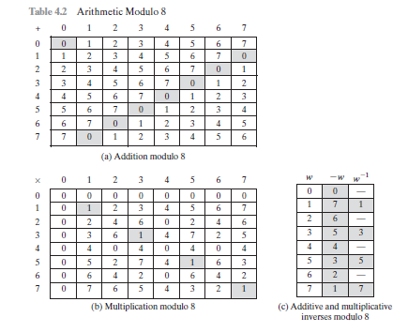

Slide 64
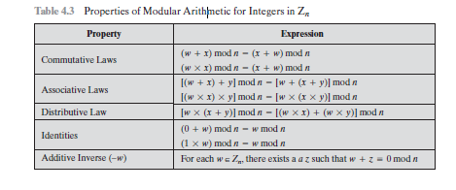
The residue classes (mod 4) are
[0] = {c, - 16, - 12, - 8, - 4, 0, 4, 8, 12, 16, c}
[1] = {c, - 15, - 11, - 7, - 3, 1, 5, 9, 13, 17, c}
[2] = {c, - 14, - 10, - 6, - 2, 2, 6, 10, 14, 18, c}
[3] = {c, - 13, - 9, - 5, - 1, 3, 7, 11, 15, 19, c}
Of all the integers in a residue class, the smallest non negative integer is the one used to represent the residue class.
Finding the smallest nonnegative integer to which k is congruent modulo is called reducing k modulo n.

Slide 65
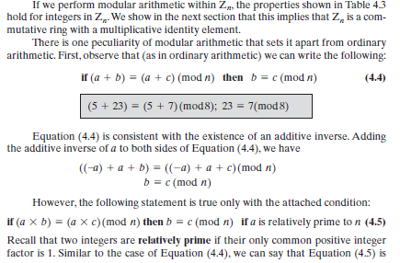

Slide 66

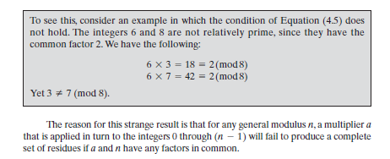

Slide 67
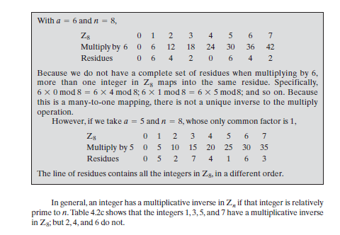
Two numbers are called Additive inverses if their sum is zero.
Two numbers are called Multiplicative inverses if their product is one.

Slide 68
Euclid’s algorithm
One of the basic techniques of number theory is the Euclidean algorithm, which is a simple procedure for determining the greatest common divisor of two positive integers
Two integers are relatively prime if and only if their only common positive integer factor is 1
gcd(a, b) denotes the greatest common divisor of a and b
The greatest common divisor of a and b is the largest integer that divides both a and b

Slide 69
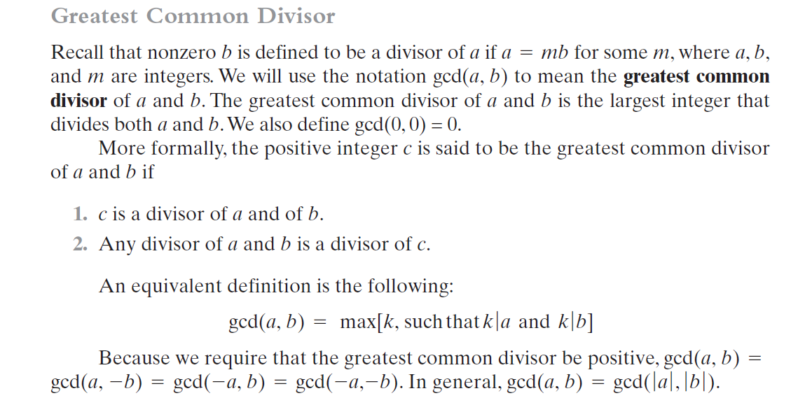

Slide 70
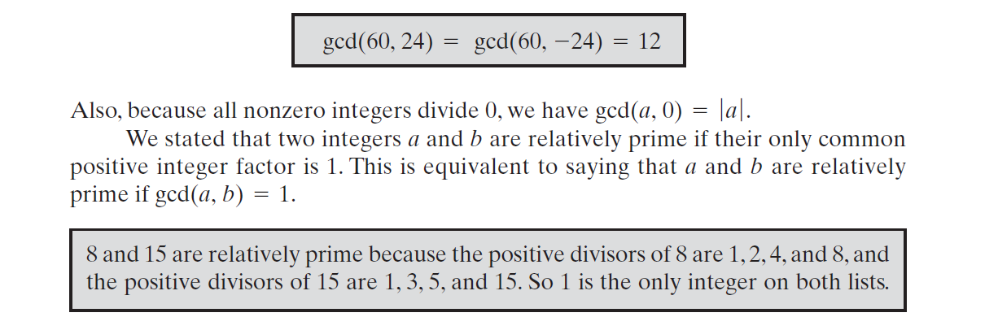

Slide 71
Euclid’s algorithm
gcd(a,b) = gcd ( b , a mod b)
gcd(30,7) =gcd ( 7 , 30 mod 7)
=gcd(7,2) = gcd(2,7 mod 2)
= gcd(2,1) =gcd(1,2 mod 1)
= gcd(1,0) = 1
gcd(18,12) = gcd ( 12,18 mod 12) =gcd( 12,6)
=gcd( 6,12mod6)=gcd(6,0)=6
gcd(11,10) = gcd(10,11 mod 10) = gcd(10,1),
= gcd( 1,10 mod 1)=gcd(1,0)=1
Find gcd(1970,1066) using Euclid's algorithm
Ans: GCD(1970,1066) = 2

Slide 72
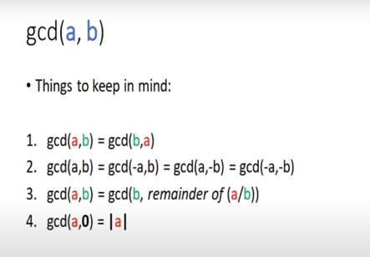

Slide 73
Finite fields
Finite Fields, also known as Galois Fields, are cornerstones for understanding any cryptography
A field can be defined as a set of numbers that we can add, subtract, multiply and divide together and only ever end up with a result that exists in our set of numbers
Galois showed that for a field to be finite, the number of elements should be p^{n,} where p is a prime and n is a positive integer
A Galois field, GF(p^{n}), is a finite field with p^{n} elements.

Slide 74
Finite Fields of Order p
For a given prime, p, the finite field of order p, GF(p) is defined as the set Zp of integers {0, 1,..., p- 1}, together with the arithmetic operations modulo p.
Define GF(5) on the set Z5 (5 is a prime) with addition and multiplication operators
GF(5) = {0,1,2,3,4}[+,*]

Slide 75
Finite Fields of Order p
Modular Addition
+ | 0 | 1 | 2 | 3 | 4
0 | 0 | 1 | 2 | 3 | 4
1 | 1 | 2 | 3 | 4 | 0
2 | 2 | 3 | 4 | 0 | 1
3 | 3 | 4 | 5 | 1 | 3
4 | 4 | 0 | 1 | 2 | 2

Slide 76
Finite Fields of Order p
Modular Multiplication
* | 0 | 1 | 2 | 3 | 4
0 | 0 | 0 | 0 | 0 | 0
1 | 0 | 1 | 2 | 3 | 4
2 | 0 | 2 | 4 | 1 | 3
3 | 0 | 3 | 1 | 4 | 2
4 | 0 | 4 | 3 | 2 | 1

Slide 77
Finite Fields of Order p
Additive inverse (w-) and Multiplicative inverse (w⁻¹)
w | w- | w⁻¹
0 | 0 | -
1 | 4 | 1
2 | 3 | 3
3 | 2 | 2
4 | 1 | 4

Slide 78
Advanced Encryption Standard
The Rijndael proposal for AES defined a cipher in which the block length and the key length can be independently specified to be 128, 192, or 256 bits
The AES specification uses the same three key size alternatives but limits the block length to 128 bits
A number of AES parameters depend on the key length (Table)
Assume a key length of 128 bits, which is likely to be the one most commonly implemented

Slide 79
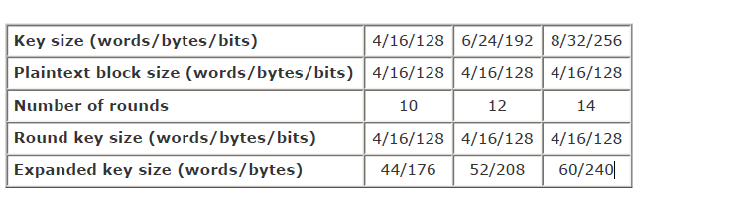
Table. AES Parameters

Slide 80


The AES Cipher - Rijndael
Rijndael was selected as the AES in Oct-2000
  Designed by Vincent Rijmen and Joan Daemen in Belgium
  Issued as FIPS PUB 197 standard in Nov-2001
An iterative rather than Feistel cipher
  processes data as block of 4 columns of 4 bytes (128 bits)
  operates on entire data block in every round
Rijndael design:
  simplicity
  has 128/192/256 bit keys, 128 bits data
  resistant against known attacks
  speed and code compactness on many CPUs
V. Rijmen
J. Daemen
Notes:
The Rijndael proposal for AES defined a cipher in which the block length and the key length can be independently specified to be 128,192,or 256 bits. The AES specification uses the same three key size alternatives but limits the block length to 128 bits. Rijndael is an academic submission, based on the earlier Square cipher, from Belgium academics Dr Joan Daemen and Dr Vincent Rijmen. It is an iterative cipher (operates on entire data block in every round) rather than feistel (operate on halves at a time), and was designed to have characteristics of: Resistance against all known attacks, Speed and code compactness on a wide range of platforms, & Design simplicity.

Slide 81
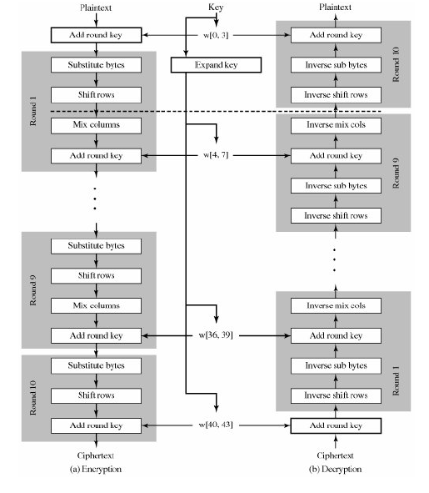
AES Data Structures

Slide 82
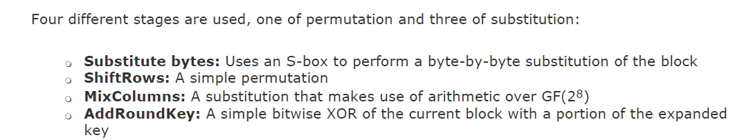
Overall AES structure
AES structure is not a Feistel structure.
Two of the AES finalists, including Rijndael, do not use a
Feistel structure but process the entire data block in parallel during each round using
substitutions and permutation.
For both encryption and decryption, the cipher begins with an AddRoundKey stage, followed by nine rounds that each includes all four stages, followed by a tenth round of three stages

Slide 83
The Figure shows the overall structure of AES. The input to the encryption and decryption algorithms is a single 128-bit block. In FIPS PUB 197, this block is depicted as a square matrix of bytes.
This block is copied into the State array, which is modified at each stage of encryption or decryption.
After the final stage, State is copied to an output matrix.
These operations are depicted in Figure a. Similarly, the 128-bit key is depicted as a square matrix of bytes.
This key is then expanded into an array of key schedule words; each word is four bytes and the total key schedule is 44 words for the 128-bit key (Figure 5.2b). Note that the ordering of bytes within a matrix is by column.
So, for example, the first four bytes of a 128-bit plaintext input to the encryption cipher occupy the first column of the in matrix, the second four bytes occupy the second column, and so on. Similarly, the first four bytes of the expanded key, which form a word, occupy the first column of the w matrix.

Slide 84

AES Encryption Round

Slide 85
Only the AddRoundKey stage makes use of the key
For this reason, the cipher begins and ends with an AddRoundKey stage
Any other stage, applied at the beginning or end, is reversible without knowledge of the key and so would add no security
The AddRoundKey stage is, in effect, a form of Vernam cipher and by itself would not be formidable
The other three stages together provide confusion, diffusion, and nonlinearity, but by themselves would provide no security because they do not use the key
We can view the cipher as alternating operations of XOR encryption (AddRoundKey) of a block, followed by scrambling of the block (the other three stages), followed by XOR encryption, and so on
This scheme is both efficient and highly secure, each stage is easily reversible

Slide 86

For the Substitute Byte, ShiftRows, and MixColumns stages, an inverse function is used in the decryption algorithm
For the AddRoundKey stage, the inverse is achieved by XORing the same round key to the block, using the result that
As with most block ciphers, the decryption algorithm makes use of the expanded key in reverse order
However, the decryption algorithm is not identical to the encryption algorithm. This is a consequence of the particular structure of AES
Once it is established that all four stages are reversible, it is easy to verify that decryption does recover the plaintext. Figure lays out encryption and decryption going in opposite vertical directions
At each horizontal point (e.g., the dashed line in the figure), State is the same for both encryption and decryption
The final round of both encryption and decryption consists of only three stages. Again, this is a consequence of the particular structure of AES and is required to make the cipher reversible

Slide 87
Substitute Bytes Transformation
Forward and Inverse Transformations
The forward substitute byte transformation, called SubBytes, is a simple table lookup (Figure .a)
AES defines a 16 x 16 matrix of byte values, called an S-box (Table a), that contains a permutation of all possible 256 8-bit values
Each individual byte of State is mapped into a new byte in the following way: The leftmost 4 bits of the byte are used as a row value and the rightmost 4 bits are used as a column value.
These row and column values serve as indexes into the S-box to select a unique 8-bit output value.

Slide 88
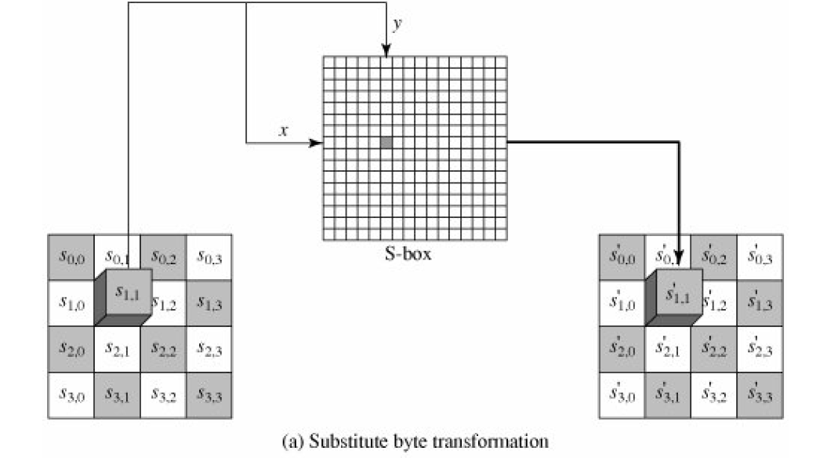
Figure. Substitute Bytes Transformation

Slide 89
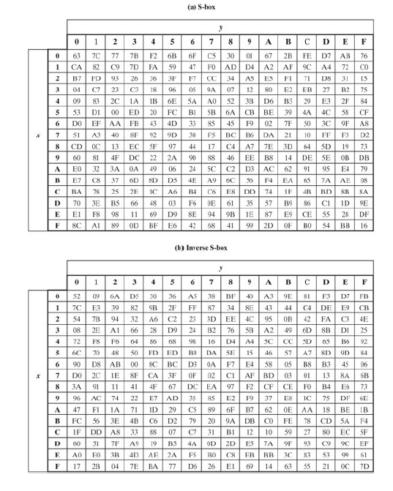
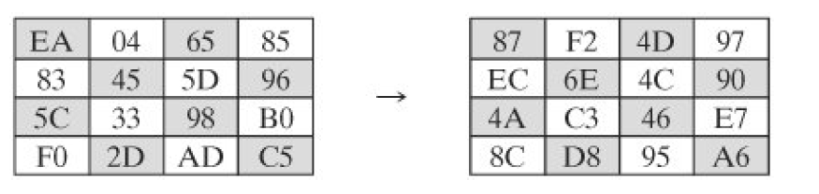
Example of the SubBytes transformation

Slide 90
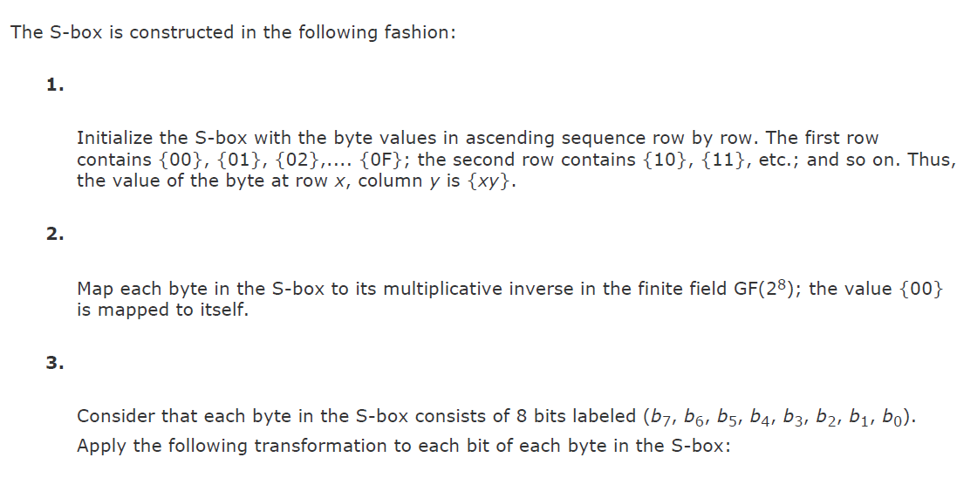


Slide 91

ShiftRows Transformation
Forward and Inverse Transformations
The forward shift row transformation, called ShiftRows, is depicted in Figure a
The first row of State is not altered. For the second row, a 1-byte circular left shift is performed. For the third row, a 2-byte circular left shift is performed. For the fourth row, a 3-byte circular left shift is performed

Slide 92
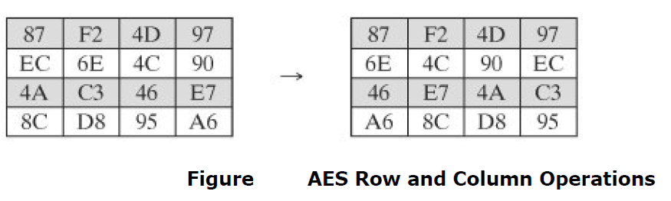
The following is an example of ShiftRows:
The inverse shift row transformation, called InvShiftRows, performs the circular shifts in the opposite direction for each of the last three rows, with a one-byte circular right shift for the second row, and so on
The shift row transformation is more substantial than it may first appear. This is because the State, as well as the cipher input and output, is treated as an array of four 4-byte columns
Thus, on encryption, the first 4 bytes of the plaintext are copied to the first column of State, and so on. Further, as will be seen, the round key is applied to State column by column.
Thus, a row shift moves an individual byte from one column to another, which is a linear distance of a multiple of 4 bytes

Slide 93
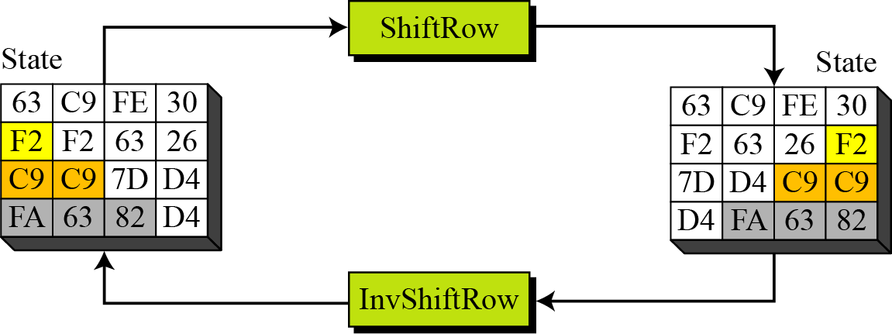
ShiftRows and InvShiftRows

Slide 94
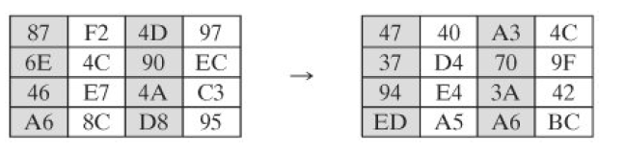
MixColumns Transformation
Forward and Inverse Transformations
The forward mix column transformation, called MixColumns, operates on each column individually
Each byte of a column is mapped into a new value that is a function of all four bytes in that column.
The transformation can be defined by the following matrix multiplication on State
The following is an example of MixColumns:

Slide 95

The MixColumns transformation operates at the column level; it transforms each column
of the state to a new column.

Slide 96
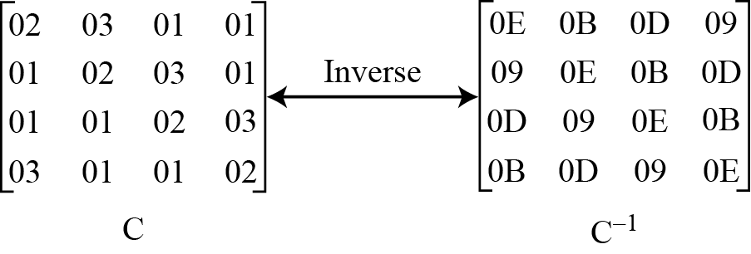
MixColumn and InvMixColumn

Slide 97
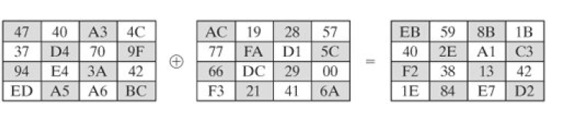
AddRoundKey Transformation
Forward and Inverse Transformations
In the forward add round key transformation, called AddRoundKey, the 128 bits of State are bitwise XORed with the 128 bits of the round key
As shown in Figure, the operation is viewed as a columnwise operation between the 4 bytes of a State column and one word of the round key; it can also be viewed as a byte-level operation.
The following is an example of AddRoundKey:

Slide 98

The first matrix is State, and the second matrix is the round key
The inverse add round key transformation is identical to the forward add round key transformation, because the XOR operation is its own inverse

Slide 99
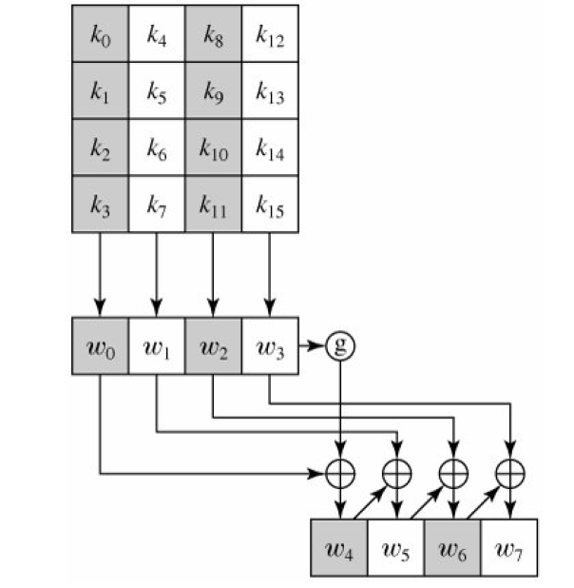
AES Key Expansion

Slide 100
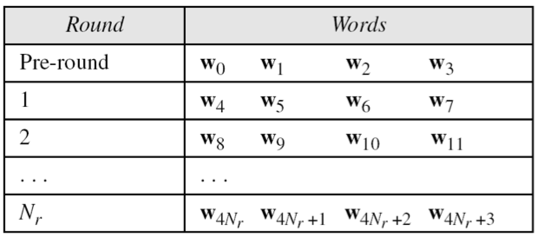
AES Key Scheduling
takes 128-bits (16-bytes) key and expands into array of 44 32-bit words
Notes:
The AES key expansion algorithm takes as input a 4-word (16-byte) key and produces a linear array of words, providing a 4-word round key for the initial AddRoundKey stage and each of the 10/12/14 rounds of the cipher. It involves copying the key into the first group of 4 words, and then constructing subsequent groups of 4 based on the values of the previous & 4th back words. The first word in each group of 4 gets “special treatment” with rotate + S-box + XOR constant on the previous word before XOR’ing the one from 4 back. In the 256-bit key/14 round version, there’s also an extra step on the middle word.

Slide 101
AddRoundKey
XOR state with 128-bits of the round key
AddRoundKey proceeds one column at a time.
  adds a round key word with each state column matrix
  the operation is matrix addition
Inverse for decryption identical
  since XOR own inverse, with reversed keys
Designed to be as simple as possible
Notes:
Lastly is the Add Round Key stage which is a simple bitwise XOR of the current block with a portion of the expanded key. Note this is the only step which makes use of the key and obscures the result, hence MUST be used at start and end of each round, since otherwise could undo effect of other steps. But the other steps provide confusion/diffusion/non-linearity. That us you can look at the cipher as a series of XOR with key then scramble/permute block repeated. This is efficient and highly secure it is believed.

Slide 102
Key Expansion submodule
RotWord performs a one byte circular left shift on a word For example:
RotWord[b0,b1,b2,b3] = [b1,b2,b3,b0]
SubWord performs a byte substitution on each byte of input word using the S-box
SubWord(RotWord(temp)) is XORed with RCon[j] – the round constant

Slide 103
AES Security
AES was designed after DES.
Most of the known attacks on DES were already tested on AES.
Brute-Force Attack
  AES is definitely more secure than DES due to the larger-size key.
Statistical Attacks
  Numerous tests have failed to do statistical analysis of the ciphertext
Differential and Linear Attacks
  There are no differential and linear attacks on AES as yet.

Slide 104
RC4
Rivest Cipher 4 (RC4) is a stream cipher designed in 1987 by Ron Rivest for RSA Security.
It is a variable key size stream cipher with byte-oriented operations.
The algorithm is based on the use of a random permutation.
For encryption and decryption, a byte k is generated from S by selecting one of the 255 entries in a systematic fashion.
To encrypt, XOR the value k with the next byte of plaintext.
To decrypt, XOR the value k with the next byte of ciphertext.

Slide 105
RC4 – Key Scheduling Algorithm (KSA)
A variable-length key of from 1 to 256 bytes (8 to 2048 bits) is used to initialize a 256-byte state vector S, with elements S[0],S[1], ..., S[255].
If the length of the key k is 256 bytes, then k is assigned to T.
Otherwise, for a key with length(k-len) bytes, the first k-len elements of T as copied from K and then K is repeated as many times as necessary to fill T.
Use T to produce the initial permutation of S. Starting with S[0] to S[255], and for each S[i] algorithm swap it with another byte in S according to a scheme dictated by T[i], but S will still contain values from 0 to 255

Slide 106
RC4 – Key Scheduling Algorithm (KSA)
/* Initialization */
for i = 0 to 255 do
S[i] = i;
T[i] = K[i mod keylen];
/* Initial Permutation of S */
j = 0;
for i = 0 to 255 do
j = (j + S[i] + T[i]) mod 256;
Swap (S[i], S[j]);

Slide 107
RC4 – Pseudo Random Generation Algorithm (PRGA)
For each S[i] algorithm swap it with another byte in S according to a scheme dictated by the current configuration of S.
After reaching S[255] the process continues, starting from S[0] again.
/* Stream Generation */
i, j = 0;
while (true)
i = (i + 1) mod 256;
j = (j + S[i]) mod 256;
Swap (S[i], S[j]);
t = (S[i] + S[j]) mod 256;
k = S[t];

Slide 108
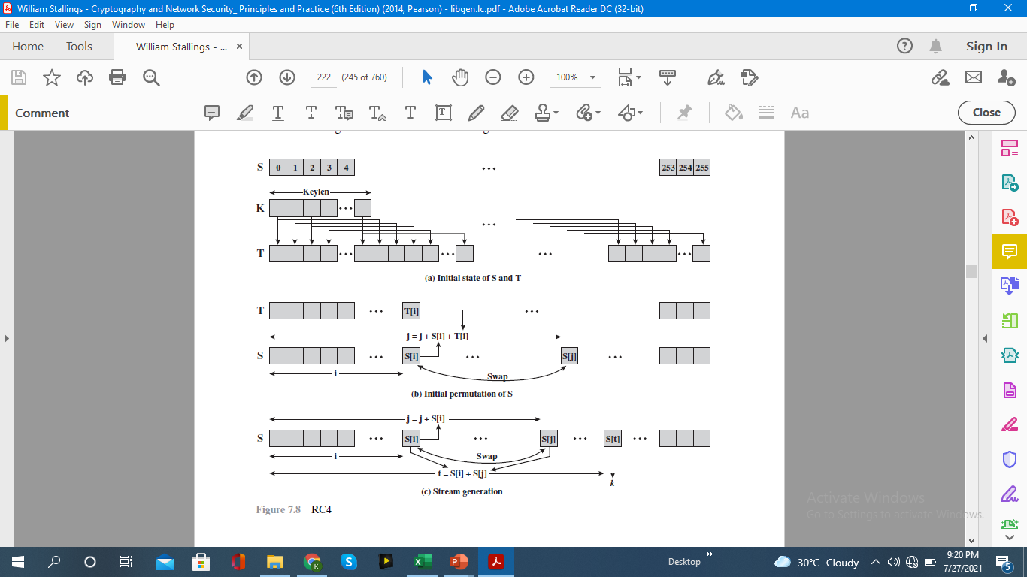
RC4 – Stream generation

Slide 109
KEY DISTRIBUTION
A term that refers to the means of delivering a key to two parties who wish to exchange data without allowing others to see the key.
For two parties A and B, key distribution can be achieved in a number of ways, as follows:
- A can select a key and physically deliver it to B.
- A third party can select the key and physically deliver it to A and B.
- If A and B have previously and recently used a key, one party can
transmit the new key to the other, encrypted using the old key.
- If A and B each has an encrypted connection to a third party C, C can
deliver a key on the encrypted links to A and B.

Slide 110
DIFFIE-HELLMAN KEY EXCHANGE
The purpose of the algorithm is to enable two users to securely exchange a key that can then be used for subsequent encryption of messages
The Diffie-Hellman algorithm depends for its effectiveness on the difficulty of computing discrete logarithms

Slide 111
A primitive root of a prime number whose powers modulo p generate all the integers from 1 to p -1
That is, if a is a primitive root of the prime number p , then the numbers
a mod p, a² mod p, … , a^{p-1} mod p
are distinct and consist of the integers from 1 through p-1 in some permutation
For any integer b and a primitive root a of prime number p , a unique exponent can be found such that the exponent is referred to as the discrete logarithm of b for the base a , mod p .This value can be expressed as dlog_{a,p}(b)

Slide 112
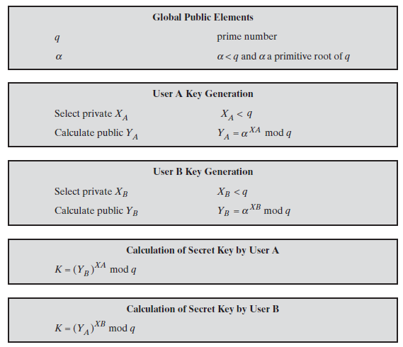

Slide 113
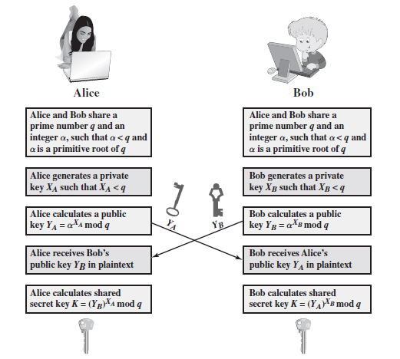

Slide 114
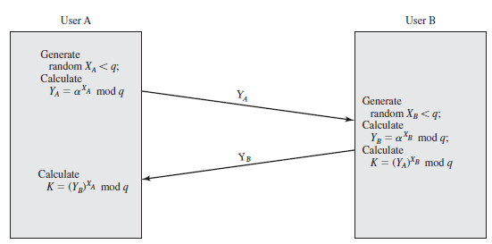
Key Exchange Protocols

Slide 115

Man-in-the-Middle Attack

Slide 116
Darth prepares for the attack by generating two random private keys X_{D1} and X_{D2} and then computing the corresponding public keys Y_{D1} and Y_{D2}
Alice transmits Y_{A}to Bob
Darth intercepts Y_{A} and transmits Y_{D1} to Bob. Darth also calculates
Bob receives Y_{D1} and calculates
Bob transmits Y_{B} to Alice
Darth intercepts Y_{B} and transmits Y_{D2} to Alice. Darth calculates
Alice receives Y_{D2} and calculates

