Slide 1

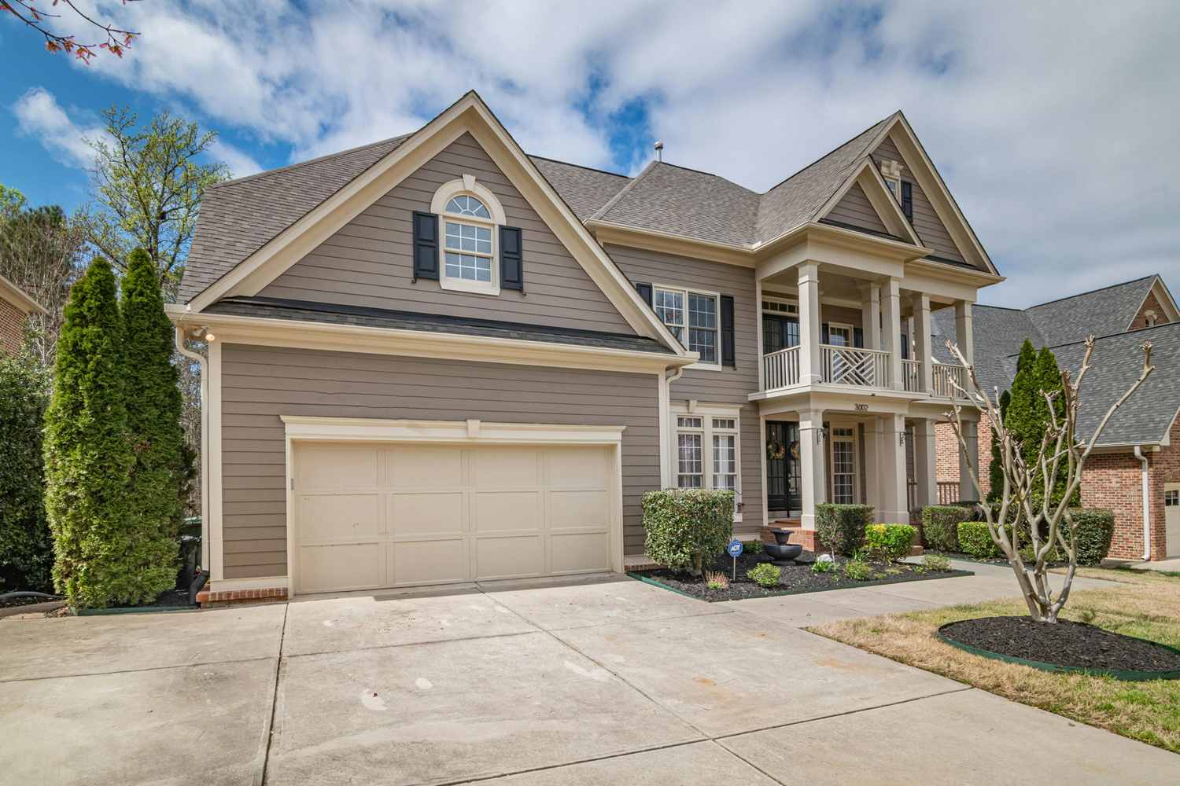


J&F Realty Insighters
REAL ESTATE ANALYTICS
MS-ADS 508 GROUP 6
Jun Sik Ryu, Faye Shawntel Corprew
Notes:
Hello everyone, today we will be presenting our project titled Real Estate Analytics: Housing Price Prediction.
This project was completed by Group 6 and focuses on using data to better understand and predict housing prices.
The goal of this presentation is to walk through the problem, our approach, key findings, and recommendations in a clear and practical way.”

Slide 2


Challenge
Housing prices fluctuate unpredictably
Limited data-driven guidance
Traditional analysis is slow
Notes:
The housing market is complex and influenced by many factors.
Housing prices fluctuate unpredictably, which makes it difficult for buyers, sellers, and investors to make informed decisions.
Additionally, there is limited data-driven guidance available, and traditional analysis methods tend to be slow and reactive; instead of being predictive.
To address this, our project had three main goals:
First, to predict housing prices using historical data.
Second, to identify the key factors that drive those price changes.
And third, to support stakeholders in making better, data-driven decisions.
Overall, the objective was to reduce uncertainty and improve decision-making using data.

Slide 3


Our Goal
Collect Data
Create Model
Decisions
Insights
Predict housing prices
Identify key drivers
Support stakeholders
Support better decisions
Notes:
This slide summarizes our overall approach in a simple workflow.
We started by collecting relevant housing data from Zillow.
Next, we created a predictive model using that data.
From the model, we generated insights about pricing patterns.
Finally, those insights can be used to support better business decisions.
This structured approach allowed us to move from raw data all the way to actionable outcomes.

Slide 4


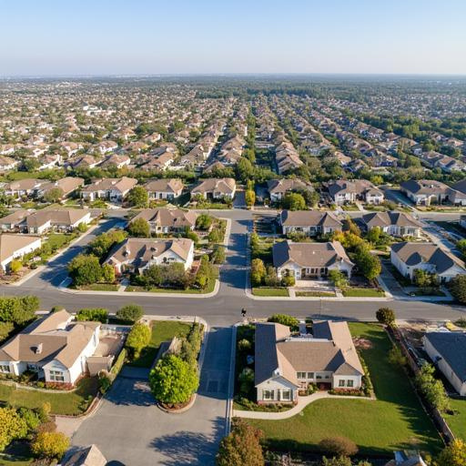
Implementations
Zillow housing data
Cleaned and prepared data
Combined the cleaned and prepared data
Built predictive model
Evaluated performance
Notes:
In terms of implementation, we used real-world housing data from Zillow.
The first step was data preparation, where we cleaned and processed the data to ensure quality and consistency.
We then combined multiple datasets to create a more complete view of the housing market.
After preparing the data, we built a predictive model designed to capture patterns in housing prices.
The model was trained and then evaluated using historical data to measure its accuracy.
At a high level, this process follows a standard data science workflow, where data is transformed into a model, and the model produces predictions.

Slide 5

Conclusion
Model predicts housing prices effectively
Market trends strongly influence prices
Data-driven insights
Notes:
Based on our analysis, we found several important insights.
First, the model was able to predict housing prices effectively, showing that historical data can be used to forecast future trends.
Second, market trends play a major role in influencing prices, meaning that changes in demand and supply significantly impact outcomes.
Finally, the project demonstrates that data-driven insights can provide meaningful value in understanding the housing market.
In summary, the results confirm that predictive modeling is a useful tool for analyzing real estate trends.

Slide 6

Recommendations
Deploy the trained model into dashboard
Update with new, recent data
Add more external data sources
Continuously improve the data model
Notes:
Based on these findings, we developed several recommendations.
First, the model should be deployed into a dashboard so that users can easily access predictions and insights.
Second, the model should be updated regularly with new data to maintain accuracy over time.
Third, incorporating additional external data sources could further improve prediction performance.
Finally, the model should be continuously refined and improved as more data becomes available.
These steps will help ensure that the system remains relevant, accurate, and valuable for decision-making.

