Slide 1
Unveiling Transportation Coverage Maps of New York
Team 03
DS4A Colombia
2019

Slide 2
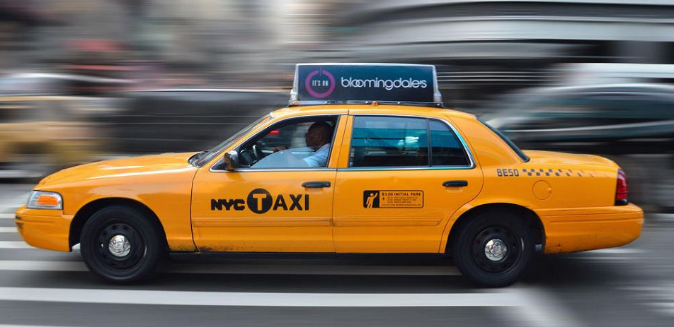
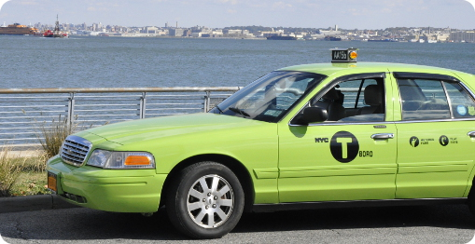
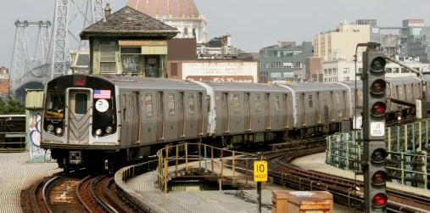
Background
Yellow cabs (1907)
Pick up passengers anywhere
Mostly located in Manhattan and airports
Very difficult to get a taxi out of Manhattan
Green cabs or Boro Taxi (2013)
Created to standardize street hails in NYC
Operate in: Brooklyn, Queen, The Bronx, upper Manhattan
Rides cheaper than yellow
UBER (2011)
Started in Manhattan but expanded at the same time that green taxis
MTA (1870)
The largest and oldest (1904) subway systems in the world
MTA has one of the worst commutes in the world (35.6 min)
Images from:
https://livingnomads.com/2017/03/why-are-taxicabs-of-new-york-city-often-painted-yellow/
https://dzone.com/articles/nyc-taxi-ride-analysis-with-couchbase-and-cloud9-c
https://www.railjournal.com/regions/north-america/new-york-mta-publishes-us-51-5bn-investment-plan/

Slide 3
Questions
Is public transportation coverage in New York City equally attending all areas?
Exploratory questions:
Is there a pattern in the areas unattended by public services in New York?
Is there are relationship between demographic information and peoples’ choices of public transportation?

Slide 4
Explored Data
Trips: # of pick ups or # drop offs
Trip distance: pick up location - drop off location
MTA: # entries and # entries exits
Demographic: age and income
Explored plots:
Analysis of number of trips per system: per month, rush/non rush hours, week, hour, borough
Weather: Average temperature per month, Average snowfall per borough, snowfall per borough monthly, average monthly precipitations per borough

Slide 5
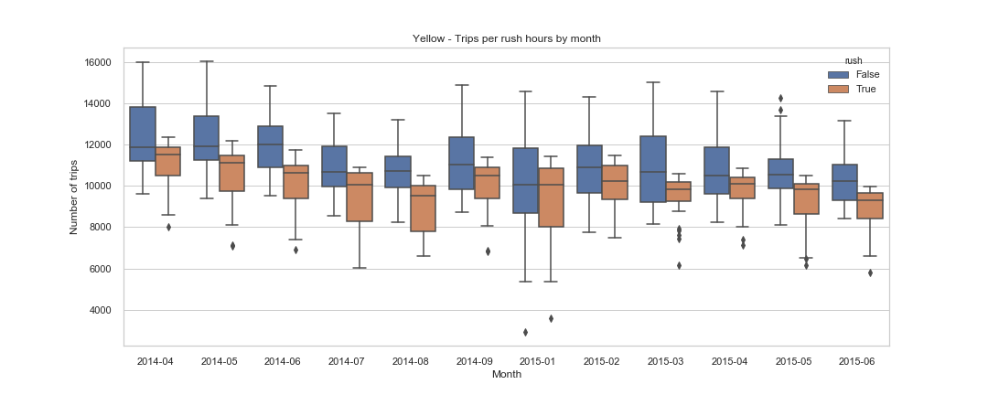
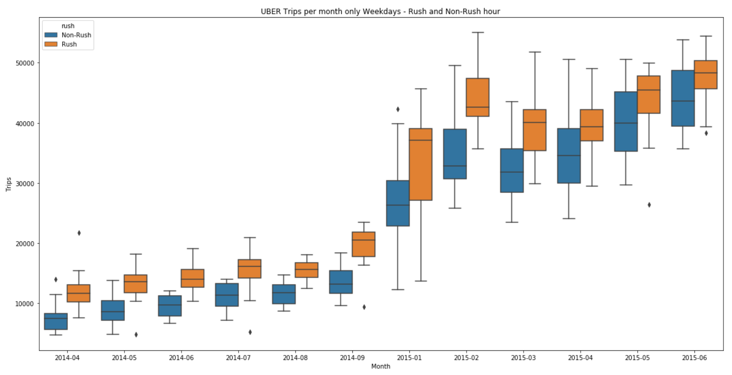
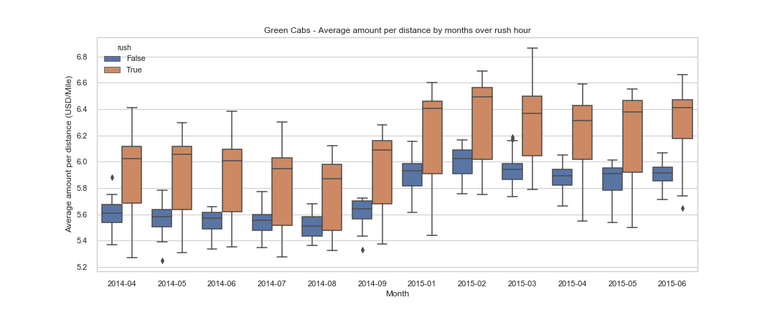
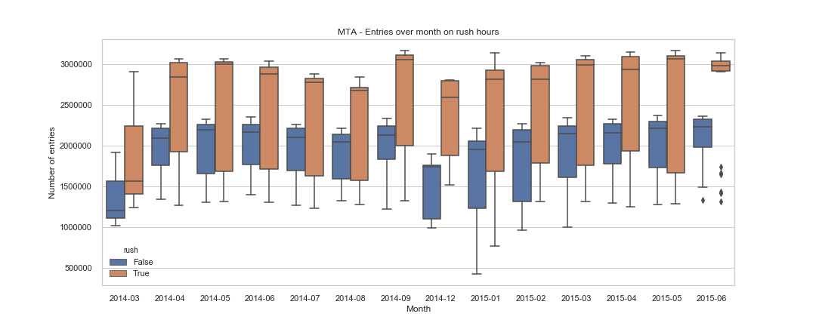
Exploratory Data Analysis
Number of Trips per system (monthly)
UBER
Yellow
Green
MTA

Slide 6
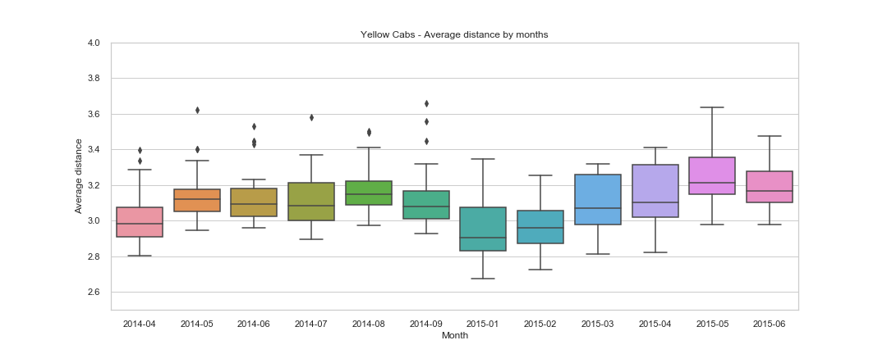
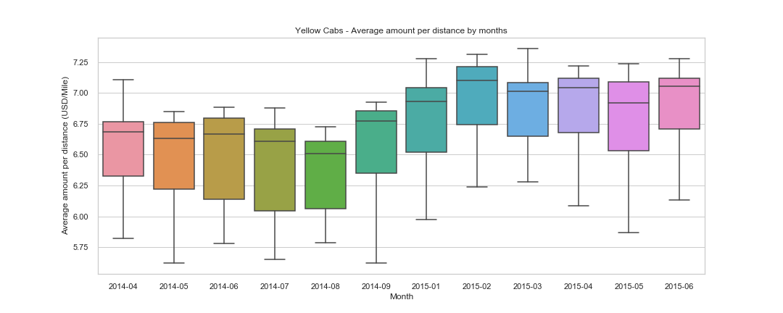
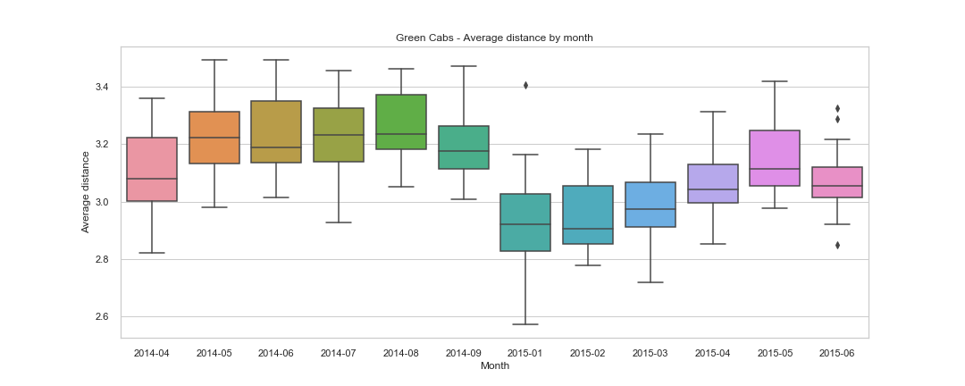
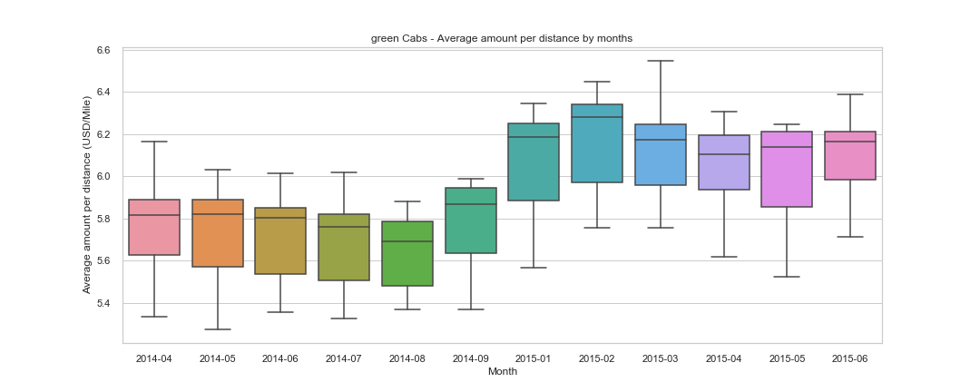
Exploratory Data Analysis
Monthly Average Trip Distance
Monthly Average price/distance
Yellow
Yellow
Green
Green

Slide 7
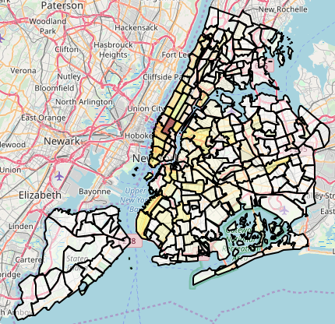
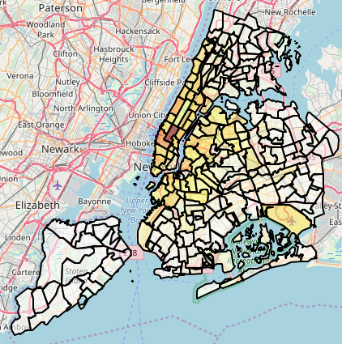
Exploratory Data Analysis
Pick ups normalized
by population per NTA
Drop off normalized by
population per NTA

Slide 8
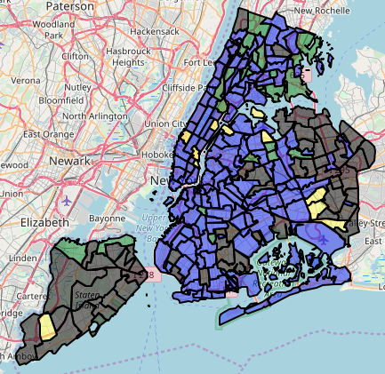
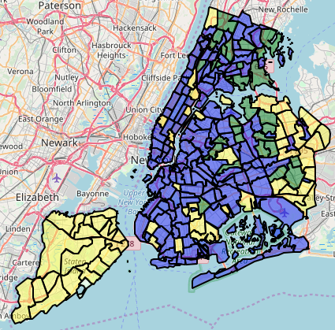
Exploratory Data Analysis
Max coverage: the maps show the transportation system mostly used per NTA (i.e. with the highest number of trips) for both, pick ups and drop offs
Gray = UBER
Purple = MTA
Yellow = yellow cabs
Green = green cabs
PICK UPS DROP OFF

Slide 9

Statistical Analysis
Hypothesis testing
H1: Due to UBER, the travel distances of yellow cabs trips increased.
H2: Due to UBER, the number of trips of yellow cabs was reduced.
H3: The areas of the city where there is no public transportation coverage, especially for hire transportation, correspond to areas with low income families (where ).
H4: Due to UBER incursion in the city, the price of yellow cabs trips have decreased.
From EDA:
- H2 → confirmed
- H4 → rejected
From ttest:
- H1 → Null hypothesis (no change in the mean distance of Yellow cabs in 2014 and 2015) rejected

Slide 10
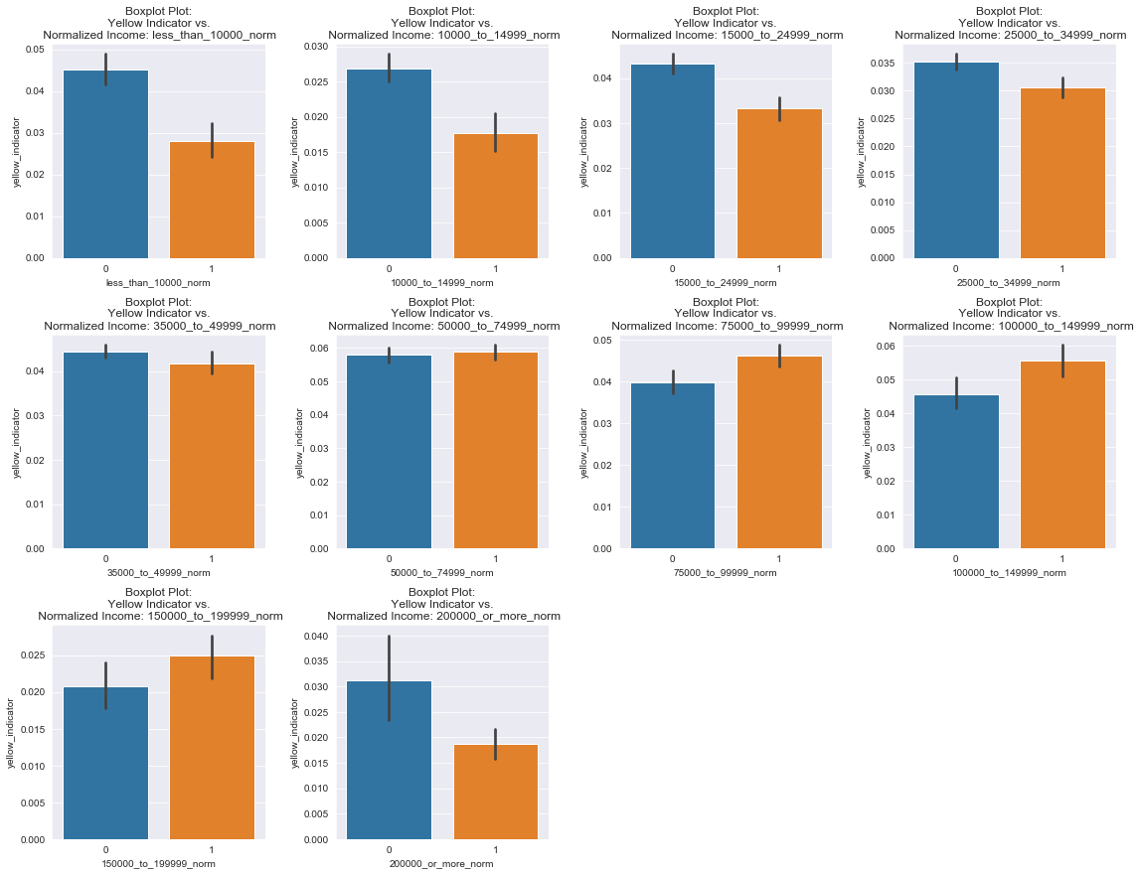
Statistical Analysis
From EDA:
- H3 → rejected
Most of the people that live in those areas are adults over 40 years old, some families with children.\item Most of them with higher incomes ($50000<$ incomes $< 200.000$ USD) than the ones that live in the zones with yellow\_indicator = $0$. Excluding the ones with incomes $> 200.000$
Most of the people that live in the yellow areas are:
Adults over 40 years old, some families with children.
With higher incomes (50000< incomes < 200.000 USD). Excluding the ones with incomes $> 200.000$

Slide 11
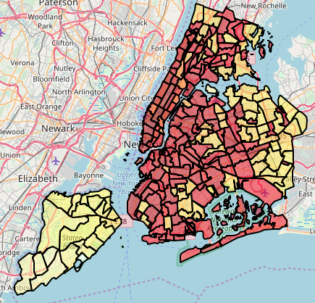
Key Findings
The UNSEEN MAP of
New York City
Red NTAs: log of # of pick ups > thresh.
Yellow NTAs: log of # pick ups < thresh.
The Map reveals:
Possible areas unattended by different transportation means (yellow areas).
An idea of people’s mobility choices, depending on where they live.

Slide 12
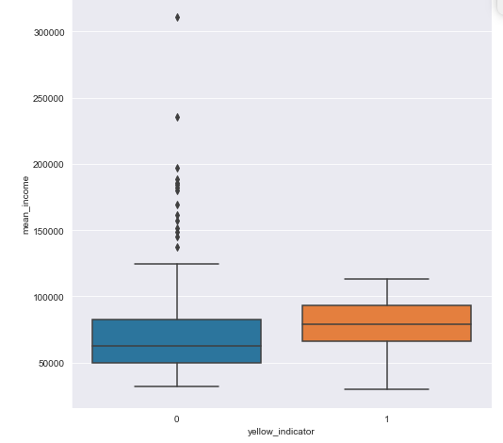
Key Findings
What are the patterns of the yellow NTAs where public transportation demand is low?
Excluding incomes > 200.000 USD → most of the people that do not frequently use public transportation, correspond to people with high incomes (yellow box).
People with the highest rent live in Manhattan (outliers of blue box) → one of the areas with a good public transportation coverage.

Slide 13
The UNSEEN MAP of
New York City
The Map reveals:
People in Yellow areas:
They use other transportation means such as their own car for long distance trips, bikes, scooters, or even walk for short distances.
Uber is one of the services that is attending the outer NTAs. However, not with a very high demand yet.

Slide 14
The UNSEEN MAP of
New York City
Despite efforts to improve public transportation coverage (e.g. including green cabs), outer areas are still unattended (see map)

Slide 15
Model Fitting:
Random Forest model used to predict the Yellow indicator, based on demographic information.
Accuracy: 87.72%
Precision: 82.35%
The model could be used to create a projected coverage map.
With the aim of analyzing:
If no changes are done in terms of mobility, and if population and demographic information changes, how do those changes affect the coverage.

