Slide 1
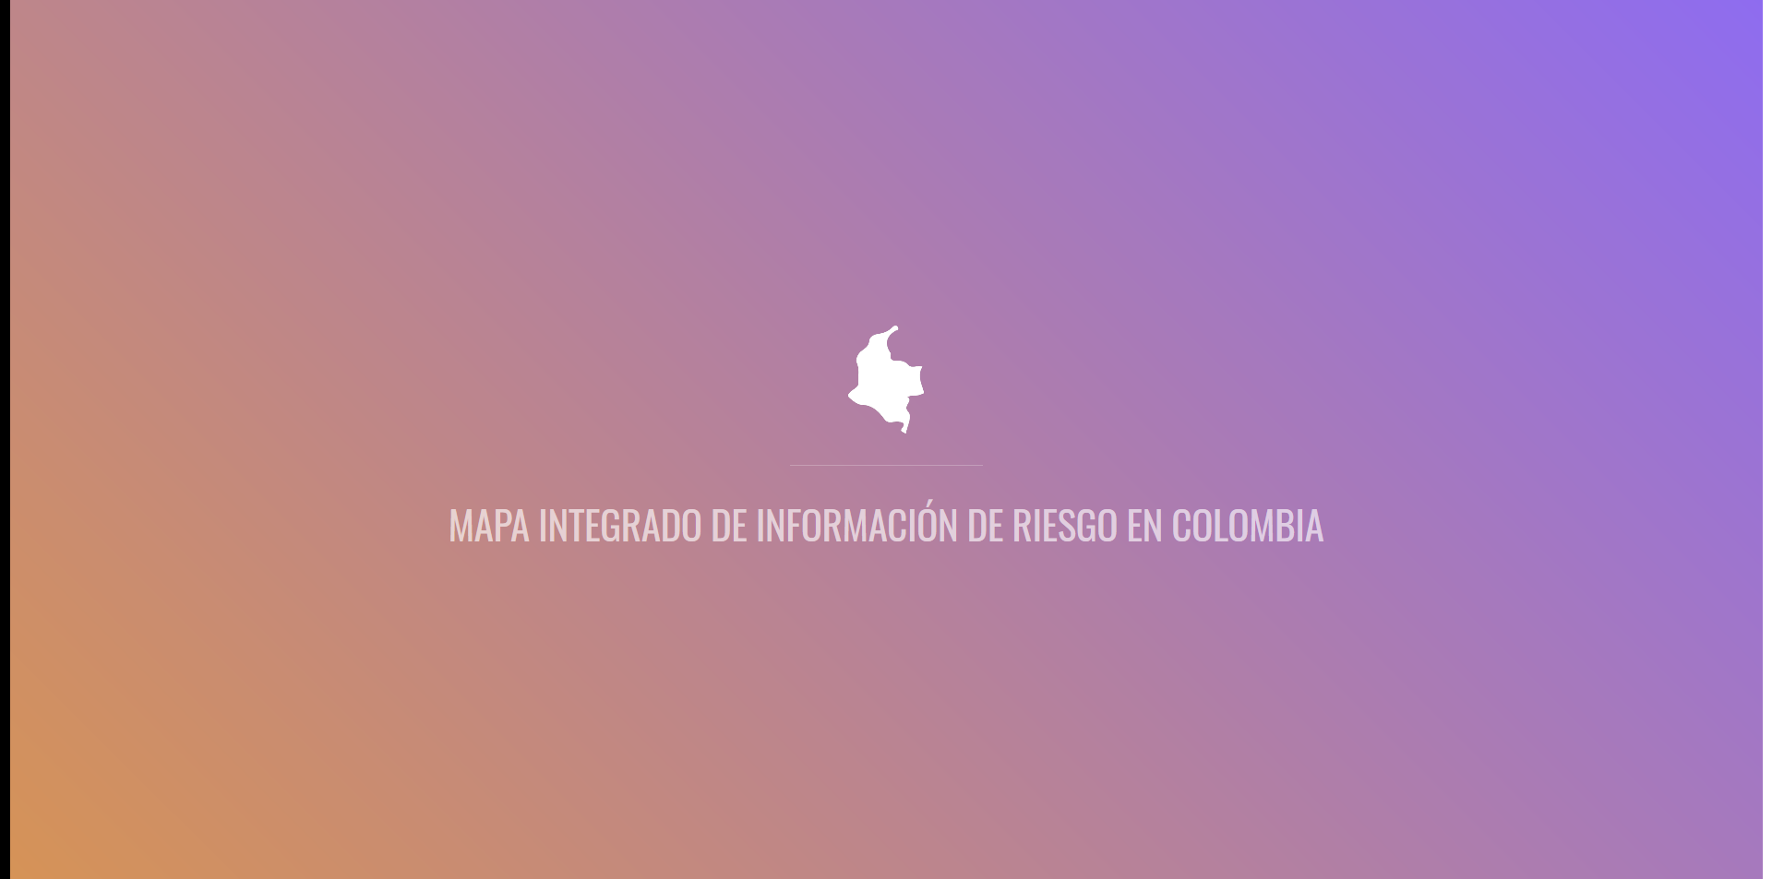
DS4A COLOMBIA 2019
Group 03 – Bogotá
Dec. 11 2019

Slide 2
WHY / WHAT

Slide 3
WHY

Slide 4
WHY RISK FROM NATURAL DISASTERS?

Slide 5
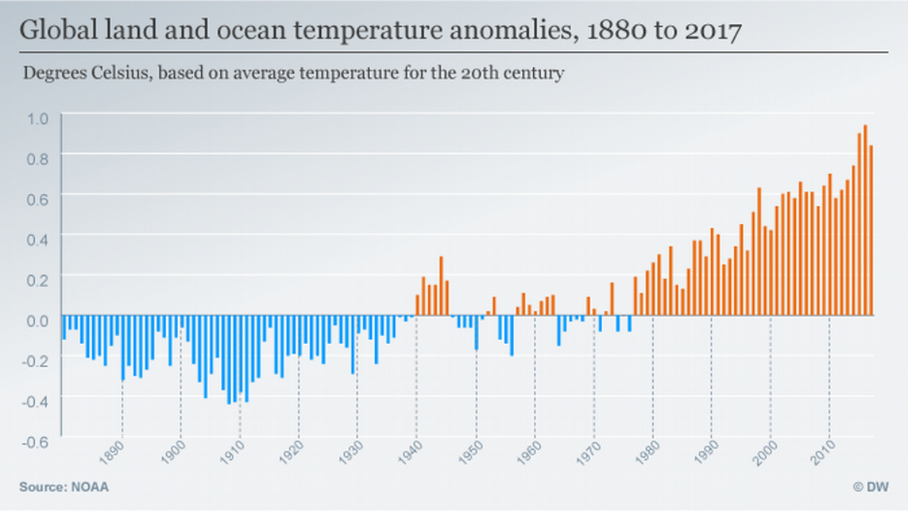
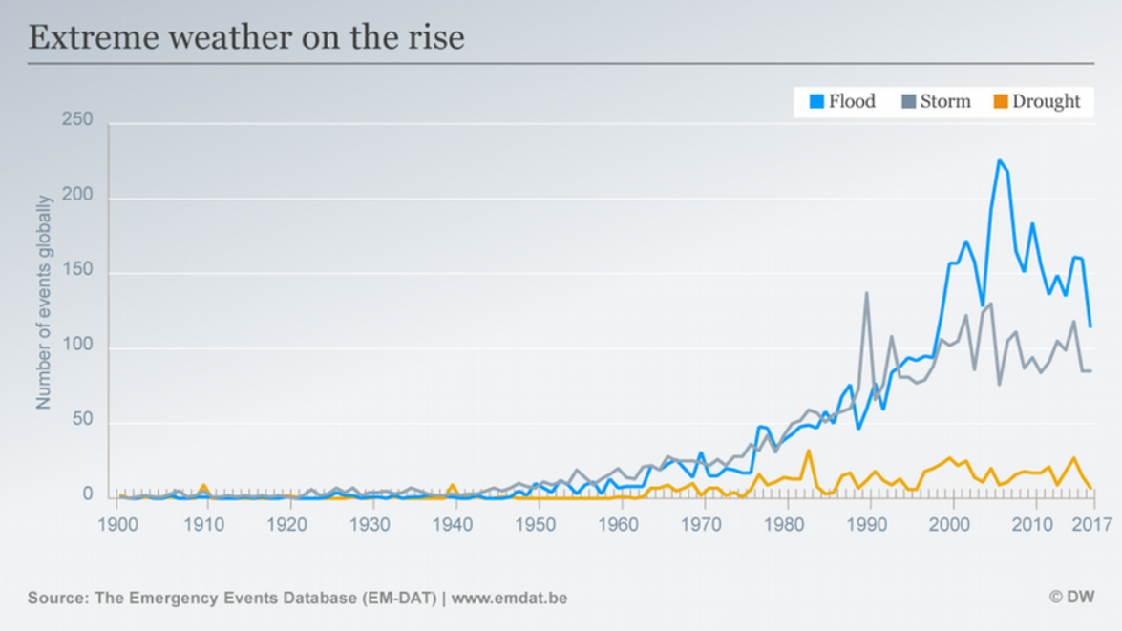
WHY

Slide 6
UNITED NATIONS| Inequality and Climate Change Vicious Cycle*
Greater exposure of disadvantaged.
Disproportionate Loss of Assets and Income.
Multidimensional
Inequality.
WHY
CLIMATE HAZARD
* Climate Change and Social Inequality
Department of Economic and Social Affairs
DESA Working Paper No. 152S T/ESA /2017/DWP/152

Slide 7
Past.
Present.
Future.
Find Historical Data.
Index the imbalance in coping capabilities and available resources.
Offer actionable information to understand future impact of climate events.
WHAT

Slide 8
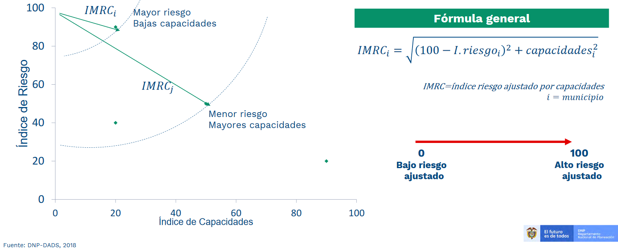
DNP| ÍNDICE MUNICIPAL DE RIESGO AJUSTADO POR CAPACIDADES.
WHAT
Notes:
Not a bad thing.

Slide 9

Notes:
Realize: How long did it take.
Make sense.
Enters Integrated Map of Climate Associated Risk

Slide 10
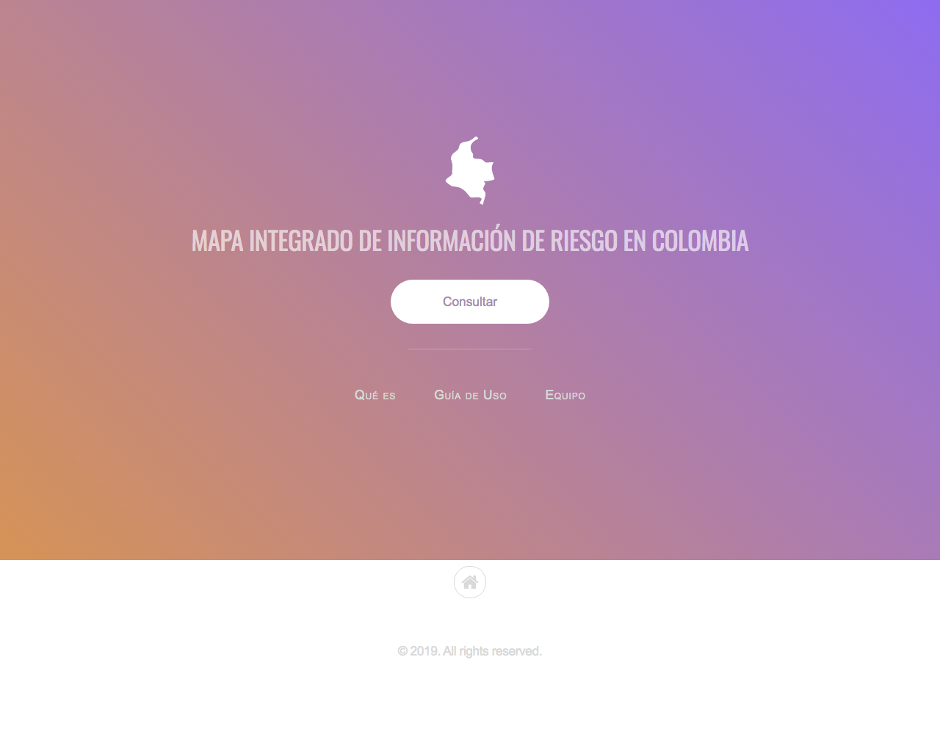
Home
WHAT: Enable any person to find, read and understand the basic risk profile of her region of interest.
Notes:
Remember, this is about decisión Making
Person casting a vote
Reaching a key point

Slide 11

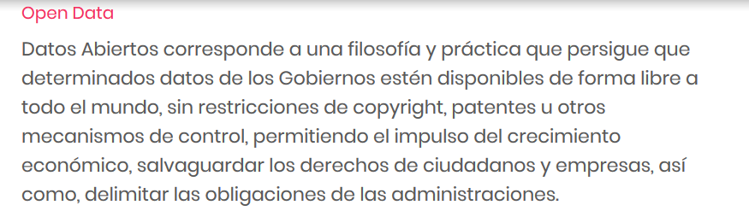
WHAT IS OPEN DATA?
https://www.mintic.gov.co/portal/604/w3-article-5664.html?_noredirect=1

Slide 12
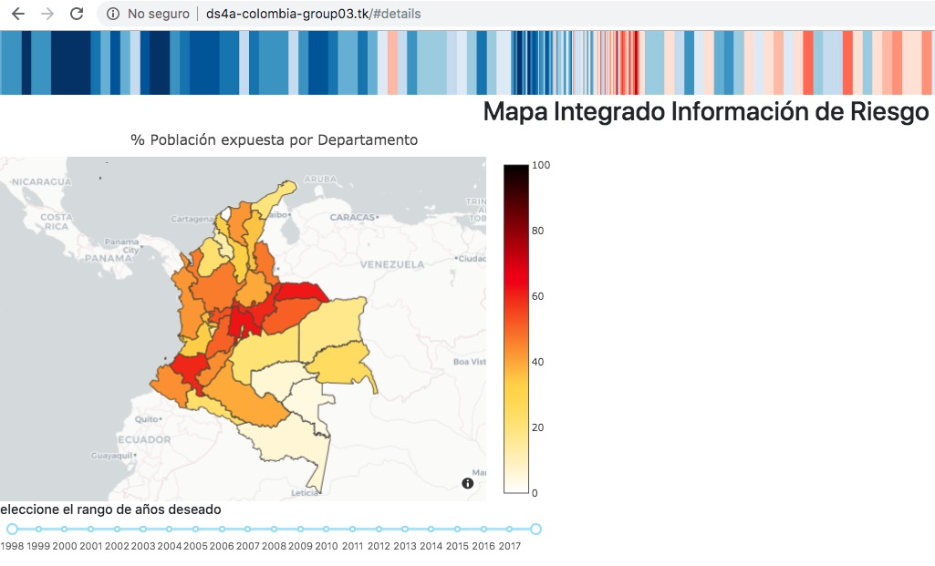
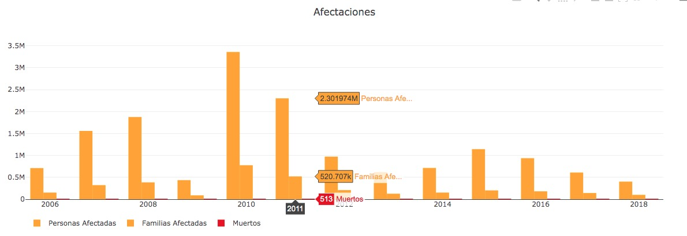
/Consultar
Notes:
Departments heatmap responds to Percentage of population exposed.
Right hand side: Impact variables exploration.
Click to drill down into the municipal level

Slide 13
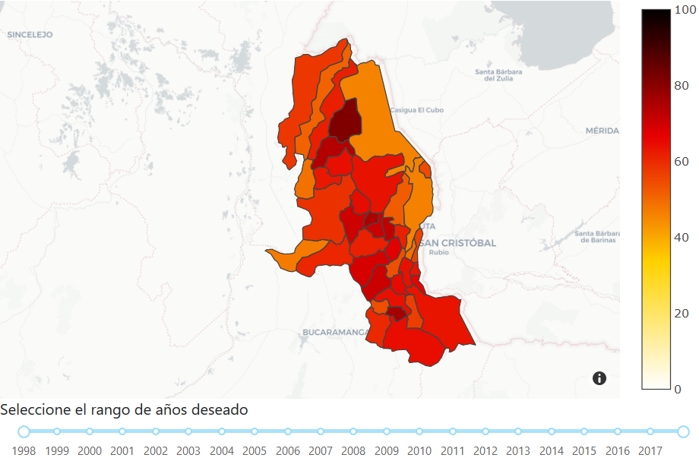
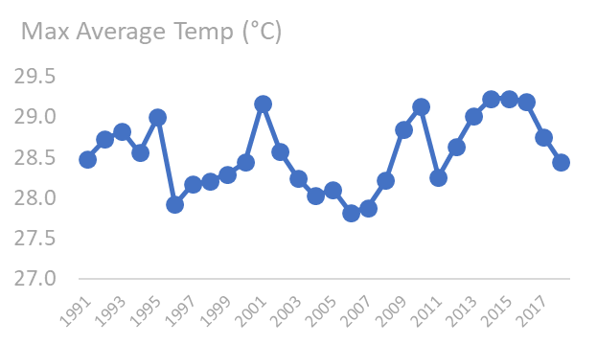
/Drill down: Municipal level.
El Tarra| Norte de Santander
Notes:
Now we can also see the Max and Min average temperatura for that particular Latitud and Longitud. We are reaching a key point here. But let’s see an example. CLICK

Slide 14
Notes:
Max avg mean temp
Reaches 29° Threshold roughly 6 to 10 years
That’s up to 2010 when not only the Interval is shorter but temp stays above 29 for the next 3 years.
Recap what we know:

Slide 15
El Tarra| Norte de Santander
Notes:
A higher max average temperature means that you are experiencing more hot days during the year.
But we already stablished that is correlated to a higher frequency of the kind of events responsable for 88% of disasters in Colombia.

Slide 16
TEMP +1.5°
Global Population Exposed to Severe Heat Waves.
TEMP + 2.0°
14%
37%
Urban Population exposed to Water Scarcity.
WHAT’S
HALF A DEGREE WORTH?
31M - 69M
32M - 80M
Population exposed to flooding from sea level rise.
350M
411M
By BRAD PLUMER and NADJA POPOVICH OCT. 7, 2018
Ilustrations by IRIS GOTTLIEB
https://www.nytimes.com/interactive/2018/10/07/climate/ipcc-report-half-degree.html?mtrref=www.google.com&assetType=REGIWALL
Notes:
When talking about climate data, tiping points are crucial.

Slide 17
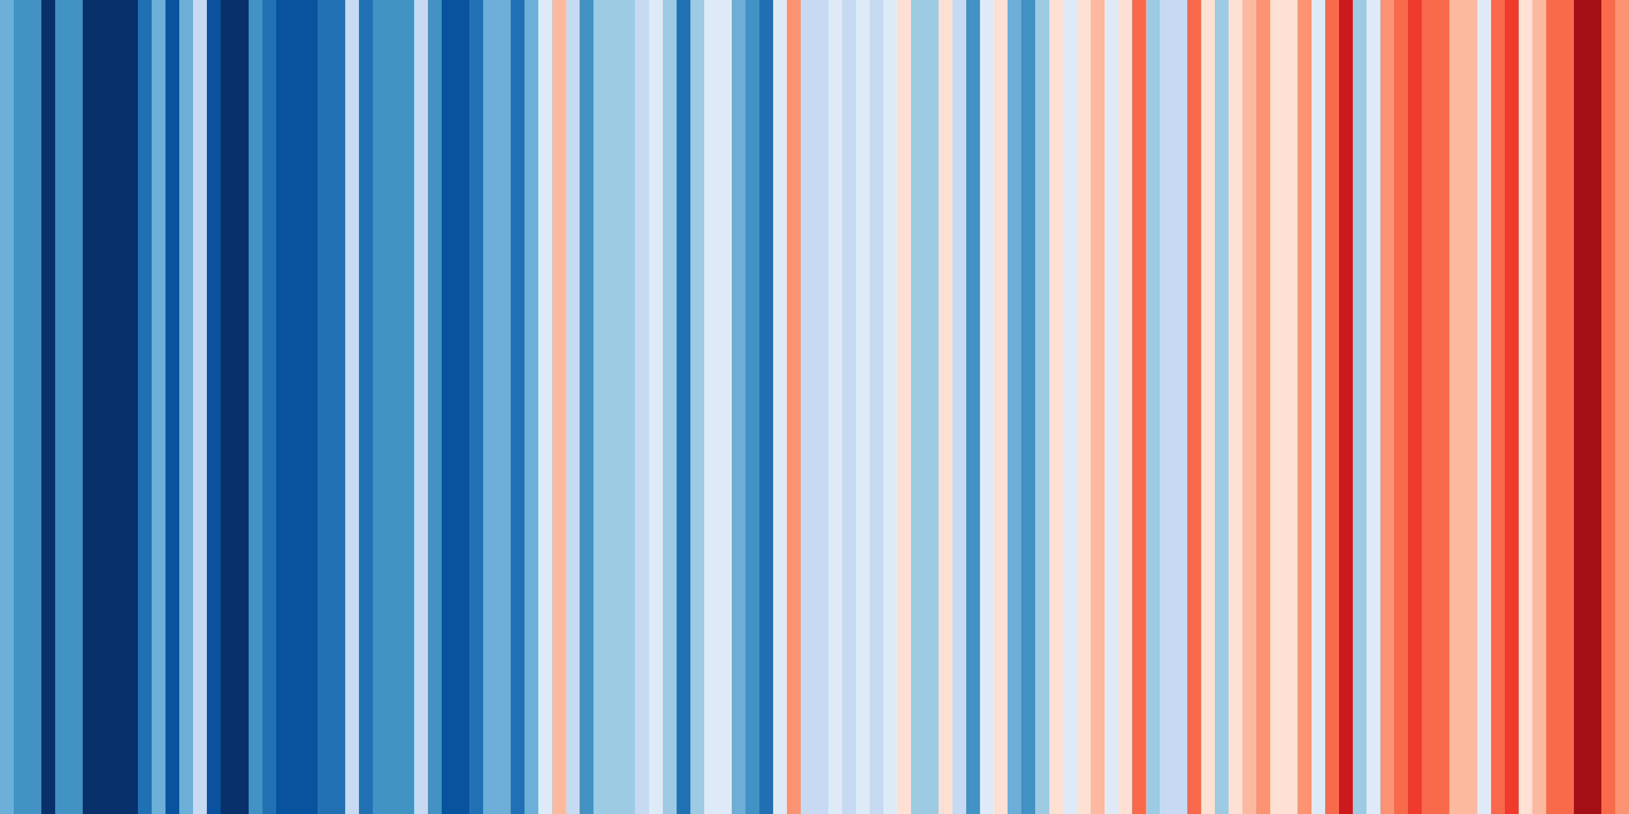
Ed Hawkins’ – Warming Stripes.
Notes:
Trying to solve a problema through data visualization requires a balance:::::::::for instance:….
Hopefully we accomplished some of that: Surfacing information from the past, removing friction to access current data and giving some clues about the future.

Slide 18
Álvaro Muñoz Lovera.
Carol Martínez, PhD.
THANK YOU!
Javier Cocunubo.
DS4A COLOMBIA 2019
Group 03 - Bogotá
Johnathan Salamanca.
Mario Alberto Cerón.
Jairo José Niño.

