Slide 1
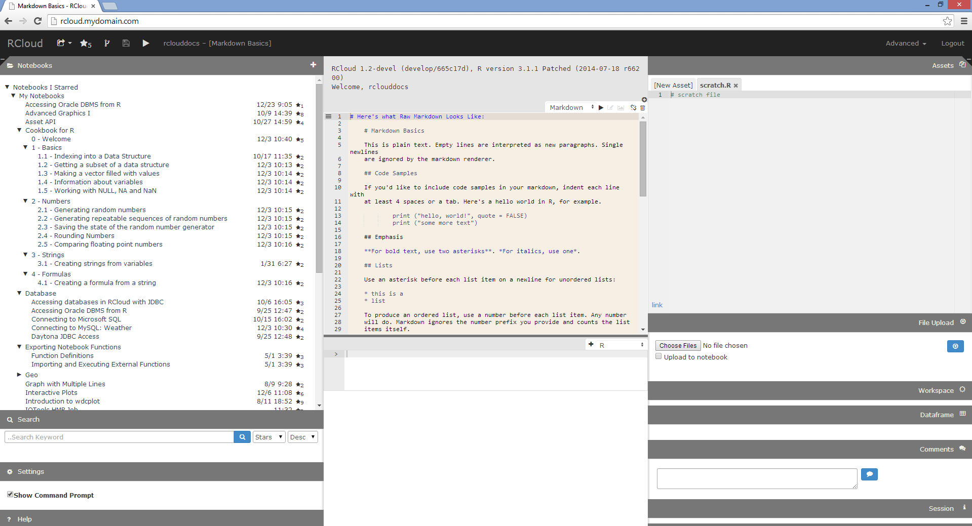
Header Bar
Markdown Cells
“Windowshade” Panels
Notebooks, Search, Settings, Help
“Windowshade” Panels
Assets, File Upload, Workspaces, Dataframe, Comments, Session
Prompt Cells

