Slide 1
Women in Film and Box Office Revenue
Jonathan Shepard

Slide 2
The Research Question
What is the nature of the relationship between women’s ‘screen time’ in a film, and the expected box office revenue of that film?

Slide 3

Guardians of the Galaxy (2014) Total Box Office = $771 million
DUDE
LADY
TREE GUY
DUDE
RACCOON

Slide 4

Frozen (2013) Total Box Office: $1.27 billion
Snowman
Lady
Dude
Lady
Dude
Reindeer

Slide 5

The Avengers: Age of Ultron Total Box Office: $1.4 billion
Dude/Norse
god
Dude
Dude
Dude
Dude
Lady
Sick and tired
Of these
motherfuckin’
Snakes on this
motherfuckin’
plane

Slide 6
SO WHAT’S GOING ON HERE?

Slide 7
What’s the Deal?
Fivethirtyeight did an analysis of gross revenue as a function of films passing or failing the “Bechtel test”
Alison Bechtel noticed gender bias in Hollywood movies way back when – created Bechtel test. Do two women appear and have a conversation about something other than a man?
Bechdeltest.com: Pass rate about 50-50

Slide 8
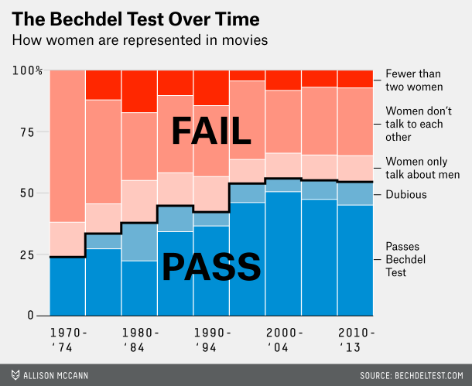

Slide 9
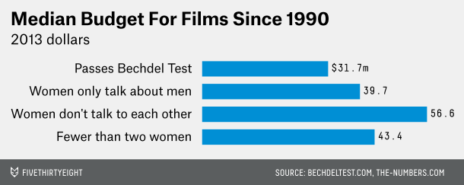
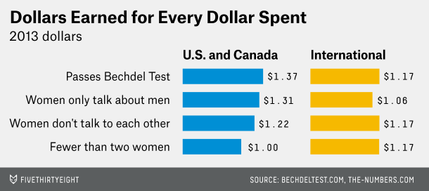
Fivethirtyeight’s conclusion:
Hollywood ‘dinosaurs’ and
their gender bias continue
to overpower basic financial
analysis

Slide 10
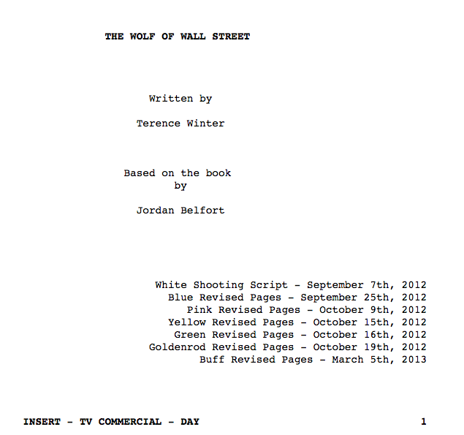
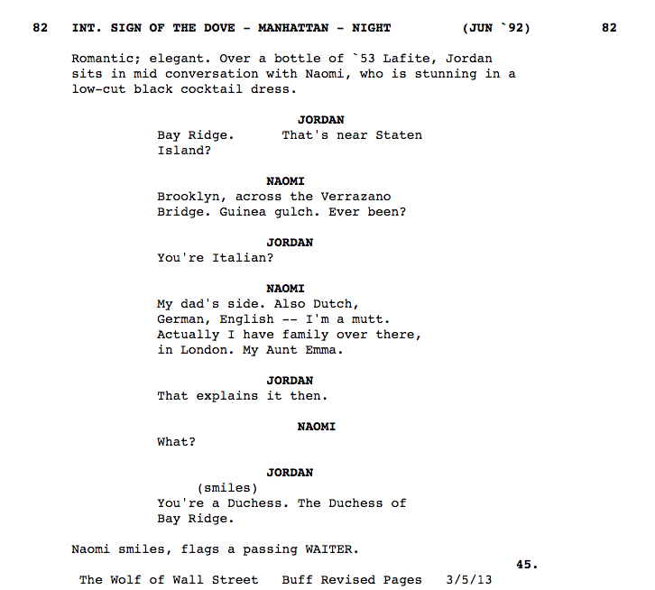
What’s New About This Project?
Script Analysis

Slide 11
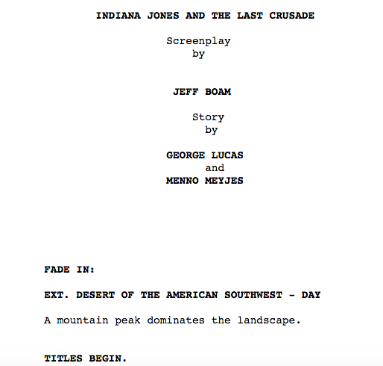
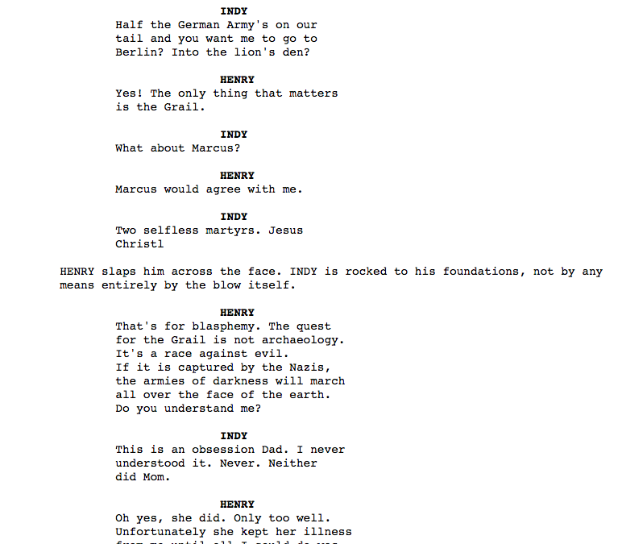

Slide 12
Data Sources
Movie financial data – thenumbers.com
Scripts – imsdb.com, possibly others?
Names – randomnames.com

Slide 13
Anticipated Issues
Access to scripts
Name assignment (M/F/Neither) – ex. How to Train Your Dragon
Writing code to parse number of spoken lines
Selection bias
Spoken time as proxy for screen time (better than Bechtel test?)
Classification problems (outliers?)
Other variables may be more predictive

Slide 14
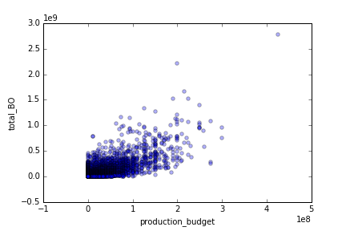
Box Office vs. Production Budget

