Slide 1
Textures
Texture mapping
Sampler
Vertex texture information
Initialize sampler state
Animated textures

Slide 2
Textures
Pictures.
Format: JPG, PNG, DDS, BMP, TGA
Textures are mapped on triangles.

Slide 3
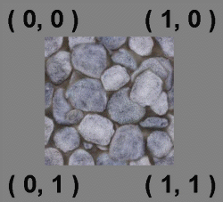
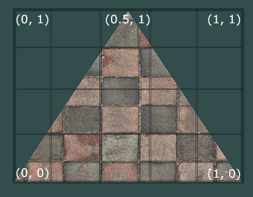
Texture mapping

Slide 4
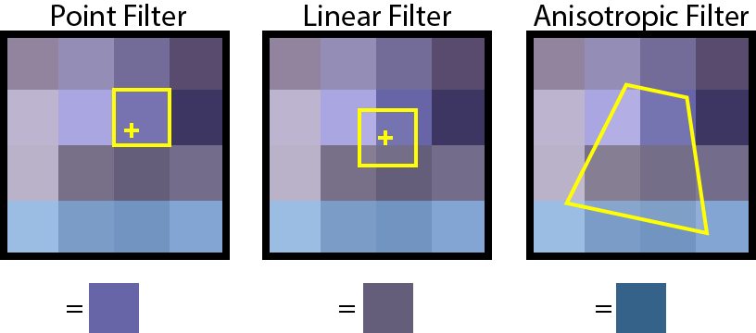
Texture sampler
point, linear, anisotropic

Slide 5
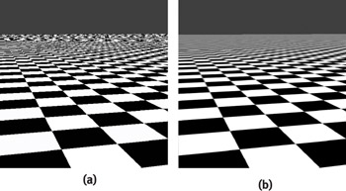
Texture sampler

Slide 6
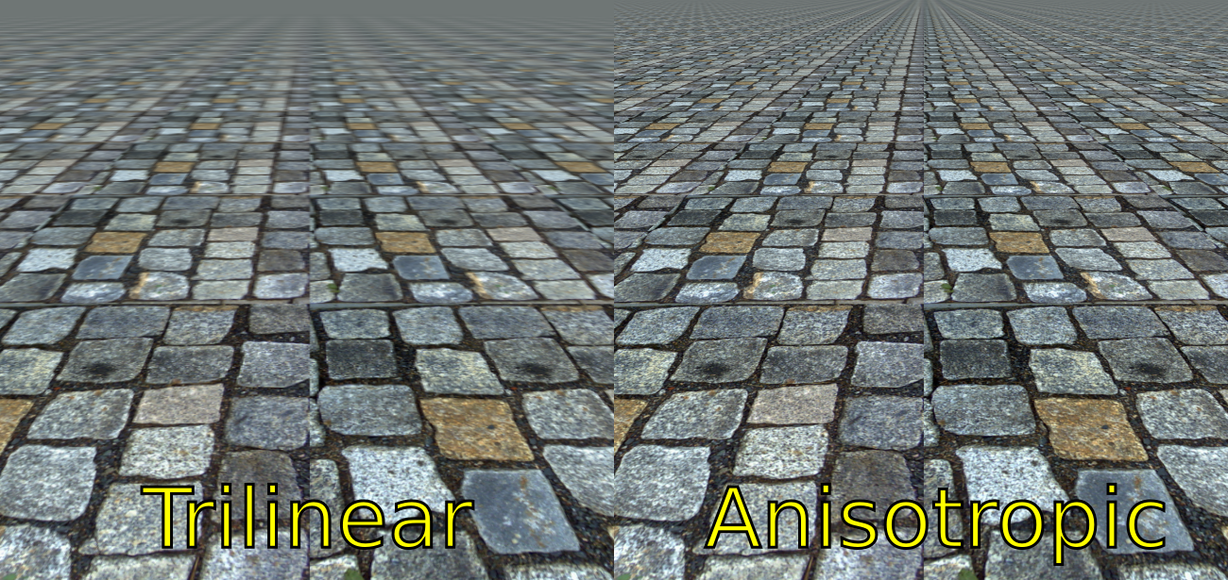
Texture sampler

Slide 7
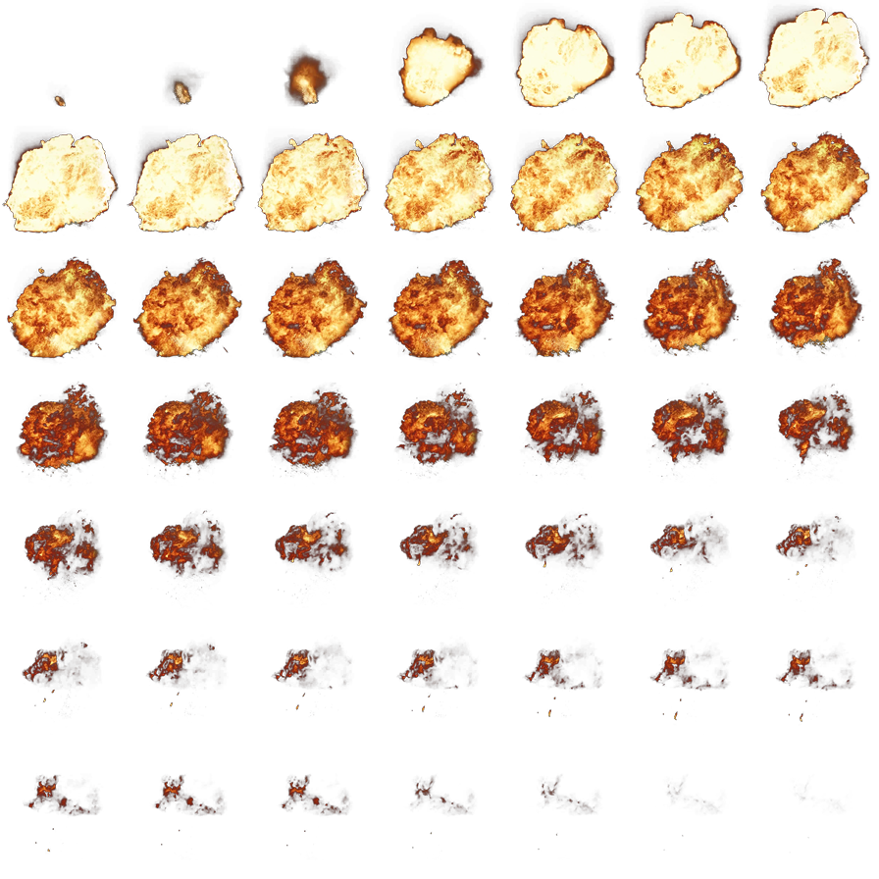
Animated textures

