Slide 1
American Red Cross Mass Care

Slide 2
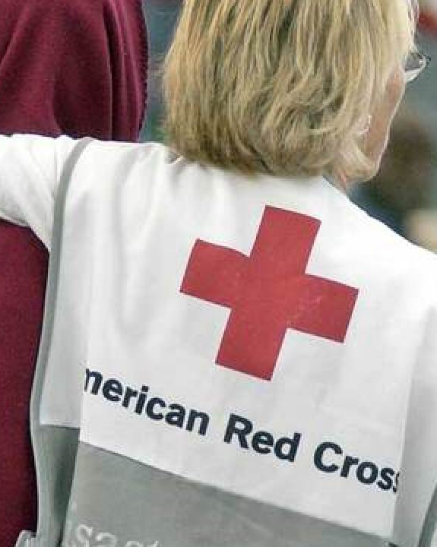
The American Red Cross prevents and alleviates human suffering in the face of emergencies by mobilizing the power of volunteers and the generosity of donors

Slide 3
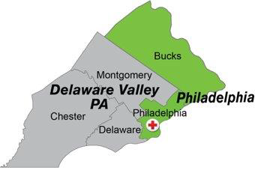
SOUTHEASTERN PA REGION
Notes:
Emphasize that Montgomery County is part of Delaware Valley Chapter. Two chapters make up the SEPA region. The region reports to a district. And the District reports to the National.
The steady state Red Cross organization is organized geographically.
This structure enables us to:
Leverage local knowledge
Collaborate with partners and the community
Align with partners at every level of government
Mobilize quickly in times of disaster.
Our county is within the Southeastern PA Region (aka: SEPA). The SEPA Offices are in Philadelphia.

Slide 4
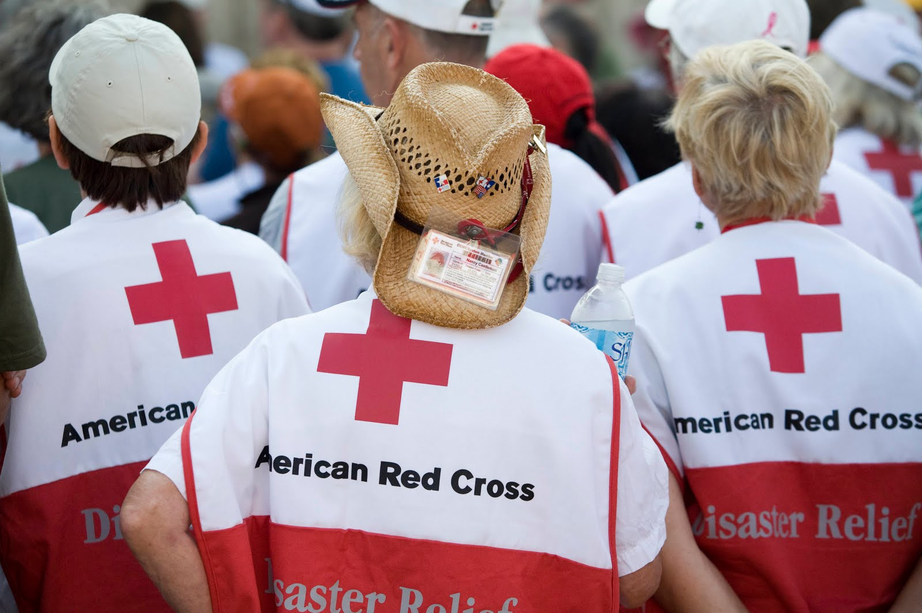
Our Principles
WHO ARE OUR VOLUNTEERS?
Red Cross Volunteers:
Have reached out to us via our website or phone number to become active members of the Red Cross.
Vetted by our DWE teams and received significant training
Volunteers comprise 90% of our workforce
Event Based Volunteers
Flexible, short-term support during high-need situations not affiliated with the Red Cross. Friends and neighbors stepping up to help their community.
  Less training required then RC volunteers
  Limited access to confidential information and some shelter tasks
  Tend to be in operational rather than client facing roles due to confidentiality
  May be able to fill a specialized need
Notes:
Explain how one signs up to be a volunteer. Heather does NOT want this to be a recruitment presentation.

Slide 5
DISASTER CYCLE SERVICES (DCS)
PREPARE
RESPOND
RECOVER
Notes:
Begin running through DCS. The first few slides are examples of how we prepare (this is not an all encompassing presentation)

Slide 6
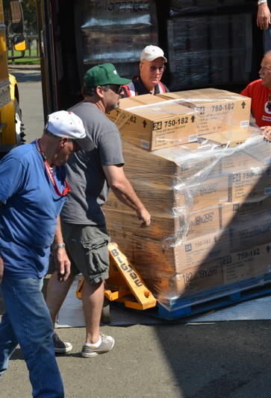
Organizational Preparedness:
Pre-position disaster supplies
Recruit and train response teams
Planning for effective facility and fleet management during disasters
Identify and inspect shelter locations.
Target of 2 hours from request to scene
Aim to be able to maintain 3 simultaneous shelters for 3 days to allow time for national support
Notes:
LOGISTICS:
Inventory and restock trailers with disaster supplies on a scheduled basis
Supply DAT teams (comfort kits, blankets, snacks, water etc.)
Ensure vehicle fleet and trailers are safe and ready to roll
Plan for effective facility and fleet management during local disasters
Inspect facilities for appropriate use during local disasters (in conjunction with Mass Care)

Slide 7
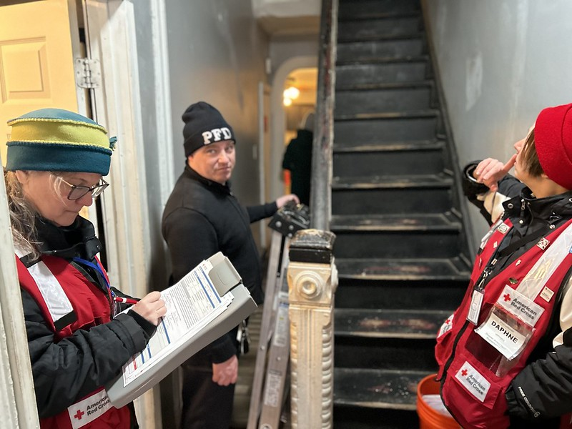
DISASTER ACTION TEAM (DAT)
Every call begins here
24/7 response to any disaster event of any size
Will handle the needs of up to 10 individual cases in the moment
Assess damage and client’s post disaster needs
Able to disburse financial assistance to help with immediate needs
Create cases and notes to allow for follow on Medical, Mental Health and Spiritual Care services
Serves as the pivot and information gathering element of escalating mass care situations
Notes:
If a DAT response escalates beyond what the team can handle, they escalate the response, drawing on additional local, District, Regional or National Red Cross resources AND WE TRANSITION FROM STEADY STATE TO OPERATIONAL status immediately.
DAT is the heartbeat of the local American Red Cross providing immediate response to those impacted by local disasters:
DAT Teams are activated by a Duty Officer.
Larger scale responses (called Disaster Relief Operation) like the recent MFF in the Tioga section of Philadelphia began with a DAT response.
DAT Teams assess damage, client’s post disaster needs and offer immediate assistance in the form of CAC activated using mobile device or computer. Value of CAC uses a simple formula based on need, livability of home and number of family members.
DAT makes referrals to other Red Cross volunteers or community resources for:
Medical needs (provided by team members with professional licenses and specialized training)
Mental health counseling (provided by team members with professional licenses and specialized training)
Spiritual Care needs (provided by volunteers who have been Chaplains with other organizations)
Longer term needs such as housing
TYPICALLY HOW MANY? HOW MANY? +- DAT RESPONSES PER YEAR IN SEPA Region.
About THIS MANY in Bucks County
About THIS MANY in Chester County
About THIS MANY in Delaware County
About THIS MANY in Montgomery County
About THIS MANY in Philadelphia County

Slide 8
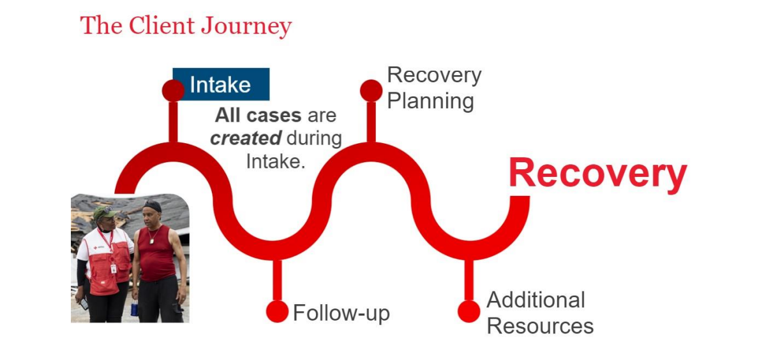
The Client Care Program (CCP)
Notes:
INSTRUCTOR: Please review the points below.
The American Red Cross CLIENT CARE PROGRAM:
Every client will receive similar types of recovery support from Red Cross regardless of the disaster or unique disaster-caused needs.
The first step with the Client Care Program is Intake. All client cases in the RC Care system are created during Intake.
As a DAT Responder you will participate in the Intake process for eligible clients with whom you meet during the disaster response.
Basic client information is collected to identify disaster-caused needs, determine eligibility, and provide financial assistance and other resources to help with recovery.
Meeting with a client during intake also sets the stage for Recovery and the information you collect during the intake interview will be used throughout the Client Journey towards Recovery.
We will discuss Intake in more detail shortly
We strive for Continuous Improvement to all of the Disaster Cycle Services policies and procedures. To ensure this the Red Cross encourages client feedback. Primary clients will receive a client satisfaction survey when their case is closed. REMEMBER: the client experience during a DAT response is usually the most important one in determining their overall satisfaction with the Red Cross.

Slide 9
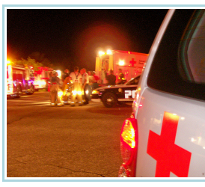
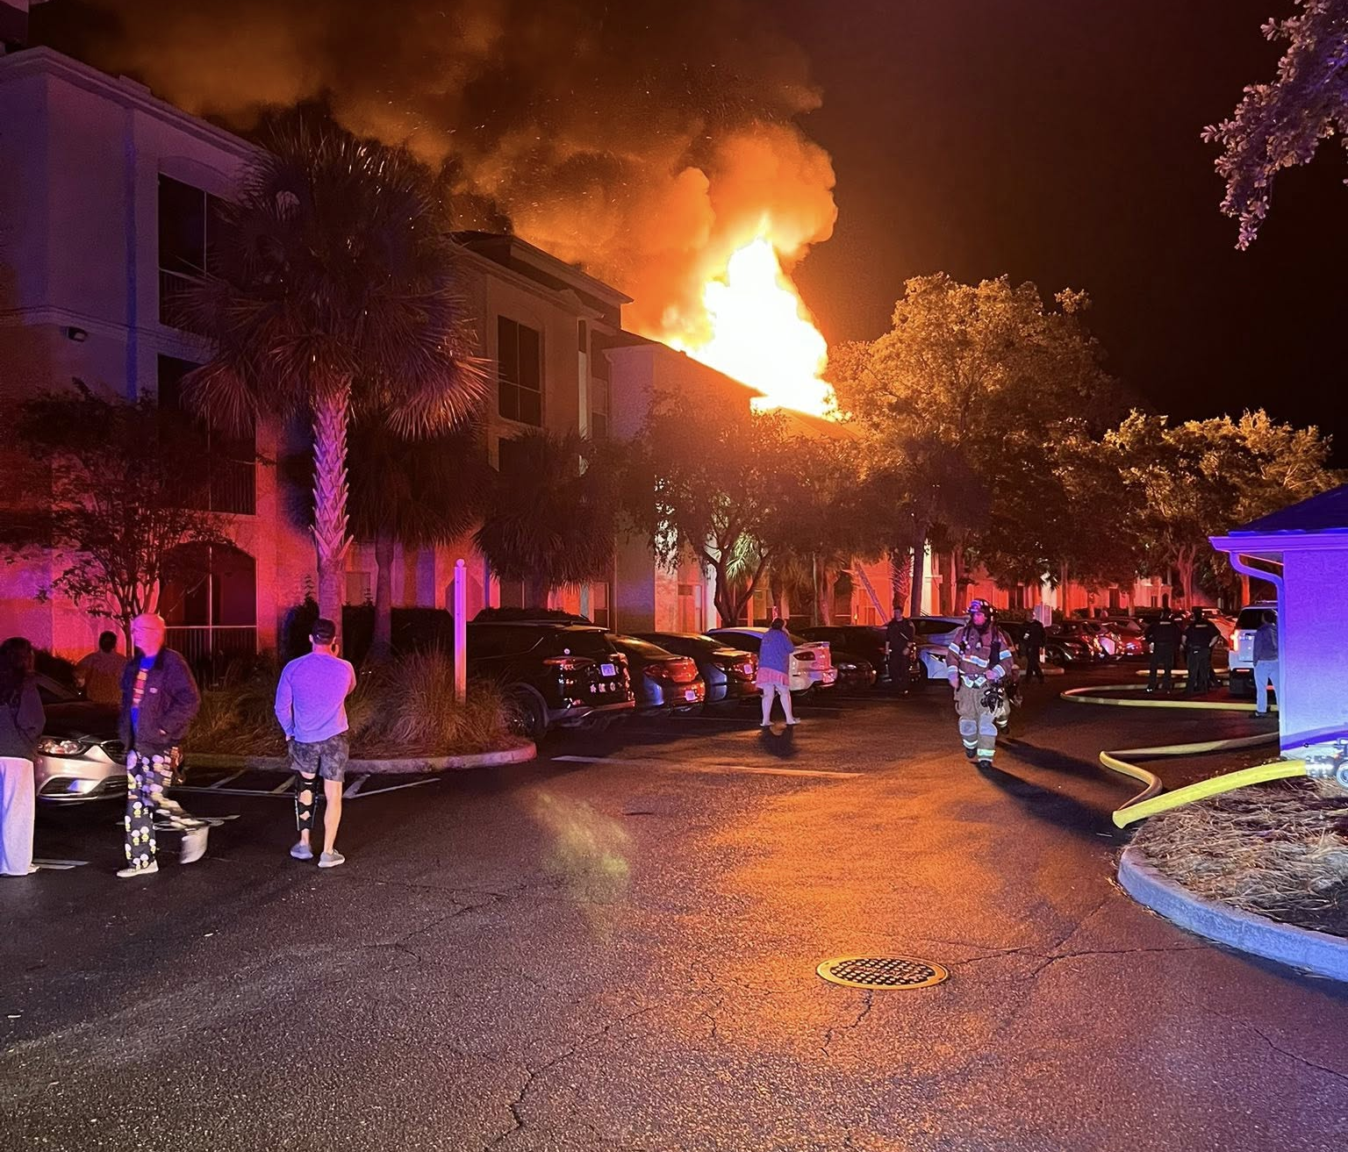
TRANSITION FROM DAT RESPONSE TO MASS CARE EVENT
Notes:
The Fundamental Principles of the Global Red Cross Network also guide all of our actions.
Humanity: The Red Cross, born of a desire to bring assistance without discrimination to the wounded on the battlefield, endeavors—in its international and national capacity—to prevent and alleviate human suffering wherever it may be found. Its purpose is to protect life and health and to ensure respect for the human being. It promotes mutual understanding, friendship, cooperation and lasting peace amongst all peoples.
Impartiality: It makes no discrimination as to nationality, race, religious beliefs, class or political opinions. It endeavors to relieve the suffering of individuals, being guided solely by their needs, and to give priority to the most urgent cases of distress.
Neutrality: In order to continue to enjoy the confidence of all, the Red Cross may not take sides in hostilities or engage at any time in controversies of a political, racial, religious or ideological nature.
Independence: The Red Cross is independent. The national societies, while auxiliaries in the humanitarian services of their governments and subject to the laws of their respective countries, must always maintain their autonomy so that they may be able at all times to act in accordance with Red Cross principles.
Voluntary Service: The Red Cross is a voluntary relief movement not prompted in any manner by desire for gain.
Unity: There can be only one Red Cross society in any one country. It must be open to all. It must carry on its humanitarian work throughout its territory.
Universality: The Red Cross is a worldwide institution in which all societies have equal status and share equal responsibilities and duties in helping each other.
If you ever question the proper response to a situation in a shelter, let these principles guide your decisions.

Slide 10
Our Principles
Mass Care Escalation
Some triggers:
A situation where there may be more than 10 separate cases or over $10,000 in financial aid given
A situation involving prolonged power outages or other critical service interruptions
A direct support request from a partner agency
Different teams, different training:
DAT is for immediate response to get a client through the next 48 hours and connect them with recovery services they will pursue individually. Operate in teams of two direct to the site of a disaster
Mass Care is for open ended displacement and broader long term recovery options. It requires multiple interlocking teams and services and does not respond to the scene of a disaster but to a predetermined off site location.
Notes:
The Fundamental Principles of the Global Red Cross Network also guide all of our actions.
Humanity: The Red Cross, born of a desire to bring assistance without discrimination to the wounded on the battlefield, endeavors—in its international and national capacity—to prevent and alleviate human suffering wherever it may be found. Its purpose is to protect life and health and to ensure respect for the human being. It promotes mutual understanding, friendship, cooperation and lasting peace amongst all peoples.
Impartiality: It makes no discrimination as to nationality, race, religious beliefs, class or political opinions. It endeavors to relieve the suffering of individuals, being guided solely by their needs, and to give priority to the most urgent cases of distress.
Neutrality: In order to continue to enjoy the confidence of all, the Red Cross may not take sides in hostilities or engage at any time in controversies of a political, racial, religious or ideological nature.
Independence: The Red Cross is independent. The national societies, while auxiliaries in the humanitarian services of their governments and subject to the laws of their respective countries, must always maintain their autonomy so that they may be able at all times to act in accordance with Red Cross principles.
Voluntary Service: The Red Cross is a voluntary relief movement not prompted in any manner by desire for gain.
Unity: There can be only one Red Cross society in any one country. It must be open to all. It must carry on its humanitarian work throughout its territory.
Universality: The Red Cross is a worldwide institution in which all societies have equal status and share equal responsibilities and duties in helping each other.
If you ever question the proper response to a situation in a shelter, let these principles guide your decisions.

Slide 11

MASS CARE TEAMS
Sheltering
Feeding
Distribution of Emergency Supplies (DES)
Recovery/Client Care
Government Operations
Reunification

Slide 12
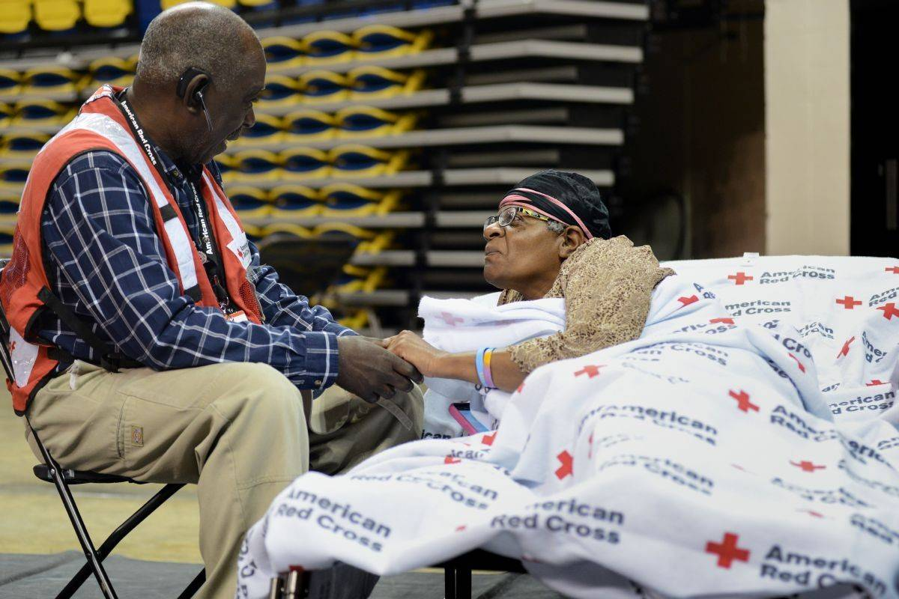
SHELTERING
Safe havens where people can come for food, shelter, emergency supplies, information and connections with recovery services
Community hubs for reorganization, inspiration and healing
Refuges ahead of the storm; anticipatory rather than reactive
Information and planning centers for relief organizations like FEMA and PEMA

Slide 13
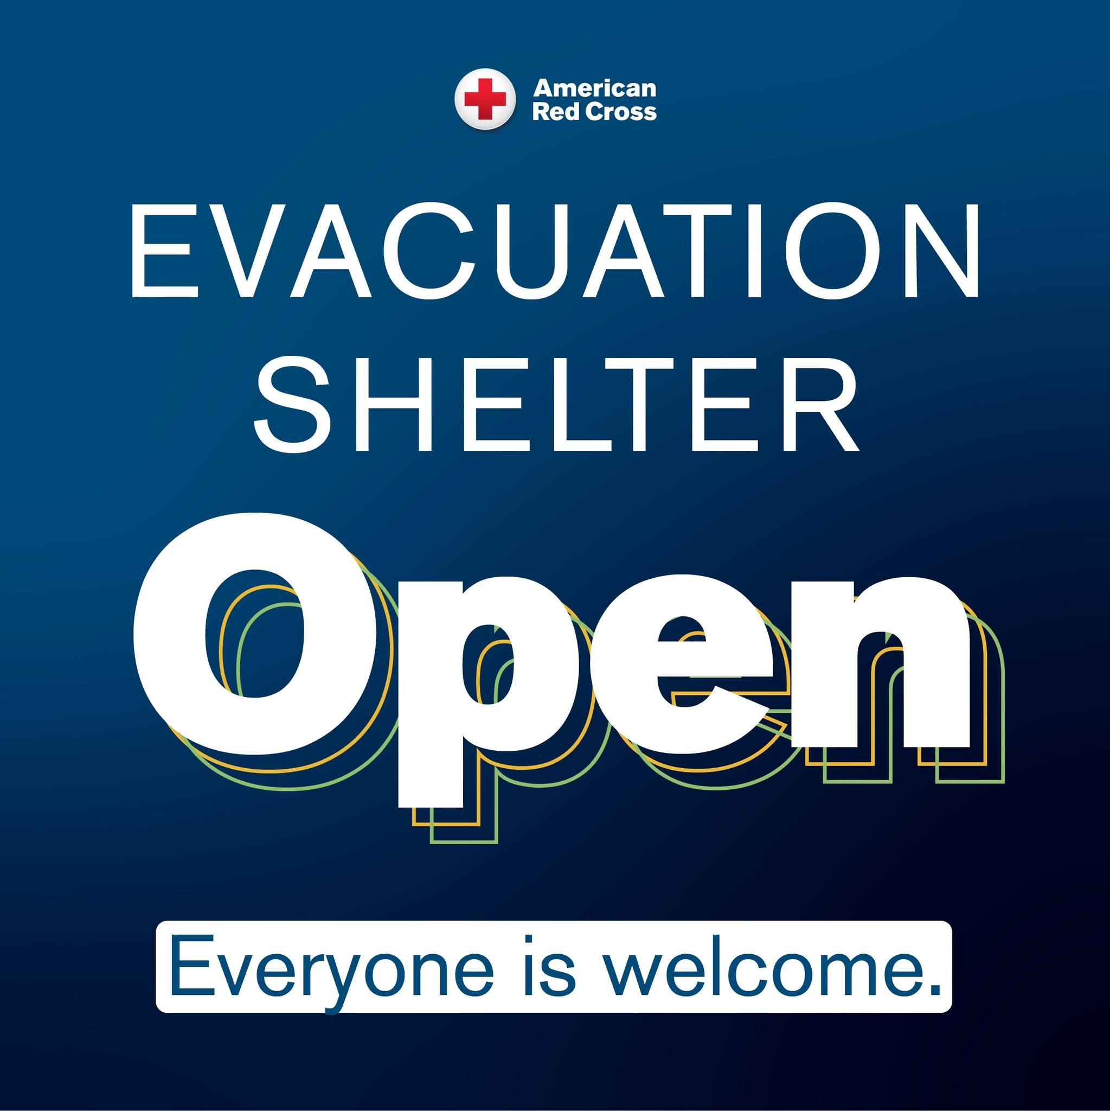
RED CROSS SHELTERING PRINCIPLES
Everyone is Welcome
All affected people regardless of race, color, national origin, religion, gender identity, age, disability, sexual orientation, citizenship, veteran status or pre-disaster housing situations are welcome in our shelter
We work with individuals with access and functional needs, visual or hearing impairments, or any other issue to ensure their physical and mental health
We accommodate pets and service animals
We work with community partners to serve our clients to the best of our abilities
Red Cross sheltering activities do not finish until all client’s needs are met to the best of our abilities

Slide 14
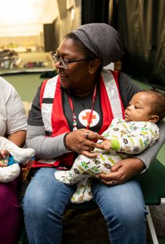
CLIENT FIRST SHELTERING
Sheltering is not about facilities, processes and rules, but about supporting people who need our help.
We show compassion and make each person feel they are important.
We work to understand and meet individual needs.
Our aim to help each person move toward a more sustainable location for their recovery.

Slide 15
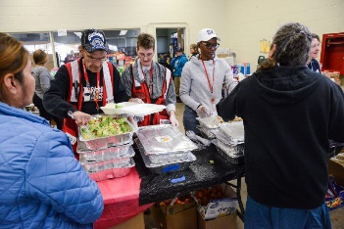
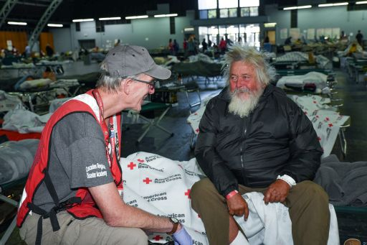
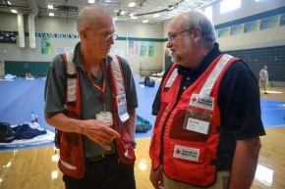
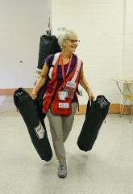
YOU ARE ALWAYS SUPPORTED
Red Cross Leadership/ Emergency Services
Shelter Manager/ Site Supervisor
Specialty Teams
(DHS, DMH, DSC, Recovery)
Shift Supervisor (day shift; night shift)
Function Supervisors
(reception/registration; dormitory; feeding, services, etc.)
Shelter Service Workers
(Red Cross; event-based volunteers; others)

Slide 16
FUNCTIONAL AREAS
Lobby | Dormitory | Dining | Recreation
Reception Registration Information | Sleeping/Living area for residential clients | Meals Snacks | Television Books Games
Red Cross Services | Government Services | Storage | Toilets and Showers
Disaster Health Services Disaster Mental Health/Disaster Spiritual Care Casework | FEMA Housing Veterans Social Services | Red Cross supplies Client belongings | Inside Additional portable units outside

Slide 17
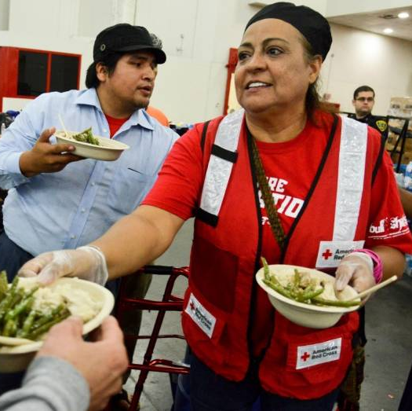
FEEDING
Three meals a day and 24/7 availability of snacks
Meals will accommodate dietary and cultural needs
Strict regulation of food safety best practices
Meals served will be tracked for information and planning purposes
Feeding is often done in partnership with third parties

Slide 18
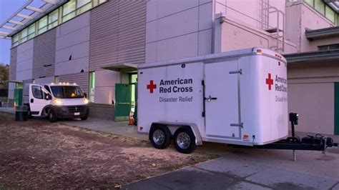
Logistics, Recovery & Operations
Pre-loaded trailers and a central warehouse
Daily requestions of needed supplies including non-standard requests
Ongoing support to identify client recovery needs and aid in their short and long term planning
Reunification teams to connect clients with others and with concerned outside parties with client consent
Constant interfacing with local EMS, the owners of the physical shelter, media federal agencies and others

Slide 19
Contact Information
Heather Gale
Heather.gale@redcross.org
(267) 542-9827
https://www.redcross.org/volunteer

