Slide 1
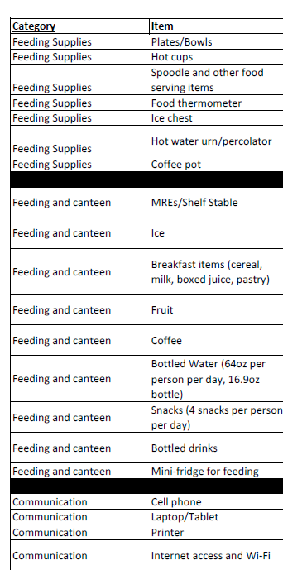
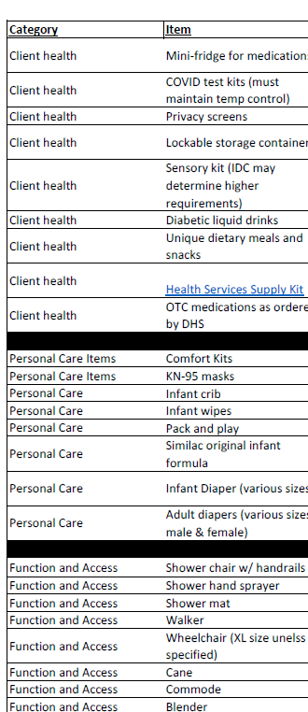
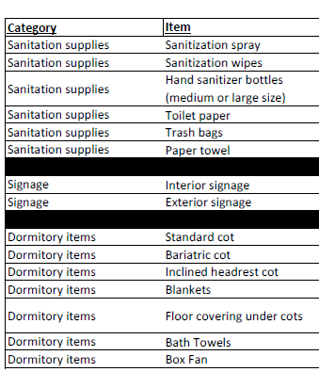
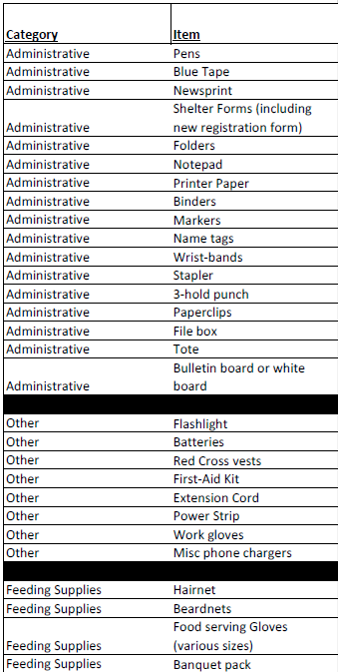
Approved Shelter Needs List (At-A-Glance)
Purchase using P-card (if available) or MCPC – make sure to record all purchases on MCPC form or P-card download
FIK
FIK
FIK
FIK
FIK
FIK
FIK
FIK
Additional Approved ASN Items
FIK

Slide 2
Approved Shelter Needs List (At-A-Glance)
Additional Approved ASN Items

