Slide 1
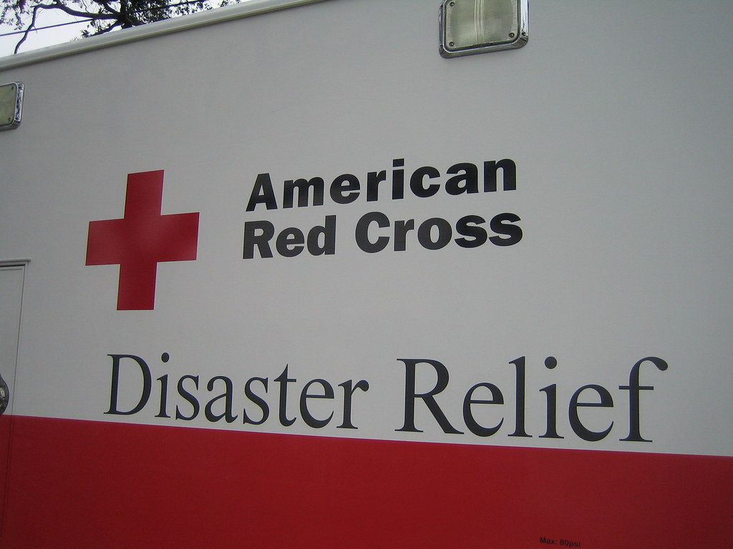
Strengthen Your Feeding and Canteening Skills
Are Your Feeding Skills Ready for the Next Disaster?

Slide 2
Agenda
Introduction – What have you experienced and what do you expect?
Feeding Method Overview – What have we seen, what might the future look like, and how are we getting ready?
Preparation
Event Set Up
Mass Casualty Incident Feeding
Congregate Feeding
Outreach Feeding
Canteening & Mobile Feeding
Wrap up & Next Steps

Slide 3
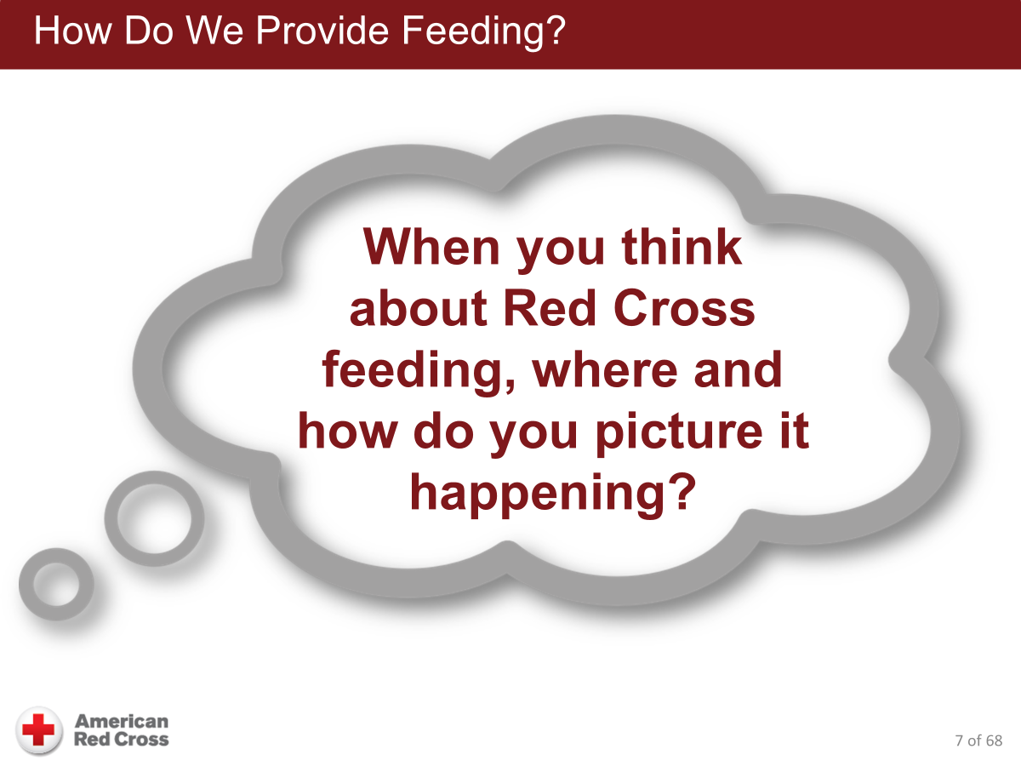
Source: Feeding Fundamentals V2 Course Presentation

Slide 4
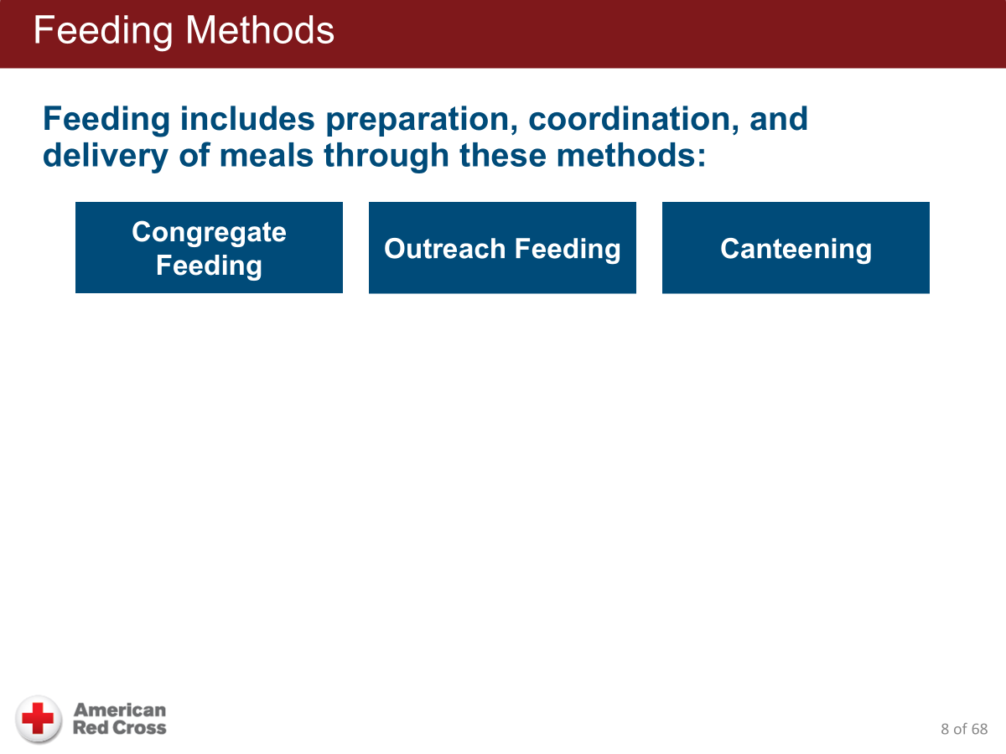
In this workshop your instructors will provide actual lessons learned in SEPA operations.
Discuss the types of feeding, diagrams, set up and coordination.
Source: Feeding Fundamentals V2 Course Presentation

Slide 5
Before We Get There...
Let's focus on our nation and local challenges
National Readiness Targets
  Near constant large-scale operations nationally
  Each Region has been assigned goals to achieve
  SEPA's Goal = operate six 200-bed shelters simultaneously for over 3 days before help arrives
    720 shelter guests (in FY2026)
    Over 10,152 meals served in 4 days (in FY2026)
To meet these challenges, we need:
  More trained volunteers or partners
  More feeding partners and vendors
  More equipment
  More supplies

Slide 6
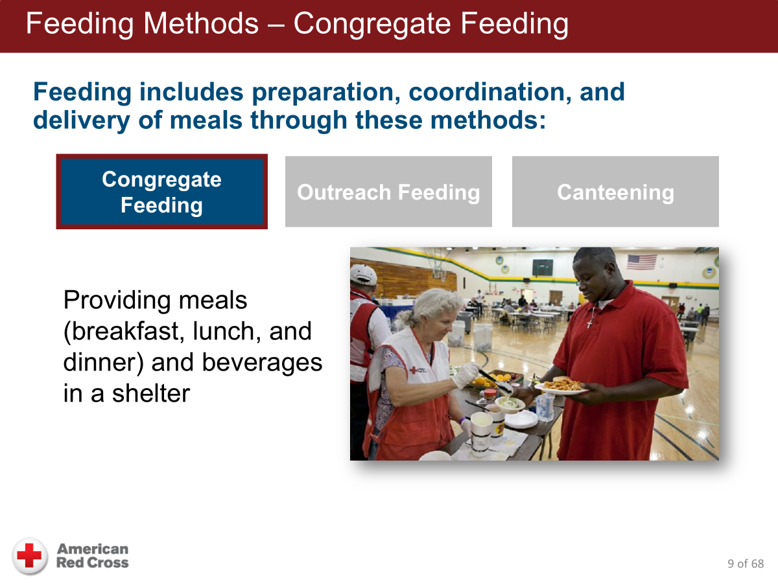
Source: Feeding Fundamentals V2 Course Presentation

Slide 7
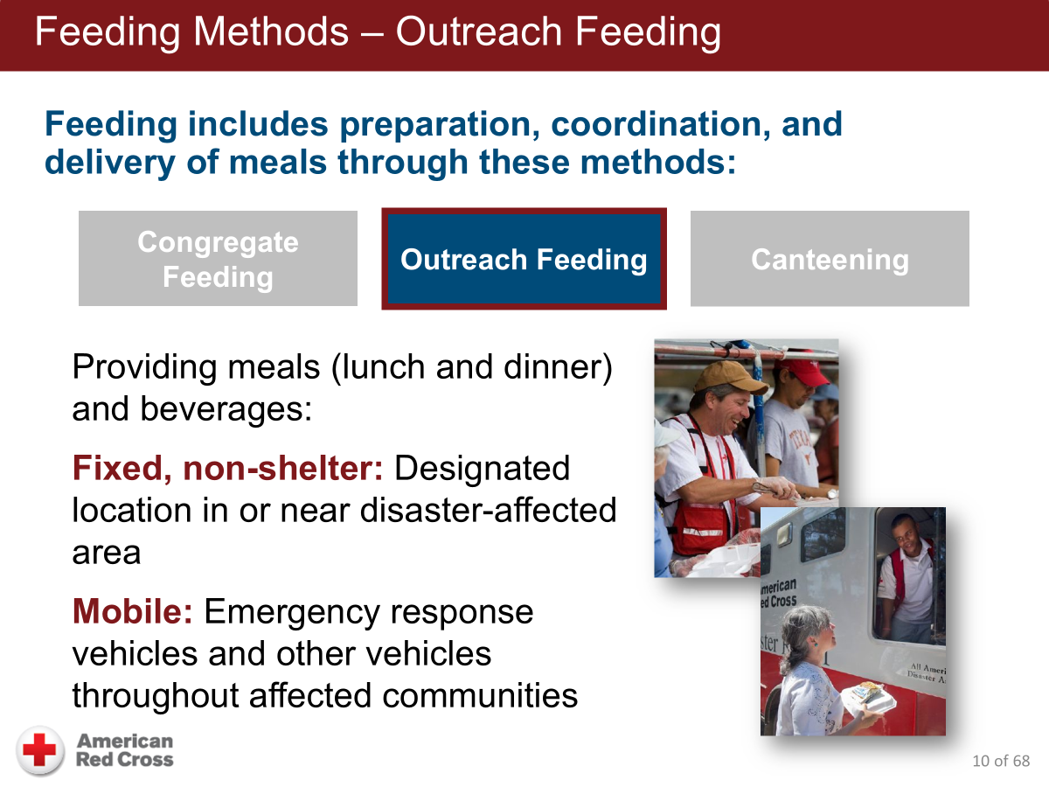
Sometimes Grab & Go Breakfast
Reception or Community centers, gov’t buildings, church halls, ERV @ hotels.
ERVs, MRVs, trucks, SUVs, etc.
Source: Feeding Fundamentals V2 Course Presentation

Slide 8
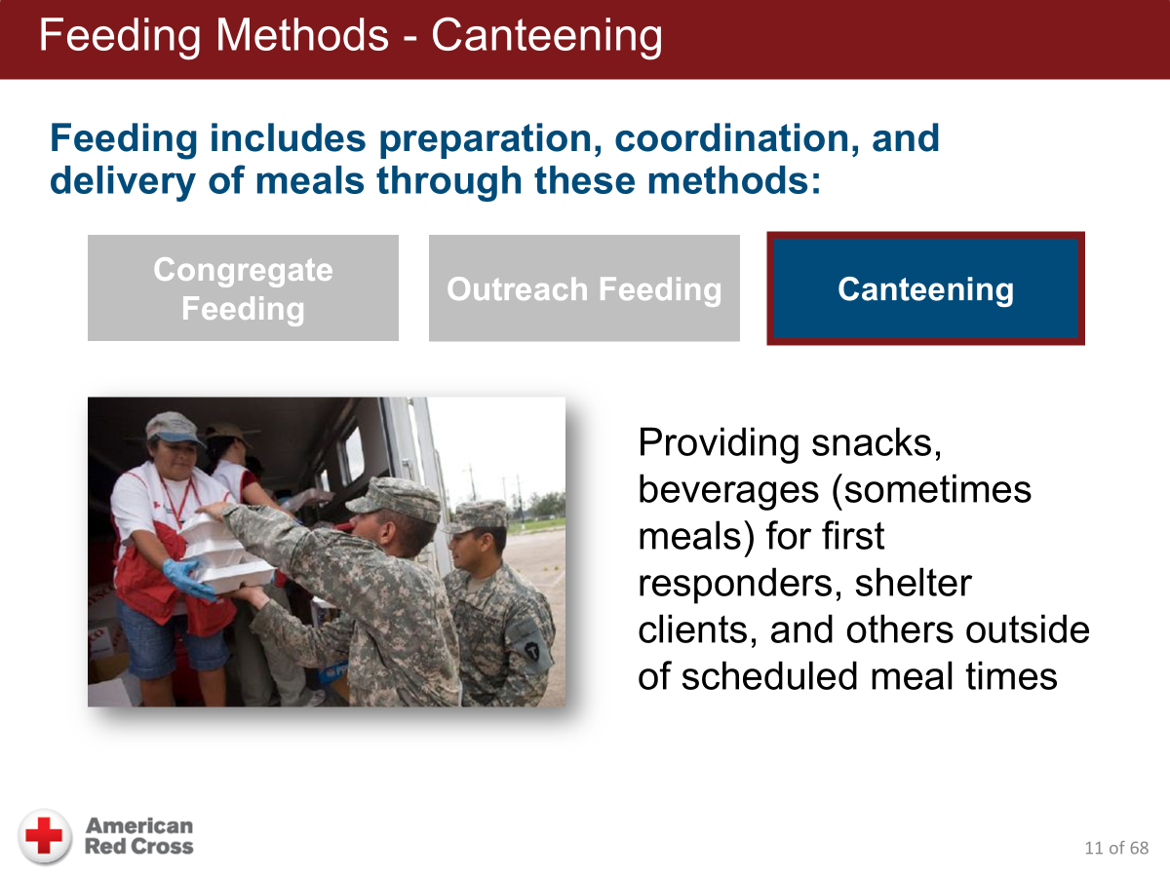
More frequent in large scale disasters. If we see frequent Level 3 and above DROs we will have increased canteening.
Source: Feeding Fundamentals V2 Course Presentation

Slide 9
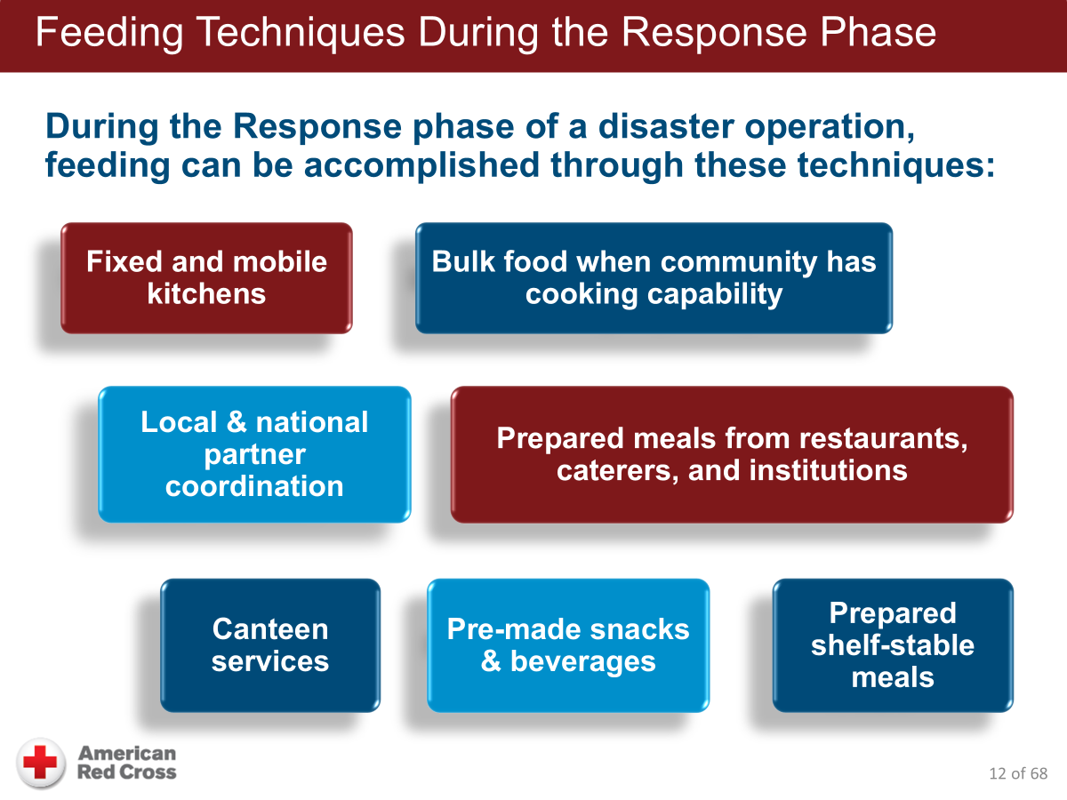
Level 4 to 7?
Salvation Army and Wawa but we need more
Vendor Expansion Project – build partners thru 2030
MREs or _____________
Source: Feeding Fundamentals V2 Course Presentation

Slide 10
Preparation - Personal
Training complete/refreshed
  Talk to your Team Leaders – identify need for review of course material.
  We are looking to promote 12 existing SAs who have the appropriate knowledge and experience to SV level.
Staffing
  Replace 12 promoted SAs
  Add another 10 to 20 SAs before June 30, 2026
Mobile Phone
  Charged & charger cable packed
  Red Cross Emergency App loaded
  Links to Mass Care Teams site
Appropriate clothing & footwear
  Red Cross hat, shirt & vest
Transportation plan
  Method & resources
  Destination address
  Traffic/route assessment
  Backup plan
Building team to meet NRT goal challenge

Slide 11
Preparation - Congregate & Fixed Outreach Feeding
Initial load of feeding equipment & supplies delivered in the trailer or by Logistics:
Box #1 on the Shelter Pallet
Equipment & Supplies in an initial 6409
The NRT goals are changing those quantities
Shelter and Feeding Lead met with Logistics Lead on 10/29 to establish game plan
Storage of all things necessary for six 200-bed shelters is a huge problem.
Solutions will be worked in Nov and Dec. Might include:
Additional storage space
Prearranged orders to Division or National
Prearranged purchase orders with vendors

Slide 12
Preparation - Congregate & Fixed Outreach Feeding
Food/ Drink Service | BOX 1 |  | Quantity needed to support 25-bed shelter over 4 days | Quantity needed to support 200-bed shelter
Provided Supplies | Qty. | Packaging
Food Service Gloves, all sizes, approx. 100/box? | 1 | BX | 1
Hair Nets, approx. 100 - 144/box | 1 | BX | 1
Food Thermometer | 1 | EA | 2 | 4
Disinfecting wipes, re-sealable container, approx. 100 wipes | 3 | PK | 2 | 3
Paper Towels, rolls, decent absorbency, not super cheap, 2 rolls | 1 | PK | 1 | 4
Hand sanitizer, for behind counter | 1 | EA | 1 | 2
Plates, paper, dinner size, approx. 50/PK | 2 | PK | 6 | 10
Cups, paper, hot liquid, approx. 50/PK | 2 | PK | 6 | 10
Napkins, 100/pk | 2 | PK | 4 | 24
Banquet Packs (fork, spoon, knife, napkin), 50/PK | 1 | PK | 6 | 48
Zip-Locs, freezer, gal. size, for carry out & organization, approx 25-38/PK | 1 | box | 1 | 4
Utensil, Spoodle | 1 | EA | 3 | 3
Utensil, slotted spoon | 1 | EA | 3 | 3
Utensil, Knife | 1 | EA | 2 | 2
Utensil, tongs | 1 | EA | 5 | 5
Garbage Bags, black - contractor size, approx. 30 bags | 1 | BX | 1 | 2

Slide 13
Preparation - Congregate & Fixed Outreach Feeding
SEPARATE 6409 (might be combined with other groups) | Quantities need to be adjusted based on existing inventories in the shelter locations. |  | Quantity needed to support 25-bed shelter over 4 days | Quantity needed to support 200-bed shelter
Provided Supplies Separate from Pallet | Qty | Packaging
Water (2, 16 oz. bottles per person per day) (in addition to other drinks provided by partners) |  | EA | 200 | 1600
Tables (5-serving line, 5-supply/stock tables, 6-dining area) |  | EA | 16 | 35
Chairs |  | EA | 30 | 160
Plastic Table Cloth |  | EA | 16 | 35
Coffee Pots |  | EA | 3 | 3
Toaster (4 slice or industrial type) |  | EA | 2 | 4
Food Cambros (use and quantity varies with shelter site) |  | EA | 4 | 8
Beverage Cambros |  | EA | 3 | 3
Food Cambros Liners (use and quantity varies with shelter site) |  | EA | 48 | 96
Large Cooler (use and quantity varies with shelter site) |  | EA | 4 | 8
Broom |  | EA | 2 | 4
Dust Brush and Pan |  | EA | 2 | 4
Bucket and Mop |  | EA | 2 | 4
Medical Isolation Panels |  | EA | 2 | 2

Slide 14
Preparations - Mobile & Canteen Feeding
ERV Equipment
  Food thermometer and utensils: spoodles, tongs
  Cambros (food and beverage ones)
ERV Supplies
  Paper towels, gloves, hair nets, hand sanitizer, non-toxic cleaning wipes, trash bags, dry erase marker
  Clamshells, banquet (eating utensils) packs
Other: Phone with app to perform vehicle inspection
What’s the Plan
  What are we doing?
  Where are we going?
  Is there a schedule?
  Who is supplying the food and beverages?

Slide 15
Event Set Up - Congregate & Fixed Outreach Feeding
Layout depends on shelter space and room arrangement
Food line placement & configuration
Wall
T
T
Storagee
Eating area
C/T
C/T
T
FeEEatu
S
FL
I
About 30 feet
I- iced beverages, T- trash, C/T – coffee/tea, S-snacks, FL - Feeding line
T
Notes:
We are adding slides behind this slide as requested by TL to provide.

Slide 16
Event Set Up - Congregate & Fixed Outreach Feeding
Dining Food & Supply - Storage and Maintenance
C/T
Keep food off floor in sealed containers, wipe constantly.
Cleaning
coffee/tea pots, wipe constantly
Eating area,
wipe down
and trash cleared
FeEEatu
Fillup​
Keep reloading,
clean area
Clean before and after meals
I- ice, T- trash, C/T – coffee/tea, S-snacks, FL - Feeding line
Notes:
We are adding slides behind this slide as requested by TL to provide.

Slide 17
DINING HOURS
7AM – 9AM – BREAKFAST
12PM – 2PM LUNCH
5PM – 7PM DINNER
WATER, COFFEE, TEA AND SNACKS AVAILABLE
Please clean your area and no food in the sleeping area.

Slide 18
Event Set Up - Mobile & Canteen Feeding
Mobile feeding on the ERV
  Cambros "tempered" and used to maintain food at safe temperature for extended periods
    Food safety "Rule of 4's": Danger zone 40 – 140, 4 hours max
  Verify food temps upon receipt and monitor regularly
Park Vehicle: ALWAYS HAVE A SPOTTER!
  Face serving window away from traffic, avoid trip hazards. Use wheel chocks. Do not idle vehicle.
  Keep vehicle doors closed during serving
Use food prep shelf & open cambro small side
  Wear hat/hair net, wash hands/use sanitizer & wear gloves
  Do not pre-scoop food as temp will change quickly
Clean immediately afterwards
  Cambros, utensils, and vehicle must be kept properly clean
  No food storage on the ERV. Trash must be immediately removed.

Slide 19
Mass Casualty Incident Feeding
Feeding during mass casualty incident responses generally occurs in two forms:
  Canteening or Mobile Feeding for families and/or responders;
  Congregate feeding at
    Family Reception Centers or
    Family Assistance Centers.
Feed disaster survivors and emergency workers at separate sites.
  Morgue, disaster recovery, a reconstruction site, or a disaster command post may also require feeding sites.
Provide feeding on a 24-hour basis.
Provide food that is easy to serve.

Slide 20
Mass Casualty Incident Feeding
Menus and meals should not include the following items: barbeque, spaghetti, rice, tomato sauce, or chicken on the bone.
Staff and volunteers should take care of each other to better cope with the stresses of this type of incident. Use the resources provided by:
  Staff Services
  Disaster Mental Health
  Disaster Spiritual Care

Slide 21
Congregate & Fixed Outreach Feeding Process
Maintain ice in the drink cooler, monitor
Set aside food allergy & restriction meals by bunk number
Set up food line arrangement – plates to drinks. Set food on the serving line (entries, sides, breads, fruit, deserts, & drinks)
Check food temperatures every 30 minutes; mark labels
Establish waiting queue, help as needed (have extra volunteer)
Volunteers serve the food, keeping in mind portions
Ensure Food safety – hair nets, gloves, and clean utensils
Follow Food storage and maintenance standards
Cleanup (containers, utensils, serving line tables, dining area tables, sweep & mop floors unless covered)

Slide 22
Mobile & Canteen Feeding Process
Obtain food and beverages, along with clamshells and banquet packs
Park vehicle with vehicle safety and client safety during food service in mind
  Vehicle: watch height, sides clear, along with regular debris and road hazards
  Client safety: Serving window away from traffic, path without tripping hazards
Prepare for serving:
  Trash bag ready, wear hat/hair nets & gloves
  Open small portion of cambro lid on one of each food item
  Open the food bag and stir food with appropriate portion-size spoodle
  Check food temperature
Establish client flow – approach and exit. Open serving window when ready.
Prepare meals according to portion sizes.
  Utilize prep shelf above cambros for clamshells. Note: will cool quickly!
  When not serving, keep cambros closed. Check food temps at least hourly.
Confer with feeding lead on dispositioning remaining food
Clean Up – remove trash & food items, sweep/clean floor, shelves, walls
  Cambros and serving utensils must be appropriately cleaned and dried.

Slide 23
Wrap Up & Next Steps
What topics were new for you, and do you want more information?
How can we make the next session of this workshop more meaningful?
Who would like to work toward becoming a feeding supervisor?
To be ready to meet the NRT goals and workload, who knows a relative, friend, colleague or neighbor who might be interested in becoming a Feeding Service Associate?

Slide 24
References
Feeding Tool Kit - https://onesource.redcross.org/page/2397?SearchId=11429674
Sheltering Tool Kit - https://onesource.redcross.org/page/3674?SearchId=11429736
Feeding Activity Introduction Fact Sheet –
https://onesource.redcross.org/page/14274?SearchId=11429740
Feeding Webinars
  6-26-24 Feeding Webinar
  5-28-25 Seasonal Feeding and DES Webinar
Feeding Fundamentals V2
https://onesource.redcross.org/page/14275?SearchId=4858451

