Slide 1
NEXUS Spacecraft Integrated Modeling and Simulation
Olivier L. de Weck
July 2001
Sponsor: Gary E. Mosier, NASA GSFC

Slide 2
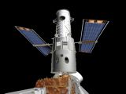
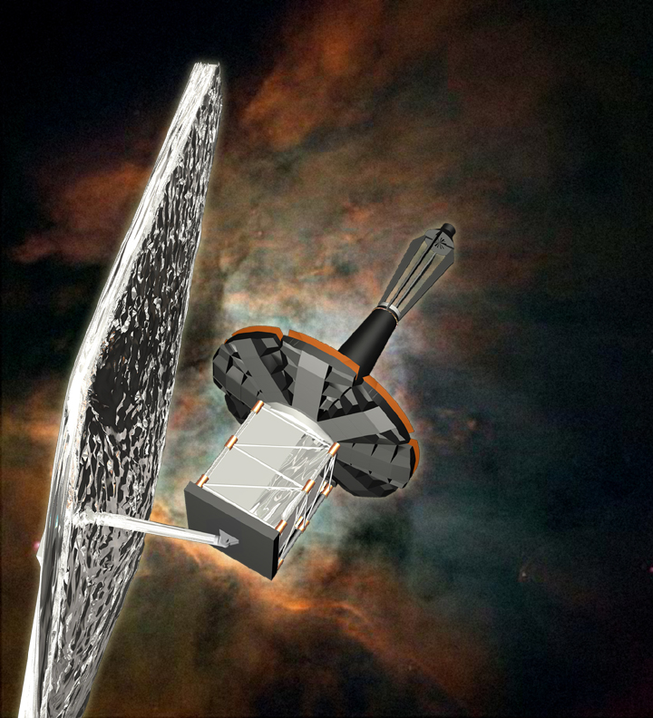
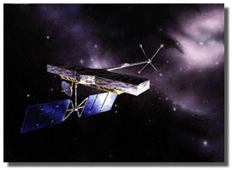
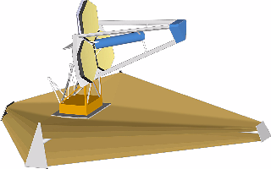
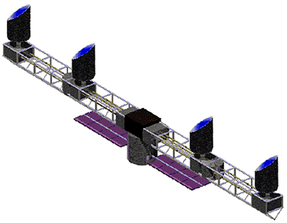
Background and Motivation
HST - 1990
Requirements Flowdown Process
Science
Requirements
Functional
Requirements
Subsystem
Requirements
5 year wide-angle astro- metric accuracy of 4 μasec
for 20th Magnitude stars
Fringe Visibility
> 0.8 for astrometry
Science Interferometer
OPD < 10 nm RMS
Space-Based Observatory
Multipurpose UV/Visual/IR
Imaging and Spectroscopy
NGST-2008
“Performance”
NEXUS-2004
SIM-2006
TPF-2011
Deployable Cold Optics
NGST Precursor Mission
Lightweight 8m-Optics
IR Deep Field Observations
Faint Star Interferometer
Precision Astrometry
Nulling Interferometer
Planet Detection
Achieve stringent requirements in a cost-effective manner with predictable risk level.

Slide 3
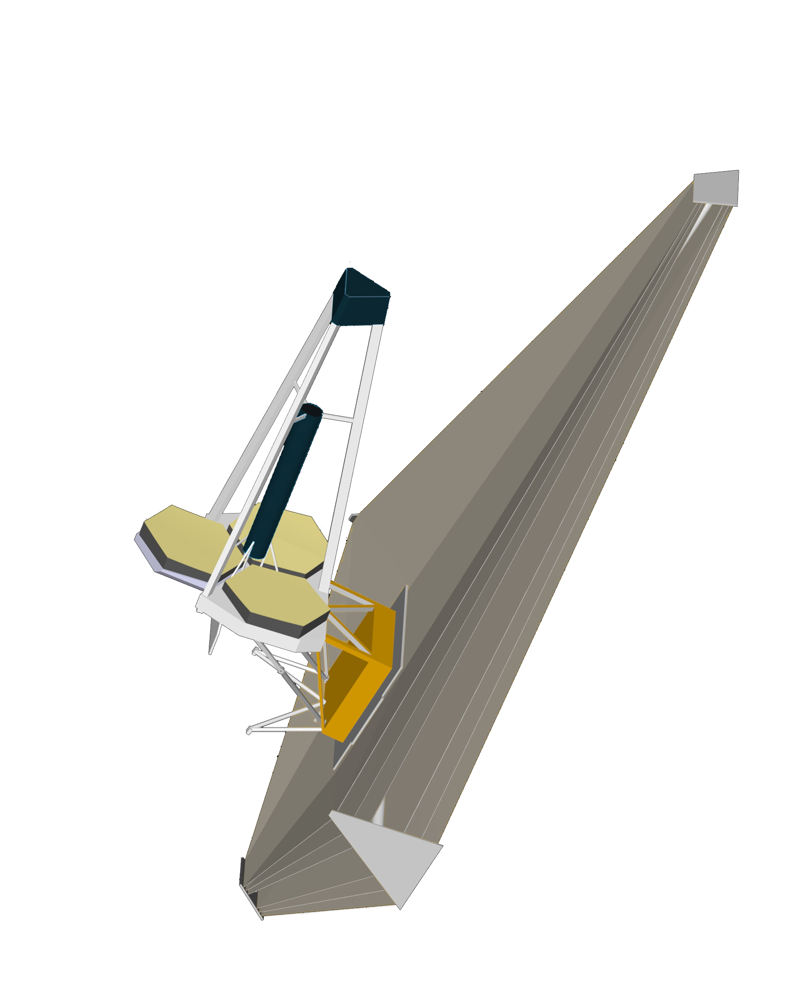
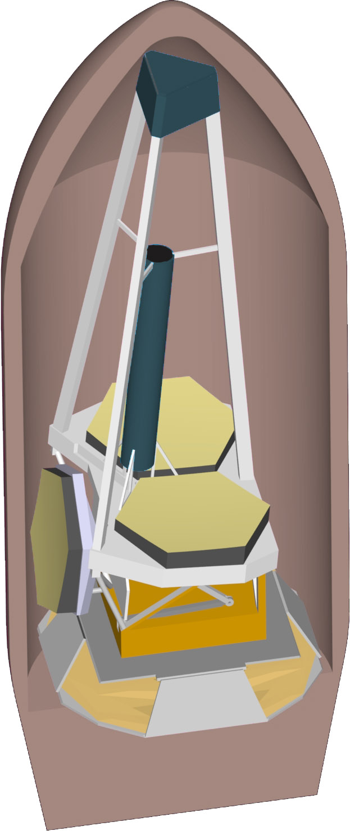
Nexus Case Study
Purpose of this case study:
Pro/E models
© NASA GSFC
on-orbit
configuration
Demonstrate the usefulness
of Isoperformance on a realistic
conceptual design model of
a high-performance spacecraft
Nexus
Spacecraft
Concept
OTA
launch
configuration
The following results are shown:
Sunshield
Instrument
Module
Integrated Modeling
Nexus Block Diagram
Baseline Performance Assessment
Sensitivity Analysis
Isoperformance Analysis (2)
Multiobjective Optimization
Error Budgeting
0
1
2
meters
NGST Precursor Mission
2.8 m diameter aperture
Mass: 752.5 kg
Cost: 105.88 M$ (FY00)
Target Orbit: L2 Sun/Earth
Projected Launch: 2004
Deployable
PM petal
Details are contained in CH7
Delta II
Fairing

Slide 4
Nexus Integrated Model
Z
X
Y

Slide 5
Nexus Block Diagram
Number of performances: n_{z}=2
Number of design parameters: n_{p}=25
Number of states n_{s}= 320
Number of disturbance sources: n_{d}=4
RWA Noise
Inputs
WFE
NEXUS Plant Dynamics
Outputs
physical
Sensitivity
RMMS
Out1
24
dofs
[m]
[nm]
[N,Nm]
30
K
In1
Out1
[m,rad]
3
30
x' = Ax+Bu
36
3
Performance 2
WFE
Out1
Mux
y = Cx+Du
Demux
Centroid
Performance 1
[N]
K
Sensitivity
LOS
WFE
Cryo Noise
3
[microns]
3
2
2
[Nm]
[m]
Demux
-K-
m2mic
Control
Attitude
2
Torques
x' = Ax+Bu
3
rates
[m]
y = Cx+Du
[rad/sec]
Centroid
Measured
FSM Controller
3
FSM
Centroid
x' = Ax+Bu
8
Mux
K
Coupling
2
Out1
y = Cx+Du
[rad]
Out1
[m]
ACS Controller
Angles
ACS Noise
GS Noise
2
2
K
[rad]
desaturation signal
gimbal
[rad]
angles
FSM Plant

Slide 6
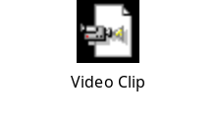
Initial Performance Assessment J_{z}(pº)
Cumulative RSS for LOS
Results
Lyap/Freq Time
20
J_{z,1} (RMMS WFE)
J_{z,2} (RSS LOS)
[nm]
[μm]
m]
25.61 19.51
15.51 14.97
μ
10
RSS [
requirement
0
-1
0
1
2
23.1 Hz
10
10
10
10
Frequency [Hz]
Critical Mode
Centroid Jitter on Focal Plane [RSS LOS]
60
/Hz]
10
0
40
1 pixel
2
m
T=5 sec
μ
20
PSD [
-5
Freq Domain
Centroid Y [μm]
10
Time Domain
0
10
-1
10
0
10
1
10
2
14.97 μm
Frequency [Hz]
-20
m]
50
μ
-40
0
Requirement: J_{z,2}=5 μm
Cent x Signal [
-60
-50
5
6
7
8
9
10
-60
-40
-20
0
20
40
60
Time [sec]
Centroid X [μm]

Slide 7
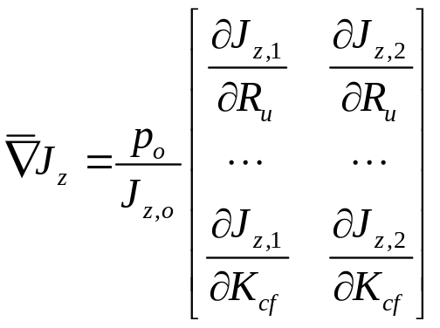
Nexus Sensitivity Analysis
Norm Sensitivities: RMMS WFE
Norm Sensitivities: RSS LOS
Graphical Representation of
Jacobian evaluated at design
p_{o}, normalized for comparison.
Ru
Ru
Us
Us
Ud
Ud
fc
fc
disturbance
parameters
Qc
Qc
Tst
Tst
Srg
Srg
Sst
Sst
Tgs
Tgs
m_SM
m_SM
K_yPM
K_yPM
K_rISO
K_rISO
Design Parameters
plant
parameters
m_bus
m_bus
K_zpet
K_zpet
RMMS WFE most sensitive to:
Ru - upper op wheel speed [RPM]
Sst - star track noise 1σ [asec]
K_rISO - isolator joint stiffness [Nm/rad]
K_zpet - deploy petal stiffness [N/m]
t_sp
t_sp
I_ss
I_ss
I_propt
I_propt
zeta
zeta
lambda
lambda
optics
params
Ro
Ro
RSS LOS most sensitive to:
Ud - dynamic wheel imbalance [gcm²]
K_rISO - isolator joint stiffness [Nm/rad]
zeta - proportional damping ratio [-]
Mgs - guide star magnitude [mag]
Kcf - FSM controller gain [-]
QE
QE
Mgs
Mgs
fca
fca
control
params
Kc
analytical
Kc
Kcf
finite difference
Kcf
-0.5
0
0.5
1
1.5
-0.5
0
0.5
1
1.5
p
o
/J
z,1,o
*
∂
J
z,1
/
∂
p
p
o
/J
z,2,o
*
∂
J
z,2
/
∂
p

Slide 8
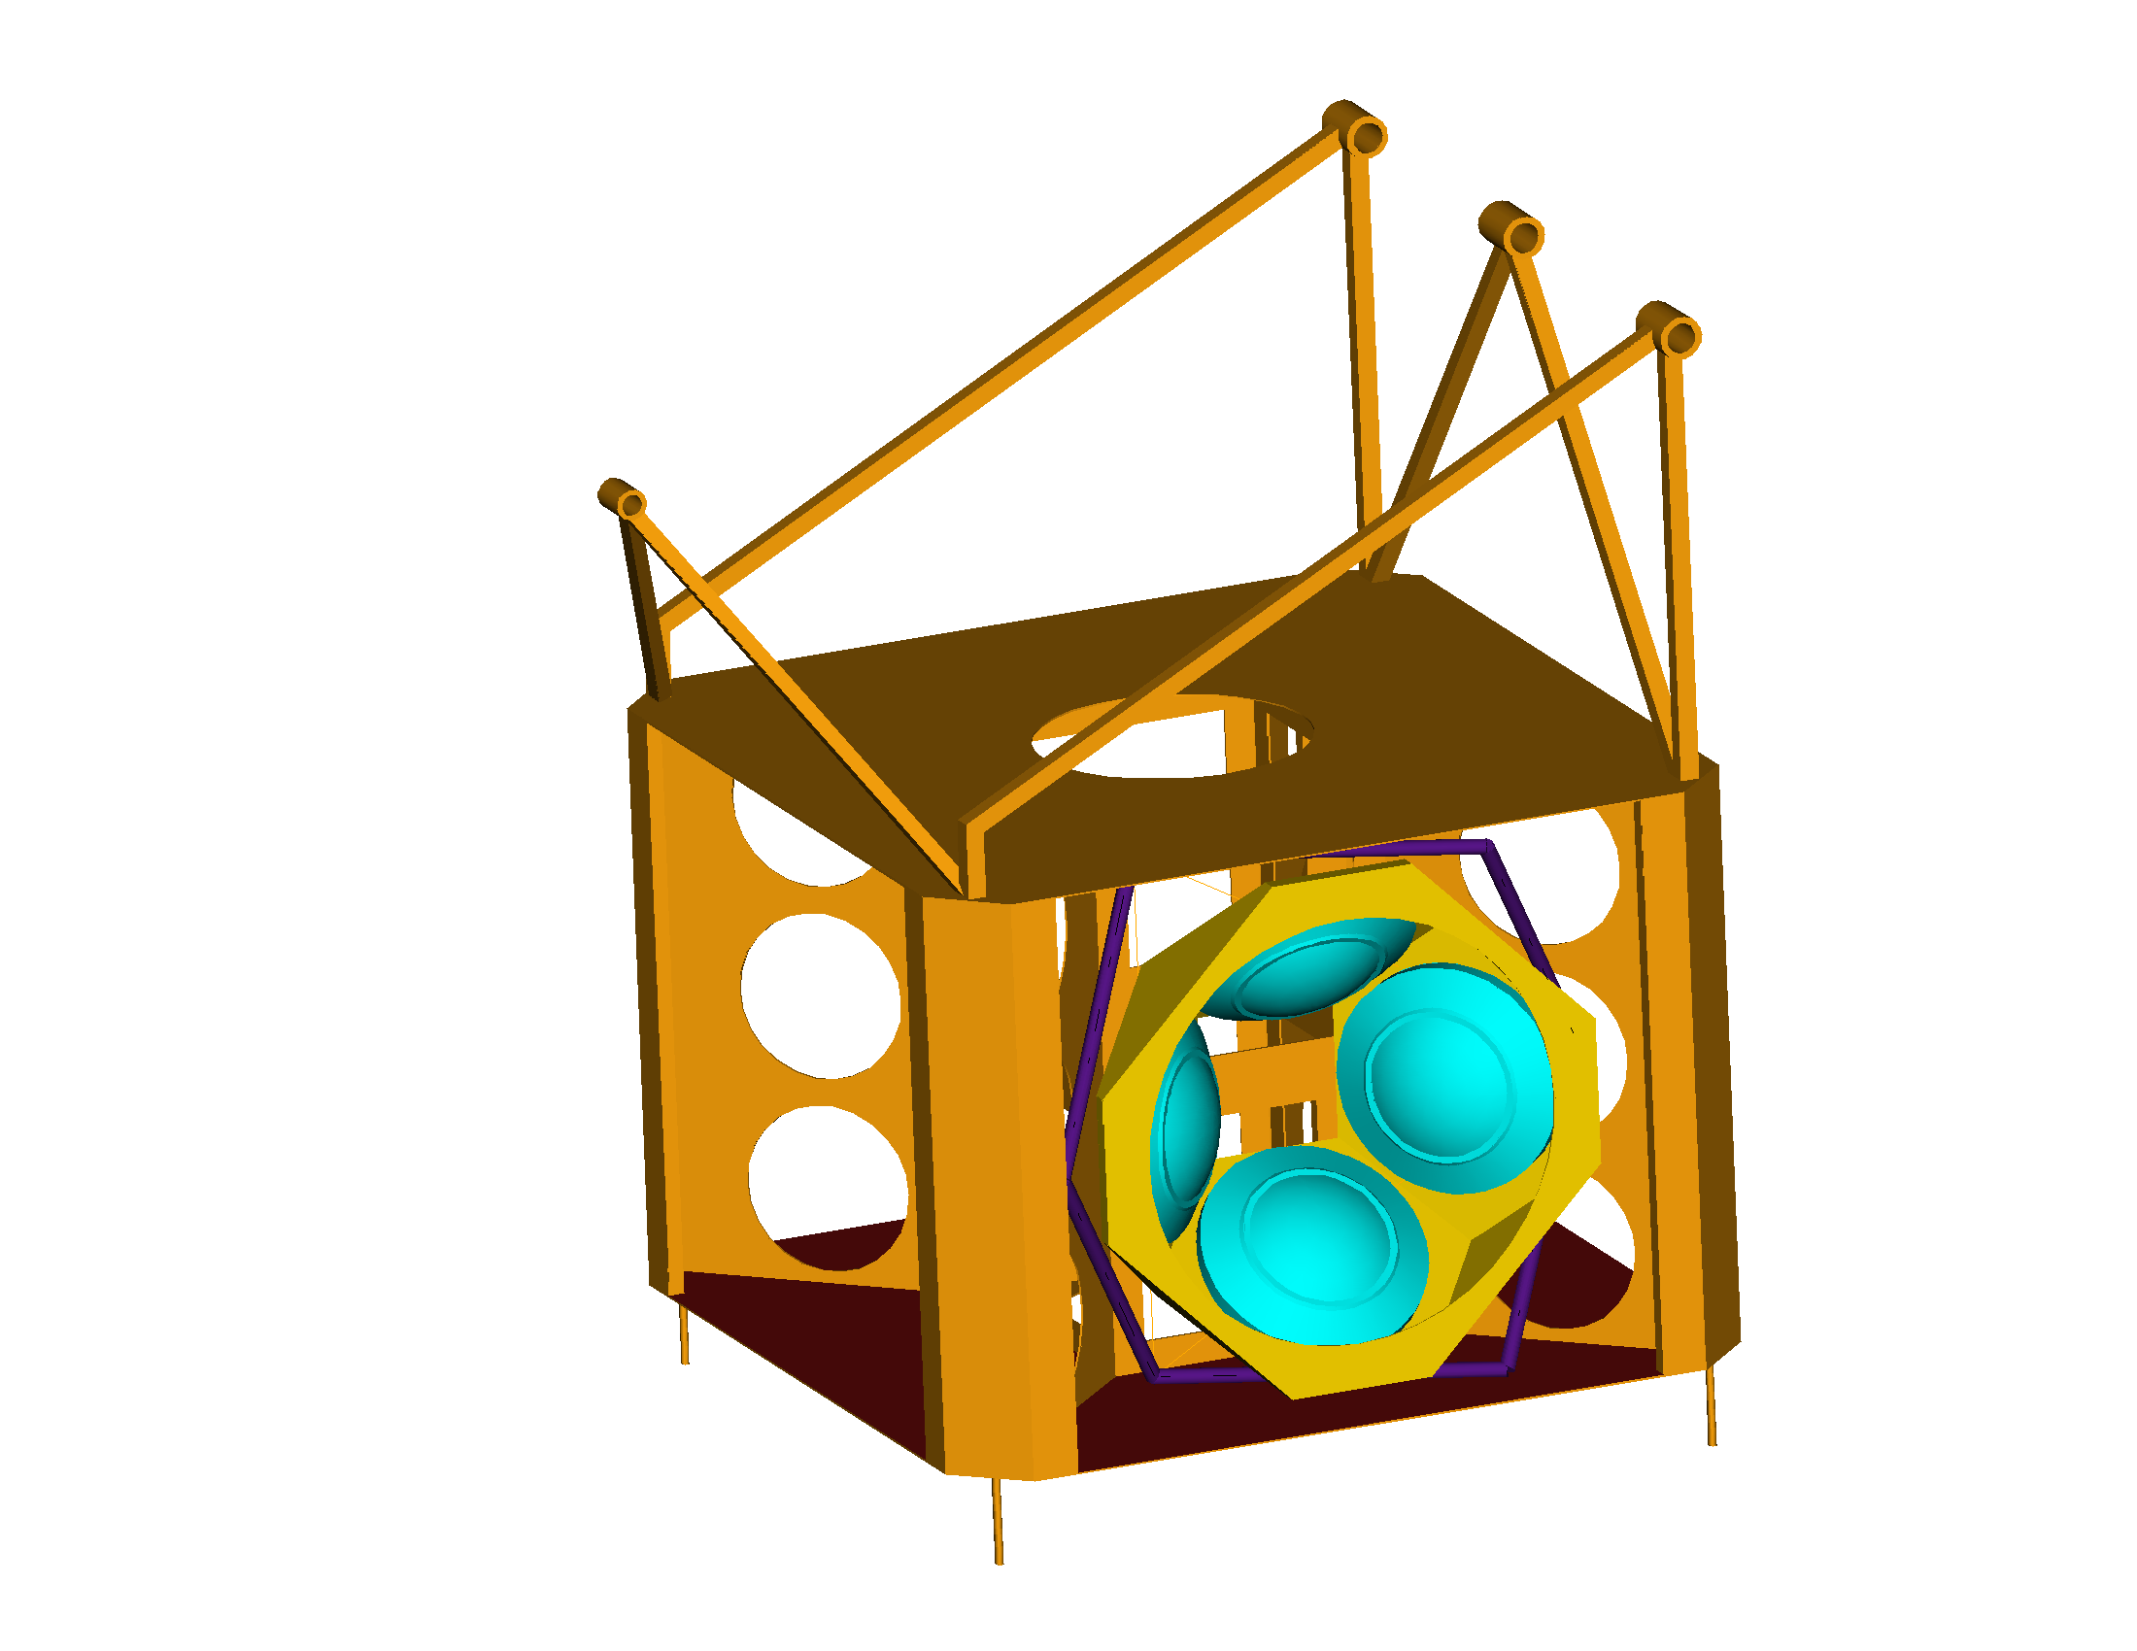

2D-Isoperformance Analysis
isolator
strut
joint
Isoperformance contour for RSS LOS : Jz,req = 5 μm
10000
Parameter Bounding Box
K_rISO
[Nm/rad]
9000
60
8000
20
120
7000
160
60
120
6000
CAD
Model
K_rISO RWA isolator joint stiffness [Nm/rad]
60
5000
20
Initial
design
4000
3000
HST
20
p
o
2000
5
test
10
Ud=mrd
[gcm²]
1000
spec
ω
E-wheel
5
m
0
d
m
0
10
20
30
40
50
60
70
80
90
Ud dynamic wheel imbalance [gcm²]
r

Slide 9
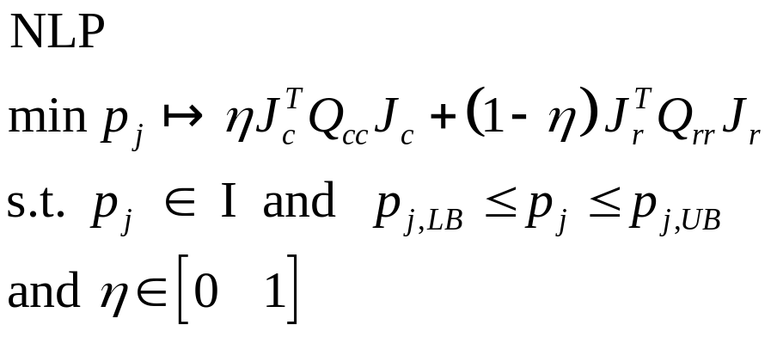
Multiobjective Design Optimization
Since solutions p_{iso} in the isoperformance set I do not distinguish them-
selves via their performance, we may satisfy additional objectives:
Performance J_{z}(p_{iso}) =J_{z,req}
Cost Objectives J_{c}
Risk Objectives J_{r}
Control effort
Implementation Cost (mid-bound)
System Mass
Dissipated Power
Closeness to “cheap” bound
Stability Margins (SISO)
max SV of sensitivity function / mvar Nyquist
Sensitivity of performance to parameter variations
Knowledge Error
Can scalarize NLP problem with preference order (weightings) η,Q_{cc},Q_{rr} as shown on the left or can look for efficient set E of pareto-optimal solutions, p_{iso}*.

Slide 10
Nexus Multivariable Isoperformance n_{p}=10
Qc
Ud
Pareto-Optimal Designs p*_{iso}
0.025 [-]
90 [gcm
2
]
Design A
Cumulative RSS for LOS
Best “mid-range”
compromise
m]
6
Tgs
Us
μ
4
0.4 [sec]
2.7 [gcm]
RMS [
2
0
0
2
Design B
10
10
K
ISO
Frequency [Hz]
r
Ru
Smallest FSM
control gain
5000 [Nm/rad]
3850 [RPM]
/Hz]
10
0
Design C
2
m
K
z
pet
Kcf
μ
18E+08 [N/m]
1E+06 [-]
Smallest
performance
uncertainty
PSD [
10
-5
t
s
p
Mgs
0.005 [m]
20 [mag]
10
0
10
2
Performance
Cost and Risk Objectives
Frequency [Hz]
Jz,1 Jz,2 Jc,1 Jc,2 Jr,1
A: min(J
)
Design A 20.0000 5.2013 0.6324 0.4668 +/- 14.3218 %
Design B 20.0012 5.0253 0.8960 0.0017 +/- 8.7883 %
Design C 20.0001 4.8559 1.5627 1.0000 +/- 5.3067 %
B: min(J
c
1
)
C: min(J
c
2
)
r
1

Slide 11
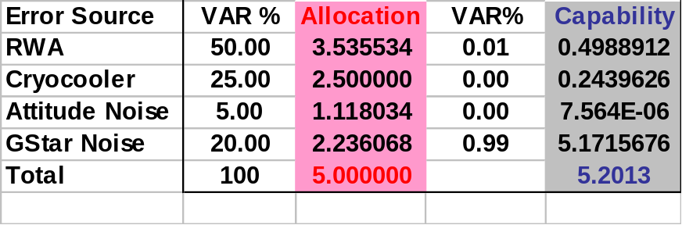

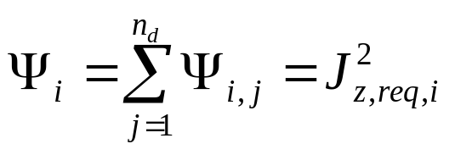
Nexus Error Budgeting
LTI System , J_{z,req}, p_bounds, p_nom
(Design A)
Isoperformance
Toolbox
p_{iso}
Allocated Budget
C
A
Capability Budget
Error Source
Contributions
0.8
var_contr
Note: ACS
sensor noise
contributions
not shown
0.6
FGS
0.4
Plot Error
Contribution Sphere
Budget
0.2
B
0
0
0.2
0.2
0.4
0.4
LOS Budget
0.6
0.6
Capability
0.8
0.8
Cryo
RWA

Slide 12
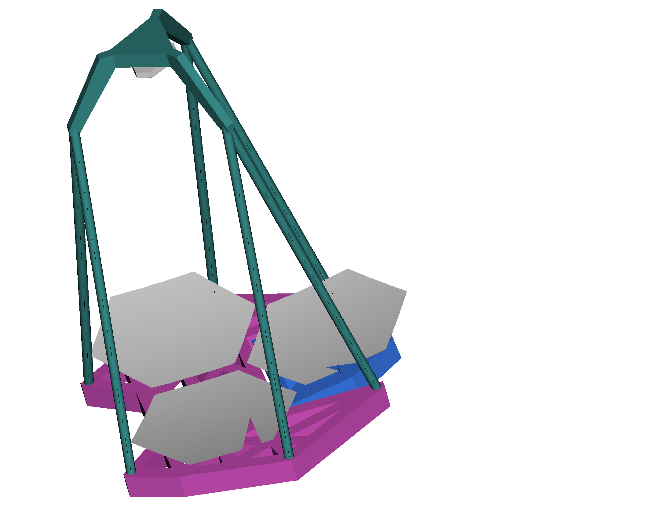
Nexus Initial pº vs. Final Design p**_{iso}
Parameters
Initial
Final
secondary
hub
+Y
Ru 3000 3845 [RPM]
Us 1.8 1.45 [gcm]
Ud 60 47.2 [gcm²]
Qc 0.005 0.014 [-]
Tgs 0.040 0.196 [sec]
KrISO 3000 2546 [Nm/rad]
Kzpet 0.9E+8 8.9E+8 [N/m]
tsp 0.003 0.003 [m]
Mgs 15 18.6 [Mag]
Kcf 2E+3 4.7E+5 [-]
+Z
+X
SM Spider Support
t_{sp}
Spider wall
thickness
SM
D_{sp}
Deployable
segment
50
K_{zpet}
40
T=5 sec
Centroid Jitter on
Focal Plane
[RSS LOS]
30
20
10
Initial: 14.97
Improvements are achieved by a
well balanced mix of changes in the
disturbance parameters, structural
redesign and increase in control gain
of the FSM fine pointing loop.
0
μ
μ
m
Centroid Y
m
-10
Final: 5.155
-20
-30
-40
-50
-50
0
50
Centroid X

