Slide 1

The BEST Way to work with Data!!

Slide 2
MongoDB’s Intelligent Operational Data Platform is the best way of making your data simple
to Organize, Use, & Enrich
in Real Time, Anywhere

Slide 3

Why MongoDB?
Intelligent Operational Data Platform
Best way to work with data
Intelligently put data where you need it
Freedom to run anywhere

Slide 4
Best way to work with data
Easy:
Work with data in a natural, intuitive way
Flexible:
Adapt and
make changes quickly
Fast:
Get great performance with less code
Versatile:
Supports a
wide variety of data models
and queries
Notes:
Developer productivity, driving business productivity

Slide 5
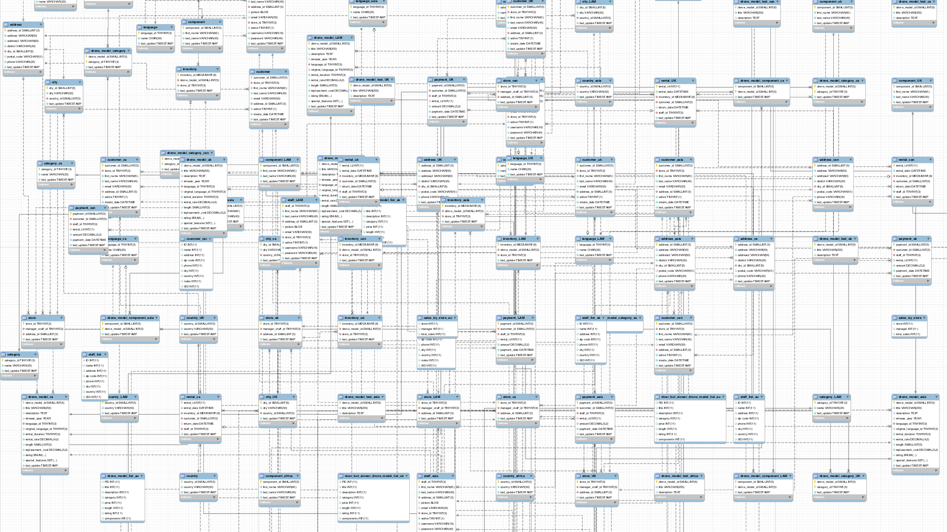
You probably have thousands of tables

Slide 6
To this: store objects directly…
Objects
Customer
Opportunity
Contact
Lead
Database
Customer
Opportunity
Contact
Lead

Slide 7
Easy: Document data model
Naturally maps to objects in code
Represent data of any structure
Strongly typed for ease of processing
Over 20 binary encoded JSON data types
Access by idiomatic drivers in all major programming language
{
"_id" : ObjectId("5ad88534e3632e1a35a58d00"),
"name" : {
"first" : "John",
"last" : "Doe" },
"address" : [
{ "location" : "work",
"address" : {
"street" : "16 Hatfields",
"city" : "London",
"postal_code" : "SE1 8DJ"},
"geo" : { "type" : "Point", "coord" : [
51.5065752,-0.109081]}},
+ {...}
],
"phone" : [
{ "location" : "work",
"number" : "+44-1234567890"},
+ {...}
],
"dob" : ISODate("1977-04-01T05:00:00Z"),
"retirement_fund" : NumberDecimal("1292815.75")
}

Slide 8

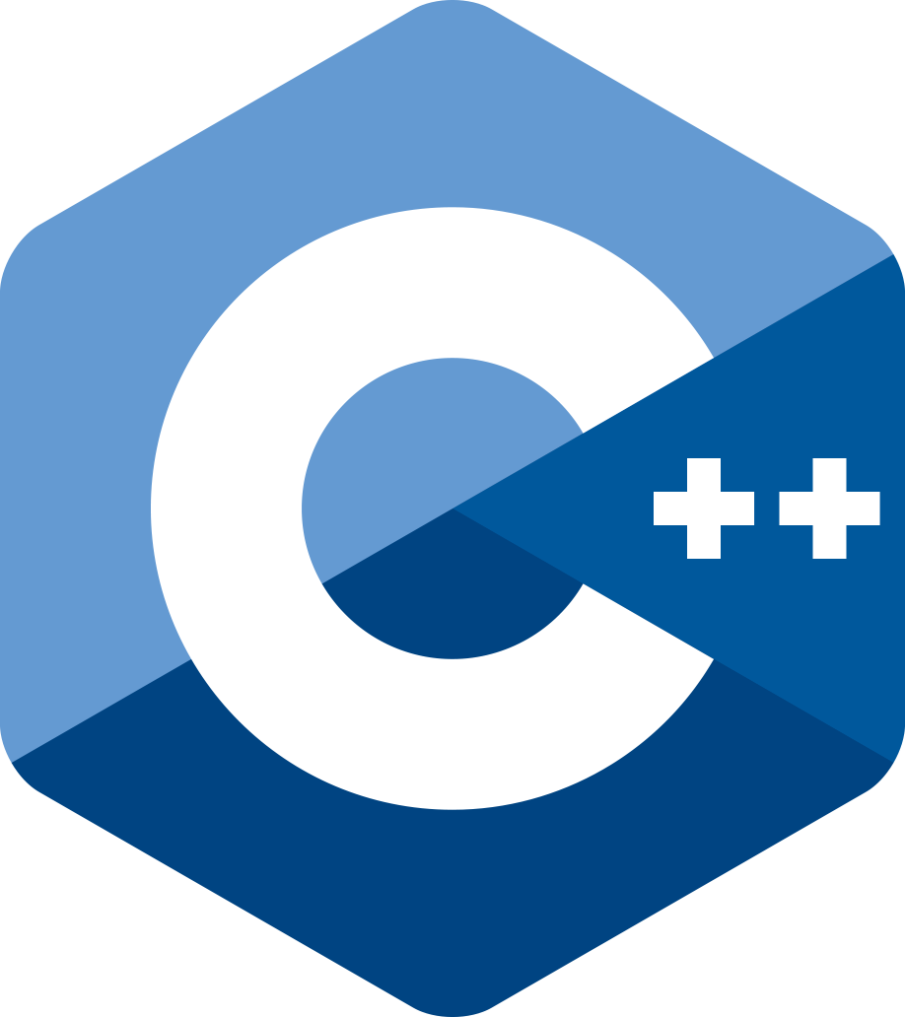
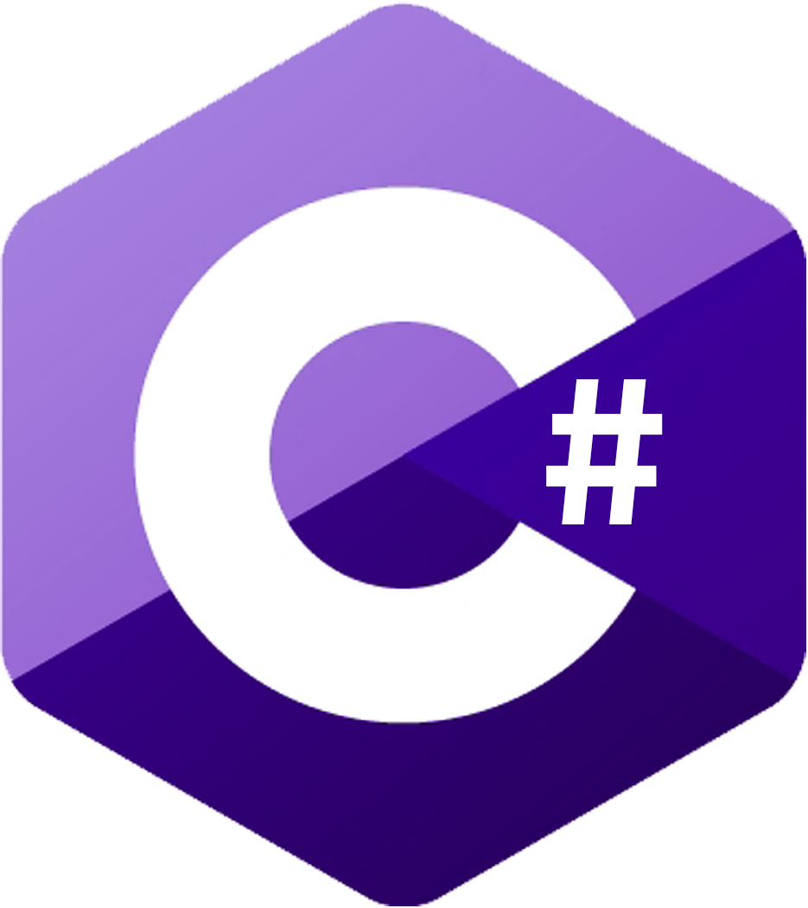







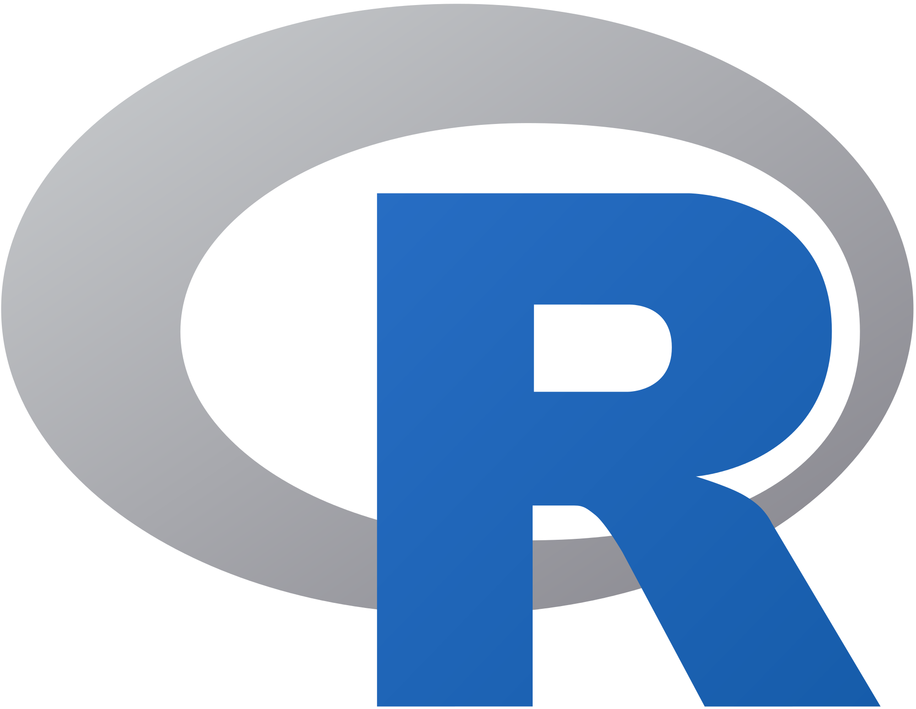

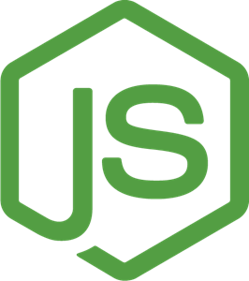










Easy: Drivers and Frameworks
Drivers
Frameworks

Slide 9
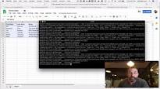
Learn More
Basic Blog Tutorial
ToDo – Web App Tutorial
Create a Data API in 10 minutes
With MongoDB Stitch

Slide 10

Freedom to run anywhere
Local
On-premises
Server & Mainframe
Private cloud
Hybrid cloud
Public cloud
Fully managed
cloud service
Database that runs the same everywhere
Leverage the benefits of a multi-cloud strategy
Global coverage
Avoid lock-in
Convenience: same codebase, same APIs, same tools, wherever you run

Slide 11
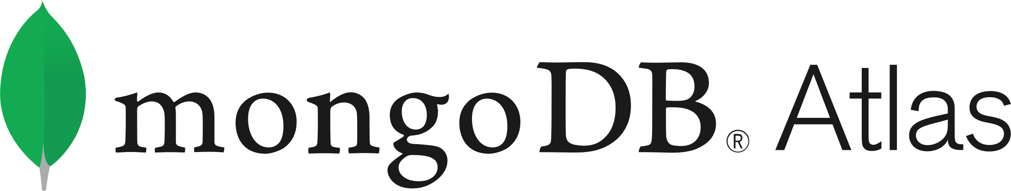

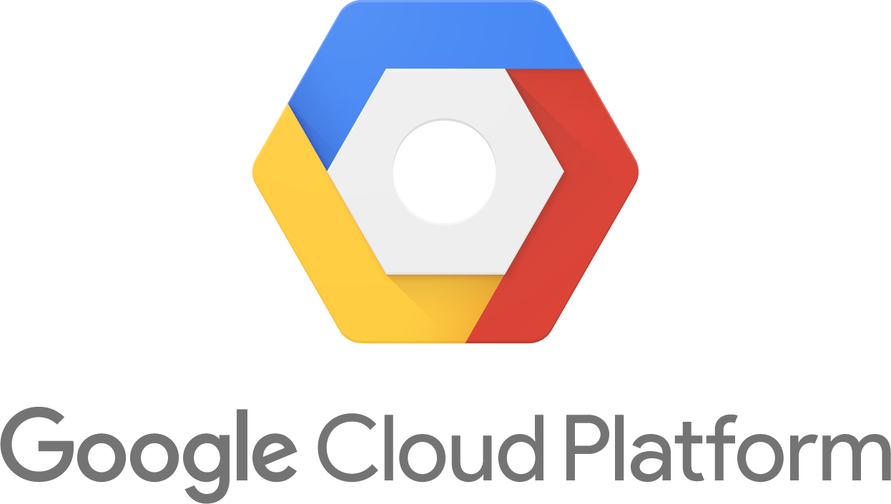

: The only true multi-cloud database as a service
Database that runs the same everywhere
Consistent experience across AWS, Azure, and GCP
Coverage in any geography
Deploy in 59 regions worldwide
Create globally distributed databases with a few clicks
Leverage the benefits of a multi-cloud strategy
Exploit the benefits of AWS, Azure, or GCP services on your data
Avoid lock-in
Easily migrate data between cloud providers

