Slide 1

Deploying Machine Learning Workflows into HPC environment
HPC-DES
(BEE Team)
Ragini Gupta
LA-UR-20-26096
08/12/2020

Slide 2
Outline
Workflows Overview
Common Workflow Language (CWL)
Example of a CWL
BEE Overview
Machine Learning Components
Machine Learning Scientific Workflow using CWL → A new test case for BEE
Discussion: Benefits and Caveats of current ML workflow
Conclusion

Slide 3
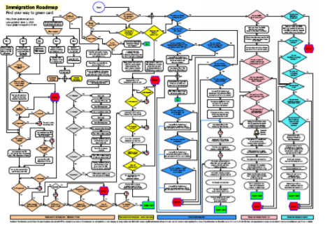
What is a Workflow
Workflows: Collection of computer applications, scripts or codes for computational data analysis and simulations
How applications are configured
How data elements flow between them
Described as chains of interconnected tasks/tools
Tools such as Command line tools are programs for processing data

Slide 4
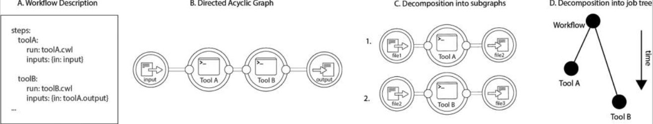
Common Workflow Language (CWL)
An open-source standard for describing tools and workflows
Described as :
Series of steps which could be a single command line tools
Subsequent steps are triggered by an intermediate outcome from preceding steps
Types of interpreters/workflow management system used for CWL:
cwl-runner, cwltool, Toil, RABIX workflow engine, LANL-BEE
Optimizing workflow parsing and execution as follows:
Interpretation of machine readable workflow description
Generation of workflow DAG (Nodes → cmd tools & Edges → flow of data elements, dependencies/rel.)
Decomposition into individual jobs (subgraphs) that can be sent to backend for scheduling or execution
A
B
C

Slide 5
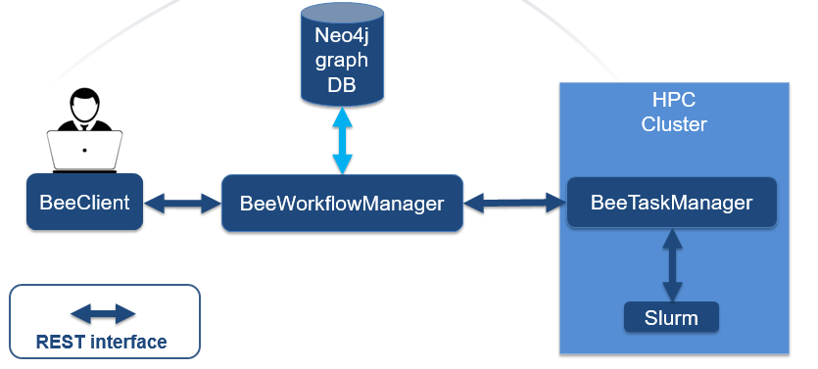
BEE: A Scientific Application Workflow Engine
Facilitate automatic job execution from workflows, job scheduling based on computing resources, scaling across clusters/nodes/or even continents
Designed for: HPC simulations, automations, reproducible/complex
CWL serves as an adaptable workflow framework for BEE:
Automatic Setup of HPC Requirements
Supports the use of HPC Containers, Charliecloud, etc.
A typical cycle of a workflow execution on BEE →
CWL workflows submitted as sequence of steps (jobs) → BEE Client → Workflow Manager (parses workflow) → Graph Database (generates DAGs, metadata, send ready workflow tasks) → Task Manager (schedules job execution across compute nodes)
BEE Components

Slide 6
Motivation
Modern big data analysis involves complex machine learning models and algorithms
Basic ML methodology runs on a single application, single compiler, fixed number of cores
Serialized execution of ML models is computationally expensive, scales poorly, time-consuming
Problem Statement: Serialized execution of ML models is computationally expensive, scales poorly, time-consuming for big data and/or data mining applications
Proposed solution: Using CWL as a bridge for deploying ML models in HPC
To have a reproducible and reusable method to parallelize machine learning models across HPC nodes
Decouple execution of machine learning models running on same dataset

Slide 7
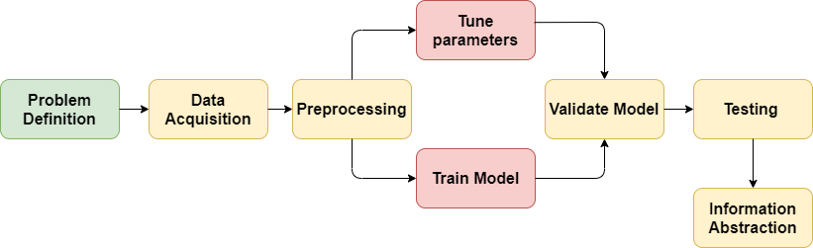
Scaling BEE with Machine Learning Workflows in CWL
Using CWL based ML workflow as a relatively new use-case and a proof-of-concept with BEE
ML stages can be mapped into ML tasks can be managed, pipelined and orchestrated using adaptable CWL workflow that builds ML model, that work on any type of data or any size
ML Stages Mapped into CWL Workflow Steps

Slide 8
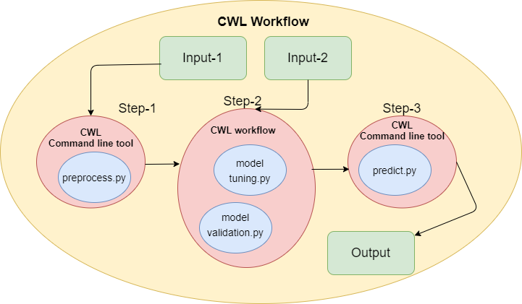
Machine learning Workflow Example
Objective: Prediction on Employee’s salary based on interview score, test score, experience
Workflow is described in four Steps:
Four steps: Each step corresponds to a machine learning stage and/or machine learning model with it’s respective CWL tool description
Each step (tool) references to a Python script written to preprocess input dataset, execute ML models, and make prediction
Execution order between intertwined steps of a workflow is determined by the connections between steps
Testing Environment: Fedora 32 VM
Interpreter used: CWL-Runner
ML Models used:
Linear Regression and Decision Tree Classifier
Python package: Scikit learn

Slide 9
Steps in a ML based CWL
Step-1 | Step-2 | Step-3 | Step-4
Load data and data cleaning | Train the model for Multi-Linear Regression | Train the model for Decision Tree Classifier | Make prediction on a new data instance (test and information abstraction)
Inputs: Dataset file path | Inputs: X,Y | Inputs: X,Y | Inputs: X,Y
Preprocess, and export Independent (interview, test, experience scores) and Dependent variables (salary) as X and Y | Finds model parameters (slopes/y intercept) | Finds root and leaf nodes, splitting feature for tree | Apply inputs to the model_1 and model_2
Output: X,Y into the file disk | Output: model_1.pkl | Output: model_2.pkl | Output: JSON object: Expected Salary of Candidate

Slide 10
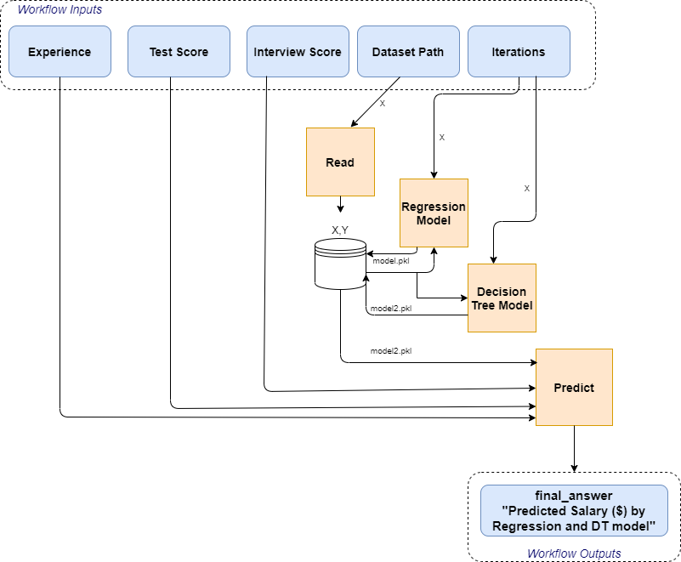

ML Workflow Graphical overview
Index:
CWL Tools
CWL Workflow I/O elements

Slide 11
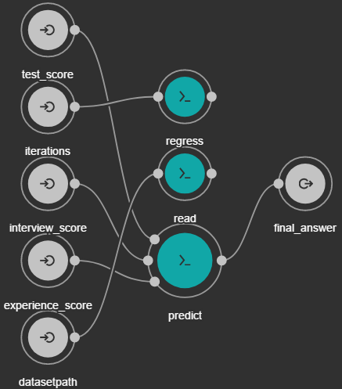
ML Workflow DAG and Commands
CWL-Runner Sequence Commands
ML Workflow DAG
cwl-runner -- validate myworkflow.cwl “/home/bee/dataset.csv” -- interviewscore 5 -- testscore 3 -- experience 3 -- iterations 50
cwl-runner --validate myworkflow.cwl myinput.yaml # OK
(Note: YAML file specifies input parameters such as file path, number of iterations, in the structure of map)
cwl-runner --validate main.cwl # OK
cwl-runner main.cwl main-input.yml # Fails
cwl-runner --debug main.cwl main-input.yml # Debug ?

Slide 12
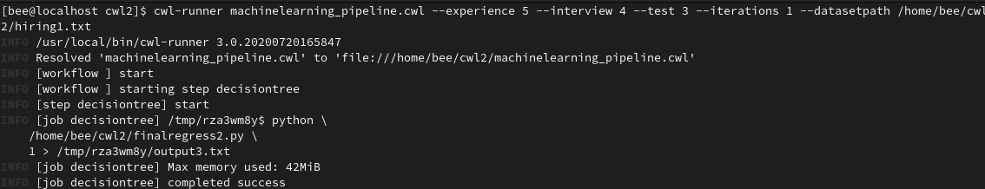
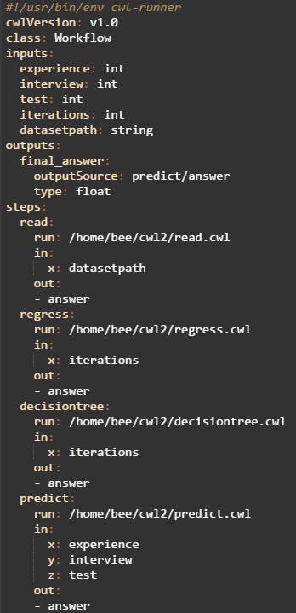
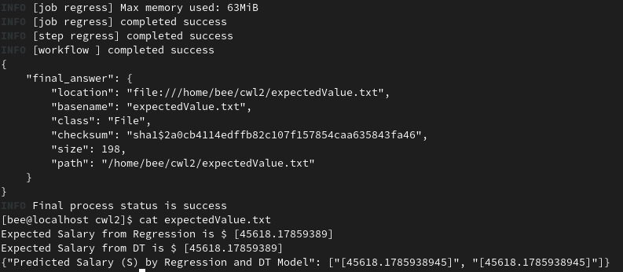
Code Snippet and Output
myWorkflow.cwl

Slide 13
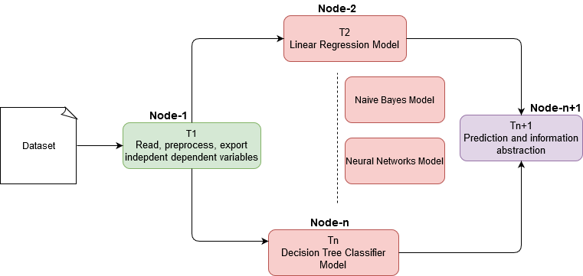
Parallelizing ML Tasks across cluster nodes using BEE engine
Since CWL-Runner executes each step sequentially, BEE engine can facilitate simultaneous execution of ML models across HPC nodes
HPC Cluster
Client

Slide 14
Discussion
Representing Machine learning models for data analyses using a CWL workflow is relatively a new use-case in an HPC environment
Benefits of new workflow:
Three key properties: Portable, flexible, reproducible (1-workflow → ML cases)
Automate machine learning stages into an HPC cluster
Parallel execution of machine learning algorithms across modern hardware architectures in a cluster
Dynamic scheduling of ML models to reduce computational overhead
The proposed CWL ML workflow is loosely-coupled between steps
Helps avoid redundant execution of steps on the same dataset
If the workflow contains a job that has previously been executed and the outputs are still available, the engine can reuse them even if the job was part of a different workflow run
Scalable to ‘n’ number of ML models
Caveats:
Assumes that the ML models have been learned, and is frozen, and now needs to be applied to a large batch of data for distributed processing across cluster
For ML code optimization and scalable auto-tuning, a more complex CWL workflow would be required

Slide 15
Future Work and Conclusion
CWL workflows are designed for extensive data analyses applications
Allows data elements to be transformed during runtime
Nested workflows can be written as steps in CWL for reusing existing code
Using a CWL workflow for ML algorithms:
We can make use of available computational capacity for evaluating performance of different ML models operating on large scale data
To further explore:
BEE engine can be integrated with the proposed ML workflow to parallelize execution of different models on the dataset
Parsing and executing machine learning workflows with BEE
Containerize current workflow to test for software dependencies and portability

Slide 16
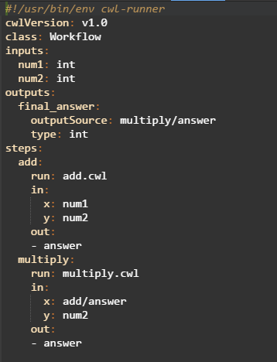
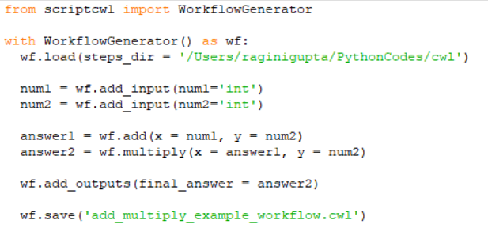
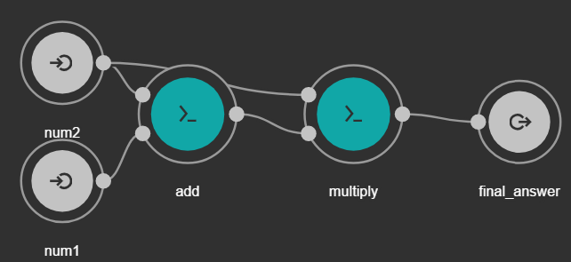
A Python based handy tool for creating CWL workflows
CWL→ specific schema, fields, and style to adhere
Alternative: ScriptCWL, a python package for creating workflows in CWL,
If we input a number of CWL Command line tools, it generates a workflow

Slide 17
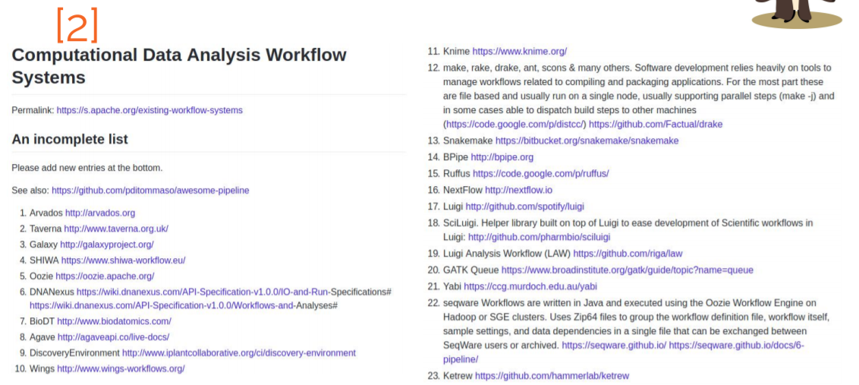
Existing Workflow Systems

Slide 18
References
www.ncbi.nlm.nih.gov/pmc/articles/PMC5166558
Dataset source: https://www.kaggle.com/pankeshpatel/hiring
https://github.com/common-workflow-language/common-workflow-language/wiki/Existing-Workflow-systems
CWL guide: http://www.commonwl.org/user_guide/21-1st-workflow/index.html

Slide 19
Acknowledgements
HPC Supercomputing Institute
Julie Wiens
BEE Team
Mentors: Tim Randles, Pat Grubel

Slide 20
Thank you
Questions?

