Slide 1
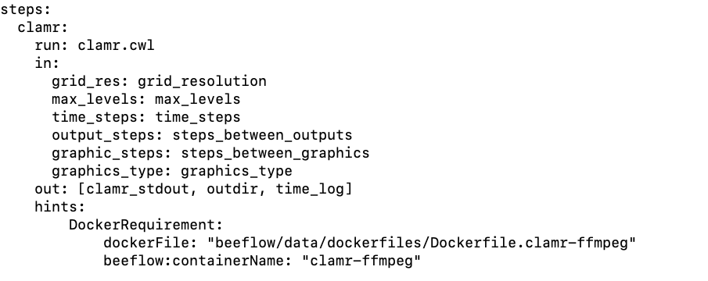
DockerRequirement specifies building container with specified dockerFile
giving it the specified containerName using Charliecloud

