Slide 1
Logistic Regression / Classification

Slide 2
Why Not Linear Regression?
Linear regression outputs any real number
Classification needs discrete labels (0/1, cat/dog)
Linear regression can give probabilities <0 or >1
We need outputs between 0 and 1 → probabilities!

Slide 3
Logistic Regression
Model: z = w·x + b
Prediction: ŷ = σ(z) = 1 / (1 + e^(-z))
Output ŷ is between 0 and 1
Interpretation: probability of label = 1

Slide 4
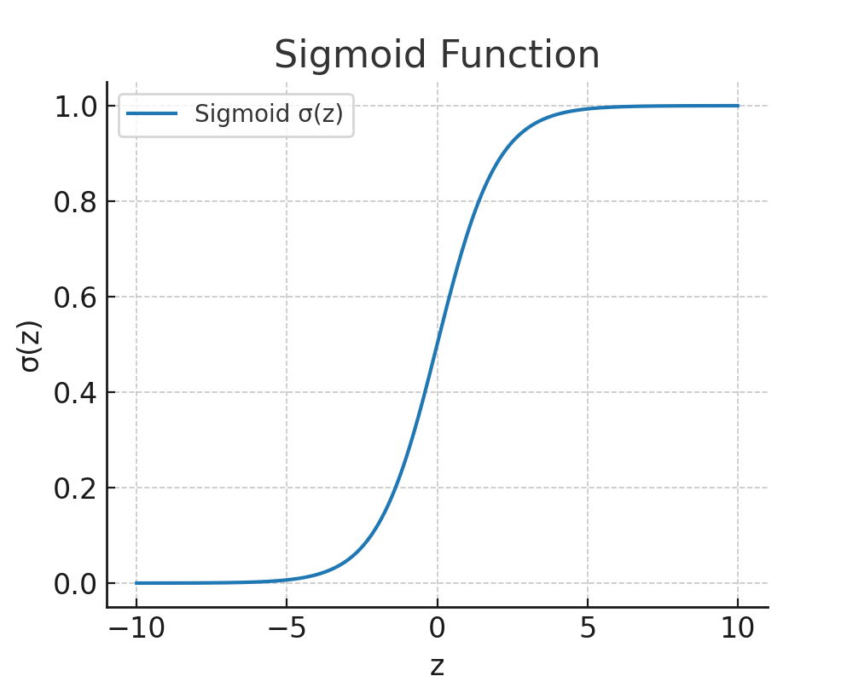
Sigmoid Function
S-shaped curve
Small/negative input → near 0
Large/positive input → near 1
σ'(z) = σ(z)(1 - σ(z)) (for backprop)

Slide 5
Loss Functions for Classification
MSE is possible but not ideal
Binary Cross-Entropy (Log Loss):
L = - [ y log(ŷ) + (1-y) log(1-ŷ) ]
Better gradients, penalizes confident wrong predictions

Slide 6
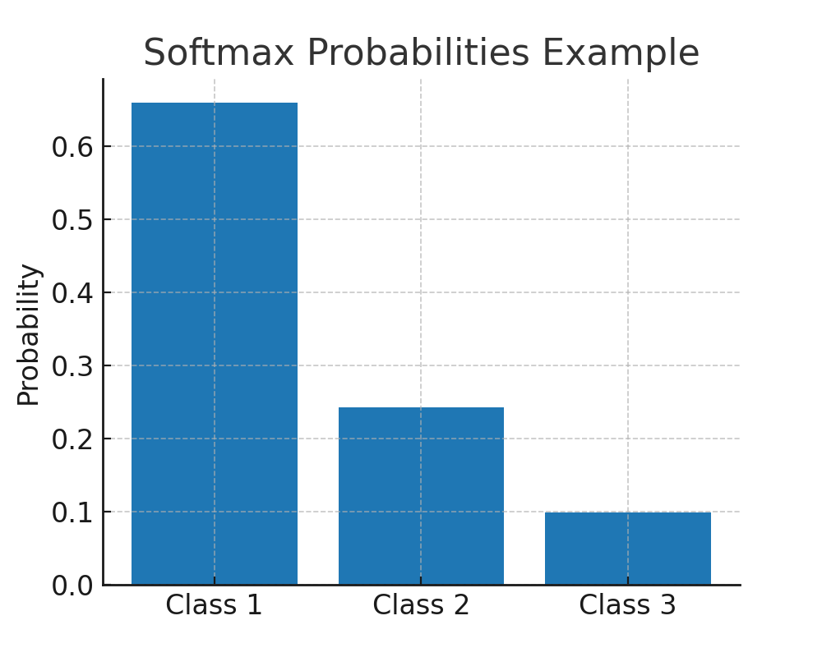
Multi-Class Classification
Softmax: converts scores into probabilities
P(y=i) = e^(z_i) / Σ e^(z_j)
Cross-Entropy Loss:
L = - Σ y_i log(ŷ_i)
y_i = 1 for correct class, 0 otherwise

Slide 7
KL Divergence
Measures distance between two probability distributions
D_KL(P || Q) = Σ P(i) log(P(i)/Q(i))
Cross-Entropy ≈ minimizing KL divergence
In ML: predicted distribution vs. true distribution

Slide 8
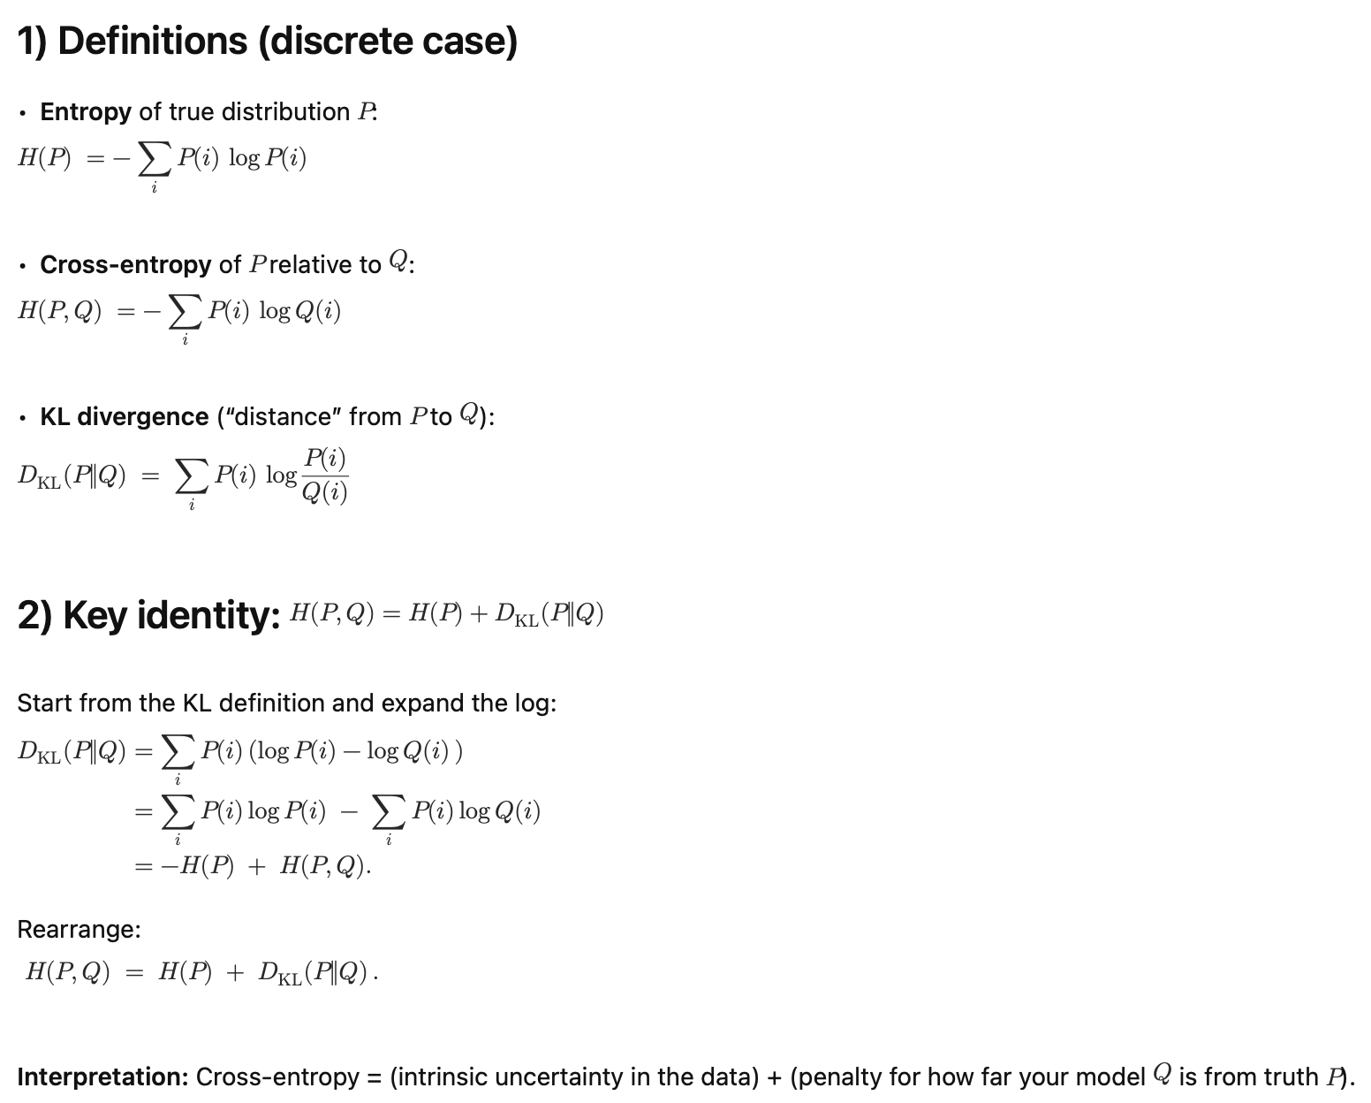
(KL Divergence → Cross Entropy Loss)

Slide 9
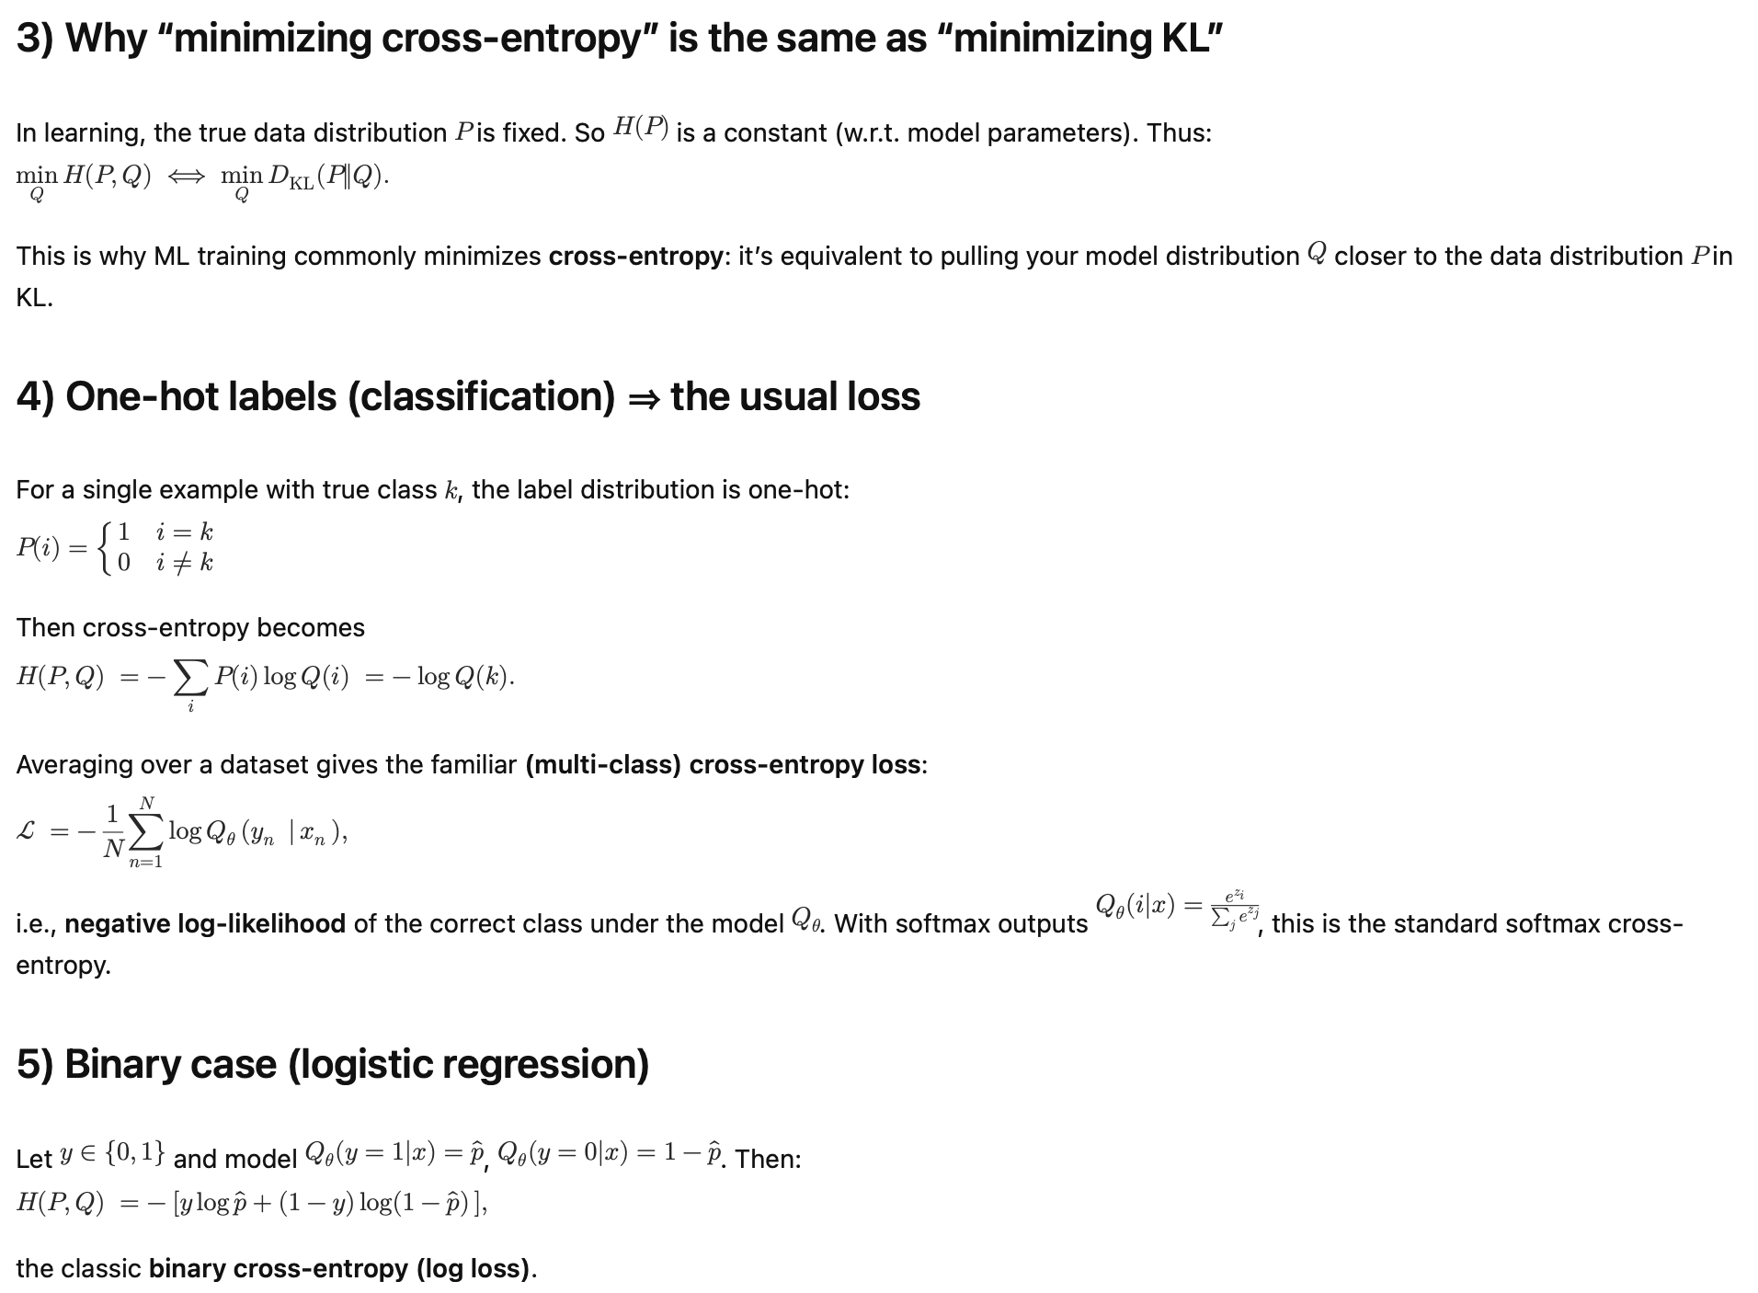
(KL Divergence → Cross Entropy Loss)

Slide 10
Training Logistic Regression
Same process as linear regression:
Forward pass → compute loss → backpropagation → update weights
Difference: use sigmoid/softmax + cross-entropy

Slide 11
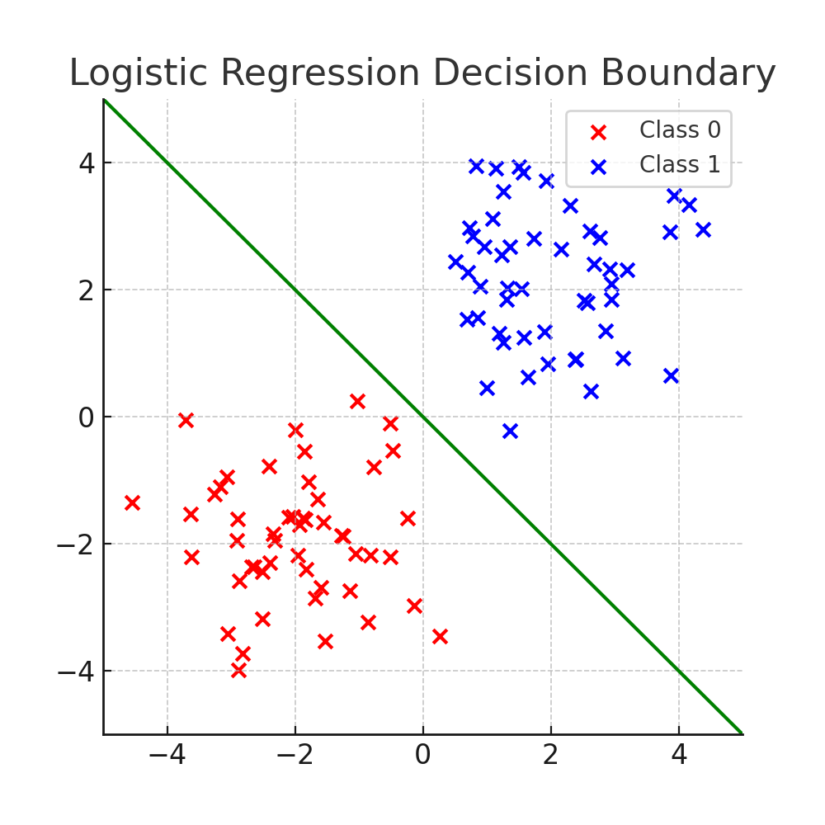
Example: Pass/Fail Prediction
Input: hours studied
Model: ŷ = σ(w·x + b)
Output: probability of passing
Loss: binary cross-entropy
Optimization: gradient descent

Slide 12
Worked Example: Logistic Regression
Task: Predict pass/fail based on hours studied
Input: x = 5 hours
Model: z = w·x + b, with w = 0.8, b = -2
Step 1: Compute z = 0.8*5 - 2 = 2
Step 2: Apply sigmoid: σ(z) = 1 / (1 + e^(-2)) ≈ 0.88
Interpretation: 88% probability of passing
Step 3: If true label y = 1 (passed), loss = -log(0.88) ≈ 0.13
Small loss, model prediction is good

