Slide 1

Creation of a folder

Slide 2
Creation of a text file

Slide 3

Example of renaming a file from example.txt to hello_world.txt

Slide 4
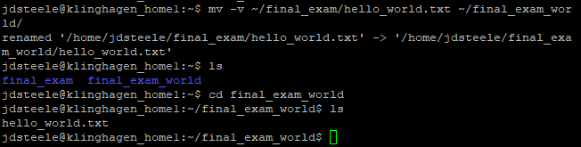
Example of moving a file from one directory to another

Slide 5
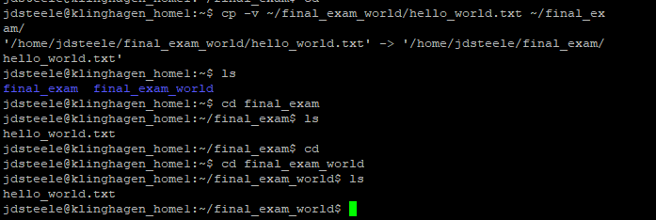
Example of copying a file to another directory

Slide 6
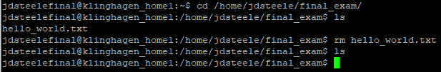
Example of deleting a file using rm command

Slide 7
Changing permissions to hello_world.txt using chmod command

Slide 8
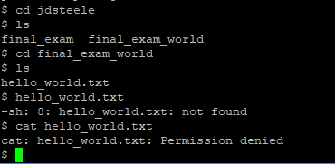
Example of user being denied access to hello_world.txt

Slide 9
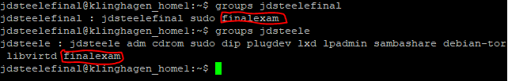
Example showing that jdsteele and jdsteelefinal users are part of the same group.

Slide 10
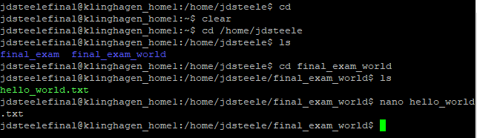
Example of jdsteelefinal user accessing the hello_world.txt file created by the jdsteele user.

Slide 11
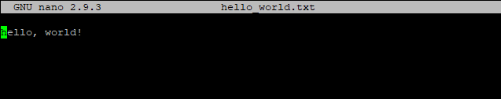
Example of the jdsteelefinal user reading the hello_world.txt file in nano

