Slide 1

ABC Telecom
Churn Rate Reduction Project
By Abdullah Habeh, Jason Steen, Suhani Patel

Slide 2
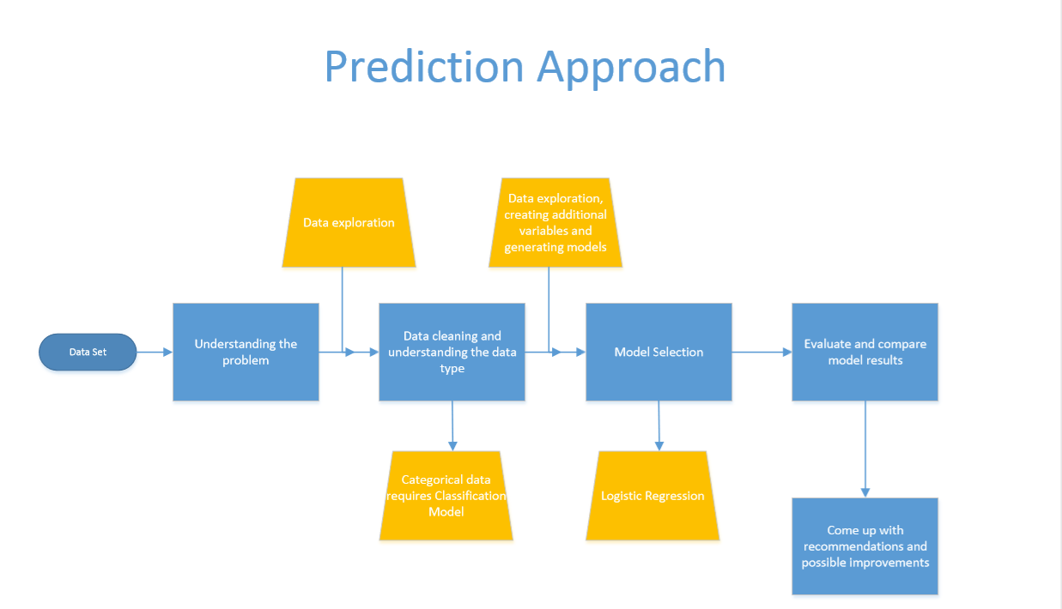
Macro process overview

Slide 3
Data exploration and modeling highlights
Churn rate is 14.4% while average current churn rate for major companies such as Verizon is 1.9%
The distribution of values for Number of Customer Service Calls varied significantly for both churn outcomes. This also occurred with the Amount of Day Charges. More issues requiring contact with customer service and greater amounts spent will cause subscribers to explore other wireless companies.
Members of the international plan are almost 4x more likely to churn

Slide 4
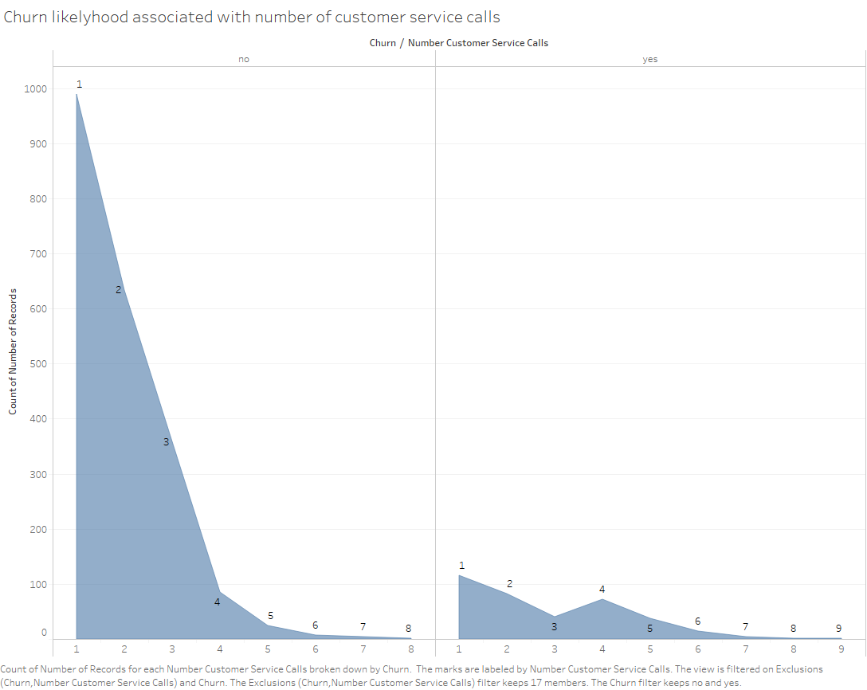
Count of Churn outcome by The number of customer service calls

Slide 5
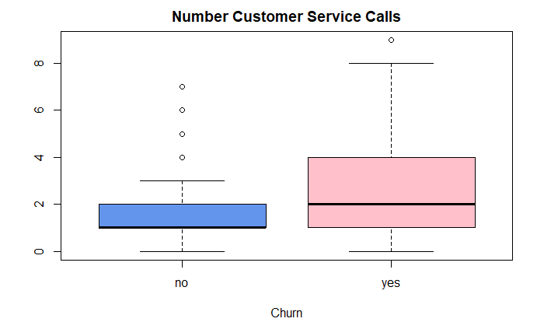
Distribution of The number of customer service calls by churn outcome

Slide 6
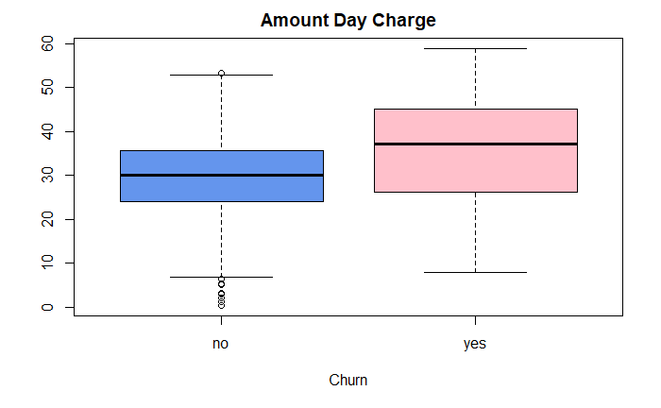
Distribution of DAY CHARGES by churn outcome

Slide 7

Membership in International plan by churn outcome

Slide 8
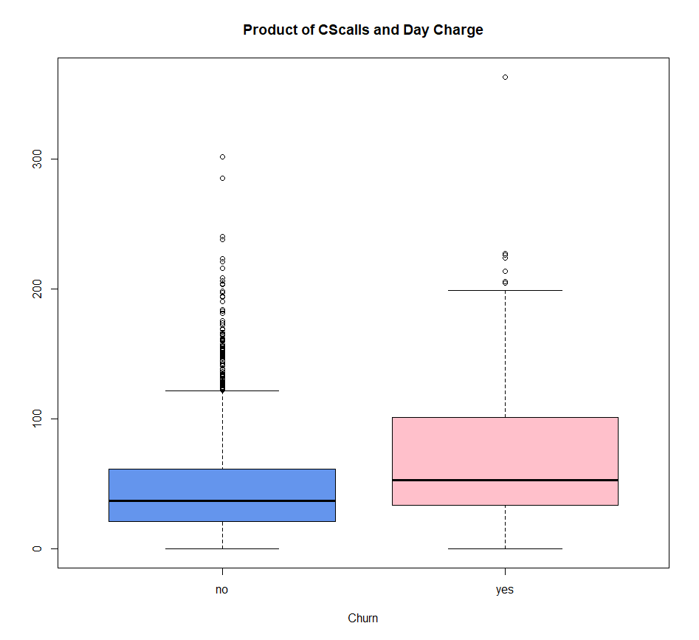
Distribution of the product of number of cs calls and day charges by churn outcome

Slide 9
HIGHER CONCENTRATION OF CALLS IN A SPECIFIC TIME ASSOCIATED WITH THE LIKELIHOOD OF CHURNING
Customers whose use does not span multiple segments of the day are more likely to churn compared to those whose use is more spread out across the multiple segments of the day.

Slide 10
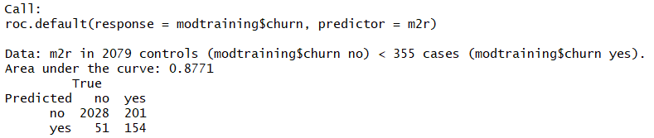
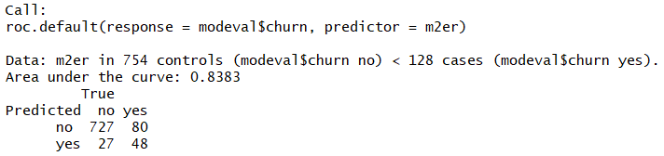
EVALUTIONS OF TRAINING & TESTING DATA
The classification model ‘s TP rate is 37.5% and the FN rate is 62.5%, assuming a 50% threshold for predicting churn. Decreasing the threshold will allow ABC to identify a greater amount of likely churners at the cost of including subscribers not likely to churn. The cost of targeting more potential churners is the additional incentives given to customers unlikely to churn.

Slide 11
recommendations
Prioritize efficiency of customer service, especially providing customer requested resolution in one call
Provide customized plans for excessive users that are more cost-effective
Consider adding services and restructuring international plan
Incentivize use across multiple day segments by offering an introductory amount of minutes at a reduced rate

Slide 12
THANK YOU
Questions?

