Slide 1
CSS 伪类和伪元素
的 N 种用法
青岛 · 易软天创 · 孙浩

Slide 2
“CSS introduces the concepts of pseudo-elements and pseudo-classes to permit formatting based on information that lies outside the document tree.”
CSS 引入伪类和伪元素的概念是为了实现基于文档树之外的信息的格式化。
翻译引自 https://swordair.com/origin-and-difference-between-css-pseudo-classes-and-pseudo-elements/

Slide 3
常用伪类和伪元素
状态[CSS1,2] | 结构[CSS3] |  | 表单[CSS3] | 伪元素[CSS2,3]
:link | :first-child | :not | :checked | :first-letter
:hover | :last-child | :empty | :disabled | :first-line
:focus | :nth-child() | :target | :enabled | :before
:active | :nth-last-child() | :root | :optional | :after
:visited | :only-child | :scoped | :out-of-range | ::section
 | :first-of-type | :lang() | :read-only | ::placeholder
 | :last-of-type |  | :read-write
 | :nth-of-type() |  | :valid
 | :nth-last-of-type()
 | :only-of-type

Slide 4

CSS 魔法类
图片来自 https://pixabay.com/photo-51358/

Slide 5

示例源码
https://github.com/catouse/css-magic

Slide 6

访问示例网站
https://catouse.github.io/css-magic/

Slide 7
简单

Slide 8
1~5 | 链接 :link, :hover, :visited, :active, :focus
6 | :root 相当于 html

Slide 9
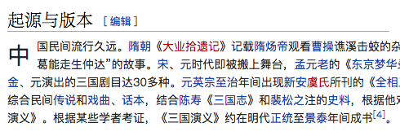
7 | 首字下沉 :first-letter
p:first-letter {
    display: block;
    float: left;
    font-size: 2em;
    margin-right: .5em
}

Slide 10
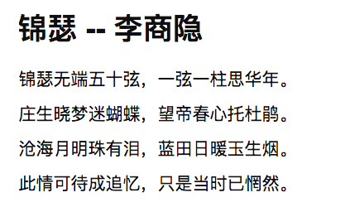
8 | 首行加粗 :first-line
p:first-line {
    font-weight: bold;
    font-size: 2em;
}

Slide 11
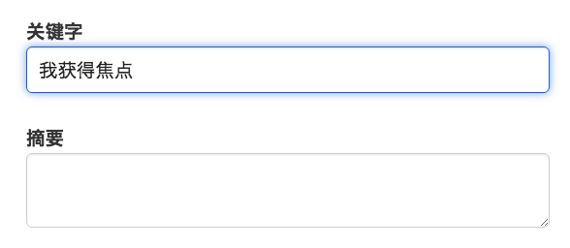
9 | 表单输入框聚焦 :focus
input[type="text"] {
    border: 1px blue solid;
}

Slide 12

10 | 图像缩放效果 :hover

Slide 13

11 | 背景翻转效果 :hover

Slide 14
12 | 修正边框 :last-child
1
2
3
.box > .item {
    border: 1px gray solid;
    border-right: none;
}
.box > .item:last-child {
    border-right: 1px gray solid;
}

Slide 15
13 | 表格隔行变色 :nth-child()
0
1
2
3
4
table > body > tr > td {
    background: #ddd;
}
table > body > tr > td:nth-child(odd) {
    background: #fff;
}

Slide 16
14 | 选中文本外观 ::selection
在这段文字内包含提示消息。
这里是提示消息
<span class=“has-tip”>提示<span class=“tip”>这里是提示消息</span></span>
.has-tip {display: inline-block; position: relative;}
.has-tip > .tip {display: none}
.has-tip:hover > .tip {
  display: block;
  position: absolute;
  top: 100%;
  left: 0;
  …
}

Slide 17
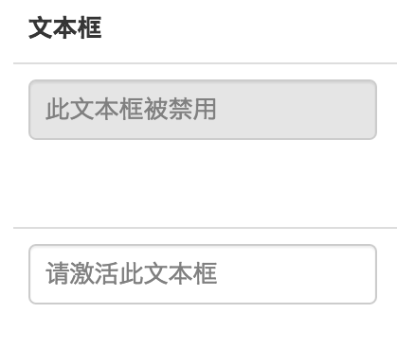
15 | 禁用外观 :disabled
input:disabled {
background: #ddd;
color: #808080;
}

Slide 18
高级

Slide 19
16 | 隐藏空元素 :empty
/* 隐藏空段落 */
p:empty {
  display: none;
}

Slide 20

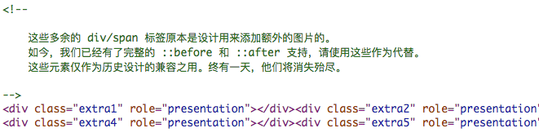
www.csszengarden.com

Slide 21
17 | 处理空链接 :empty, :before/:after
<a href="http://zui.sexy"></a>
a:empty:before {
content: attr(href);
}
http://zui.sexy

Slide 22
18 | 选中表单控件（不包括按钮） :not
<input type="text">
<input type="file">
<input type="submit">
input:not([type="submit"]) {
…
}

Slide 23
19 | 按钮切换 :hover
点击下载
大小：12GB

Slide 24
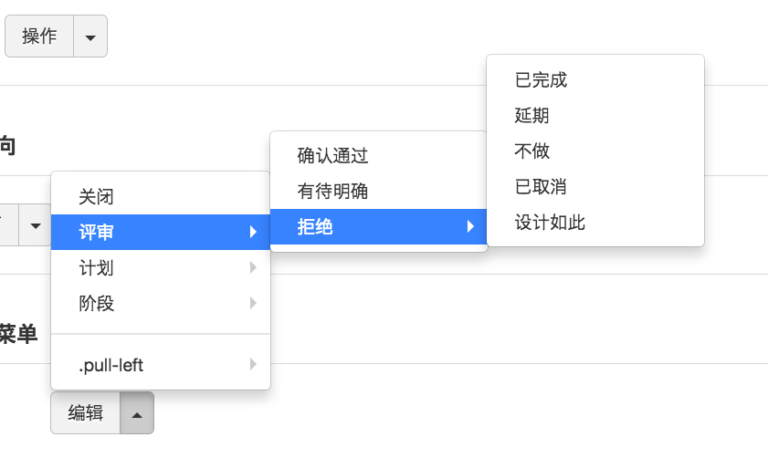
20 | 下拉菜单 :hover

Slide 25
21 | 三角形 :before, :after
.triangle:before {
content: "";
display: block;
border: 30px solid red;
height: 0;
width: 0;
border-left-color: blue;
border-right-color: brown;
border-bottom-color: yellow;
}

Slide 26
22 | 下拉菜单按钮指示图标 :before/:after
下拉菜单按钮

Slide 27
23 | 会话三角形 :before/:after
子曰：
学而时习之，不亦说乎？

Slide 28
24 | 带边框的会话三角形 :before, :after
子曰：
学而时习之，不亦说乎？

Slide 29

25 | 角标 :before, :after
  NEW

Slide 30
26 | 箭头形状 :before, :after
我家
大院
ul>li:before {…}
ul>li:after {…}

Slide 31

27 | 切角遮挡 :before/:after

Slide 32
28 | 清除浮动 :after
.container::before, .container::after {
content:"";
display:table;
}
.container::after {
clear:both;
}
.container {
zoom:1; /* For IE 6/7 */
}
参考：http://stackoverflow.com/questions/211383/what-methods-of-clearfix-can-i-use

Slide 33
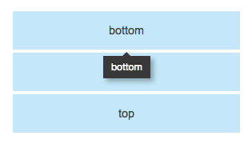
29 | 纯CSS实现工具提示 :before/:after
<div class=“has-tooltip" data-tooltip="bottom">bottom</div>
.has-tooltip {position: relative;}
.has-tooltip:before {
content: attr(data-tooltip);
display: block;
background: #000;
}
.has-tooltip:after { /* 顶部三角 */
}
参考 http://kushagragour.in/lab/hint/

Slide 34
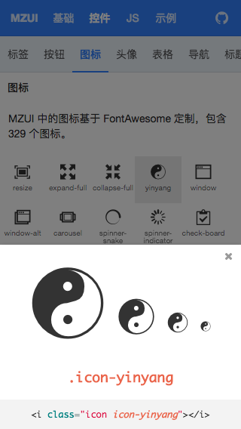
30 | 图标字体 :before/:after
.icon-yinyang:before {
font-family: 图标字体;
content: '\e687';
}
参考：http://easysoft.github.io/mzui/

Slide 35
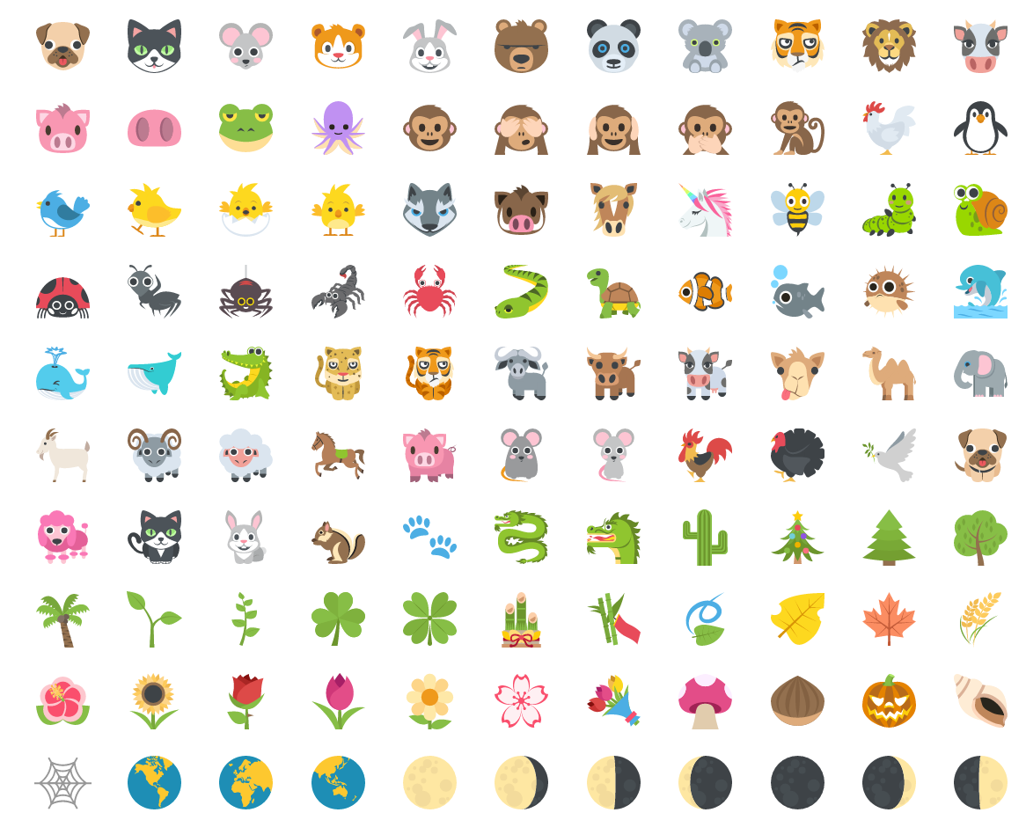
31 | Sprite 图标 :before/:after
.sprite:before {
content: ' ‘;
display: inline-block;
background-image: url(sprite.png);
background-repeat: no-repeat;
background-position: -100px -200px;
}
截图自：http://emojione.com/

Slide 36
32 | 按钮交互外观 :before/:hover
按钮
.btn {
position: relative;
background: blue;
}
.btn:before {
  content: " ";
  display: block;
  position: absolute;
  top: 0;
  right: 0;
  bottom: 0;
  left: 0;
  background: transparent;
}
.btn:hover:before {
  background: rgba(255,255,255,.2);
}
…
按钮 :hover
按钮 :focus
按钮 :active
参考：http://easysoft.github.io/mzui/

Slide 37
33 | 不规则形状背景 :before/:after
<div class="luck"><span>LUCK</span></div>
LUCK
.luck {position: relative;}
.luck:before {
content: ‘’;
display: block;
position: absolute;
width: 100px;
height: 100px;
top: 0;
left: 0;
transform: rotate(90deg);
background: red;
}
.luck > span {
  color: yellow;
  font-size: 20rem;
}

Slide 38
34 | 增加点击区域 :before/:after
按钮
button {position: relative;}
button:before {
content: ‘’;
display: block;
position: absolute;
top: -20px;
right: -20px;
bottom: -20px;
left: -20px;
}
按钮

Slide 39


35 | 绘制 Logo :before/:after
http://chanzhi.org
http://zui.sexy

Slide 40
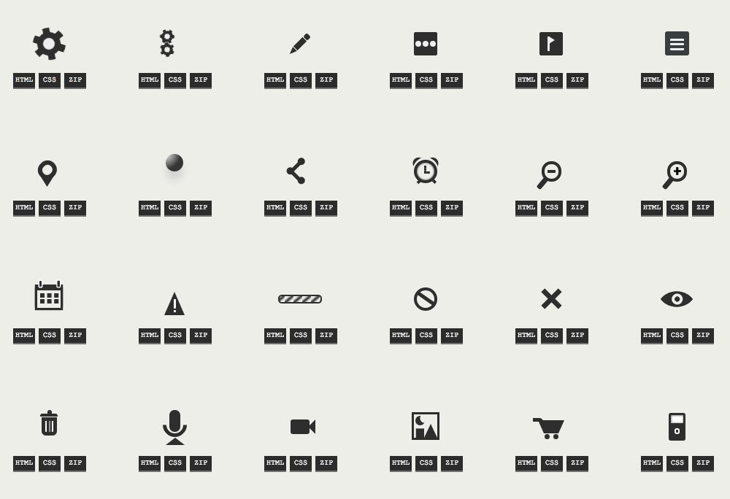
36 | 绘制图标 :before/:after
http://one-div.com/

Slide 41

37 | 绘制图形 :before/:after
http://a.singlediv.com/

Slide 42
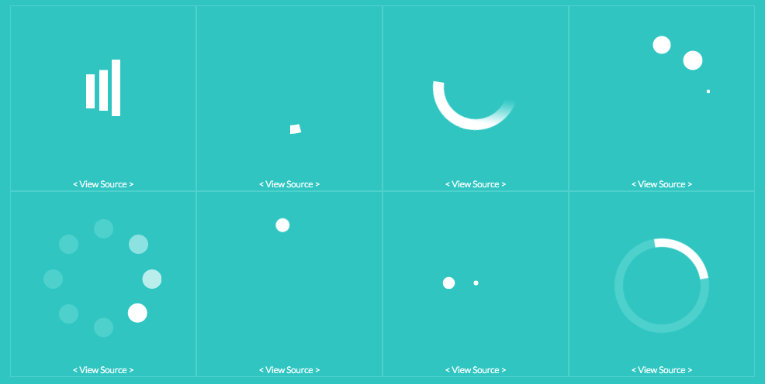
38 | CSS loading 动画 :before/:after
http://projects.lukehaas.me/css-loaders/

Slide 43
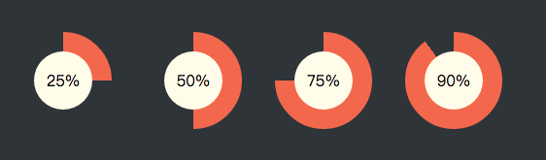
39 | 环形进度条 :before, :after
图片来自：https://codepen.io/geedmo/pen/InFfd

Slide 44
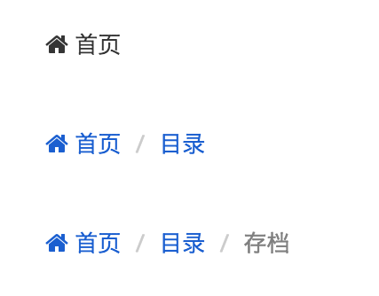
40 | 面包屑导航 :before/:after, :last-child
参考：http://zui.sexy

Slide 45
41 | 行内逗号分隔列表 :before/:after
写字两页
背古诗三首
作文一篇
算术练习
ul > li {
display: inline-block;
}
ul > li:before {
content: “，";
}
ul > li:last-child:before {
display: none;
}
写字两页，背古诗三首，作文一篇，算术练习

Slide 46
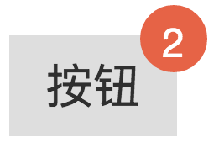
42 | 右上角徽标 :before/:after
<button data-badge=“2”>按钮</button>
button {
position: relative;]
}
button:before {
content: attr(data-badge);
display: block;
width: 16px;
height: 16px;
top: -8px;
right: -8px;
background: red;
border-radius: 8px;
}

Slide 47
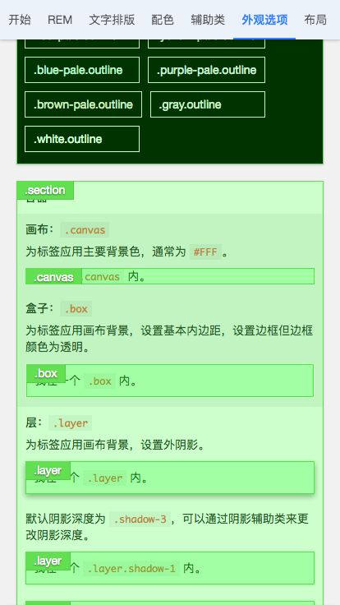
43 | 聚焦效果 :before/:after
.box {
position: relative;
}
.box:before {
content: " ";
display: block;
left: 0;
bottom: 0;
top: 0;
right: 0;
background: rgba(0,255,0,.1);
border: 1px solid #0f0;
}

Slide 48
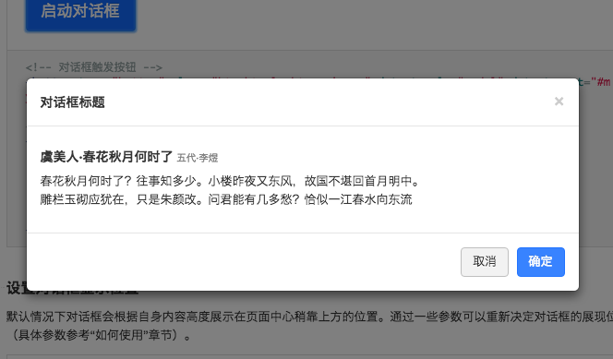
44 | 遮罩效果 :before/:after
.box:before {
border: 9999em solid rgba(0,0,0,.1);
pointer-events: none;
background: transparent;
box-sizing: content-box;
}

Slide 49
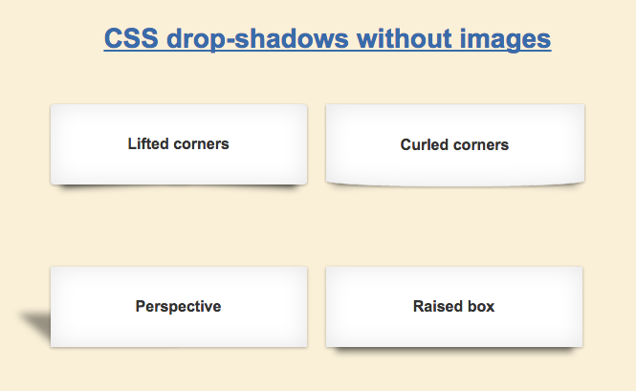
45 | 不规则阴影 :before, :afrer
参考 http://nicolasgallagher.com/css-drop-shadows-without-images/

Slide 50
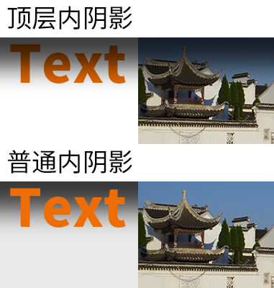
46 | 顶层内阴影 :before, :afrer
body {
position: relative;
overflow: hidden;
}
body:before {
    content: " ";
    display: block;
    position: absolute;
    top: -20px;
    left: -20px;
    right: -20px;
    height: 20px;
    box-shadow: …
}

Slide 51
47 | 自动隐藏 Dock 栏 :hover

Slide 52
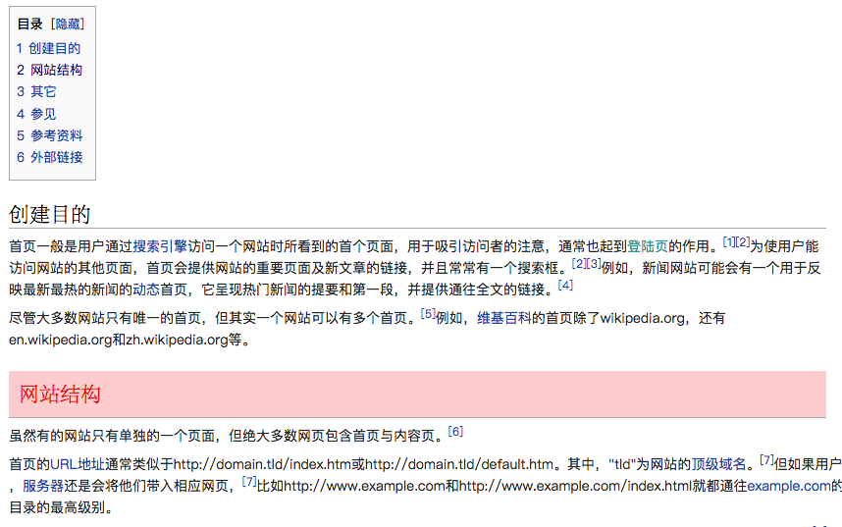
48 | TOC 内容聚焦 :target
.content:target {
background: rgba(0,255,0,.1);
color: red;
padding: 10px;
}

Slide 53
专家

Slide 54
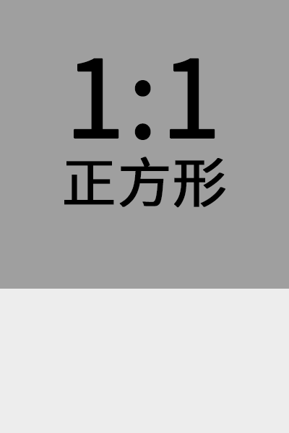
49 | 自适应正方形 :before/:afrer
<div class="squre"></div>
.squre {
width: 100%;
}
.squre:before {
    content: " ";
    display: block;
    padding-top: 100%;
}
参考 https://idiotwu.me/css-responsive-square/

Slide 55
50 | 等比例自适应媒体内容 :before/:afrer
1:1
21:9
16:9
4:3
参考 https://github.com/suitcss/components-flex-embed

Slide 56


51 | 翻转卡片 :hover
抽奖
欧耶
今天你值日
<div class=“card”>
<div class=“back”>抽奖</div>
<div class=“back”>欧耶，今天你值日</div>
</div>

Slide 57
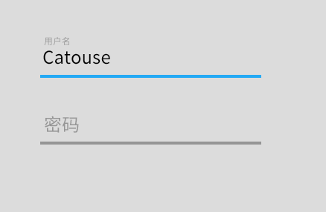
52 | 占位标签输入框 :focus, :active
<div>
<input>
<label>用户名</div>
</div>

Slide 58
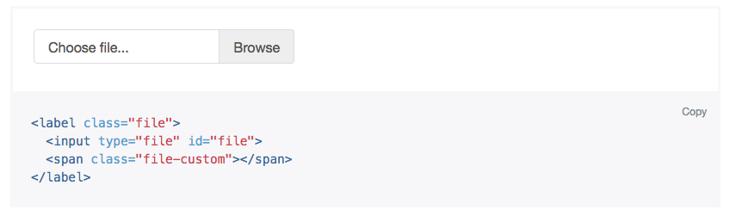
53 | File input 外观 :before, :after
参考：http://v4-alpha.getbootstrap.com/components/forms/#file-browser

Slide 59
54 | 应用单选和复选框状态样式 :checked
<input type="checkbox" id="toggle" name=“toggle">
<label for="toggle">切换开关</label>
#toggle {
/* 正常状态样式 */
}
#toggle:checked {
/* 选中状态的样式 */
}

Slide 60
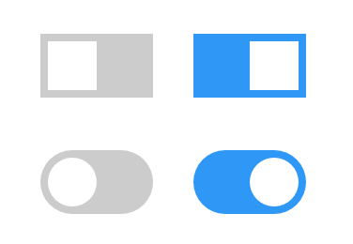
55 | Switch 开关 :checked, :before/:after
参考：http://www.w3schools.com/howto/howto_css_switch.asp

Slide 61
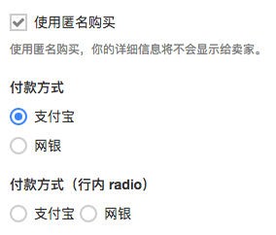
56 | Checkbox 和 Radio 外观 :checked, :before/:after, :focus
参考：http://easysoft.github.io/mzui/

Slide 62
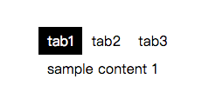
57 | 纯CSS实现标签页 :hover, :active, :checked, nth-of-type
<div class="tab-frame">
<input type="radio" checked name="tab" id="tab1">
<label for="tab1">tab1</label>
<input type="radio" name="tab" id="tab2">
<label for="tab2">tab2</label>
<input type="radio" name="tab" id="tab3">
<label for="tab3">tab3</label>
<div class="tab">sample content 1</div>
<div class="tab">sample content 2</div>
<div class="tab">sample content 3</div>
</div>
div.tab-frame input{ display:none;}
div.tab-frame label{ display:block; float:left;padding:5px 10px; cursor:pointer}
div.tab-frame input:checked + label{ background:black; color:white; cursor:default}
div.tab-frame div.tab{ display:none; padding:5px 10px;clear:left}
div.tab-frame input:nth-of-type(1):checked ~ .tab:nth-of-type(1),
div.tab-frame input:nth-of-type(2):checked ~ .tab:nth-of-type(2),
div.tab-frame input:nth-of-type(3):checked ~ .tab:nth-of-type(3){ display:block;}
此例来自 https://codepen.io/llgruff/pen/ZGBxOa

Slide 63
58 | 纯 CSS 实现折叠面板
59 | 纯 CSS 实现轮播
60 | 纯 CSS 实现对话框
61 | 纯 CSS 实现树形菜单
 | 参考 https://github.com/NamPNQ/You-Dont-Need-Javascript

Slide 64
41
67%

Slide 65






使用魔法类的前端框架
更多……

Slide 66
参考
CSS伪类与CSS伪元素的区别及由来
You-Dont-Need-Javascript
CSS 参考

Slide 67
完。

