Slide 1




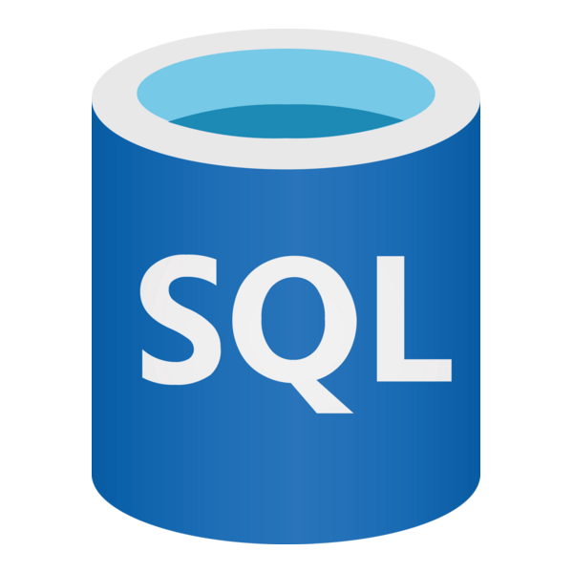
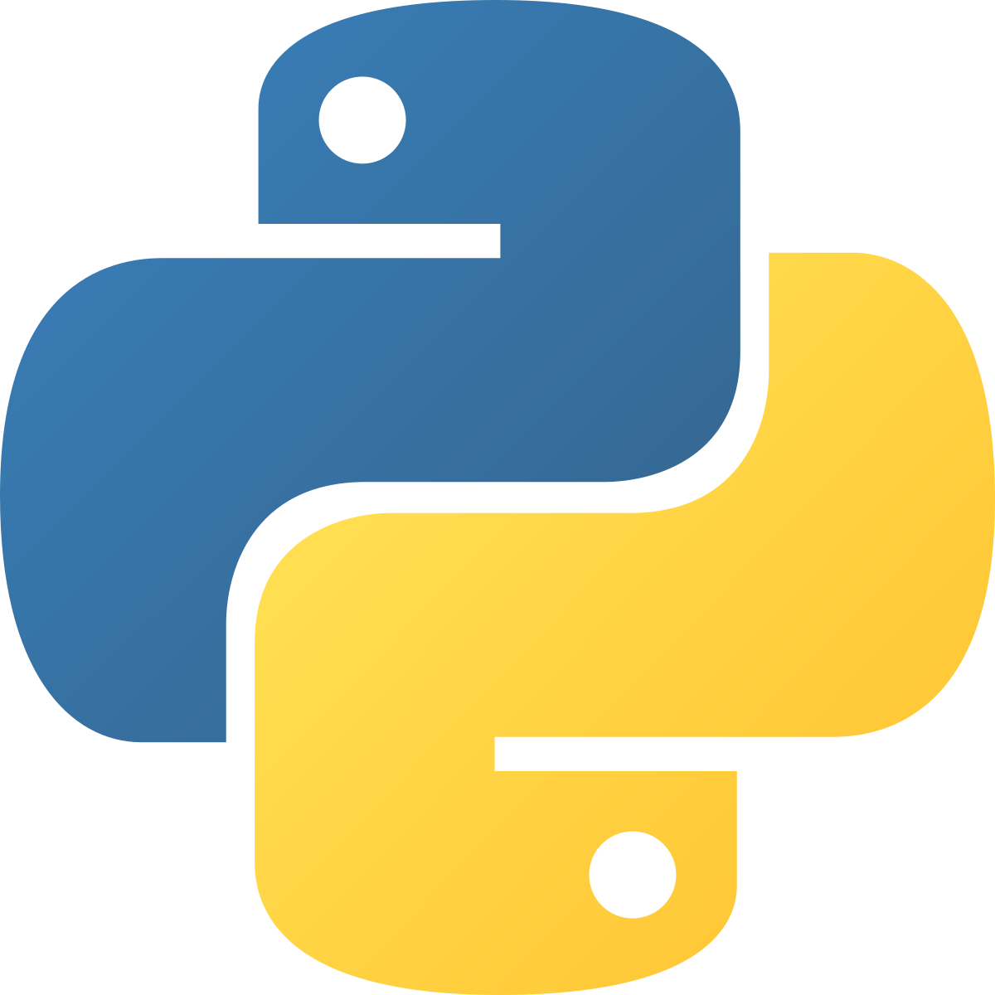

Python-based Cryptocurrency Report Scheduler
Files are written to logs folder
Requests library pulls data from CoinGecko API
Cron job orchestrates the daily running of the report at user-specified time (e.g. 7:30am)
Modular Python pipeline reads in data in JSON format
Data is transformed using Pandas and Regex
Cleaned data written to CSV or destination of user’s choice

