Slide 1


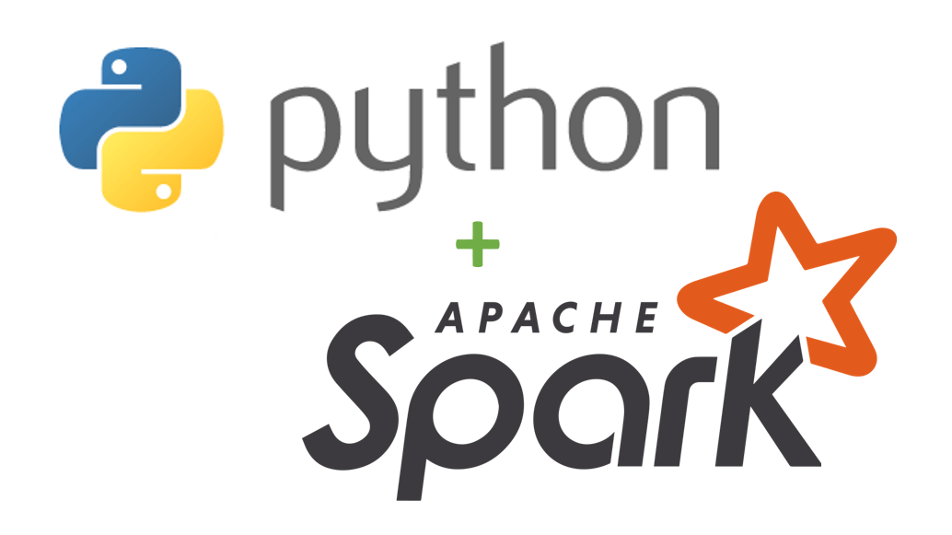



Ingestion
Transformation
Orchestration
Analytics
3 million records for NYC Taxi data transformed using PySpark and prepared for Analytics

