Slide 1
Item level unit sales forecasting
Jennifer Stipe

Slide 2
The Challenge
Analyze historical unit sales and identify modeling technique that optimizes forecast
Beat existing forecast methodology which functions OK at a brand level, but not item level - - -where it counts
Existing models are based the average of the % difference to the 4-week rolling average for the past two years, applied to the most recent data
Model over predicted sales volume by 15,186 units
Multiple LSTM, Linear Regression, Random Forest Regressor, XG Boost Regressor

Slide 3
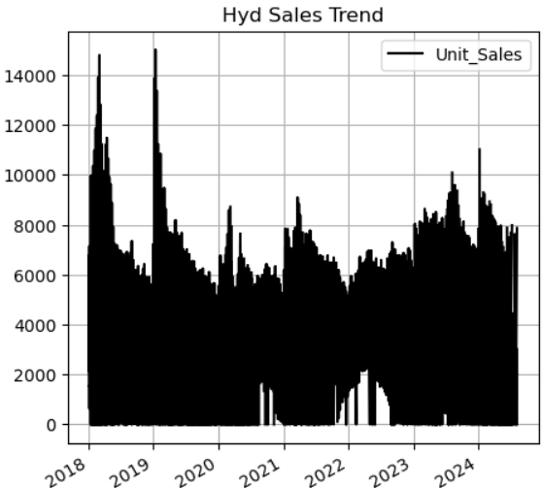
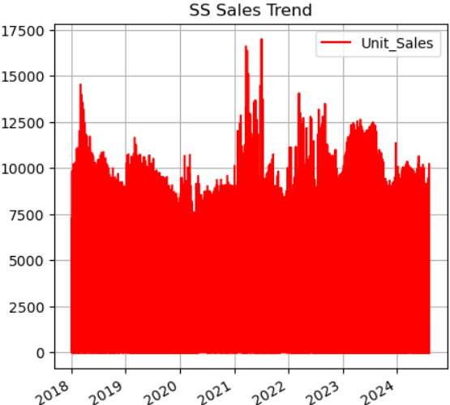
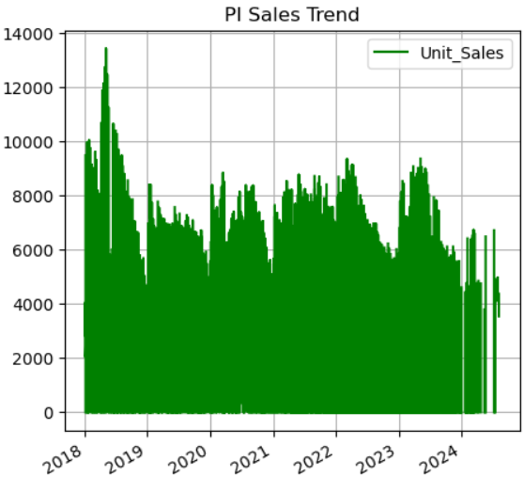
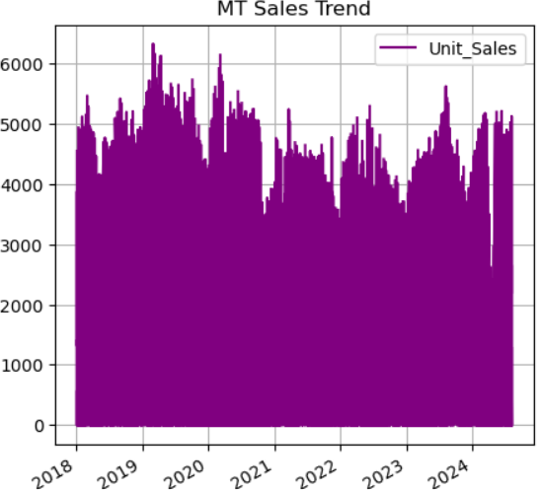
The Challenge
The company has 4 brands, all of which have their own seasonality trends

Slide 4
Methodology
Data Clean up
Pull item level unit sales data details from existing database which is originally sourced from Circana/IRI with 6 years of unit sales data at the weekly level
Data goes through weekly QC both through Circana and within my business unit so very little else was needed for cleanup
Modeling – source a model/process to forecast time series data, ideally sales related
Models were tuned to 1 individual UPC, one that has inconsistent sales volumes to, but has been sold for the entirety of the 6-year history
Additional UPCs were fed through the models with any necessary timing adjustments and the models performed similarly or better than the results presented here
All models are run off diff rather than absolute values as it provides a more reliable result
LSTM #1, LSTM #2, Linear regression , Random Forest , XG Boost
Analyze all results and compare to existing forecast for accuracy

Slide 5
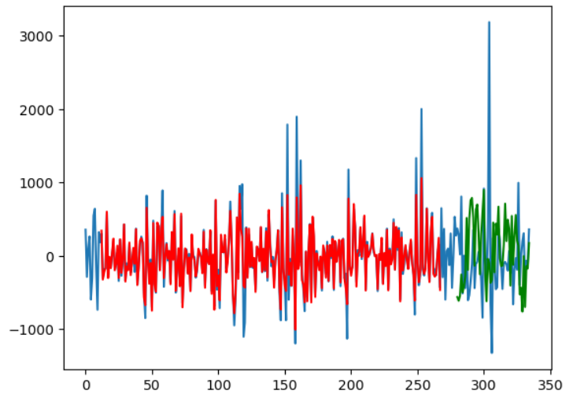
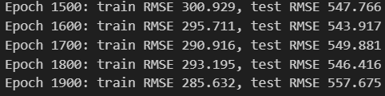
LSTM #1
LSTM model using Pytorch
Not able to predict large week over week swings
Performed better than existing model, but still significant variance to actual results due to the long swings
Process was only fed sales diff data, meaning the output was diff, which is less than idea
When analyzing the same16-week forecast the model under predicted sales by 890 units – however this was more through a law of averages than closely following the sales trend

Slide 6
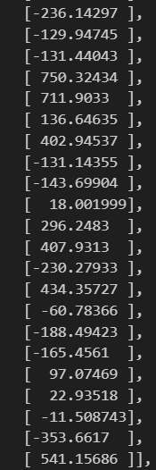
LSTM #1 results
IT WAS AT THIS MOMENT THAT I KNEW…
Delivered in diff
Couldn’t invert back to absolute volumes as the model design only presented diff data and not absolute vales
Processed the results in excel, which was faster than the number of code adjustment which would have been required

Slide 7
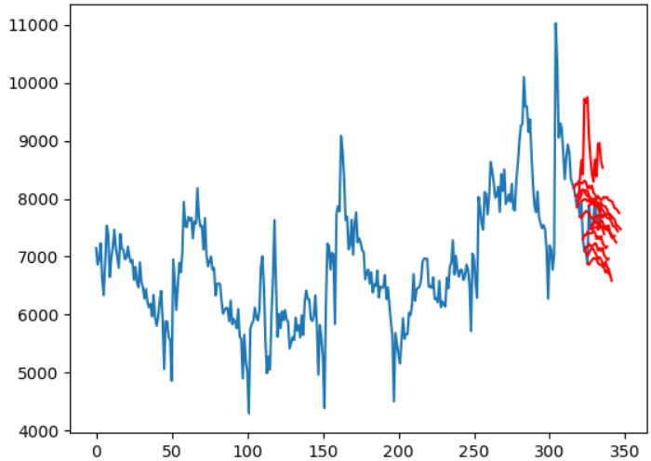
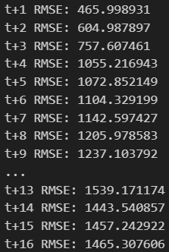
LSTM #2
Designed to predict x # of future weeks starting at a designated point and continue rolling as new data is received
Set up makes logical sense as demand planners would regularly review latest data impact to forecast
Process was fed in actual unit sales data and performed the .diff in the process and inverted the results in the output saving time and frustration
Performed the worst of all new models run, over predicting sales volume by 10,269 units

Slide 8
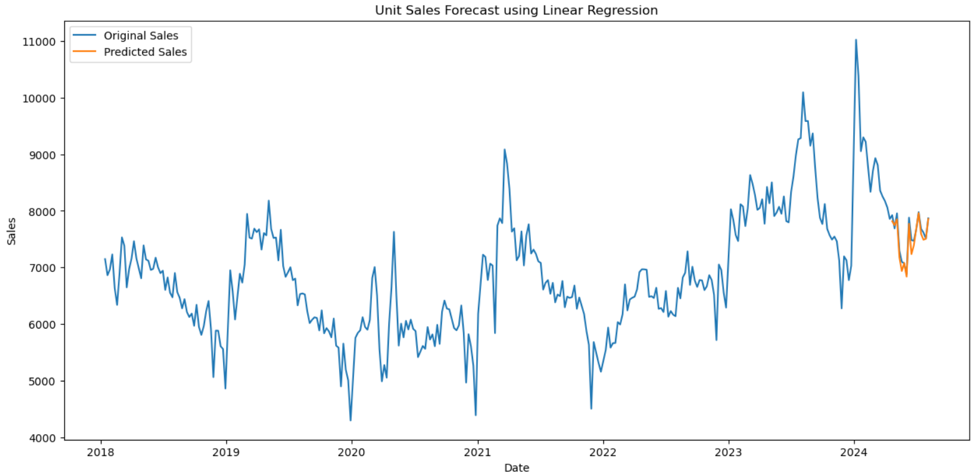

Linear Regression
While linear regressions were not officially within scope for the project, solving the business problem was a key goal
Set up to run based on sales diff grouped annually
Produced an R2 value of .906
This model performed significantly better than the existing model, under predicting sales by just 1,139 units

Slide 9
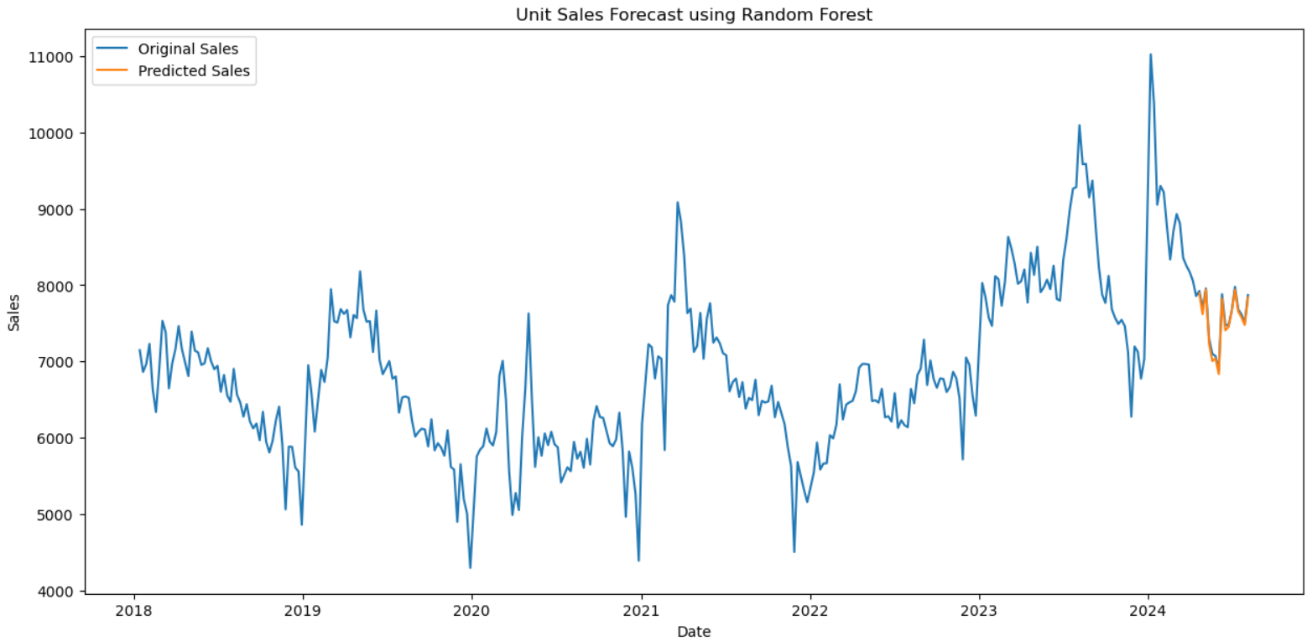

Random Forest
While linear regressions were not officially within scope for the project, solving the business problem was a key goal
Set up to run based on sales diff grouped annually
Produced an R2 value of .979
WINNER!!!! Underpredicted sales by just 679 units over the 16-week forecast period

Slide 10
Take-aways & Next steps
Take-aways
Having strong knowledge of the data is imperative
Pay attention to what data the process takes in, it will impact the amount of post processing
I can’t break-up with Excel yet
Neural Networks aren’t always the best choice for the job
Modeling takes a LOT of time!! ☺
Next Steps
Build a user-friendly interface to make individual item running easy
Roll out findings to the business and work on an implementation plan
Continued tuning to expand forecast period to 52 weeks+
Revisit model performance regularly
Expand to all retailers to encompass all forecasting
Individual tuning may be required for each retailer

Slide 11
Appendix/Iterations

Slide 12
LSTM #1 - iterations
Multiple iterations were run on the LSTM model – many of those iterations are listed in the chart pictured
While the best test RSME fell with 4-weeks of prediction, I chose to move forward with utilizing the 16-weeks of data and 1 layer. The RSME test rate wasn’t that much worse than the optimal, but provided an additional 12 weeks of prediction
Weeks of prediction | Layers | Train RSME | Test RSME
4 | 1 | 349 | 599
12 | 1 | 244 | 642
12 | 2 | 140 | 656
4 | 2 | 269 | 623
4 | 3 | 251 | 628
16 | 2 | 119 | 771
16 | 1 | 242 | 655
24 | 1 | 264 | 715

Slide 13
Linear, Random Forest, and XG Boost- iterations
Additional tuning steps were taken to hone in, but I didn’t capture them all in my notes
 | R2 Scores
 | 12-Week Predict | 16-Week Prediction
Linear Regression | 0.853 | 0.906
Random Forest | 0.926 | 0.966
XG Boost | 0.673 | 0.73

