Slide 1

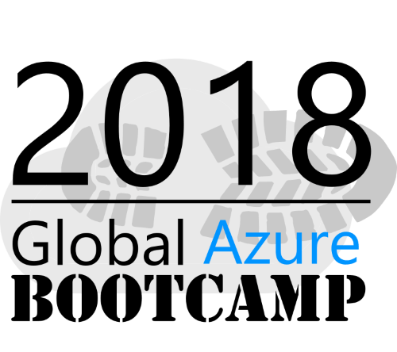
Welcome
Get Kraken:
Terraform and Ansible
Tampa, Florida
Jim
Stott

Slide 2

About Me
Jim Stott
Broad range of experience across projects spanning firmware to serverless!
Enterprise Architect and DevOps guy
Orion Technology Services (MSP) – based out of ATL, work remote in the Tampa Bay Area.
Contact Methods
Email: jim.stott@oriontech.com / jwstott@gmail.com
Twitter: @jimstott (I don’t tweet often, but when I do, its about grilling)

Slide 3

DevOps Domination
DevOps
What’s the big deal?
Infrastructure as Code a.k.a. git for the cloud
Terraform
Deploy Infrastructure
Demo Time
Ansible
Deploy Configurations
Demo Time
Wrap-up

Slide 4
Why IaC – What’s the big deal?
Practice makes perfect == consistency & confidence
Automate your deployment and recovery processes
When in doubt, Redeploy can be an option to Repair
Eliminate Snowflake deployment & the technical debt that goes with it
Did I remember to do everything?
Notes:
Versioned Infrastructure and Configurations – heck yeah!
Practice makes perfect - confidence & consistency
Recovering from failures is no different. Confidence that our recovery process will work as intended and restore the availability of our service.
Don’t Repair, Redeploy (maybe) (santity & validation)
Automate the deployment and recovery processes
With infrastructure automation, reproducible environments become possible. (That the idea anyway).
Over time, every environment becomes a snowflake, a unique configuration that cannot be reproduced automatically.
Inconsistency leads to issues during deployments.
With snowflakes, administration and maintenance is a manual processes - hard to track and contribute to errors.
Teams avoid manual configuration of environments and enforce consistency by representing the desired state of their environments via code. Infrastructure deployments with IaC are repeatable and prevent runtime issues caused by configuration drift or missing dependencies. DevOps teams can work together with a unified set of practices and tools to deliver applications and their supporting infrastructure rapidly, reliably, and at scale.

Slide 5
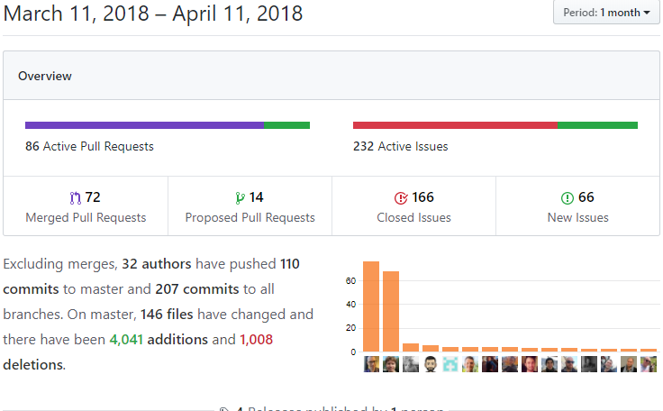
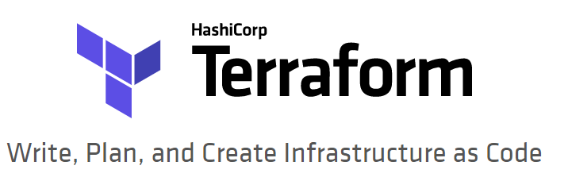
Notes:
Terraform – Create Infrastructure
Can do the same sorts of things with Portal, CLI, ARM Templates…
Other tooling that you can use as well - CloudFormation, Heat,
Terraform is not a configuration management tool -
Terraform focuses on the higher-level abstraction of the datacenter and associated services - infrastructure deployments

Slide 6

What it is and isn’t
Multi-provider – some 70+ and counting
Versioned Infrastructure – heck yeah!
It’s opinionated – and sometimes its wrong.
Standardizes infrastructure definition.
Actively developed by some really smart people
Continues to move fast
It is an open source tool that codifies APIs into declarative configuration files that can be shared amongst team members, treated as code, edited, reviewed, and versioned.
Enables you to safely and predictably create, change, and improve production infrastructure.
Fantastic for defining the bones of your infrastructure.
Maturity (?) - v0.11.5 / 1,134 issues
Cloud agnostic – nope, not that sort of magic
Don’t expect it to hide underlying complexity (Azure, AWS, others) –not that sort of magic either
Generic code in the traditional sense - hard
Debugging & Errors - hard
Notes:
IS
Fantastic for defining the bones of your infrastructure.
Versioned Infrastructure – as you make changes – it can evolve with you
Maintains State
Standardizes infrastructure definition
HCL (HashiCorp Configuration Language) – Mix of JSON, YAML, and some interesting behaviors to solve patterns.: Declarative language (if statements are, interesting)
Azure has 100+ modules, plus ability to run scripts (cli) and template deployment
Interpolation
Dry runs
Isn’t
DOESNT HIDE COPLEXITY - If you don’t understand how Azure (CLI) works, Terraform isn’t going to make your life easier – just the opposite!
In fact, you’ll have two problems - dealing with Azure and Terraform quirks.
Cloud Agnostic – for me, I deploy 95% time into Azure, so the additional providers doesn’t mean a ton to me
Generic Code: Hard to keep true OO style code – you will end up defining (multiple) variables – (DRY) and reusable code, sort of

Slide 7
How do I start?
Install (Windows, Linux, Mac OS)
Azure CLI 2.0
Terraform https://www.terraform.io/downloads.html
Up front considerations
Authentication (interactive, stored)
Overall plan for sensitive keys
tfstate – how & where (again, keys) & maintenance
Actions
Create infrastructure code (sample) – Provisioning Resources
Terraform init
Terraform plan
Terraform apply
Notes:
Install Mac’s, Linux, Windows
Top Considerations
Authentication / Keys
State (tfstate ) – how (workspaces) and where (local, backing store)
Additional Actions – there a few you will need from time-to-time:
Get – downloads modules / gathers modules need for the configuration
Refresh – helps to update metadata (state file) with changes you may have made to your resources
State – work directly with the state (meta data file) – usually to remove an item or add an item

Slide 8
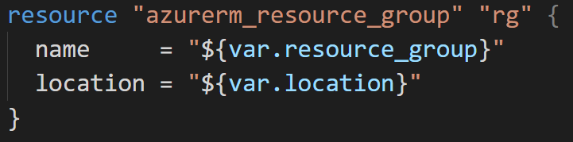

Your environments – Sanity (Parity)
DEV
Same Code
Environment Testing and Parity
Confidence and
Recovery plan
STAGE
DEV
OPS
PRODUCTION
OPS
Notes:
Party == Consistency == Expectations (time-to-ready, naming standards, confidence)
Many ways your infrastructure may be configured and deployed– but the typical model: dev, qa, uat, production is a common one.
For environments that are essentially clones – I’ll use workspaces (aka environments) (named state files)
Overall – I like to wrap terraform commands in script files – but more on that later…

Slide 9
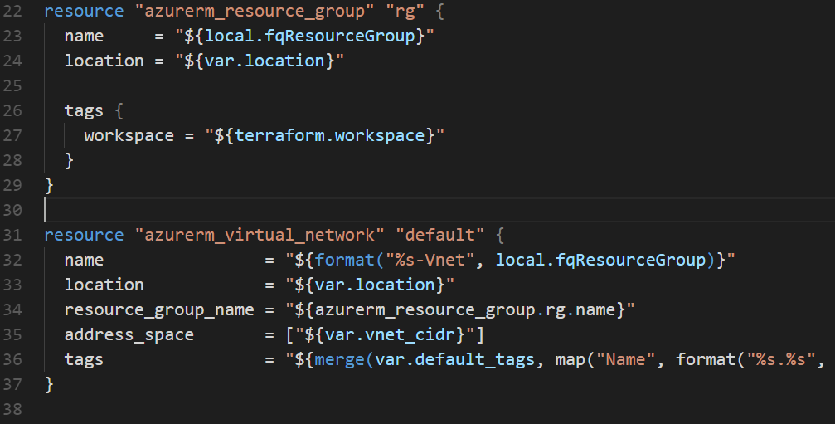
Notes:
Flip between slide 9 & 10
Interpolation and Terraform Azure Provider
Interpolation –I use the same ‘plan’, against different environments (dev – qa – uat – production)
Notion of workspaces (any names you’d like: dev, qa, uat)
Workspaces are technically equivalent to renaming your state file. They aren't any more complex than that.
For local state, Terraform stores the workspace states in a directory called terraform.tfstate.d.
Some teams commit these files to version control, although using a remote backend instead is recommended approach.

Slide 10
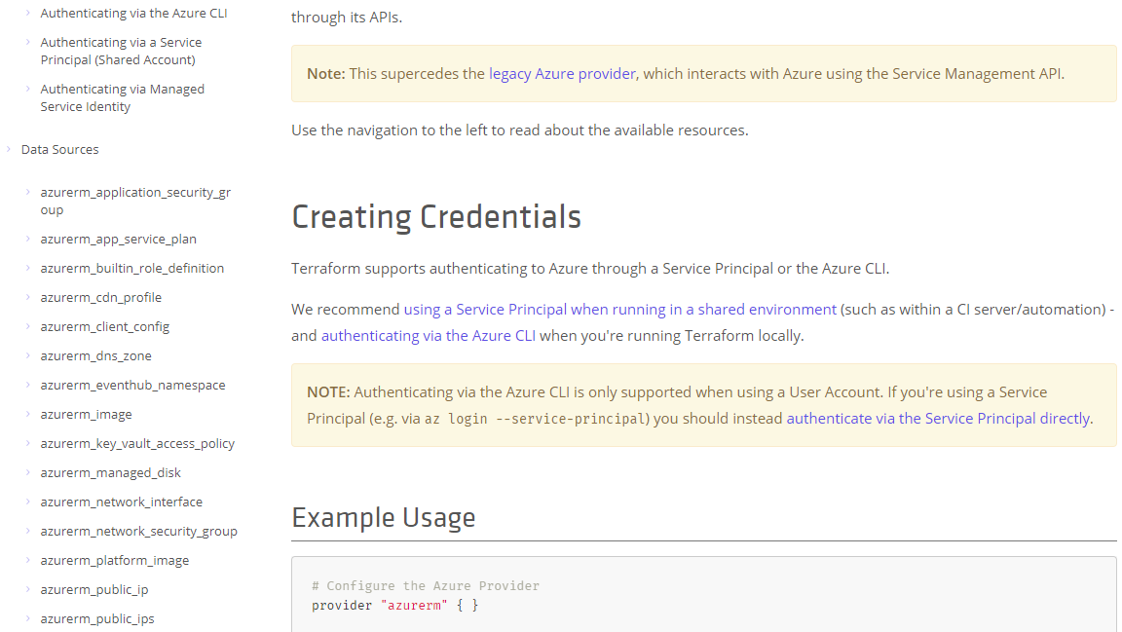
Notes:
Flip between this slides 9 & 8– Interpolation
Terraform Azure Provider – this is the list of all the backed in ‘modules’ that the provider offers
Storage, Compute, Network, Key Vault, Database, and ARM Templates etc…

Slide 11
Overall Lay of the Land
HCL – Hashicorp Configuration Language – Terraform format (*.tf, *.tfvars, or *.tf.json if you must)
Files load in alphabetical format, *.tf / *.tf.json – all others ignored, and appended together
Override files are merged, override.tf, override.tf.json, temp_override.tf – loaded after all files above - alphabetically
Terraform configurations are declarative, so references to other resources and variables do not depend on the order they're defined.
Notes:
TF files: Terraform format is more human-readable, supports comments, and is the generally recommended format for most Terraform files.
Leave the *.tf.json to machine generated files if you need to create them.

Slide 12
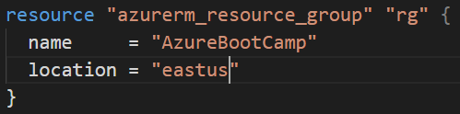
Key Notions
Interpolation
Data Types: String, number, bool (primitives)
Map, List
Input Variables - including *.tfvars
Resource Configuration – all the things!
Notes:
Interpolation Embedded within strings in Terraform, values, simple math, simple conditionals.
Comments!! – ARM or JSON can’t accommodate
Data Types: String, number, bool (primitives) , Map, List
Input Variables – serve as parameters to terraform modules
Single line comments start with #
Multi-line comments are wrapped with /* and */
Strings are in double-quotes.
Boolean values: true, false.
Don't mix manual deploy and Terraform
Start simple and build up iteratively
Establish resource naming convention quickly

Slide 13
Terraform Demo Time
ubuntu-lamp
Notes:
Code is from github
Overview of project
Variables – we separate them out - Order of precedence (override) – last one win’s
Environments (state store, folder)
Resources – separate out by context

Slide 14
Terraform – Thoughts & Gotchas
Naming convention – adopt one
Nesting Resources – be careful, can limit access outside of parent resource
Graph architecture – might find handy
ARM – yep, instant access to ARM with your variables, but as a entire entity.
Modules are more like Functions (variables are arguments in, output is a return value)
Ansible will love you later…. SSH keys vs user / password on deployment
Notes:
Nesting resources – sometimes very handy, but hides the id of that resource if you need it later
terraform graph | dot -Tpng > graph.png
Scripts are still your friends folks! Embrace scripts – just don’t go all yak shaving and what not.
Terraform Destroy – can be glacially slow, scripts/cli can be your friend in development mode

Slide 15
Thoughts & Gotchas #2
It shouldn’t be managing any kind of dynamic data, or service registry, or configs, or …. Apply KISS wherever possible.
Iteratively develop - Errors returned by Terraform (or in turn by Azure) – weak, misleading, and can be down right “seriously - wtf”.
After your first week - Find a remote place to store your tfstate files. Your laptop is not the place to store them!
You can only pass around strings – split() and join() are your friends.
Wrapper Scripts – Bash, Azure CLI – are all your friend as well, and offers options to call out to Slack, Teams etc!
Plan to handle the next phase (call) the next steps of Configuration Management…
Notes:
AzureRM resource names != Azure CLI resource names e.g.
azurerm_subnet.address_prefix vs CLI .addressPrefix property name
Nesting resources – sometimes very handy, but hides the id of that resource if you need it later
terraform graph | dot -Tpng > graph.png
Terraform validate [terraform fmt] - or use VS Code (or editor of choice) to auto format things for you.
Valid plans can fail: Plan only looks at resources in its state file – not actual environment resources!
If someone added a resource out-of-band – a valid plan will fail on apply, as that resource already exists.
Once you start using Terraform – try to ONLY use Terraform. Sure emergencies exist, and you can import / update state later….
If you have brownfield environment, use the import command to capture those resources.

Slide 16
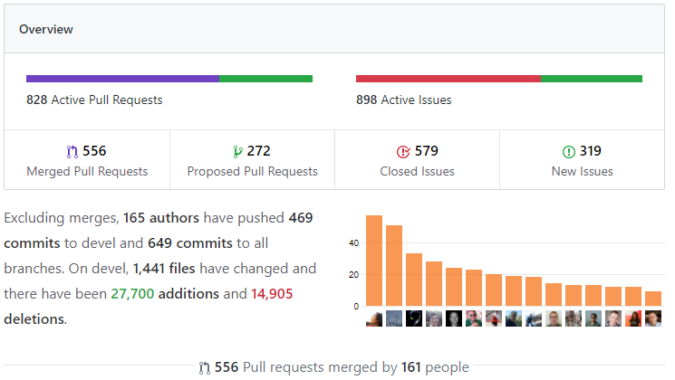


Notes:
Automation platform for configuration management, application deployment, task automation
If Ansible modules are the tools in your workshop,
playbooks are your instruction manuals,
and your inventory of hosts are your raw material. - Ansible docs.

Slide 17
The essentials - What it is and isn’t
Ansible is a configuration management and provisioning tool, similar to Chef, Puppet or Salt
Hate repetitive tasks – Ansible loves it!
Easy to leverage existing bash scripts (still a popular wait's very y to "do" configuration management) into Ansible Tasks. Since it's primarily SSH based, it's not hard to see why this might be the case - Ansible ends up running the same (ish) commands.
Ansible Tasks are can be idempotent.
Subject to Configuration Drift
Procedural
Client only –architecture – connects to your servers over SSH or WinRM
Agentless – uses SSH and WinRM
Notes:
Configuration Mananagment in Ansible terms, means (Ansible) scripts maintains configuration desired state of the host, and obtains detailed information on the host to make it complient.
Ansible Tasks are can be idempotent. Without a lot of extra coding, bash scripts are usually not safely run again and again.
Ansible uses "Facts", which is system and environment information it gathers ("context") before running Tasks.
Its syntax is fairly simple, its scope is massive,
Ansible came out around 2012 – some 6 years ago
Python
Agentless architecture – very cleaver in that it deploys modules to nodes over SSH. Modules are temporarily stored in the nodes and communication with the ‘server’ through a JSON protocol over standard output.
Strive for simplification
Optimize for readability
Think declaratively

Slide 18
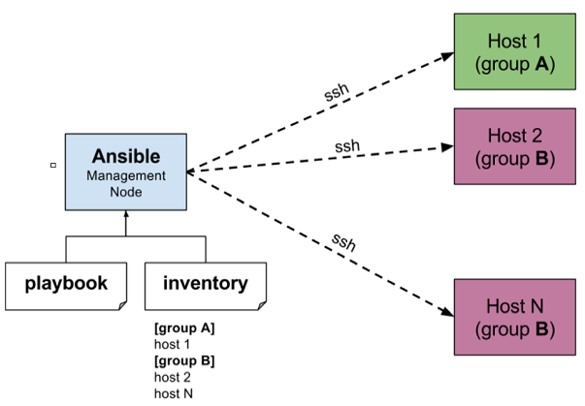
Notes:
Ansible works by connecting to your nodes and pushing out small programs, called "Ansible modules" to them. Ansible then executes these modules (over SSH by default), and removes them when finished. Your library of modules can reside on any machine, and there are no servers, daemons, or databases required.
Beauty of Ansible is that it removes the modules once those are installed so effectively it connects to host machine , executes the instructions and if it’s successfully installed removes the code which was copied on the host machine which was executed.
Playbook yaml – Not for programing. Think about the state I want to achieve – declare it - and let ansible drive to that state.
Essentially a task runner for your secure shell (ssh) or winRM

Slide 19
How do I get started
Install (Windows [bash[, Linux, Mac OS, Docker Image)
Control Machine (Windows itself isn’t supported – but Windows 10’s subsystem for Linux is)
Ansible http://docs.ansible.com/ansible/latest/installation_guide/intro_installation.html
Linux - any machine with Python 2 (2.6 or 2.7) or 3 (=> 3.5)
Docker (Linux image)
Managed Nodes
Linux w/ssh support (sftp or scp)
Dead-simple
Windows 7, 8.1, 10, Server 2008/R2, 2012/R2, 2016 – PowerShell 3.0 & .net 4.0
WinRM: PS c:\> get-service winrm [Status of service]
Little more work & decisions to configure.
Notes:
This is where you are going to need a linux host machine – or Docker
You can configure Windows machines – you just can drive the configuration from Windows
Ansible docs say: The Windows Subsystem for Linux is not supported by Microsoft or Ansible and should not be used for production systems.
It can work against a range of hosts:
Wide range of Linux systems – generally, if python can run, no worries.
For Windows Systems: http://docs.ansible.com/ansible/latest/user_guide/windows_setup.html
Windows Server 2008
Windows Server 2008 R2
Windows Server 2012
Windows Server 2012 R2
Windows Server 2016
Windows 7
Windows 8.1
Windows 10
List of Win / Powershell modules http://docs.ansible.com/ansible/latest/modules/list_of_windows_modules.html

Slide 20
Overall lay of the land
YAML – YAML Ain’t Markup Language (mostly)
Nearly every file starts with a list! (Can be abbreviated if you wish)
Batteries are included – some 1000+ modules to manage systems.
Quote your variables: name: “{{ item }}” vs name: {{ item }}
Bools: true True TRUE yes Quotes: single or double
Notes:
YAML – intermixed with *.cfg and *.ini type file flavors
Nearly every file starts with a list
Each item in the list is a list of key/value pairs (hash or dictionary)
Dictionaries and lists can be represented in a abbreviated form
Single or double-quotes for your strings

Slide 21
Key Notions
Inventory
Playbooks
Tasks
Roles
Variables – flattened (precedence lowest to highest)
“all” group (because it is the ‘parent’ of all other groups)
parent group
child group
Host
Up front considerations
Inventory – static or dynamic list of hosts targets
Accessibility to hosts (via vpn/vntets, public IP, NSG exceptions…)
Actions
Existing Script files – use the slow migration path?
Notes:
Non-SSH connection types: Local (control machine itself) & docker,
Extensive (deep) combinations of variable configurations: http://docs.ansible.com/ansible/latest/user_guide/intro_inventory.html#working-with-inventory
Ansible Configurations: http://docs.ansible.com/ansible/latest/installation_guide/intro_configuration.html
First one found from of
Contents of $ANSIBLE_CONFIG
./ansible.cfg
~/.ansible.cfg
/etc/ansible/ansible.cfg
Options:
Action Warnings, SSH_ARGS, SSH Retries, Any Errors Fatal…

Slide 22

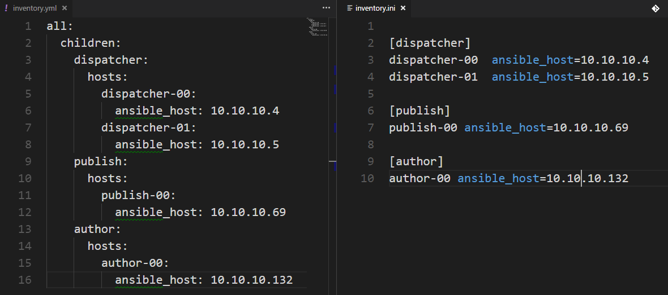
Inventory
Notes:
Inventory – identical host files Left: YAML / Right: ini
Identifies the resources (nodes) we want to manage – meaningful groups and sub-groups.
Contains all the names and/or IPs of our targets
Ansible can work against multiple systems at the same time, and can target one or more servers
Inventory can also contains login / credential or specific node variables.
Static or Dynamic
Inventory features:
Behavioral Parameters (anisble_host, ansible_ssh_user….)
Groups
Groups of Groups
Assign Variables
$ ansible all -i hosts/dev/inventory -m ping

Slide 23

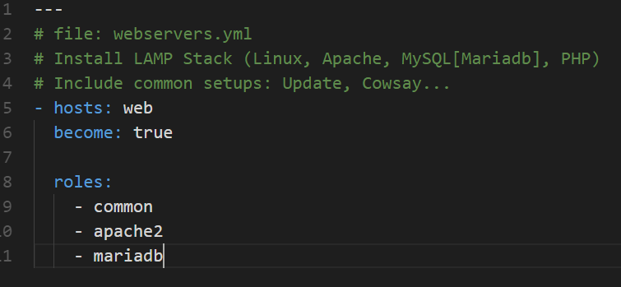
Playbook
All hosts ‘web’ will be used
Default to sudo when installing
Three roles configured
$ ansible-playbook -i dev webservers.yml
Notes:
A collection of commands and calls to modules – they run sequentially
Playbooks are Ansible’s configuration, deployment, and orchestration language
Inventory will feed into the Playbook…any inventory file can be used as a parameter to a Playbook
Good for setting up a server for servers for a specific role requiring many steps
$ ansible-playbook [options] playbook.yml

Slide 24

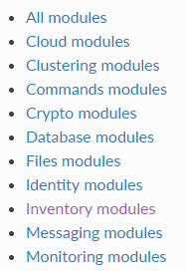
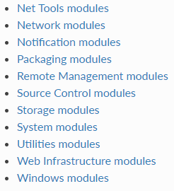
Modules
Notes:
Ships with a number of modules (module library) – pre-written functions that perform a specific task.
Can be executed directly on remote hosts – includes services, packages, files, or system commands
Use a context “Facts” to determine what actions to execute – based on state of the host machine
…modules can determine if a task is to be executed or not.
Apt or file copy is perfect example of this – should I copy a file if it exists?

Slide 25
Ansible Demo Time
ubuntu-lamp
Notes:
Code is from github
Overview of project
Variables – we separate them out - Order of precedence (override) – last one win’s
Environments (state store, folder)
Resources – separate out by context

Slide 26
Ansible – Do’s, Don’ts, Gotcha’s
Strive for simplification
Optimize for readability
Think declaratively
Create a style guide – tags, files names, project directory (team consistency)
Treat it like code – version control your Ansible files!
Iterate your work – start simple, don’t modularize everything from the get-go.
Try to be descriptive in your variable names:
Tomcat_port: 880
No Bare variables ansible_var_name vs “{{ ansible_var_name}}”
Notes:
Honestly – use your own best practices
Declarative – think in terms of roles – and the group of sub modules needed.
Ansible really is just framework around all the various scripts you’d use anyway – it provides a clean, extensible, and predictable environment that wraps around them.
Warm fuzzy blanket of happiness.

Slide 27


Wrap Up
Questions
Comments
Blimey! That’s all
Thank ye!
jim.stott@oriontech.com / jwstott@gmail.com
https://github.com/jstott/azure_bc2018_get_kraken.git

