Slide 1
Gradient Descent for Logistic Regression in Spark
Joel Stremmel
CSED516/DATA516
Fall 2019

Slide 2
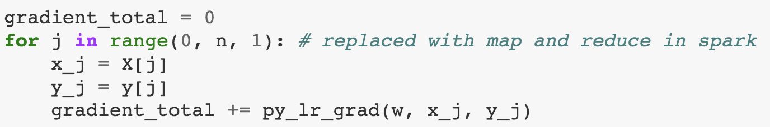
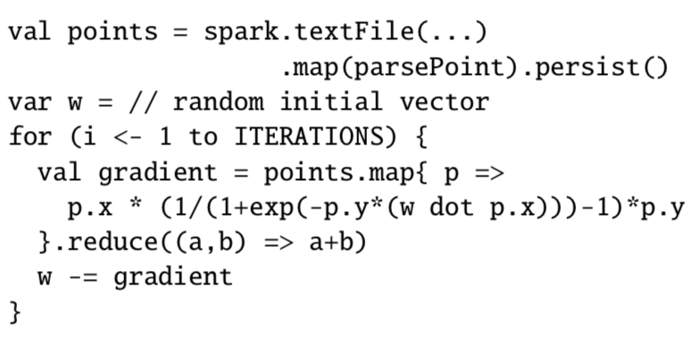
Problem Statement
Compute gradient on each sample sequentially
Research Question:
How does a from-scratch implementation of gradient descent for logistic regression in Spark scale compared to a raw Python implementation for a real-world binary classification task?
Motivation:
The authors of Resilient distributed datasets: A fault-tolerant abstraction for in-memory cluster computing, 2012 provide pseudo-code for an implementation of logistic regression on RDDs by parallelizing gradient computations for individual training samples.
Compute gradient on each sample in parallel
Pseudocode from: M. Zaharia, M. Chowdhury, T. Das, A. Dave, J. Ma, M. McCauley, M. J. Franklin, S. Shenker, and I. Stoica. Resilient distributed datasets: A fault-tolerant abstraction for in-memory cluster computing. In Proceedings of NSDI, pages 15–28, 2012.

Slide 3
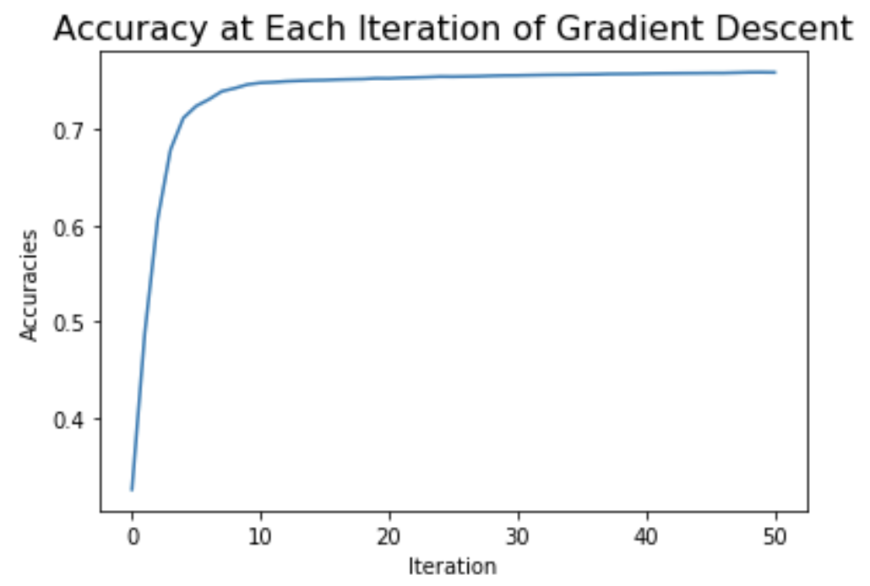
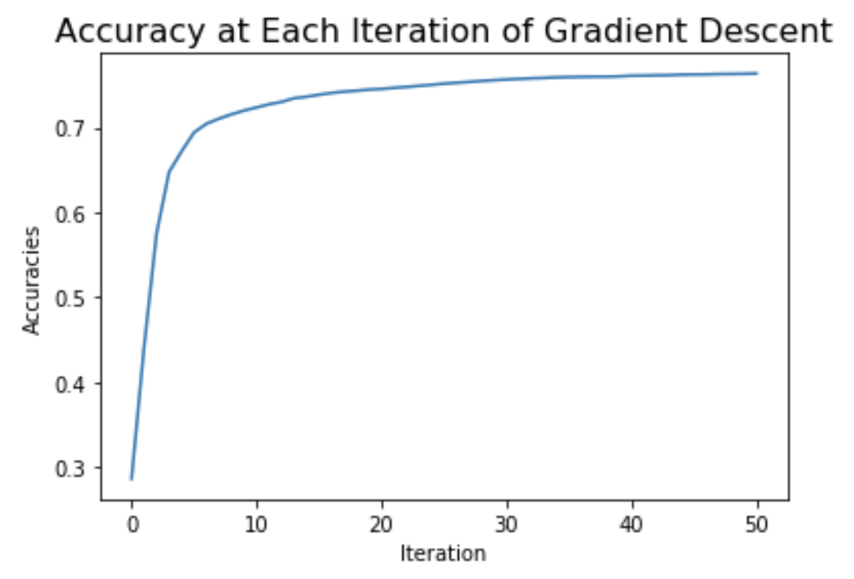
Approach
Compute gradient on each sample sequentially
I collected, cleaned, and created features for the Chicago Food Inspections Data from 2010 to present to model the real-world problem of classifying restaurants likely to fail health inspections.
Holding accuracy and the number of gradient descent iterations for the sequential Python implementation and parallelized Spark implementation constant, I compared execution time on AWS clusters of varying sizes.
I plotted min, max, and mean execution times to compare implementations and assess speedup.
Compute gradient on each sample in parallel
Compare to Scikit-learn and MLlib Implementations
Sequential Python | ~76% test accuracy | 50 iterations with learning rate = 1.0
Parallel Spark | ~76% test accuracy | 50 iterations with learning rate = 1.0
MLlib | ~77% test accuracy | Uses tolerance method, so not directly comparable but a good baseline for speed
Chicago Food Inspection Data: https://healthdata.gov/dataset/food-inspections
Data License: http://opendefinition.org/licenses/odc-odbl/
US Census Data API: https://www.census.gov/data/developers/about/terms-of-service.html

Slide 4
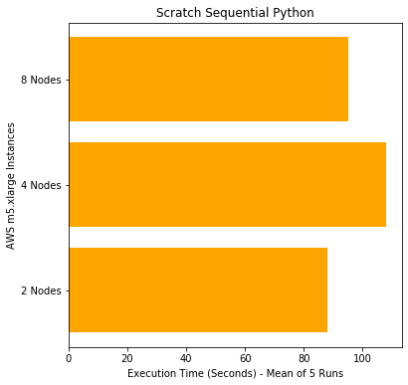
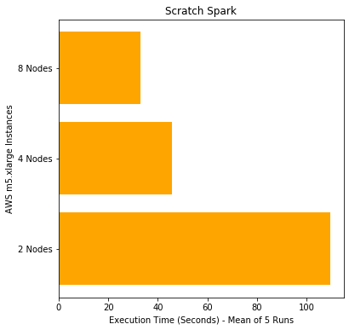
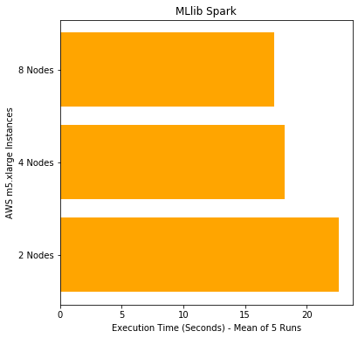
Results
Without data replication (133,496 samples, 95 features)
Fit times following kernel restart on 2, 4, and 8 m5.xlarge worker nodes with 4vCores, 16 GiB memory.
Replicated data had the target randomly flipped to the opposite sign for 5% of samples.

Slide 5
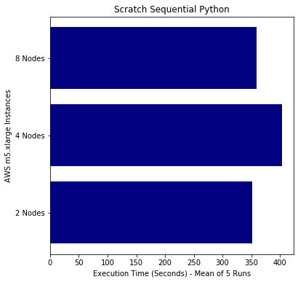
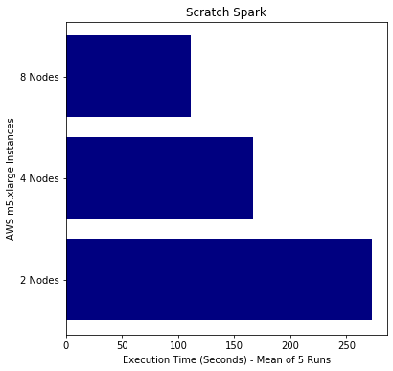
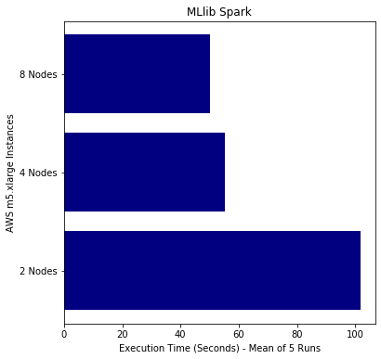
Results
With data replication (4 * 133,496 samples, 95 features)
Fit times following kernel restart on 2, 4, and 8 m5.xlarge worker nodes with 4vCores, 16 GiB memory.
Replicated data had the target randomly flipped to the opposite sign for 5% of samples.

